Slide 1
Package Delivery Application System
1552756 Shen Jinwei 1452816 Teng Yuqing
1552672 Wu Kefei 1552779 Huang Chen
1552734 Cai Xuyang

Slide 2
Contents
Background
01
Why we need this system?
Introduction
02
What is it?
Detail
03
Some vital parts of the project

Slide 3
Background
In recent years, with the development of a series of large e-commerce sites, online shopping began to occupy a large proportion in people's lives and logistics distribution also began to affect people's life.
The service logistics distribution information system provides will directly affect the user's experience of the online shopping, which indirectly influences the popularity of an e-commerce website.
The purpose of this project is to improve people's work efficiency, improve the efficiency of logistics distribution, avoid human error, ensure that the package has sent to the customer correctly and provide a series of after-sales service

Slide 4
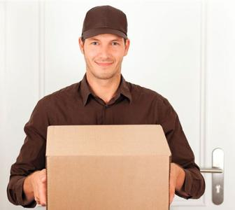
Introduction
In this project, we set up a logistics system to communicate with business man, delivery man and customer in order to provide customers with more convenient and safe logistics distribution services.

Slide 5
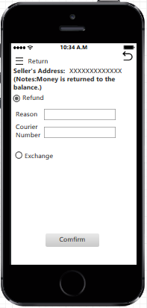
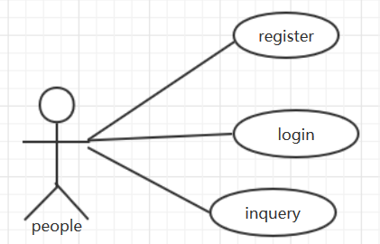
Detail
01
Use cases
02
Snapshots

Slide 6
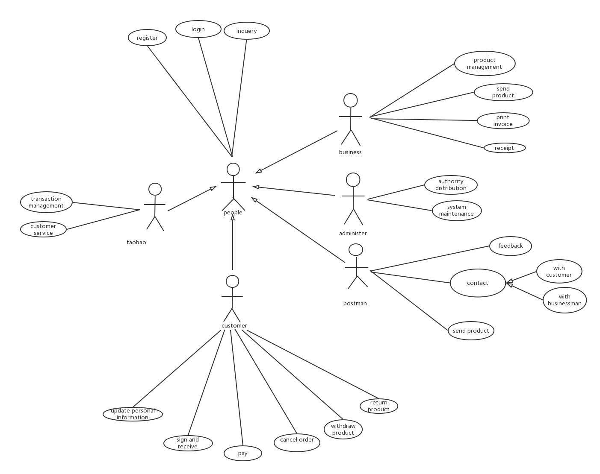
Use case diagrams

Slide 7
Inquery
For custoemers they choose the product they want to inquire.
Then the system will show the real-time situation of his product, location,status and so on.
For postman he chooses the product they are assigned to deliver
Then system tells the postman where to get the product.
Then postman inquires the system for customer’s information
For taobao they can track the product with this function.
They can confirm whether the product is dispatched to the postman.
They can confirm whether the product is received by customer
For businessman they can know whether the product is sold
After sold they can inquire the system to confirm whether customer has paid the fee.
Participant:Postman,Taobao,Customer,Adminster

Slide 8
Login
If the user is a customer ,check the order information ,update the information and process the order.
If the user is a postman ,he can get the informantion of the order he send
If the user is a business man ,he can contact the postman and customer and receive the payment.
If the user is a administer ,he can dispute the authority and maintain the system.
Participant: Postman, Customer, Administer, business

Slide 9
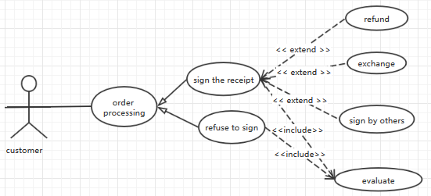
Order Processing
The postman confirm the person receive the package is the customer self or not
If he is the customer or the postman has gotten customer confirmation that he can sign the package, the sign process will continue
else the sign process will fail
The receiver check the package is intact or not. If the package is not intact, the receiver will consult with the postman and decide whether sign it or not.
The receiver decides to sign the package.
If the receiver choose to sign the receipt
he uses signature on a pad provided by the postman.
Else if the receiver choose to use the fingerprint,
he presses the finger in the pad specified area.
If the system verifies the receiver’s information successfully
It update the package status to “sign successfully”.
Else the customer needs to communicate with postman for subsequent treatment.
Participant: Customer

Slide 10
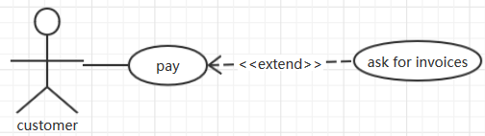
Pay
1. If the customer has paid for his package using credit cards or PayPal when purchasing them online, the postman can know that the package had been paid from the system
2.If the customer hasn’t pay for the package, he can choose the ways of paying the bill.
The customer chooses to pay by PayPal or WeiXin, the postman can provide the customer with a QR code which is from the corresponding package information stored in the system and the customer pays the package by that.
The customer chooses to pay by credit,, the postman provides his with POS machine. He offers his card ,inputs password and signs the receipt.
The customer chooses pay by cash, he can give the cash to postman directly.
3.The system updates the package information that it has been paid off.
4.If the customer has confirmed receipt and asks for the invoices, the system will print out it.
Participant:Customer

Slide 11
Refund and Exchange
1.The customer needs to log in the system and make the request of returning.
2.The system will obtain the information, it will provide the customer a label containing the address to send it back that also includes the postage.
3.The customer could communicate with the business man and have the option to send the package back and complete the deal or to replace the current package with the new one.
If the customer choose to send the package back and complete the deal
The payment will be returned to the account balance which the system provides.
If the customer choose to replace the current package with the new one.
The replacement will make a new package information in the system.
Participant: Customer

Slide 12
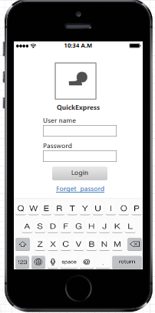
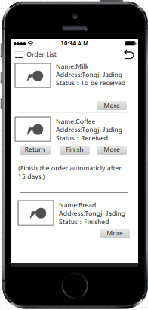
Snapshot
Login to the system.
List all the orders and their stauses.

Slide 13
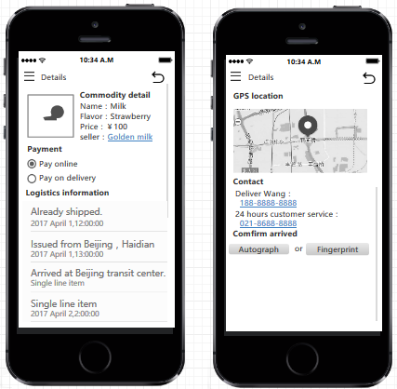
Snapshot
Display the detail of each order.
The customer can get the logistics information andcontact with seller,delivery manand the business.
If the commodity is arrived,the customer can sign on it.

Slide 14
Thank you

