Slide 1
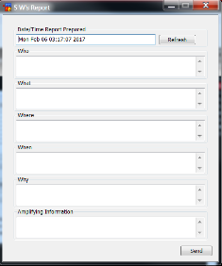
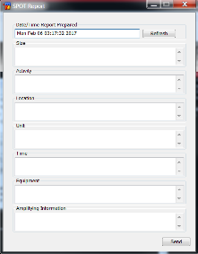
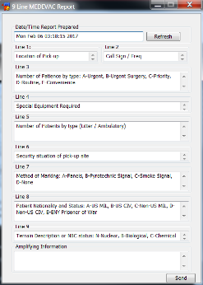
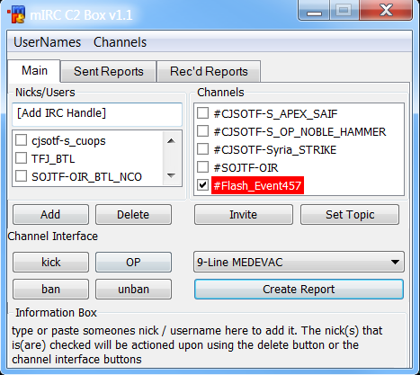
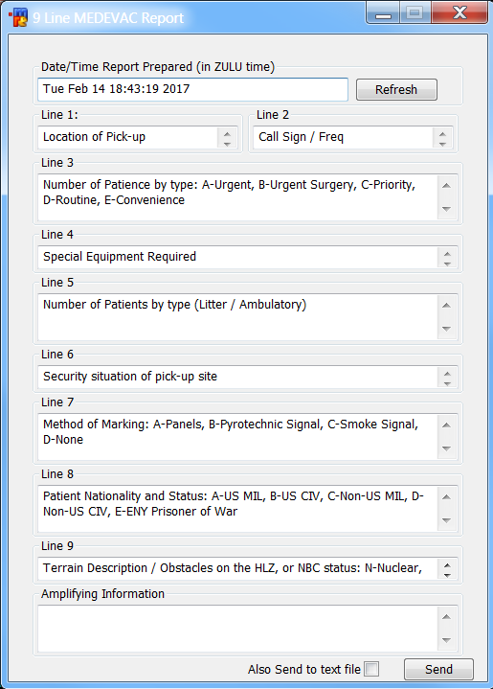
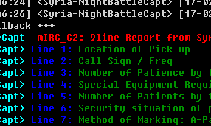
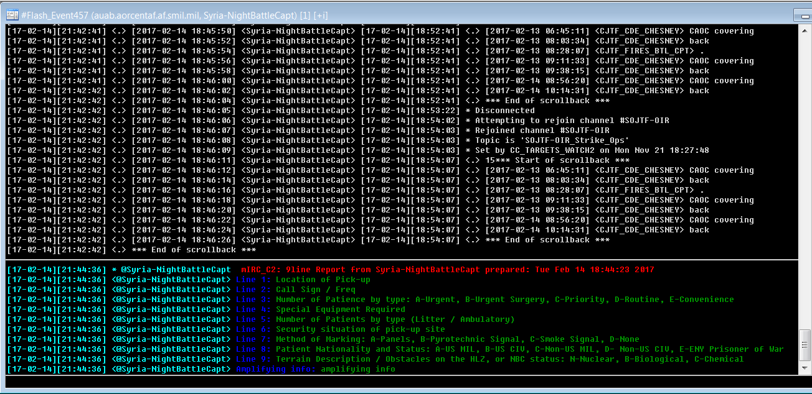
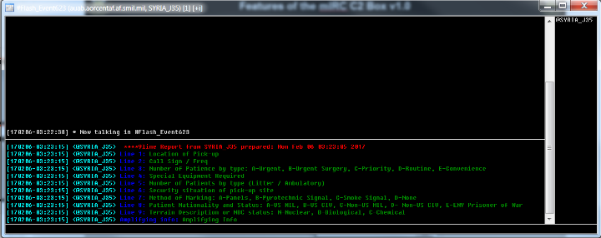
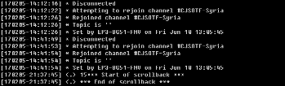
The mIRC C2 Box v1.1
The standard 5 W’s Report
Summary: The mIRC C2 Box v1.1 is a mIRC interface which allows the user to publish standard reports to several mIRC channels and users simultaneously and in a distinct color pattern to characterize it from the regular channel chatter. These reports can automatically be sent to a file and attached to emails for further distribution and knowledge management.
Additionally, the interface can alert the user when certain reports are generated in any channel in which they participate.
The standard SPOT Report
The 9-Line MEDEVAC Report
UNCLASSIFIED

Slide 2
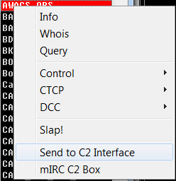

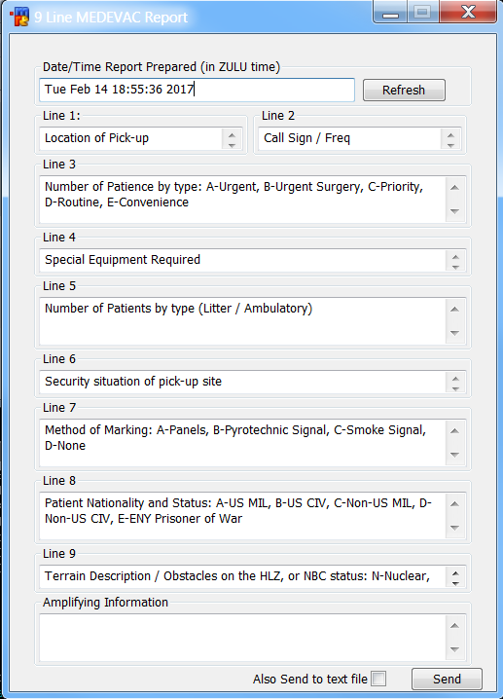
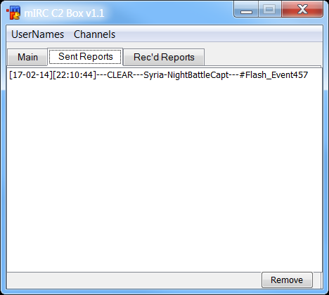
Features of the mIRC C2 Box v1.1
Type in users/nicks to add to your list
The channel box automatically updates with whatever channels you are in / open
Right click a user/nick in a channel to automatically add to your list
Set the topics in the rooms you control
Click the report drop-down to select a type of report
Reports are automatically generated with the date/time you opened it (this can be changed/refreshed)
Helpful information appears here as you roll over buttons
Click the “Create Report” button to open up the reports
The “Sent Reports” tab will keep track of when, where and by whom reports were sent
Additional report formats can be created and added to the mIRC C2 Box; Report formats can include helpful information about what needs to be written into each field.
Invite Only channels can be created on the fly to deal with flash events and critical situations
Reports will be sent to the nicks / channels selected when you click “Send”
(Future updates will include the ability to access stored versions of reports and automatically collect reports sent by other users in the channels)
This will send the report to a WORD document and open it up
(Future updates will include the option to attach it to an email automatically)
UNCLASSIFIED

Slide 3
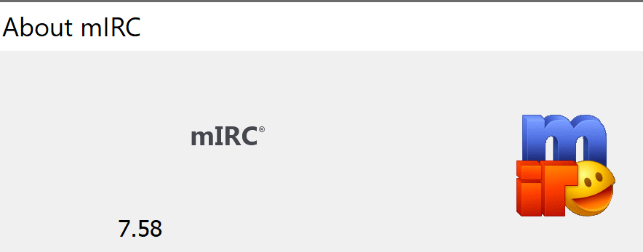
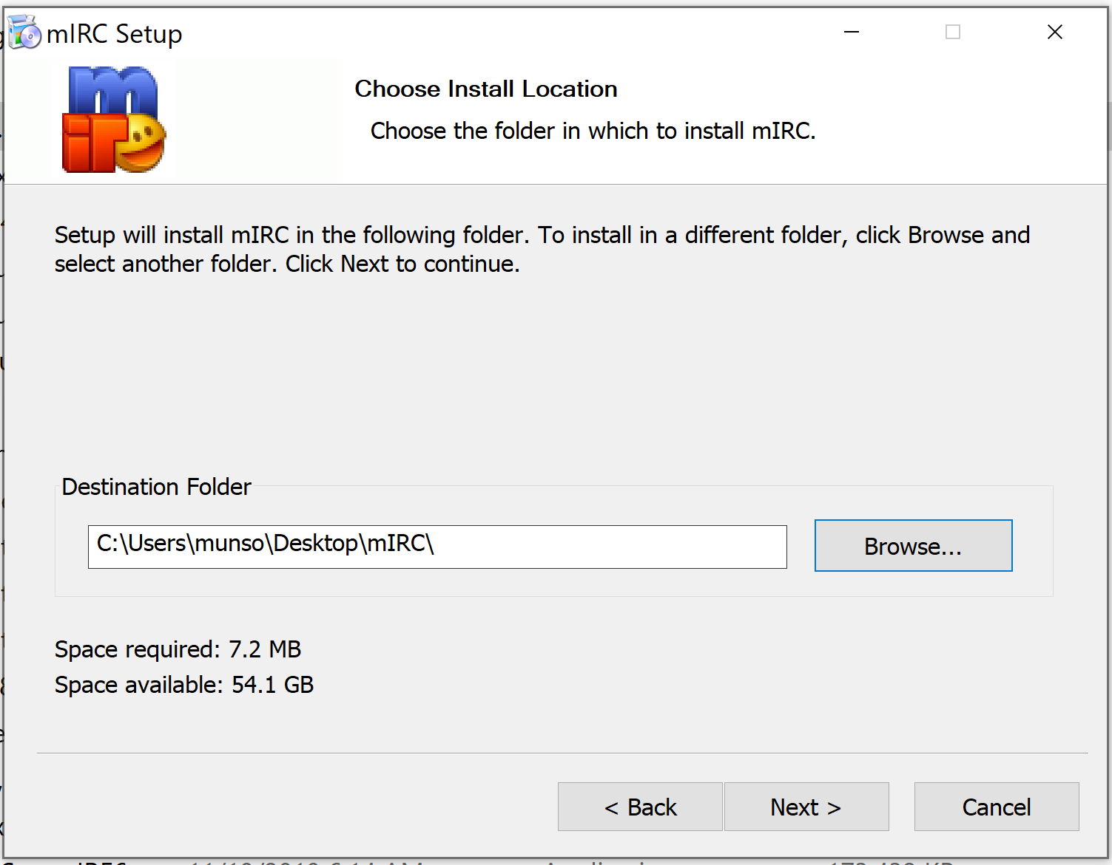
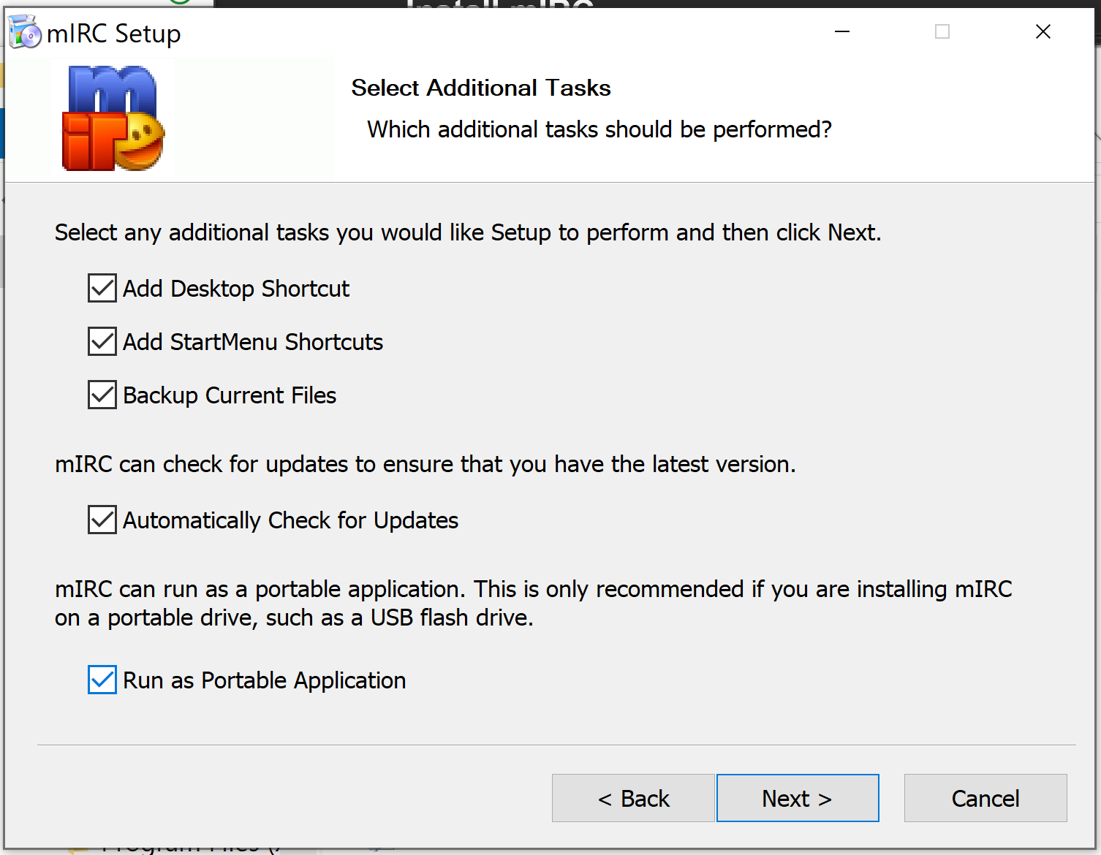
Install mIRC
The recommended installation method for mIRC is to install as a portable application that you can easily “backup” to your personal share drive. After you have done this once, you can then copy that folder to any computer you log into (and map your share drive) and have your mIRC with all the same saved settings and scripts.
These instructions were tested using new installation of mIRC 7.58 on Windows 10 x64
The portable installation of mIRC does not normally need any elevated privileges. If it does, then have J6 install it as portable, setup the scripts you want, then copy that entire folder to your share drive.
The two screenshots below show the second and fourth install windows where you need to select/create an install folder that you have access to (like on your desktop), and then click the bottom checkmark for “Run as Portable Application”.
Put the script folder somewhere:

Slide 4
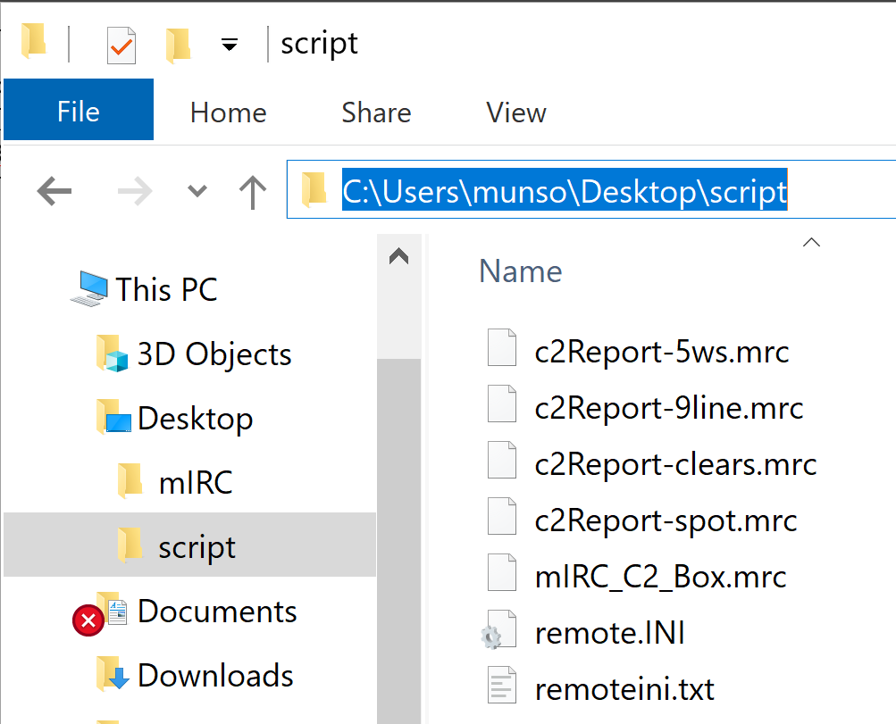
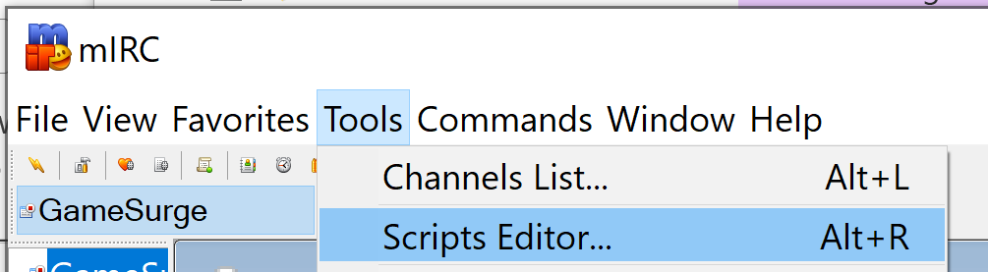
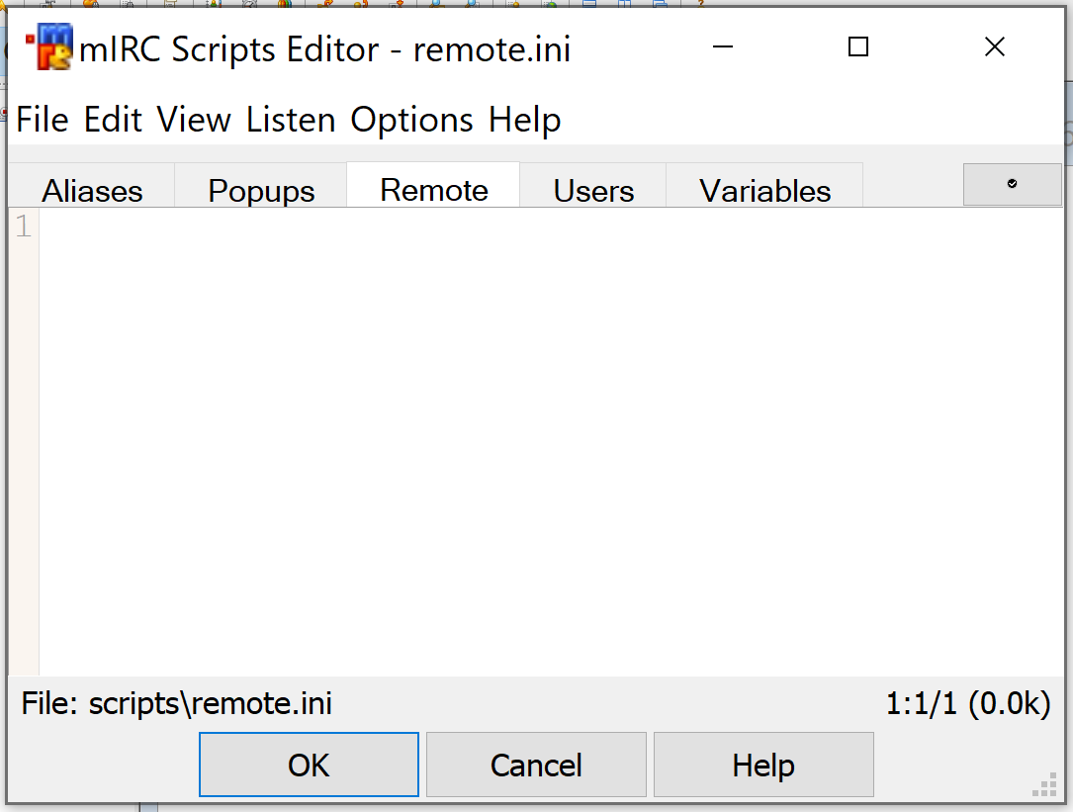
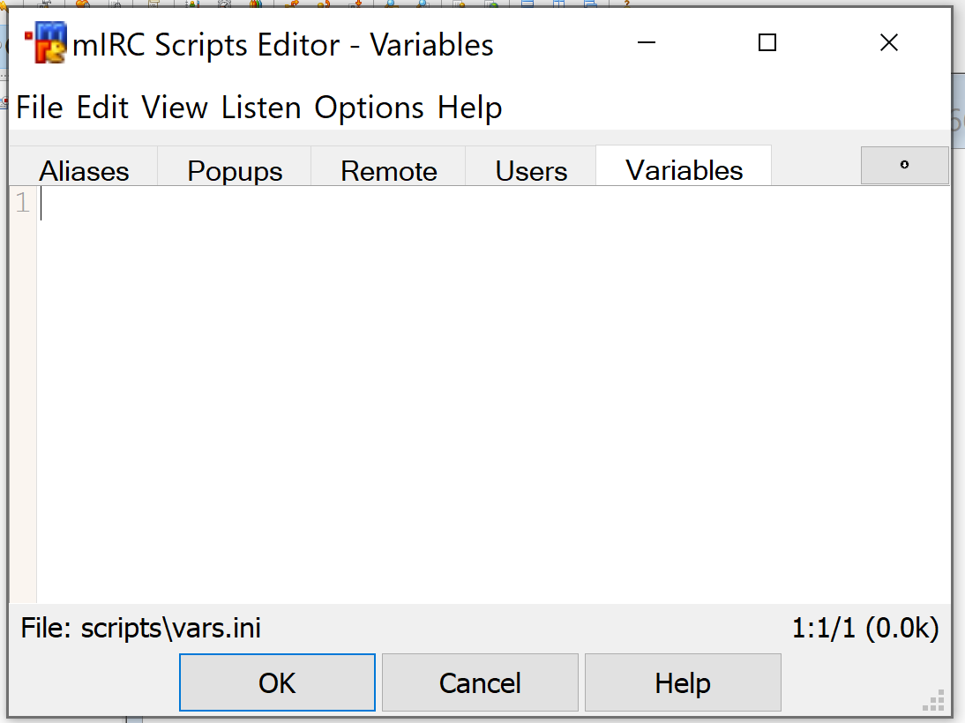
Install mIRC C2 Box v1.1
Depending on the method of installation and privileges, you may not be able to place files directly into your scripts folder.
1. Put the mIRC C2 Box script folder somewhere you can access, the Desktop for instance.
2. In your mIRC application, select the Tools → Scripts Editor option (or press ALT+R).
Make some observations about what you find in the windows that pops up.
First, is there anything at all in the Remote tab? And anything in the Variables tab?
You can copy/paste this into a text file (or an email to yourself) to back this up.
Otherwise, it is recommended not to overwrite these in the following steps, simply paste
below what you already have there.

Slide 5
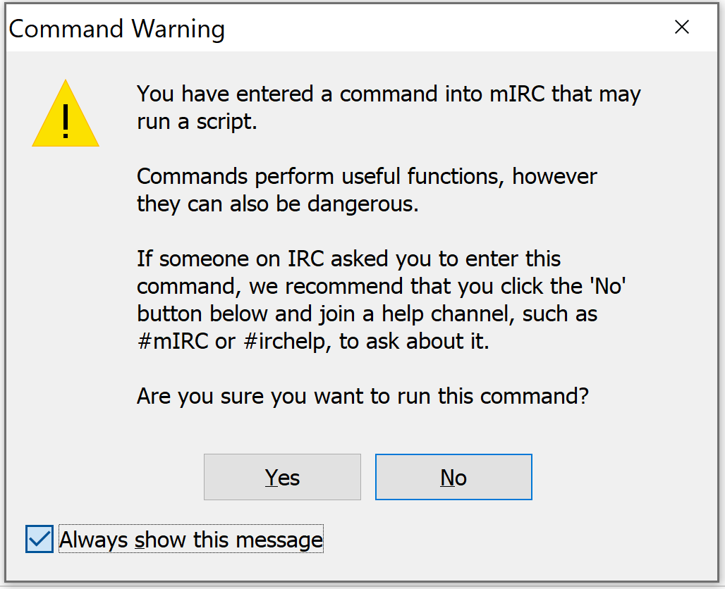
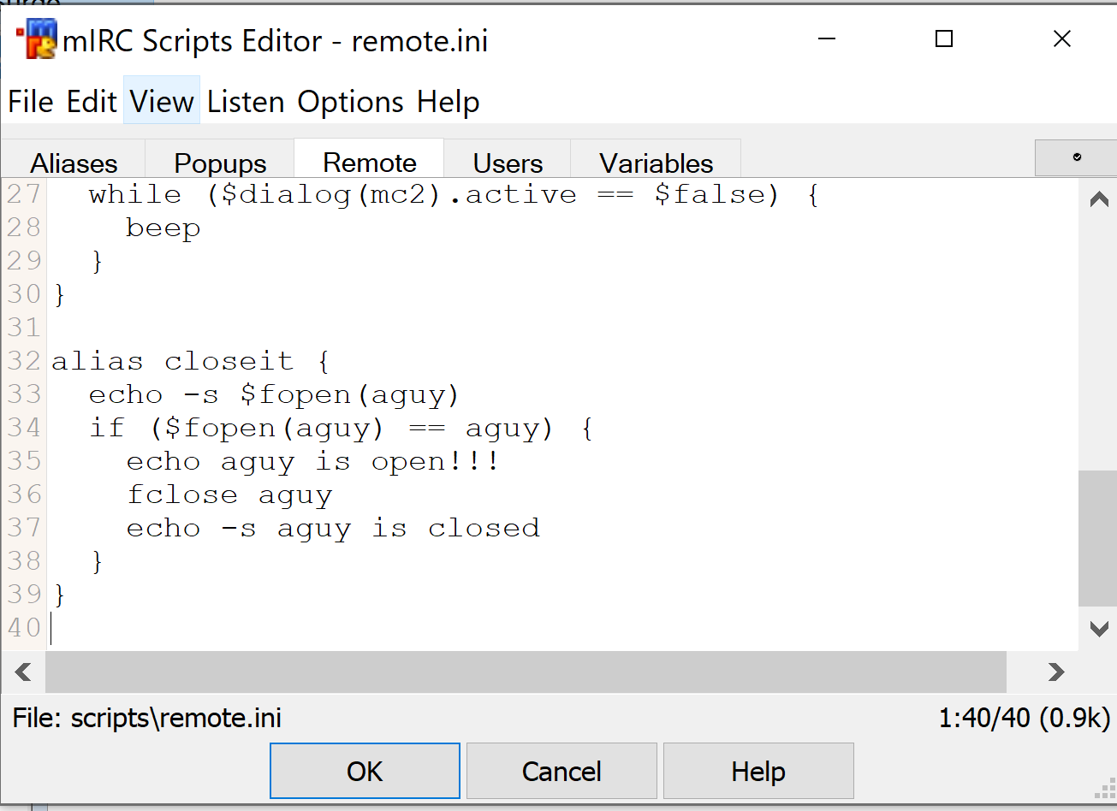
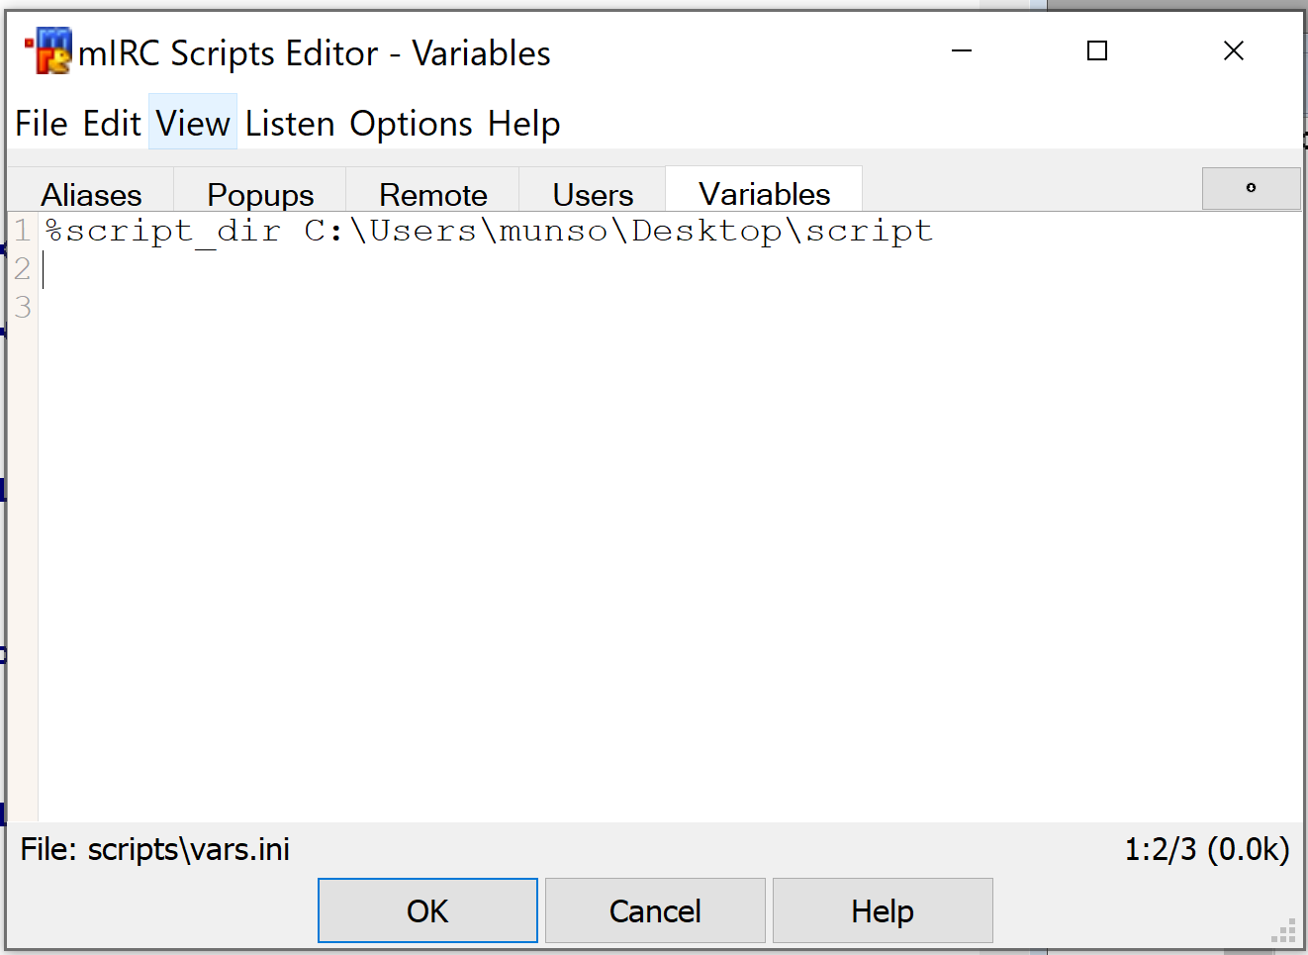
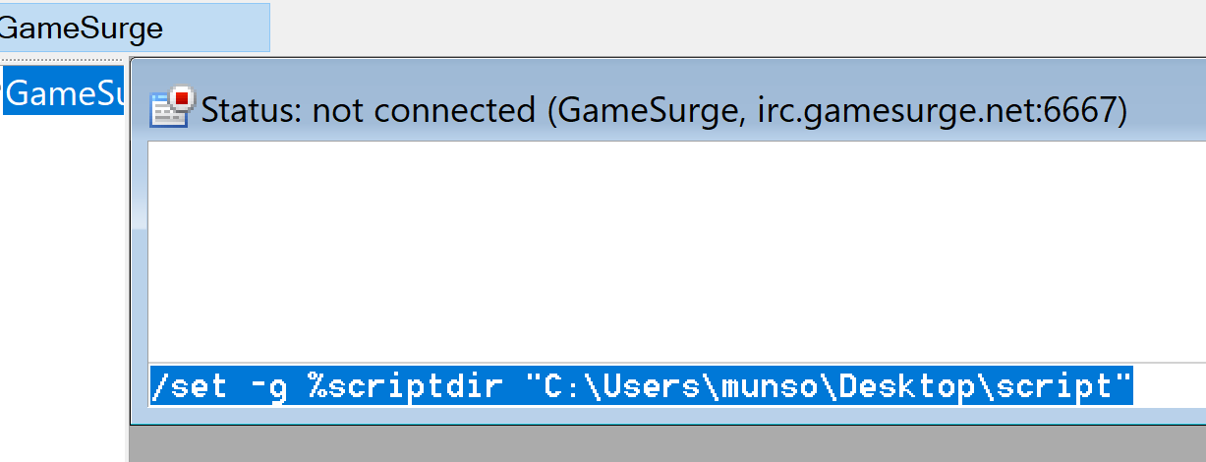
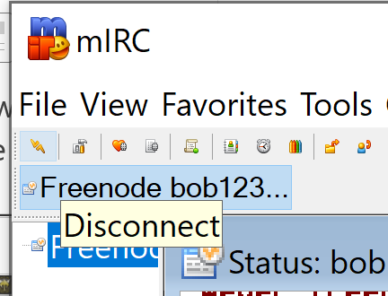
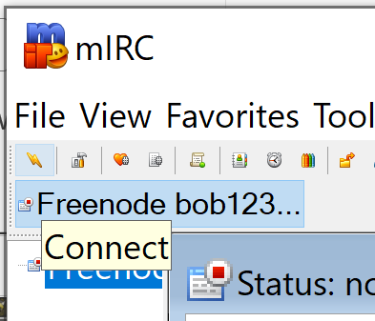
Install mIRC C2 Box v1.1
3. Open the remoteini.txt file in a text editor, and copy/paste the whole file into the Remote tab.
Then go to File → Save
4. In the Variables tab, you will define the directory that holds the mIRC C2 script files:
%script_dir C:\Users\munso\Desktop\script
Then go to File → Save
5. Next, disconnect and reconnect you session. The mIRC C2 loads up the reporting formats once a CONNECT event occurs.

Slide 6
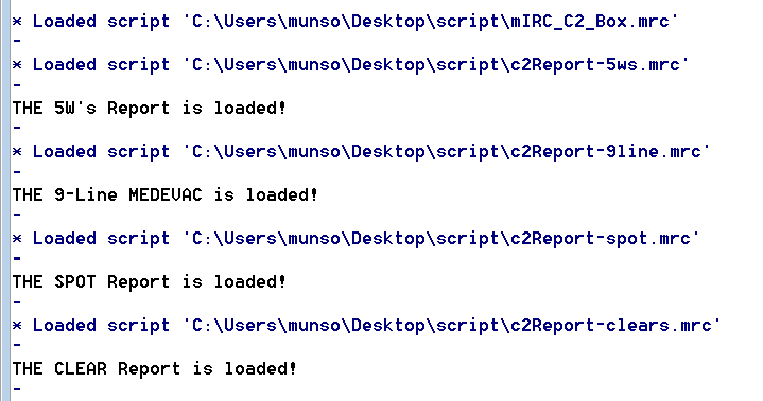
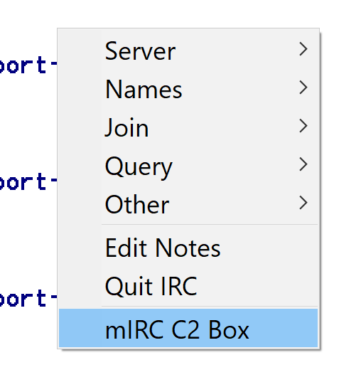
6. In the status box of your mIRC app, you should see output similar to the following, which means that the elements have been loaded successfully.
7. Now, right clicking on any channel should display an option for mIRC C2 Box

