Slide 1
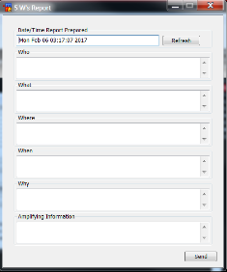
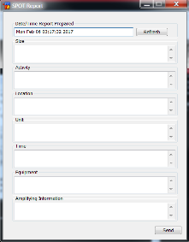
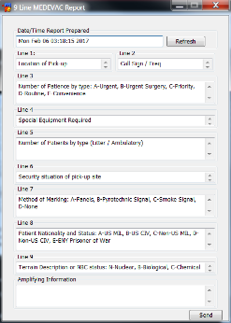
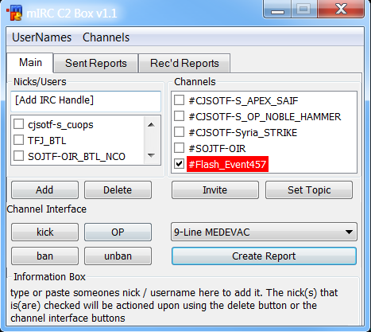
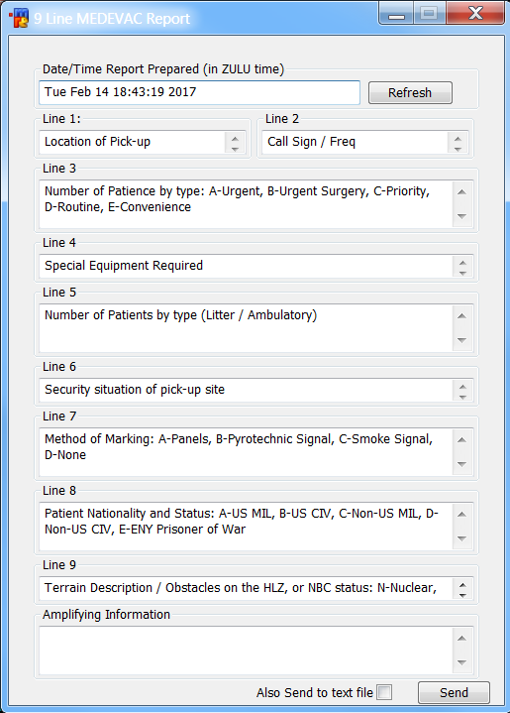
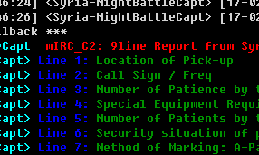
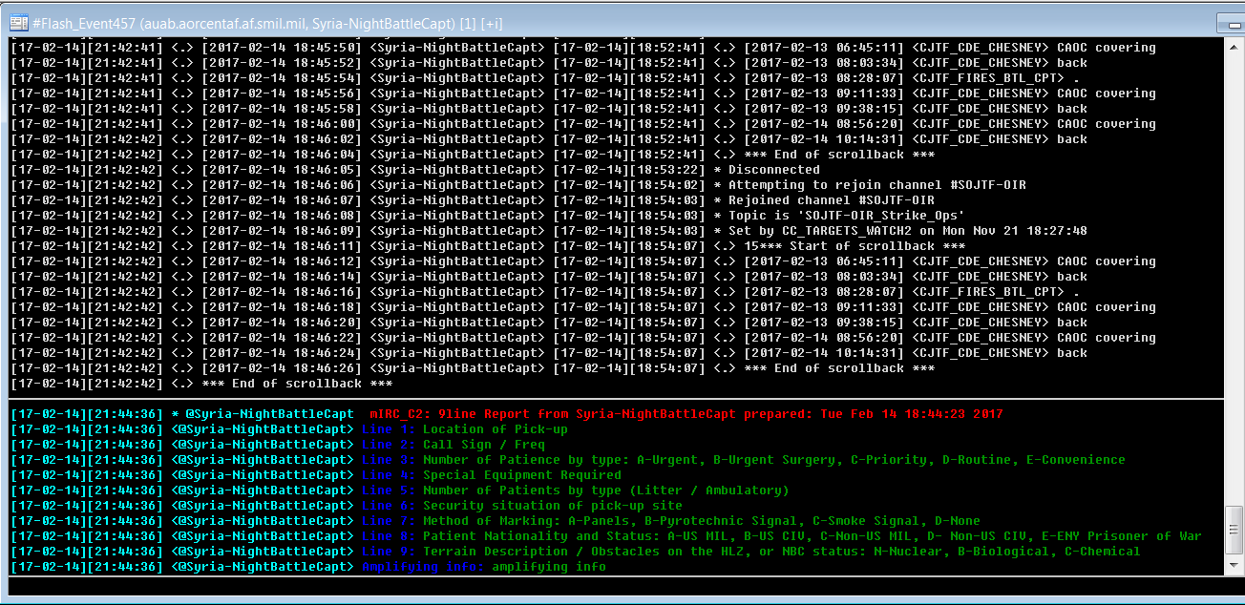
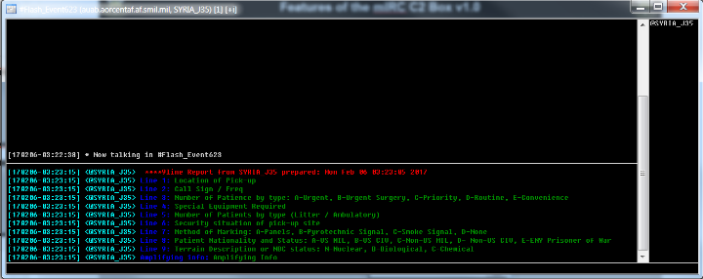
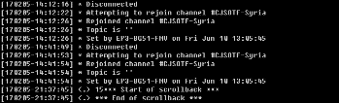
The mIRC C2 Box v1.1
The standard 5 W’s Report
Summary: The mIRC C2 Box v1.1 is a mIRC interface which allows the user to publish standard reports to several mIRC channels and users simultaneously and in a distinct color pattern to characterize it from the regular channel chatter. These reports can automatically be sent to a file and attached to emails for further distribution and knowledge management.
Additionally, the interface can alert the user when certain reports are generated in any channel in which they participate.
The standard SPOT Report
The 9-Line MEDEVAC Report
UNCLASSIFIED
Notes:
1

Slide 2
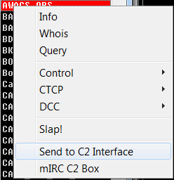

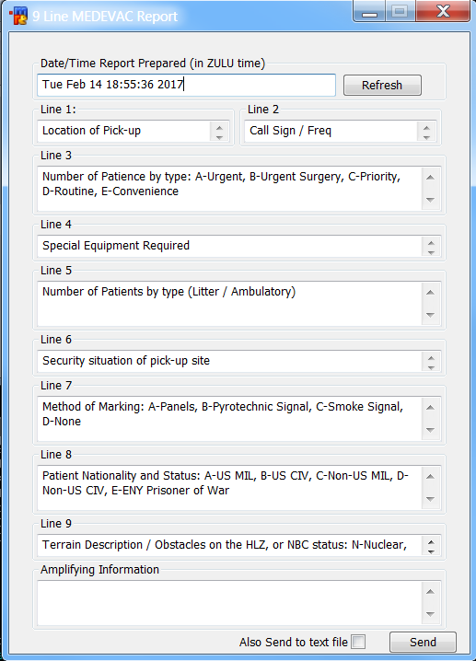
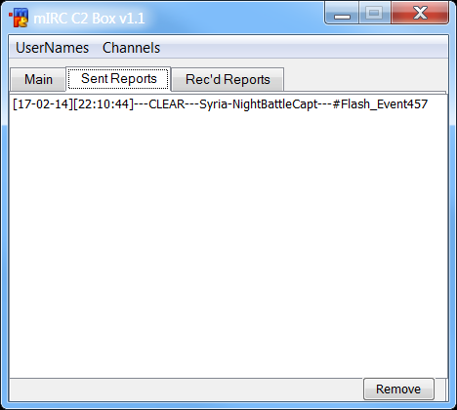
Features of the mIRC C2 Box v1.1
Type in users/nicks to add to your list
The channel box automatically updates with whatever channels you are in / open
Right click a user/nick in a channel to automatically add to your list
Set the topics in the rooms you control
Click the report drop-down to select a type of report
Reports are automatically generated with the date/time you opened it (this can be changed/refreshed)
Helpful information appears here as you roll over buttons
Click the “Create Report” button to open up the reports
The “Sent Reports” tab will keep track of when, where and by whom reports were sent
Additional report formats can be created and added to the mIRC C2 Box; Report formats can include helpful information about what needs to be written into each field.
Invite Only channels can be created on the fly to deal with flash events and critical situations
Reports will be sent to the nicks / channels selected when you click “Send”
(Future updates will include the ability to access stored versions of reports and automatically collect reports sent by other users in the channels)
This will send the report to a WORD document and open it up
(Future updates will include the option to attach it to an email automatically)
UNCLASSIFIED
Notes:
2

Slide 3
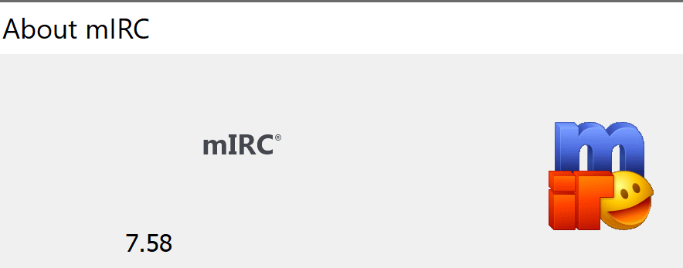
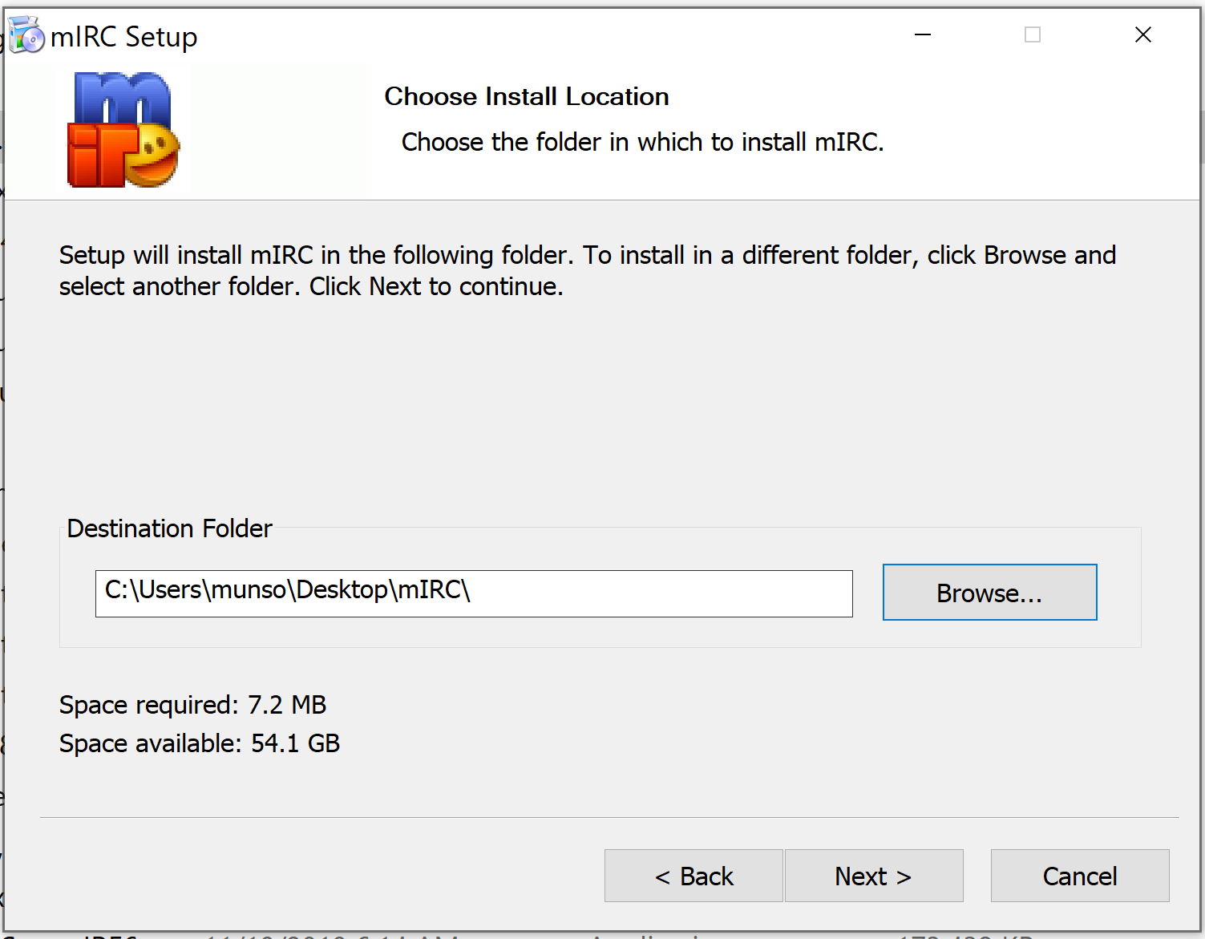
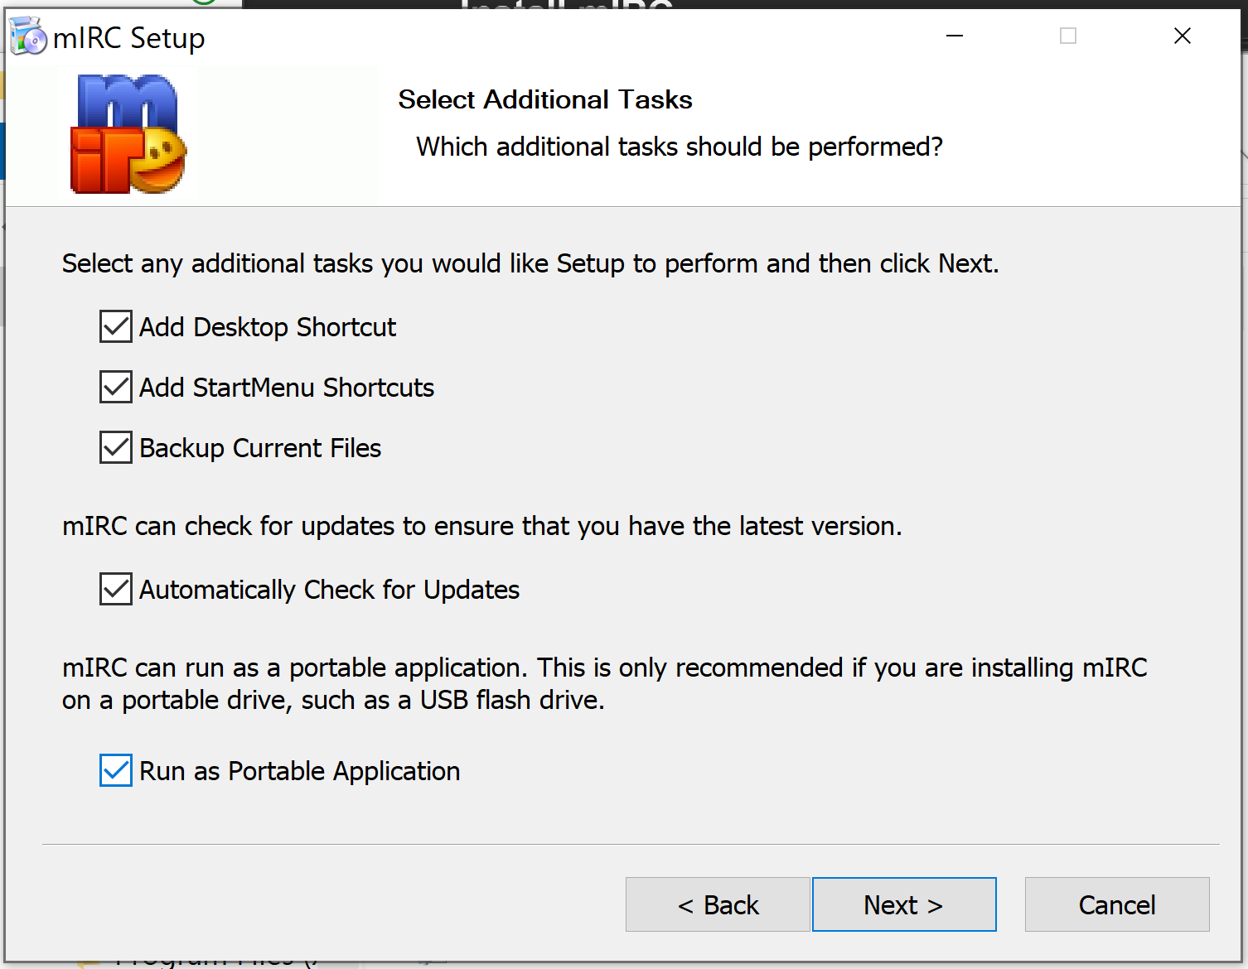
Install mIRC
The recommended installation method for mIRC is to install as a portable application that you can easily “backup” to your personal share drive. After you have done this once, you can then copy that folder to any computer you log into (and map your share drive) and have your mIRC with all the same saved settings and scripts.
These instructions were tested using new installation of mIRC 7.58 on Windows 10 x64
The portable installation of mIRC does not normally need any elevated privileges. If it does, then have J6 install it as portable, setup the scripts you want, then copy that entire folder to your share drive.
The two screenshots below show the second and fourth install windows where you need to select/create an install folder that you have access to (like on your desktop), and then click the bottom checkmark for “Run as Portable Application”.
Put the script folder somewhere:

Slide 4
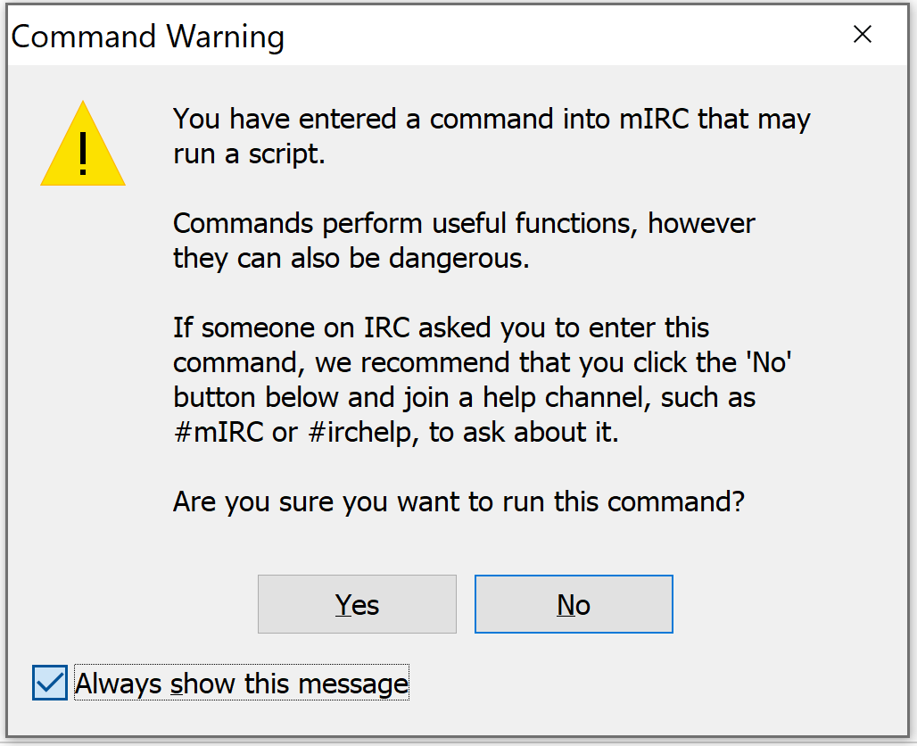
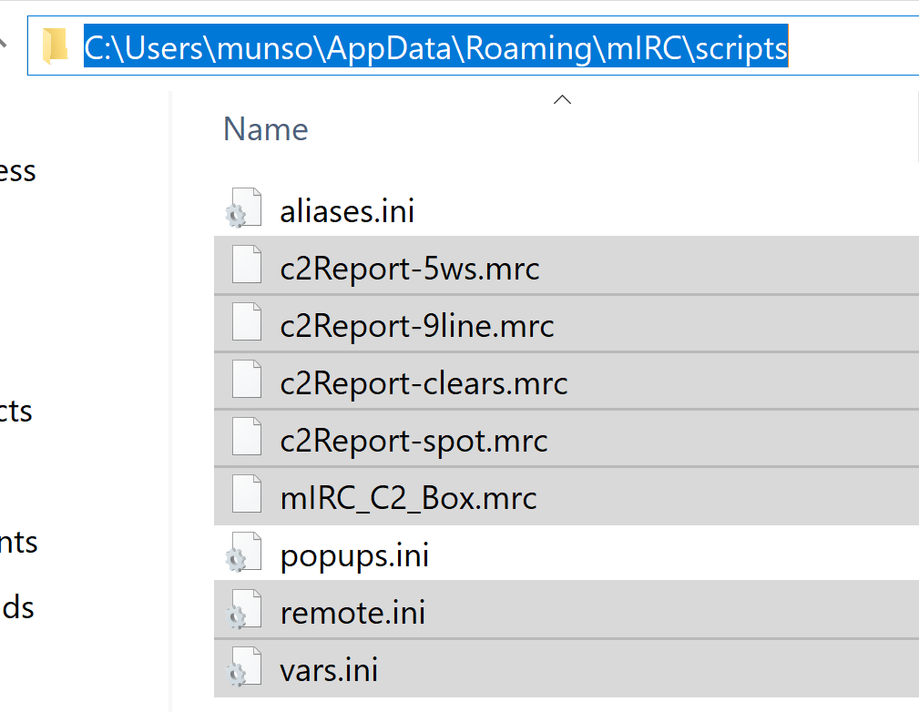
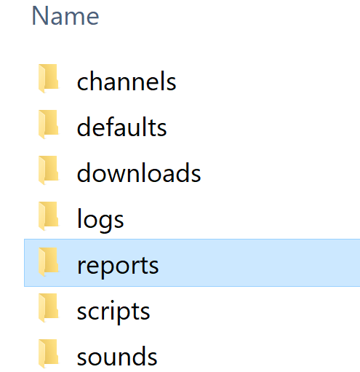
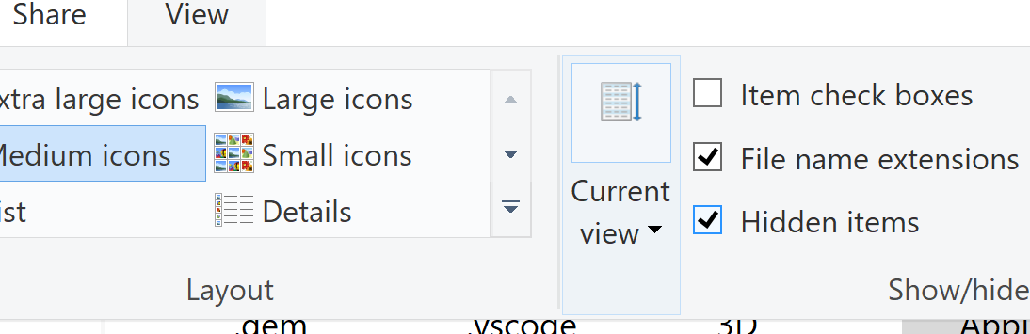
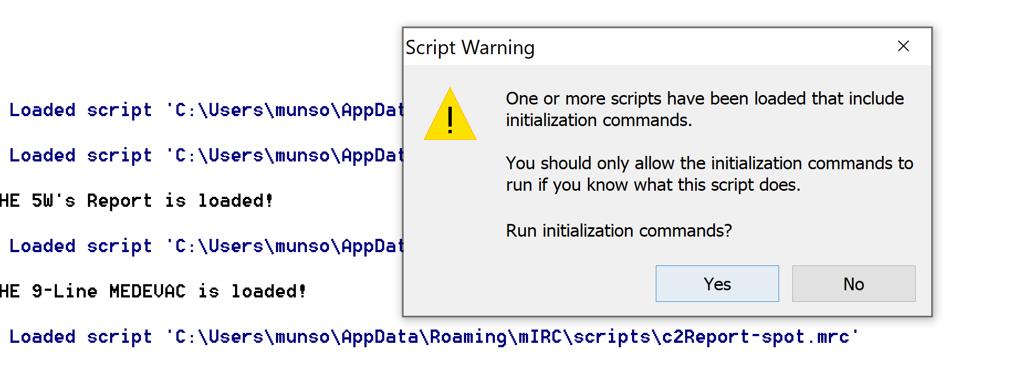
Install mIRC C2 Box v1.2
This page shows how to install when you can access the mIRC installation folder.
1. If you are dealing with an already installed mIRC, and not sure where it runs from or which folders it uses for scripts, run the following command in your mIRC status window to find out:
//echo mirc directory: $mircdir
You may see a Command Warning box, be sure to deselect the “Always show this message.”
Chances the mIRC directory will be a directory you can control. You may need to “View Hidden Files” to see the AppData directory in your file explorer as you navigate to it.
2. Place all the *.mrc files, the remote.ini and the vars.ini in the scripts subdirectory. Either backup the original remote.ini and vars.ini, or overright them. Most often thy will be blank unless there have already been modifications to this mIRC app. If that is the case, it is easy to concatenate the files using the method in the next page.
3. Create a folder in the mirc directory called “reports.”
4. Back in the status window, enter the command:
//c2start
Observe the scripts loading and select “Yes” for each one

Slide 5
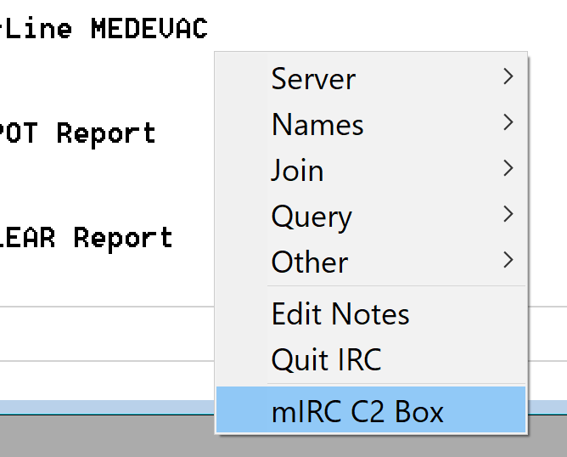
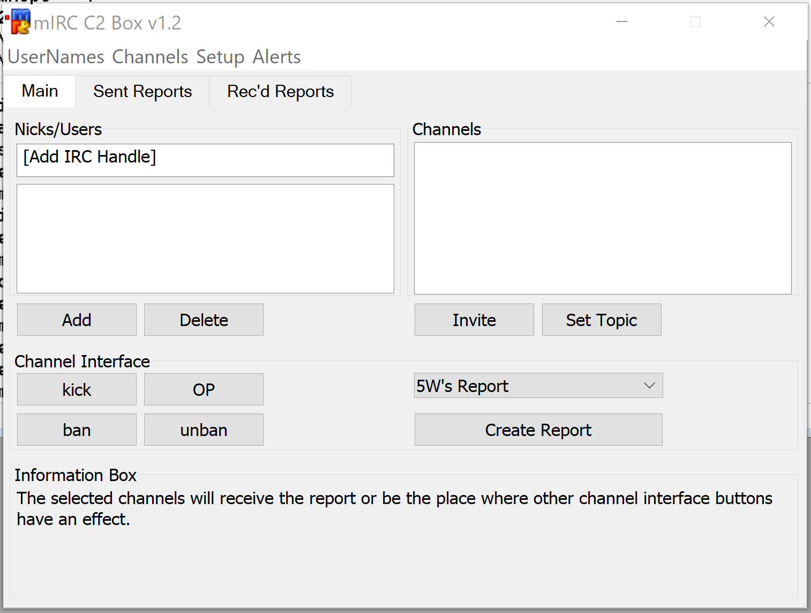
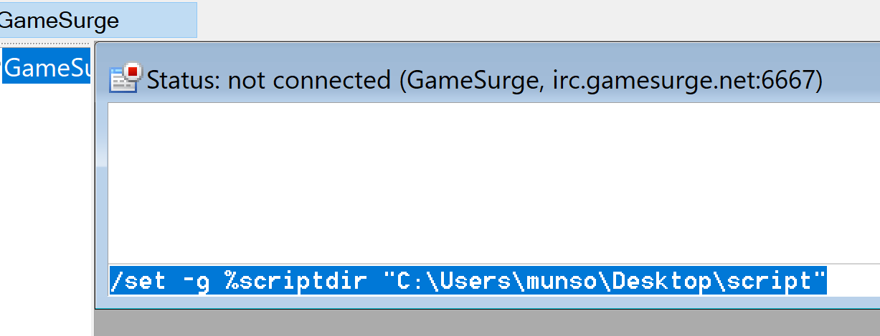
Install mIRC C2 Box v1.2
5. Right click in the status window or any chat window and select mIRC C2 Box. Alternatively, pressing F4 key should being this up as well.

