Slide 1

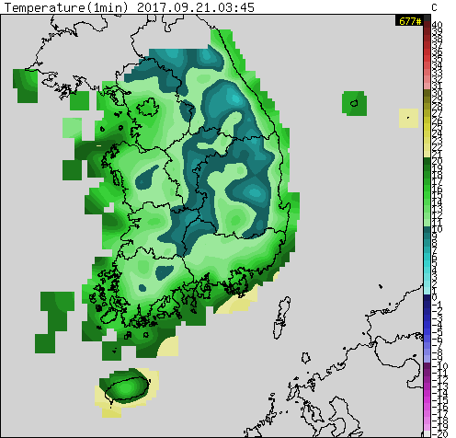
Overall Processing Flow
ColorPicker
Humidity
WeatherImage
Wind Speed
WeatherImage
Pixel[][]
Precipitation
WeatherImage
Temperature
WeatherImage
① Collect
② Merge
Classes
WeatherImage: Contains an image, provides the collection method
ColorPicker: Converts colors into actual data, from the lookup tables
Pixel: Contains aggregated data for each points,
provides conversions from (long,lat) to pixel coordinates and vice versa

Slide 2
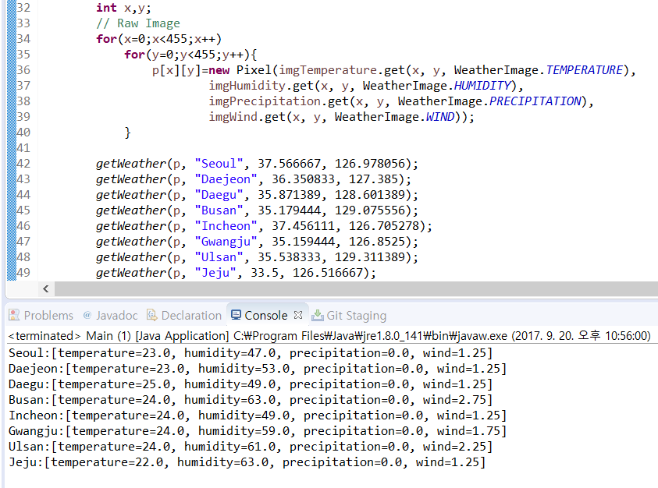
Results
Sample data of
8 major cities in Korea
(coordinates from geoHack)
Run at
Sep 20, 22:56 (EST)
Sep 21, 11:56 (KST)
Units
Temperature (℃)
25℃ = 77℉
Humidity (%)
Precipitation (mm/h)
25.8mm/h = 1 in/h
Wind Speed (m/s)
1m/s = 2.24mph

