Slide 1
Can we make people HAPPY by stimulating brain region?
NO
Heeyeon Ahn, Chanho Jang , Jiyoon Han

Slide 2
1
Why can’t we make people happy
by stimulating brain region?

Slide 3
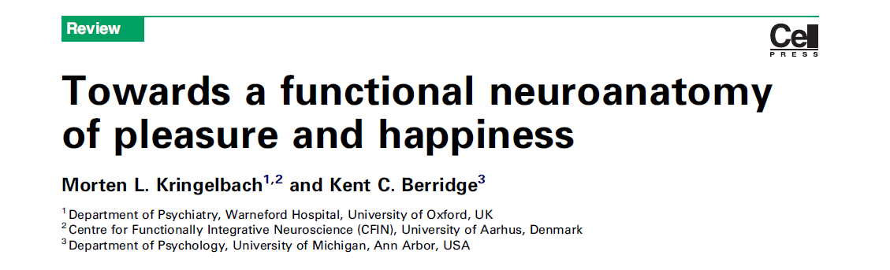
i. Complex mechanism of HAPPINESS
HAPPINESS = Hedonia + Eudaimonia
Pleasure and happiness are different concept.
Only hedonia can be measured and then manipulated. ex) by facial expression
Eudaimonia, the social part of happiness cannot be measured or manipulated.
Thus, there can be difficulty in causality study.
Interaction mechanism between pleasure and happiness is still unknown.
Pleasure
Liking
Life well-lived
Engagement

Slide 4
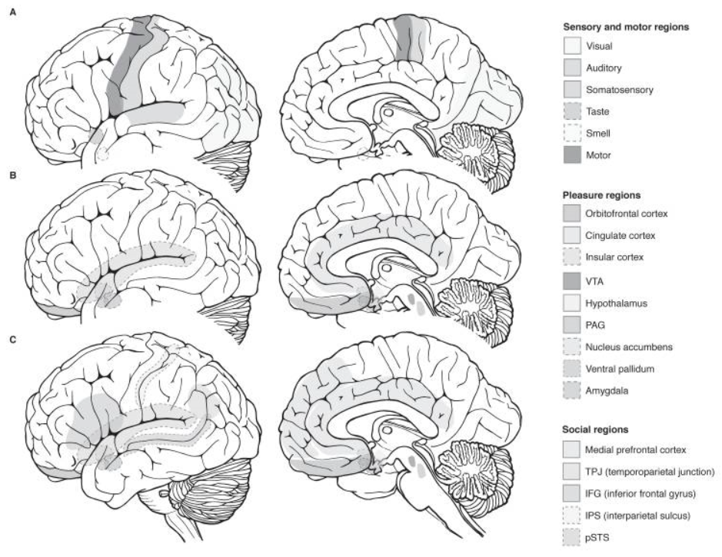
i. Complex mechanism of HAPPINESS

Slide 5
ii. Ambiguity of term “CENTER”
Term such as pleasure center or hedonic hotspot indicate site with special capability of controlling pleasure.
However, this center only functions under right circumstances.
ex) Nucleus accumbens causes pleasure ‘liking’ when stimulated with opioid or cannabinoid.
Nucleus accumbens amplifies ‘wanting’ without ‘liking’ when stimulated by dopamine.

Slide 6
iii. Controlling problem of stimulation
Size of “center” site is small. (~mm)
It is difficult to stimulate center site with electrode or microinjection.
Also, ethical problem can be occurred.

Slide 7
2
Any ethical issue?

Slide 8
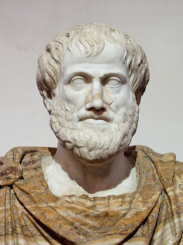
i. What is Eudaimonia?
“ Eudaimonia is achieving the best conditions possible for a human being, in every sense-not only happiness, but also virtue, morality, and a meaningful life.” - Aristotle -

Slide 9





Slide 10
3
Unsolved problem and future
: Eudaimonia and Happiness

Slide 11
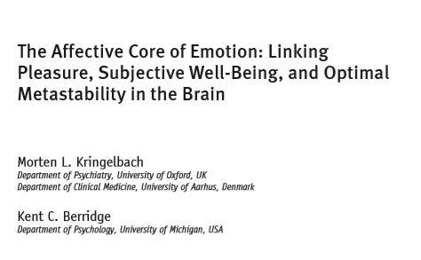
i. Hard to characterize Eudaimonia
Subjective well-being remains difficult to measure objectively
There are difficulties in fully characterizing eudaimonia with existing
correlational neuroimaging methods
Causal whole-brain computational modelling of human neuroimaging data

Slide 12
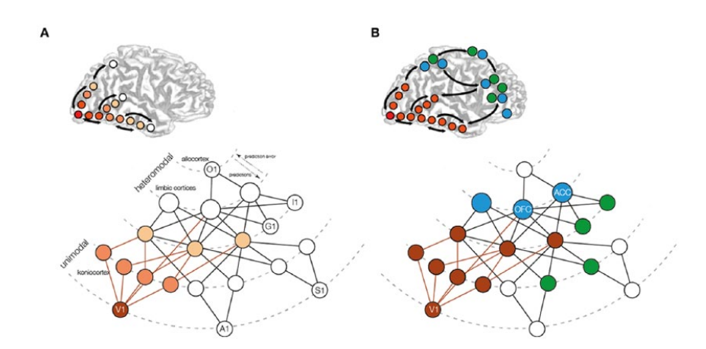
i. Hard to characterize Eudaimonia

Slide 13
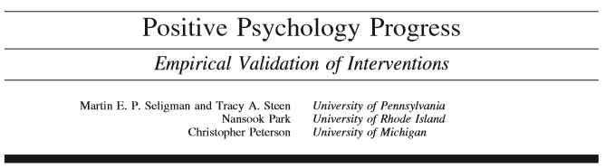
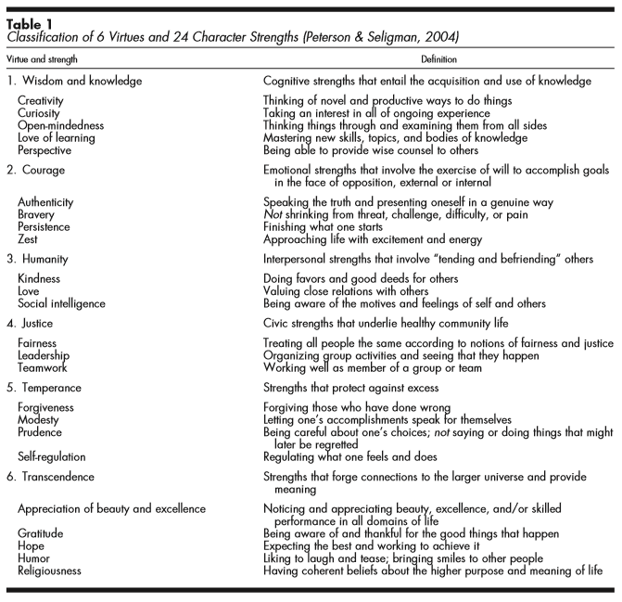
ii. Changing definition of happiness
Happiness is necessarily subjective and essentially whatever the individual
defines it to be
Measurement of positive states needs more research
Positive psychologists recently proposed to add
to third distinct component

