Slide 1


GBME Probability and Statistics
Activity 09
Activity 09
Random variables
CHOONG-WAN WOO | COCOAN lab | http://cocoanlab.github.io

Slide 2
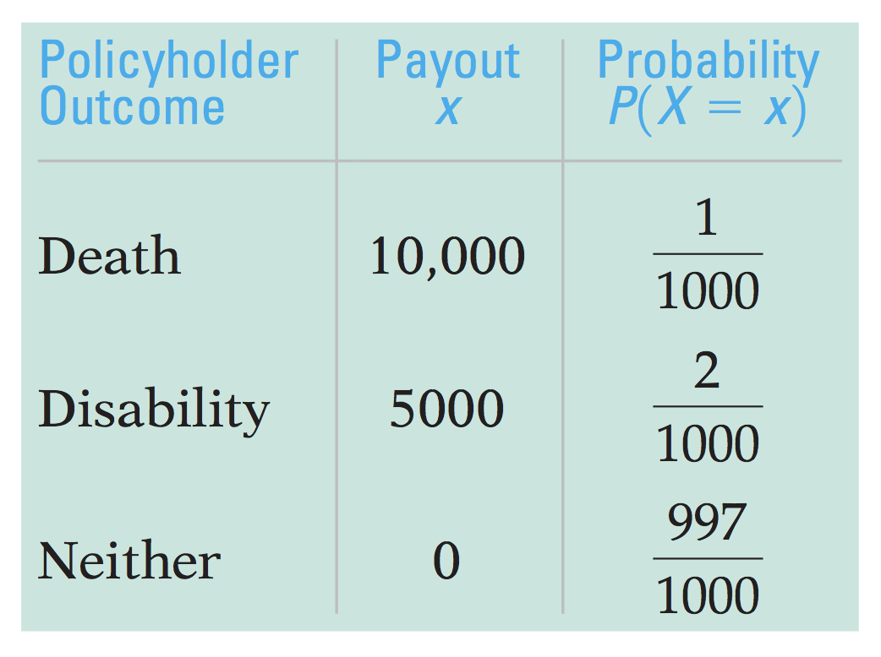
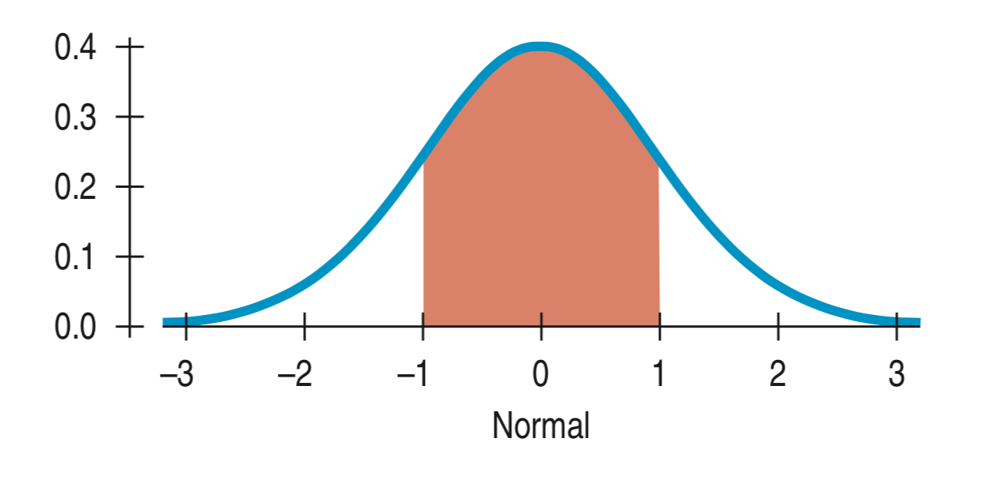
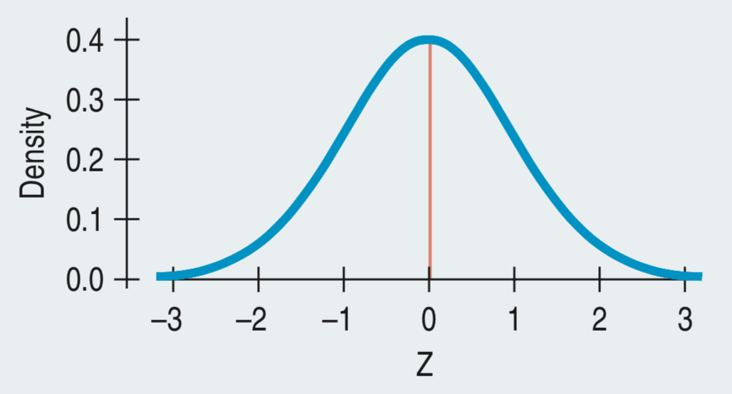
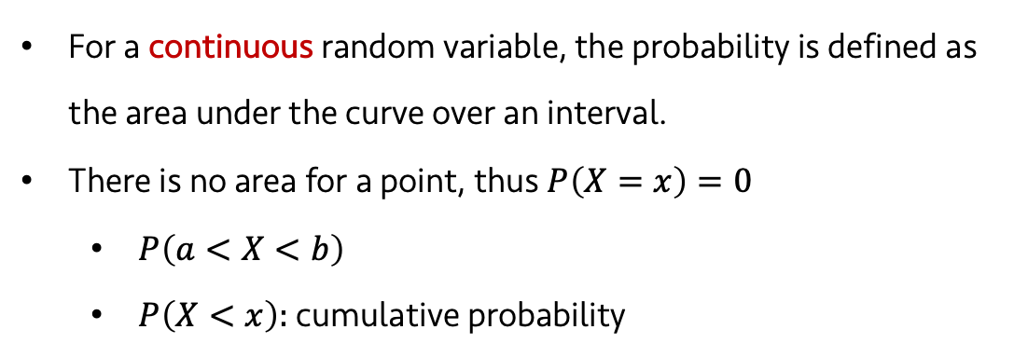
Activity 09
When its values are based on the outcome of a random event
We denote random variables using a capital letter, like X
If we can list all the outcomes, it’s discrete random variable.
Otherwise, it’s a continuous random variable.
For a continuous random variable, the probability is defined as the area under the curve over an interval.
There is no area for a point, thus $P\left(X=x\right)=0$
$P\left(a<X<b\right)$
$P\left(X<x\right)$: cumulative probability
CHOONG-WAN WOO | COCOAN lab | http://cocoanlab.github.io

Slide 3
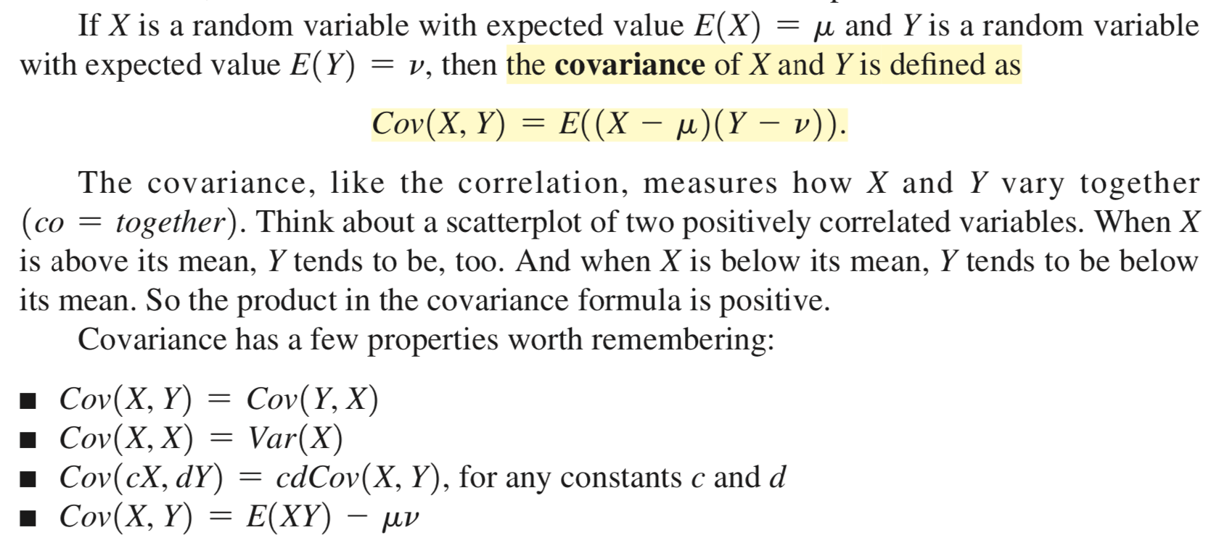
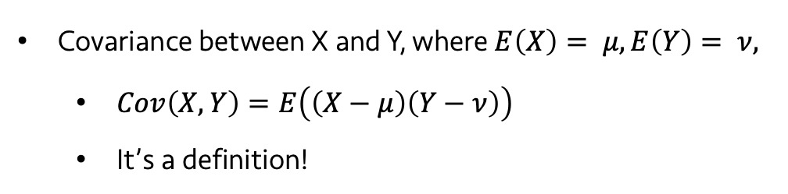
Activity 09
Covariance between X and Y, where $E\left(X\right)= μ, E\left(Y\right)= ν,$
$Cov\left(X,Y\right)=E\left(\left(X−μ\right)\left(Y−ν\right)\right)$
It’s a definition!
CHOONG-WAN WOO | COCOAN lab | http://cocoanlab.github.io

Slide 4
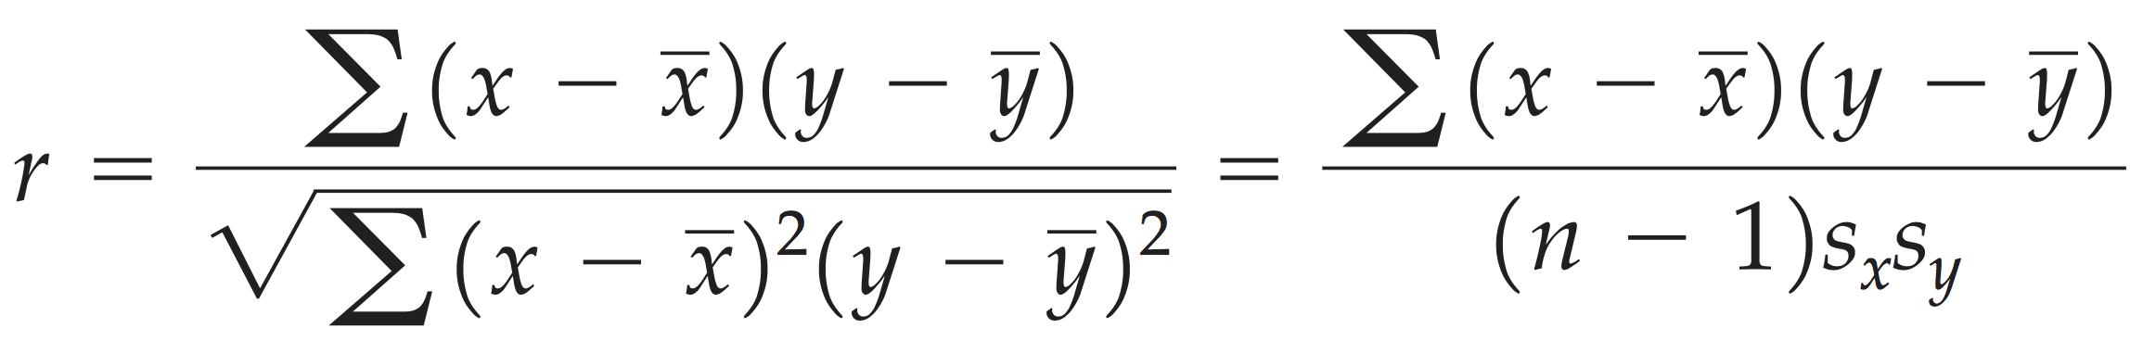
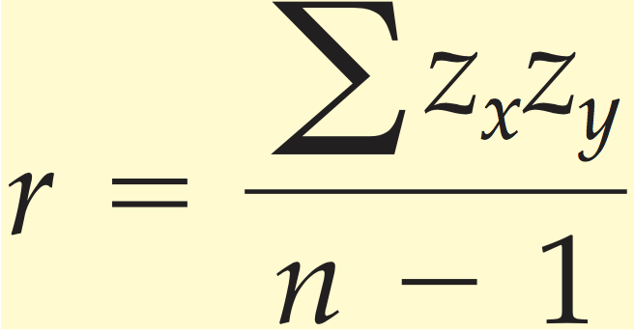
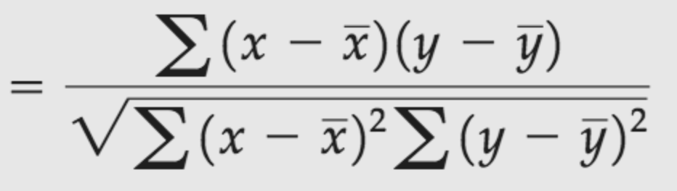
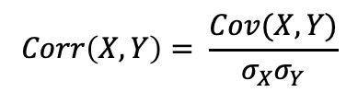
Activity 09
YES!
Yes, the slide is wrong. I uploaded the correct one:
Remember the correlation between two variables from a previous chapter
Now, correlation between two random variables.
No limit, direction and strength, but not normalized
$$Corr\left(X,Y\right)= \frac{Cov(X,Y)}{σ_{X}σ_{Y}}$$
CHOONG-WAN WOO | COCOAN lab | http://cocoanlab.github.io

Slide 5
Activity 09
CHOONG-WAN WOO | COCOAN lab | http://cocoanlab.github.io

Slide 6
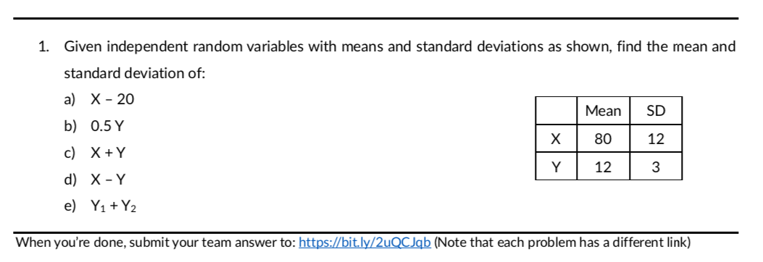
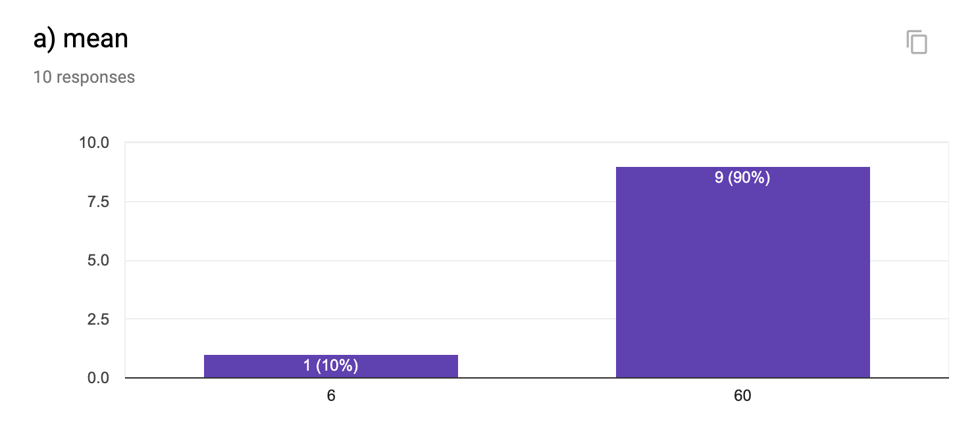
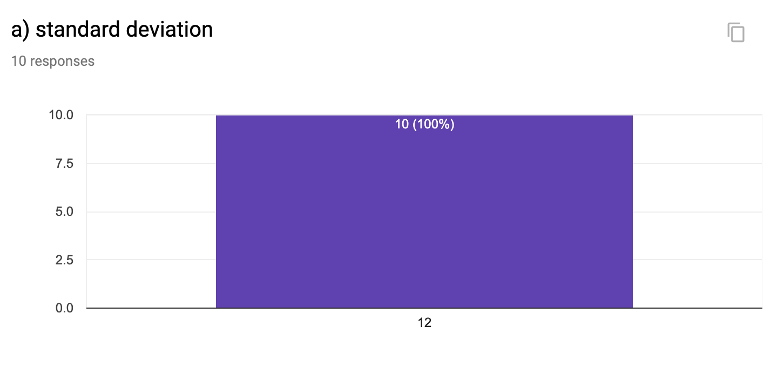
Activity 09
CHOONG-WAN WOO | COCOAN lab | http://cocoanlab.github.io

Slide 7
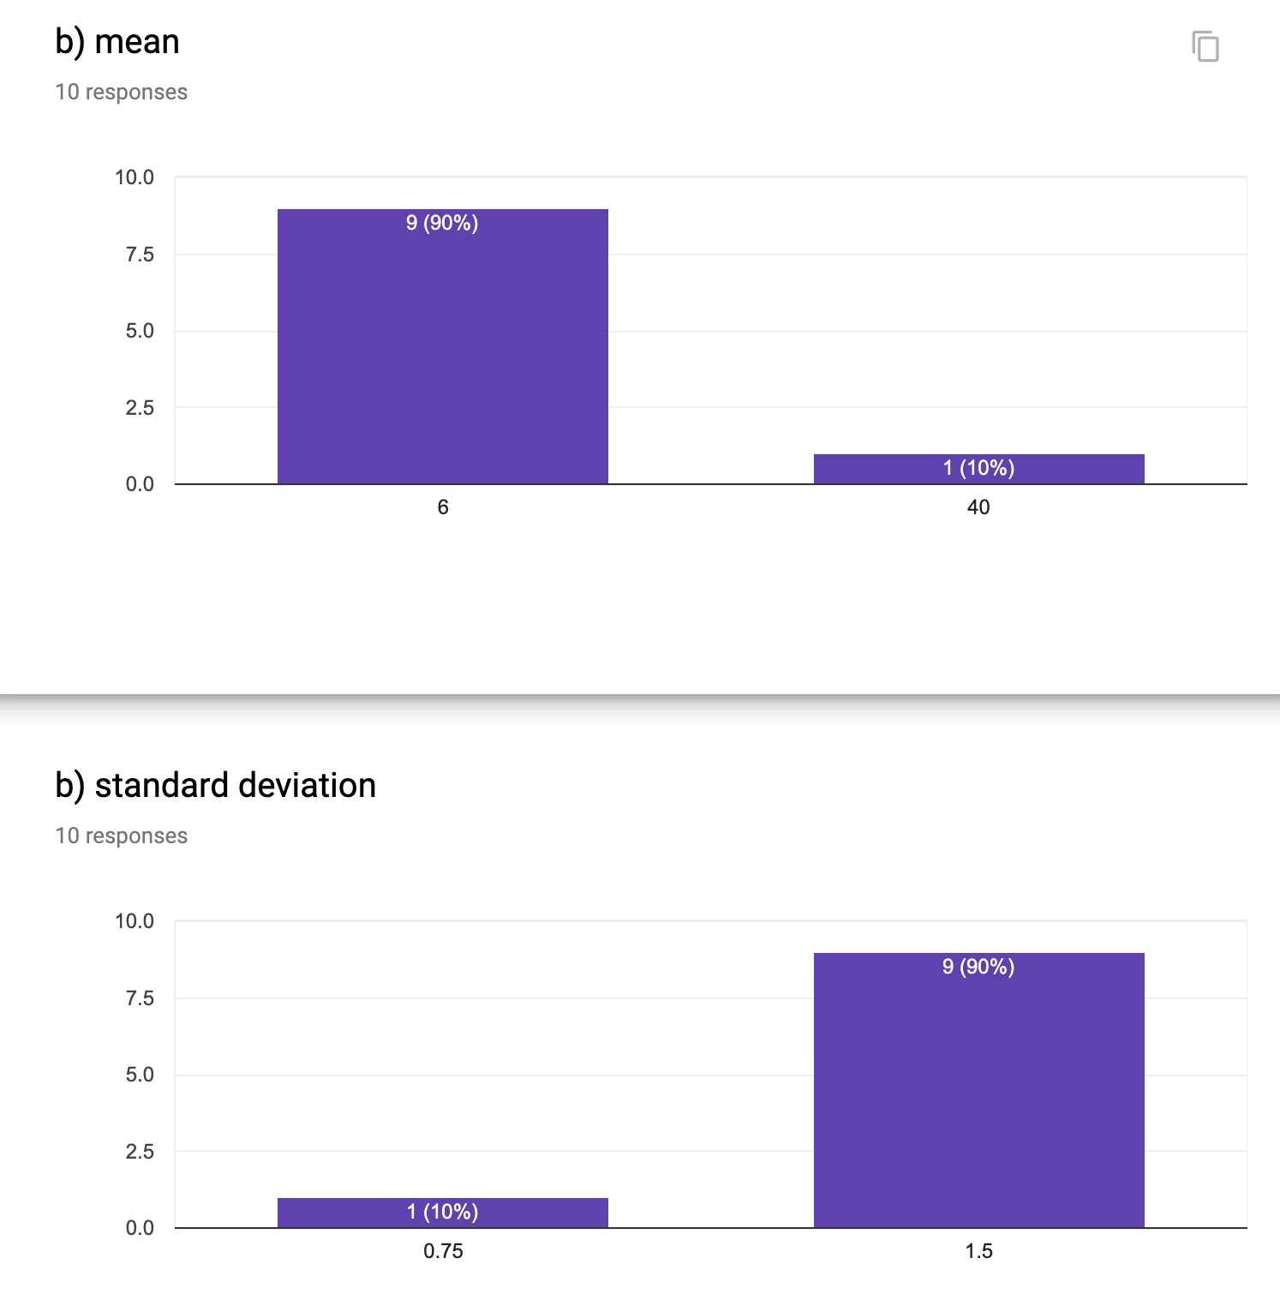
Activity 09
CHOONG-WAN WOO | COCOAN lab | http://cocoanlab.github.io

Slide 8
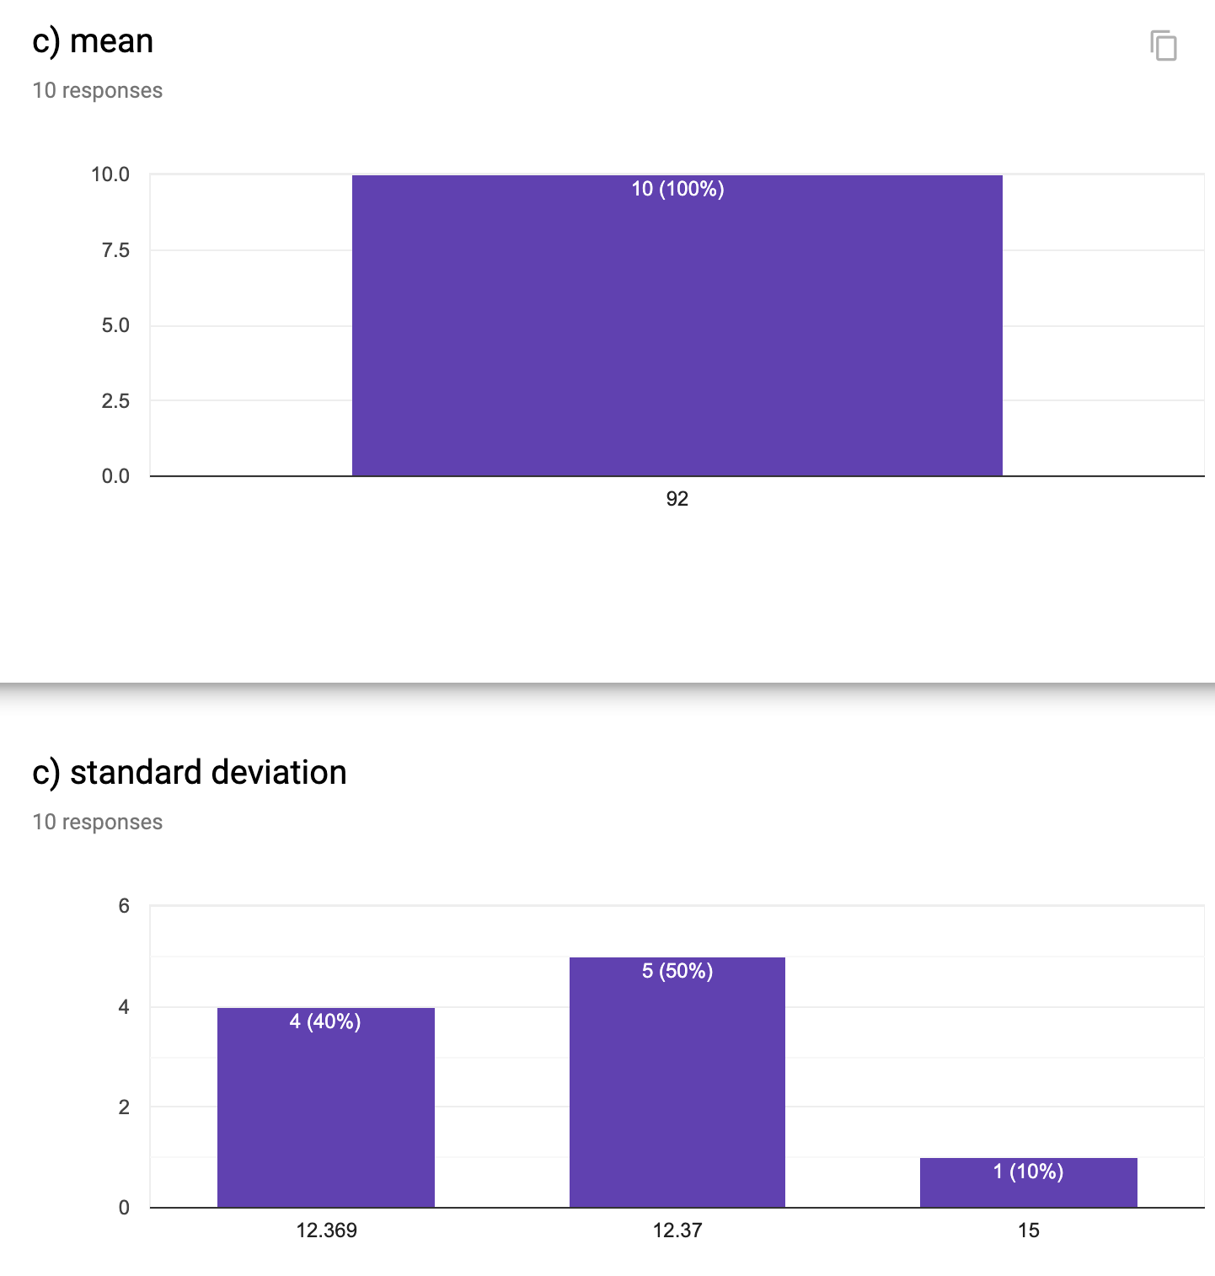
Activity 09
CHOONG-WAN WOO | COCOAN lab | http://cocoanlab.github.io

Slide 9
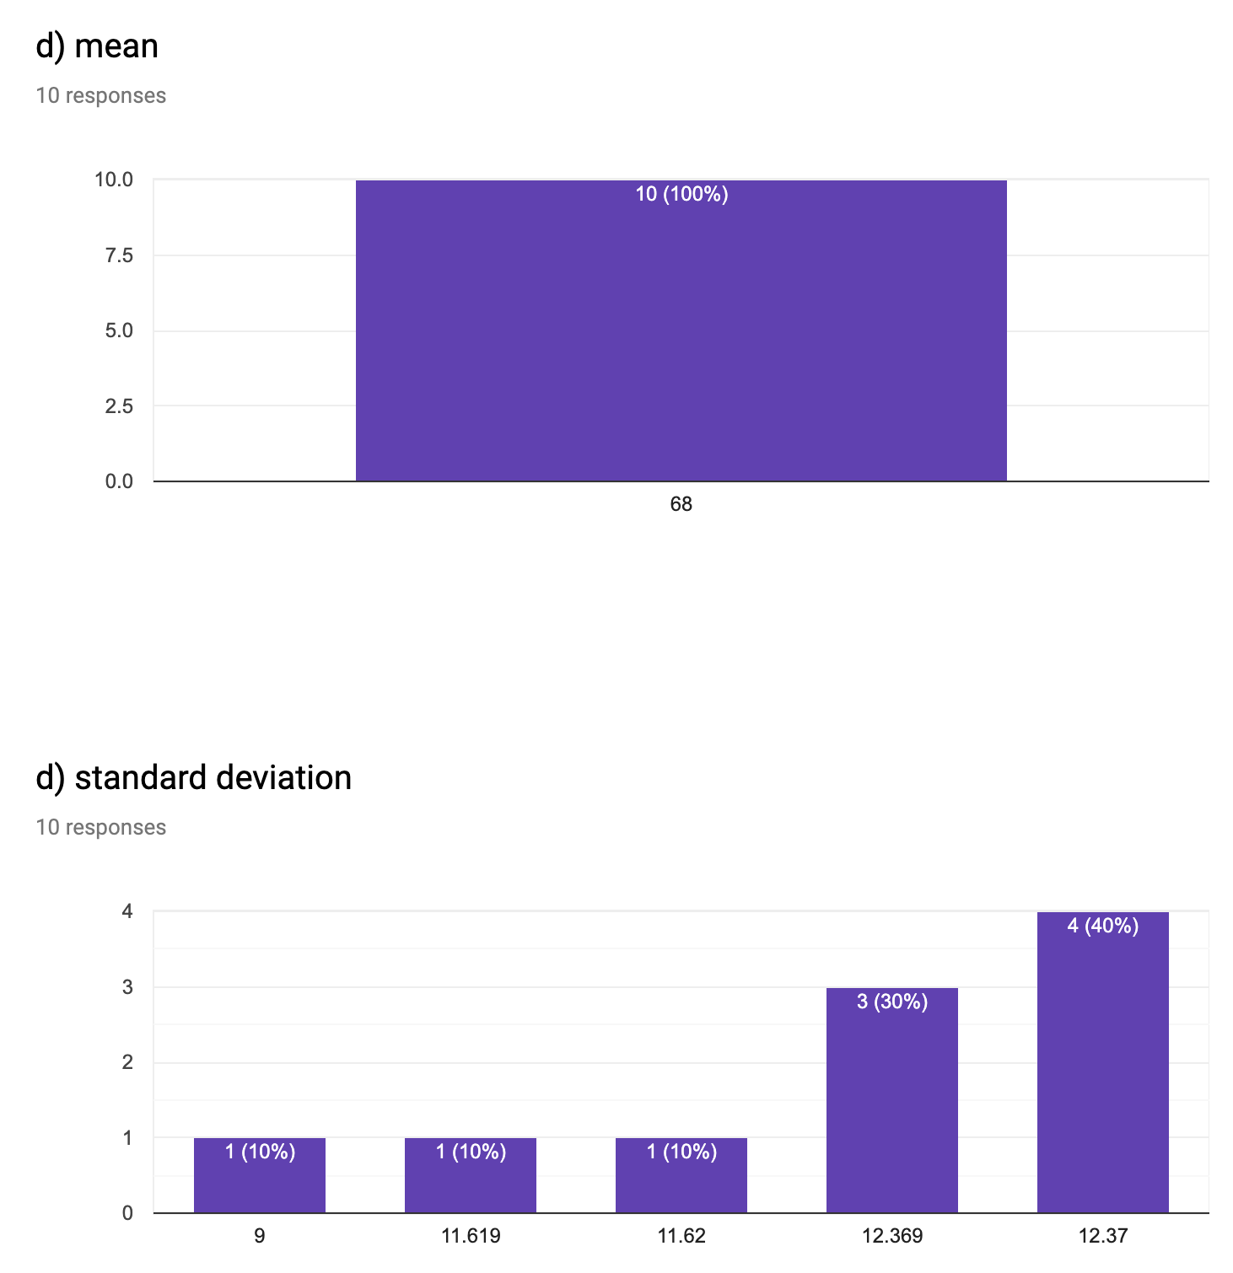
Activity 09
CHOONG-WAN WOO | COCOAN lab | http://cocoanlab.github.io

Slide 10
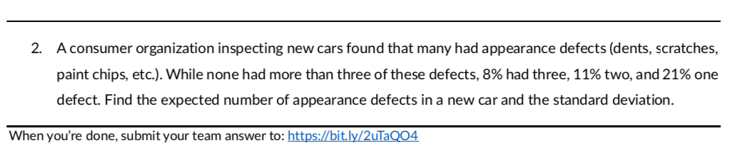
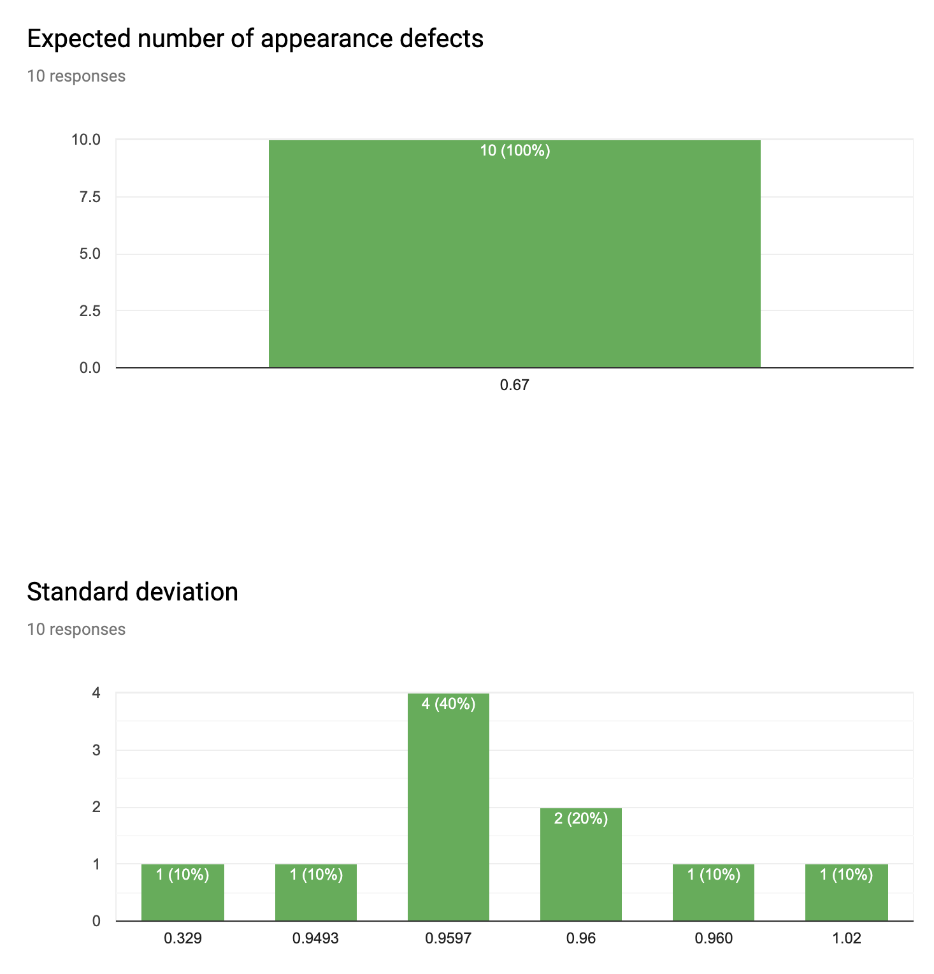
Activity 09
CHOONG-WAN WOO | COCOAN lab | http://cocoanlab.github.io

Slide 11
Activity 09
CHOONG-WAN WOO | COCOAN lab | http://cocoanlab.github.io

Slide 12
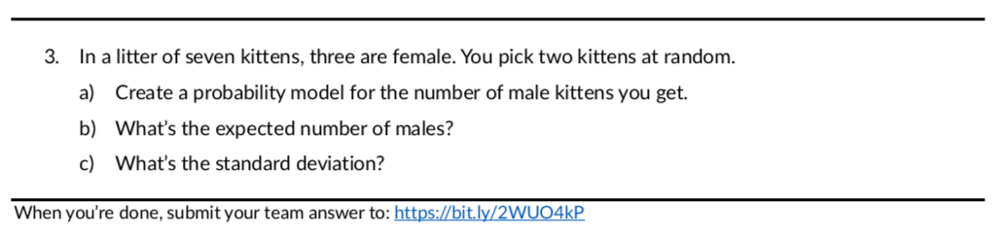
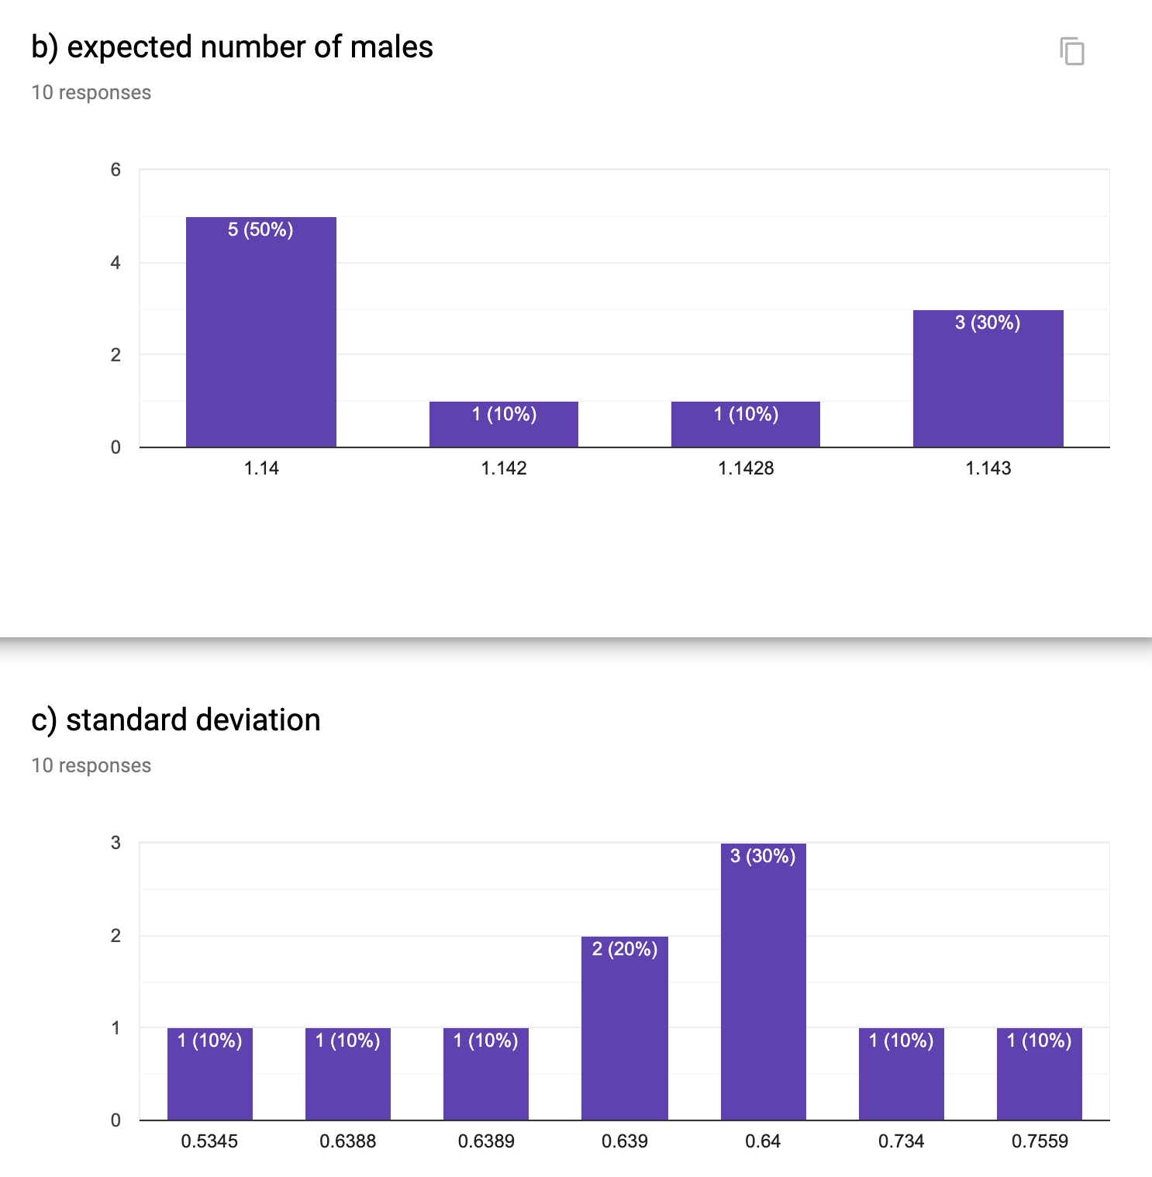
Activity 09
CHOONG-WAN WOO | COCOAN lab | http://cocoanlab.github.io

Slide 13
Activity 09
CHOONG-WAN WOO | COCOAN lab | http://cocoanlab.github.io

Slide 14
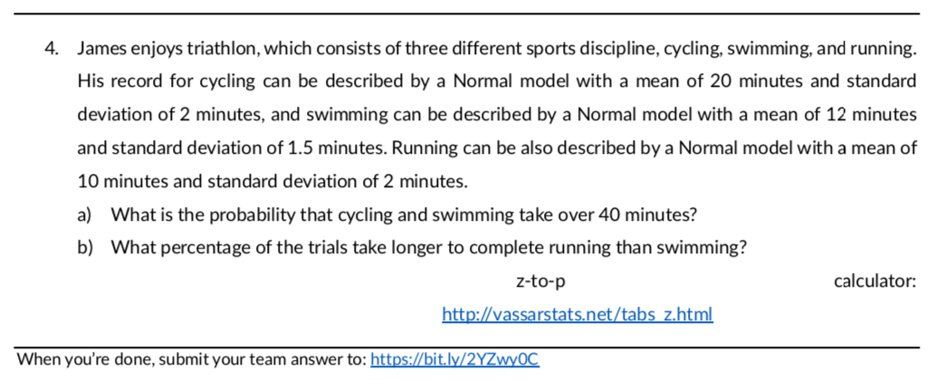
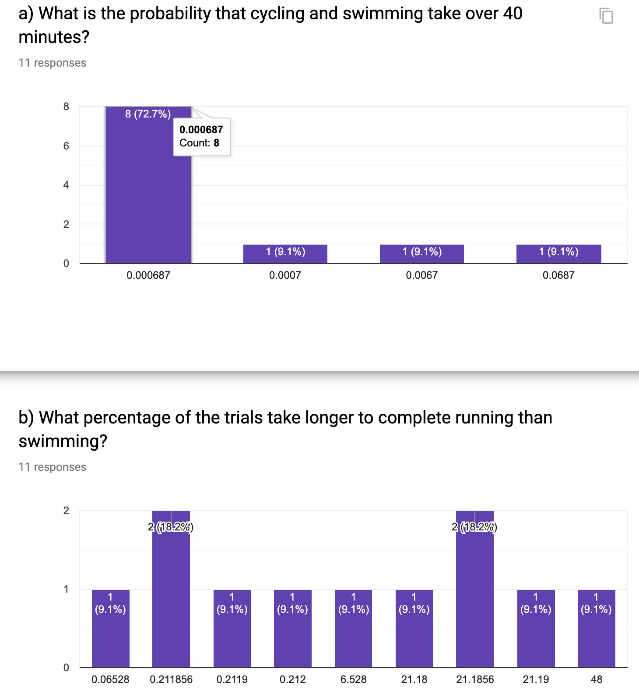
Activity 09
CHOONG-WAN WOO | COCOAN lab | http://cocoanlab.github.io

Slide 15
Activity 09
CHOONG-WAN WOO | COCOAN lab | http://cocoanlab.github.io

