Slide 1


GBME Probability and Statistics
Lecture 22
Lecture 22
Inferences for Regression
CHOONG-WAN WOO | COCOAN lab | http://cocoanlab.github.io

Slide 2
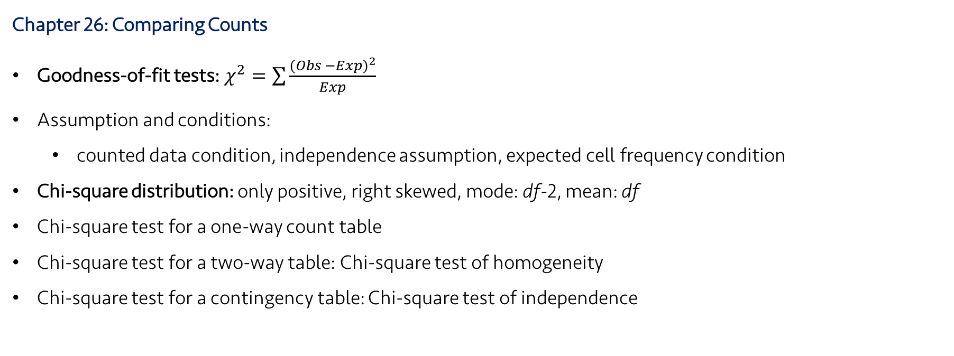
Lecture 22
Review: Key Points
Chapter 26: Comparing Counts
Goodness-of-fit tests: $χ^{2}=\sum{\frac{{(Obs −Exp)}^{2}}{Exp}}$
Assumption and conditions:
counted data condition, independence assumption, expected cell frequency condition
Chi-square distribution: only positive, right skewed, mode: df-2, mean: df
Chi-square test for a one-way count table
Chi-square test for a two-way table: Chi-square test of homogeneity
Chi-square test for a contingency table: Chi-square test of independence
CHOONG-WAN WOO | COCOAN lab | http://cocoanlab.github.io

Slide 3
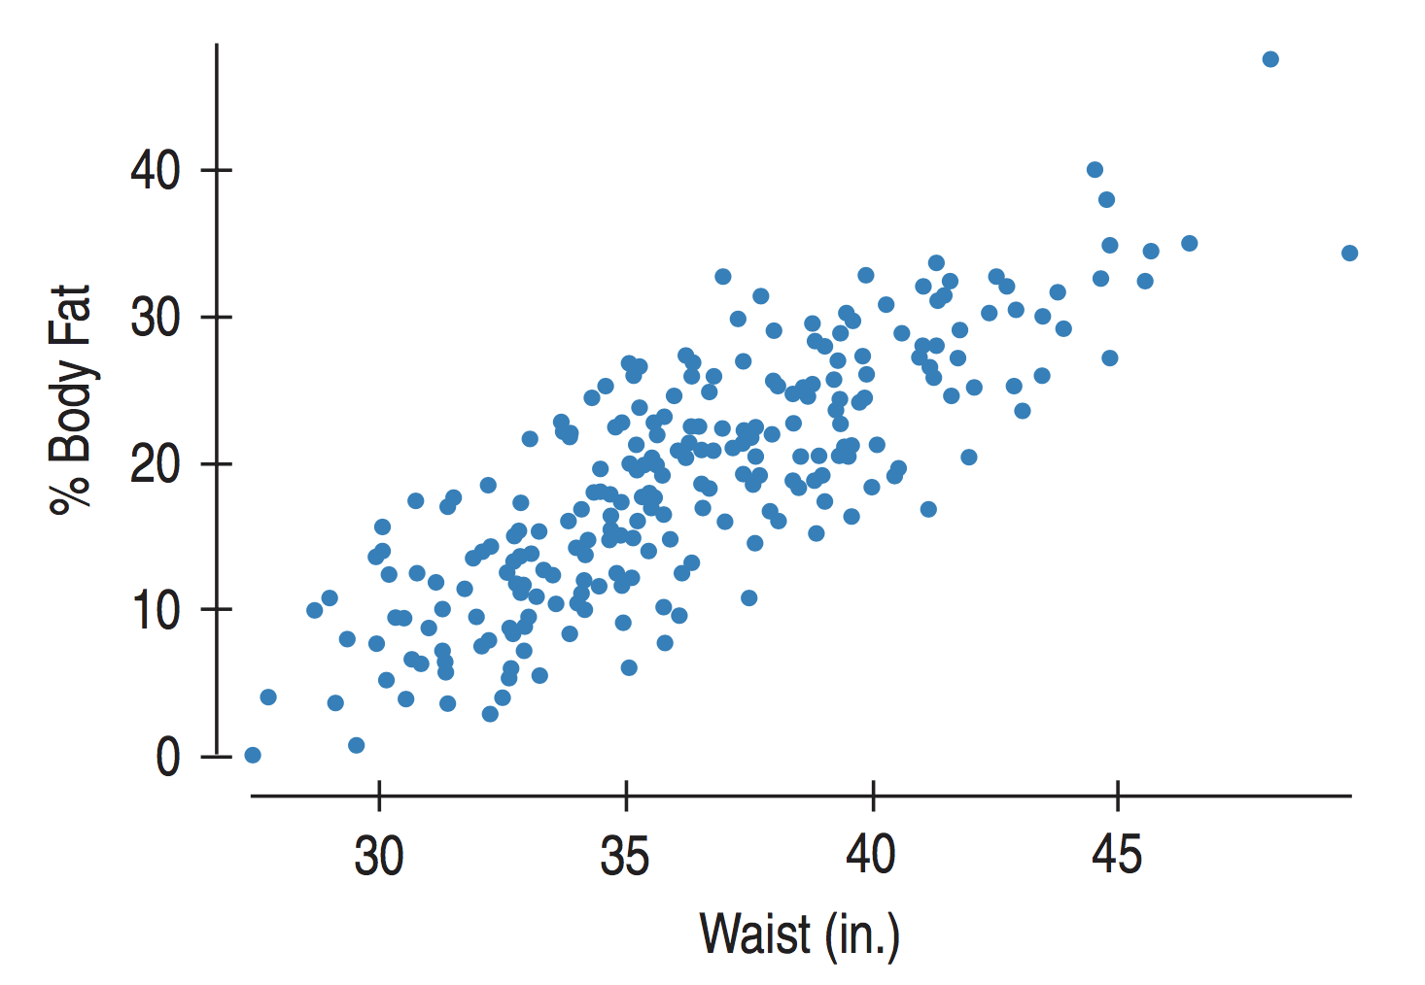
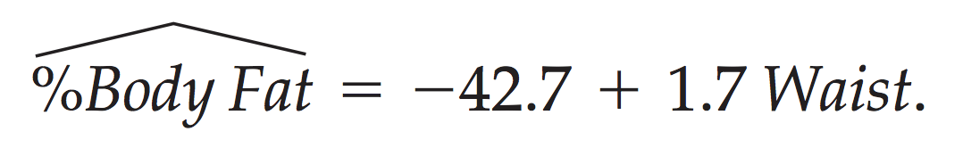
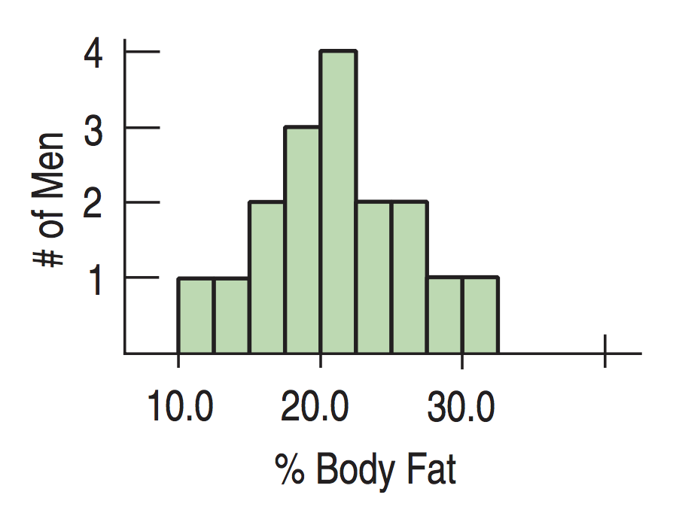
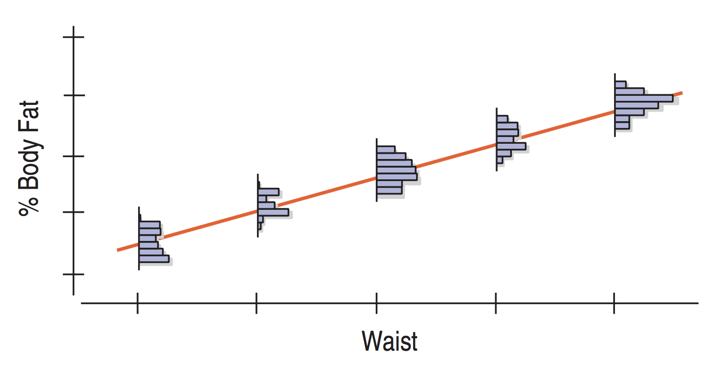
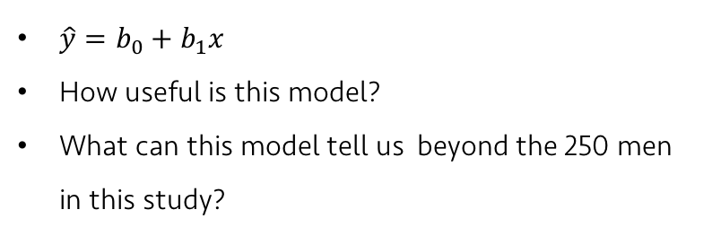


Lecture 22
Example: predicting %body fat
Measuring body fat is tedious and expensive.
Can we predict %Body fat from easily measurable variables, such as Height, Weight, or Waist size?
$\hat{y}=b_{0}+b_{1}x$
How useful is this model?
What can this model tell us beyond the 250 men in this study?
Idealized regression line:
$$μ_{y}=β_{0}+β_{1}x$$
$$y=β_{0}+β_{1}x+ε$$
CHOONG-WAN WOO | COCOAN lab | http://cocoanlab.github.io

Slide 4
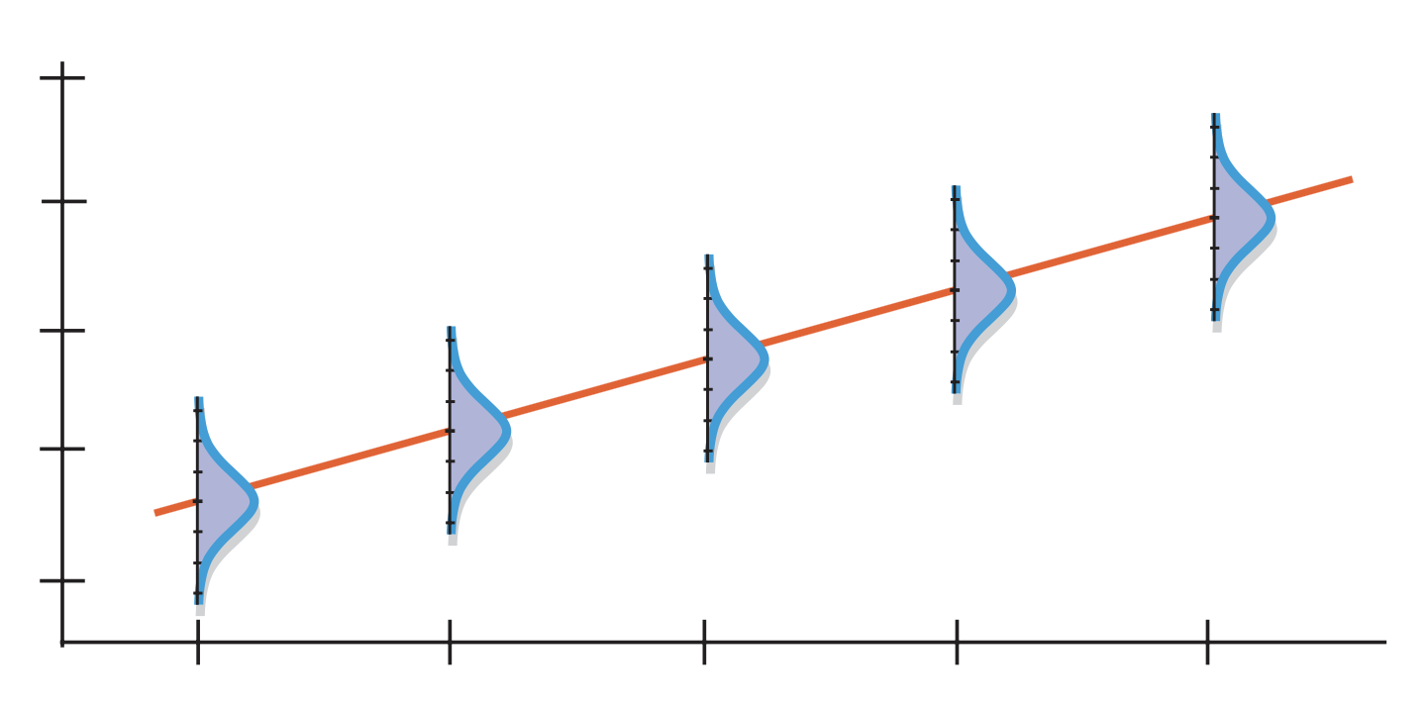
Lecture 22
Assumptions and Conditions
Linearity Assumption
Quantitative data condition
Straight enough condition
Equal Variance Assumption
Does the Plot Thicken? Condition
Normal Population Assumption
Nearly Normal condition
Outlier condition
Independence Assumption
Errors should be independence of each other
Examine residuals for evidence of patterns, trends, or clumping, etc.
If the data are related to time (e.g., time-series), plot residuals against time.
CHOONG-WAN WOO | COCOAN lab | http://cocoanlab.github.io

Slide 5
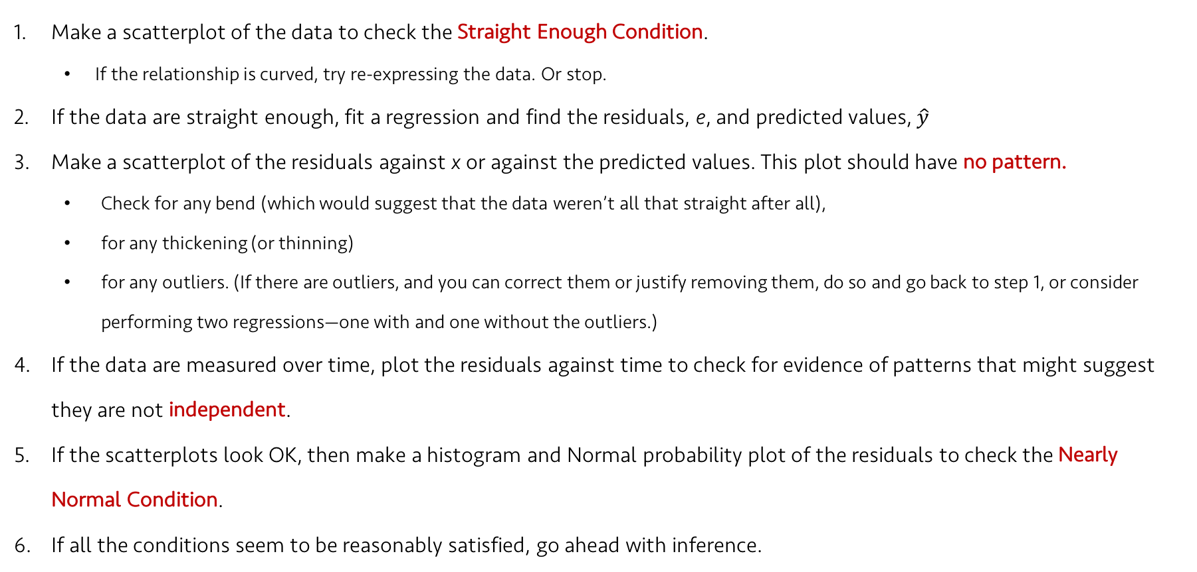
Lecture 22
The order of examining assumptions and conditions
Make a scatterplot of the data to check the Straight Enough Condition.
If the relationship is curved, try re-expressing the data. Or stop.
If the data are straight enough, fit a regression and find the residuals, e, and predicted values, $\hat{y}$
Make a scatterplot of the residuals against x or against the predicted values. This plot should have no pattern.
Check for any bend (which would suggest that the data weren’t all that straight after all),
for any thickening (or thinning)
for any outliers. (If there are outliers, and you can correct them or justify removing them, do so and go back to step 1, or consider performing two regressions—one with and one without the outliers.)
If the data are measured over time, plot the residuals against time to check for evidence of patterns that might suggest they are not independent.
If the scatterplots look OK, then make a histogram and Normal probability plot of the residuals to check the Nearly Normal Condition.
If all the conditions seem to be reasonably satisfied, go ahead with inference.
CHOONG-WAN WOO | COCOAN lab | http://cocoanlab.github.io

Slide 6
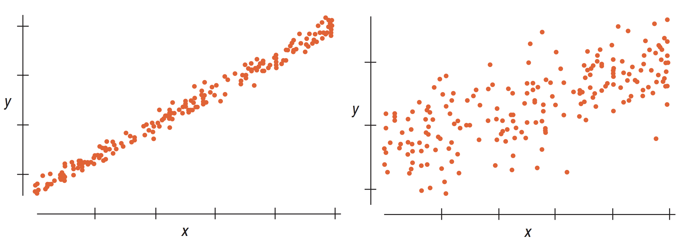
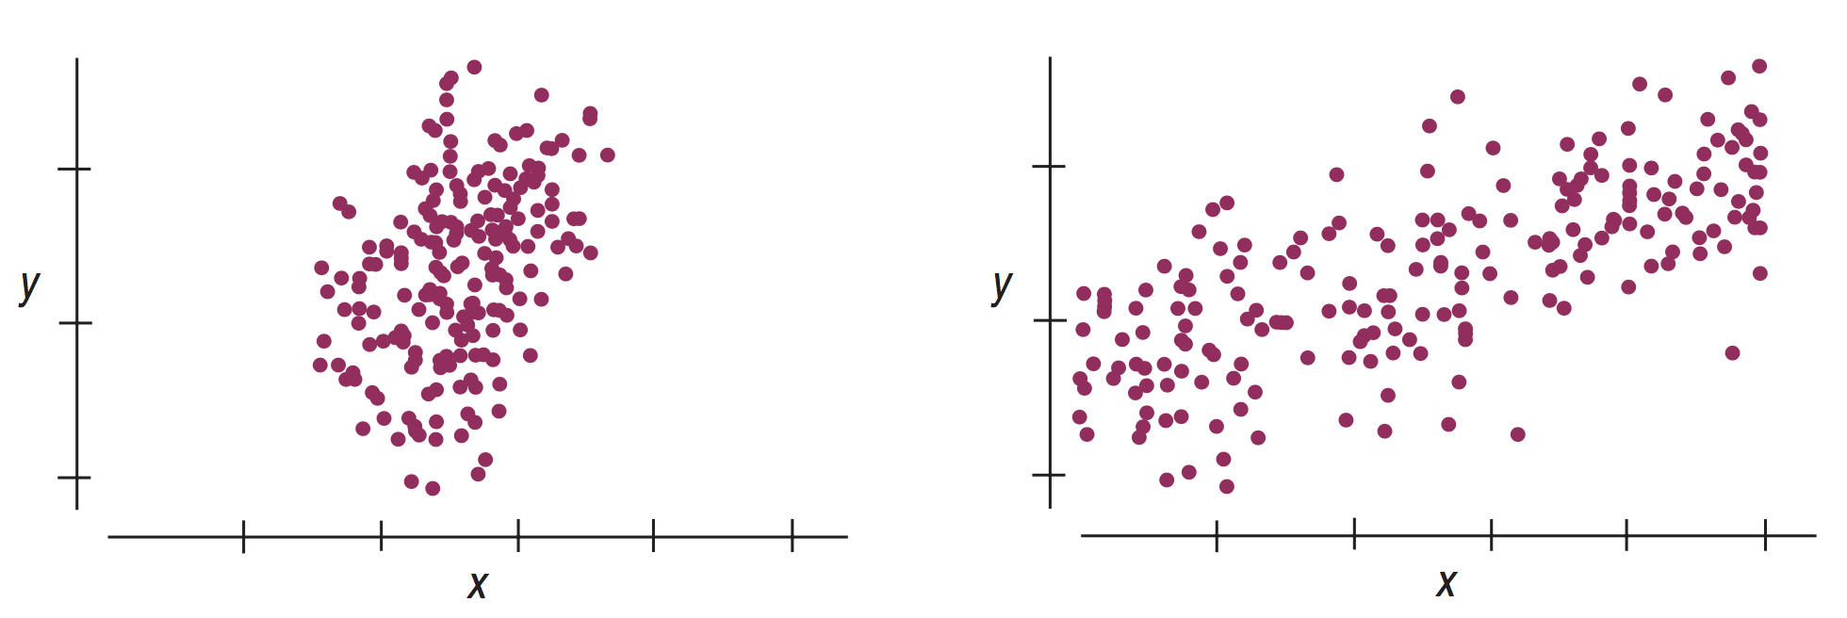
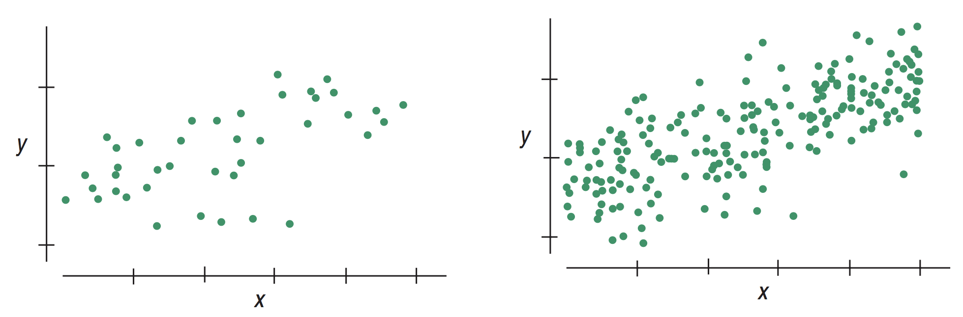

Lecture 22
Intuition about regression inference
The factors that affect how much the slope (and intercept) vary from sample to sample (stability of beta)
Spread around the line
Residual standard deviation, $s_{e}=\sqrt{\frac{\sum{{(y − \hat{y}\text{)}}^{2}}}{n−2}}$
Spread of the x’s
Sample size
CHOONG-WAN WOO | COCOAN lab | http://cocoanlab.github.io

Slide 7

Lecture 22
Standard Error for the Slope
Spread around the line: $s_{e}$
Spread of the x’s: $s_{x}$
Sample size: $n$
Standard error for the regression slope:
$SE\left(b_{1}\right)=\frac{s_{e}}{\sqrt{n−1}s_{x}}$, where $s_{e}=\sqrt{\frac{\sum{{(y − \hat{y}\text{)}}^{2}}}{n−2}},s_{x}=\sqrt{\frac{\sum{{(x −\overline{x}\text{)}}^{2}}}{n−1}}$
Similar to inferences about means, $\frac{b_{1}−β_{1}}{SE(b_{1})}∼t_{n−2}$
Same for Intercept:
$\frac{b_{0}−β_{0}}{SE(b_{0})}∼t_{n−2}$
CHOONG-WAN WOO | COCOAN lab | http://cocoanlab.github.io

Slide 8
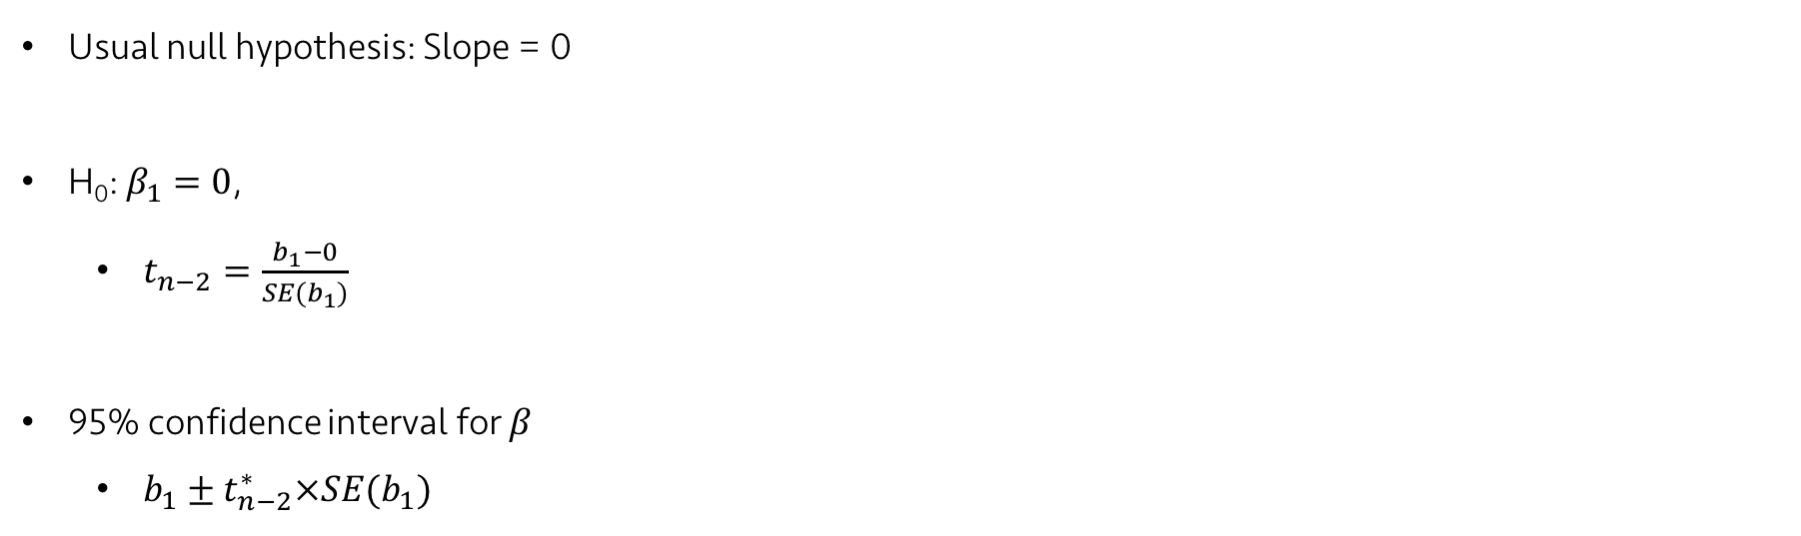
Lecture 22
Regression inference
Usual null hypothesis: Slope = 0
H₀: $β_{1}=0$,
$t_{n−2}=\frac{b_{1}−0}{SE(b_{1})}$
95% confidence interval for $β$
$b_{1}±t_{n−2}^{∗}×SE(b_{1})$
CHOONG-WAN WOO | COCOAN lab | http://cocoanlab.github.io

Slide 9
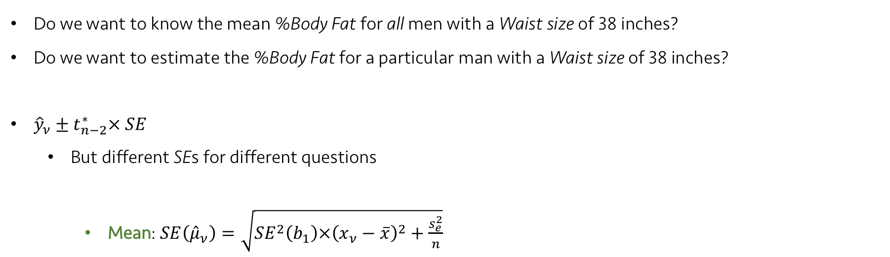
Lecture 22
Standard Errors for Predicted Values
Do we want to know the mean %Body Fat for all men with a Waist size of 38 inches?
Do we want to estimate the %Body Fat for a particular man with a Waist size of 38 inches?
${\hat{y}}_{ν}±t_{n−2}^{∗}× SE$
But different SEs for different questions
Mean: $SE\left({\hat{μ}}_{ν}\right)=\sqrt{{SE}^{2}\left(b_{1}\right)×{\left(x_{ν}−\overline{x}\right)}^{2}+\frac{s_{e}^{2}}{n}}$
CHOONG-WAN WOO | COCOAN lab | http://cocoanlab.github.io

Slide 10
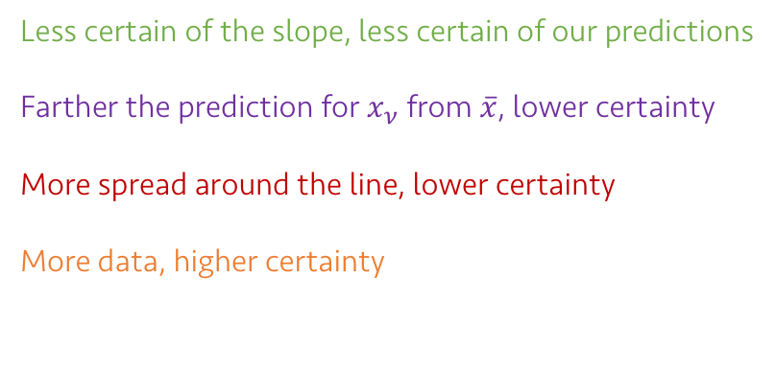
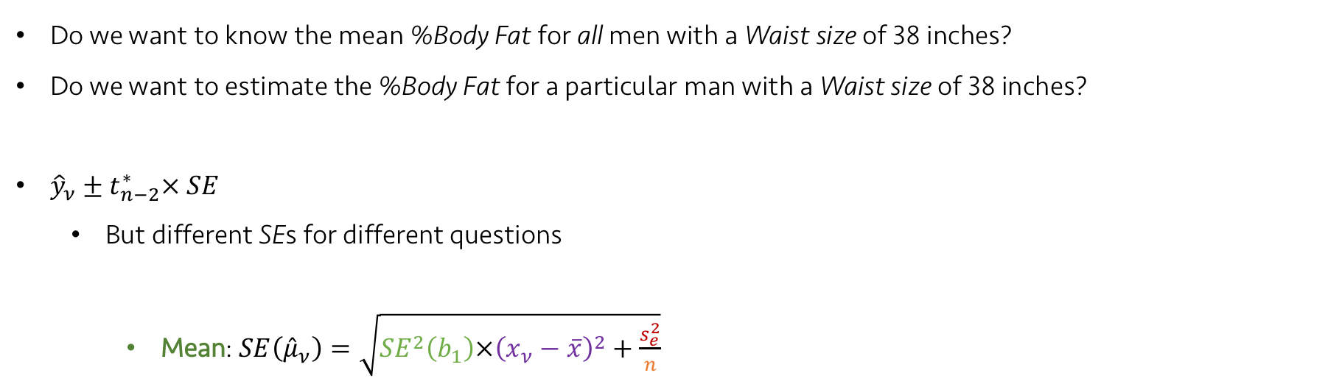
Lecture 22
Standard Errors for Predicted Values
Do we want to know the mean %Body Fat for all men with a Waist size of 38 inches?
Do we want to estimate the %Body Fat for a particular man with a Waist size of 38 inches?
${\hat{y}}_{ν}±t_{n−2}^{∗}× SE$
But different SEs for different questions
Mean: $SE\left({\hat{μ}}_{ν}\right)=\sqrt{{SE}^{2}\left(b_{1}\right)×{\left(x_{ν}−\overline{x}\right)}^{2}+\frac{s_{e}^{2}}{n}}$
Less certain of the slope, less certain of our predictions
Farther the prediction for $x_{ν}$ from $\overline{x}$, lower certainty
More spread around the line, lower certainty
More data, higher certainty
CHOONG-WAN WOO | COCOAN lab | http://cocoanlab.github.io

Slide 11
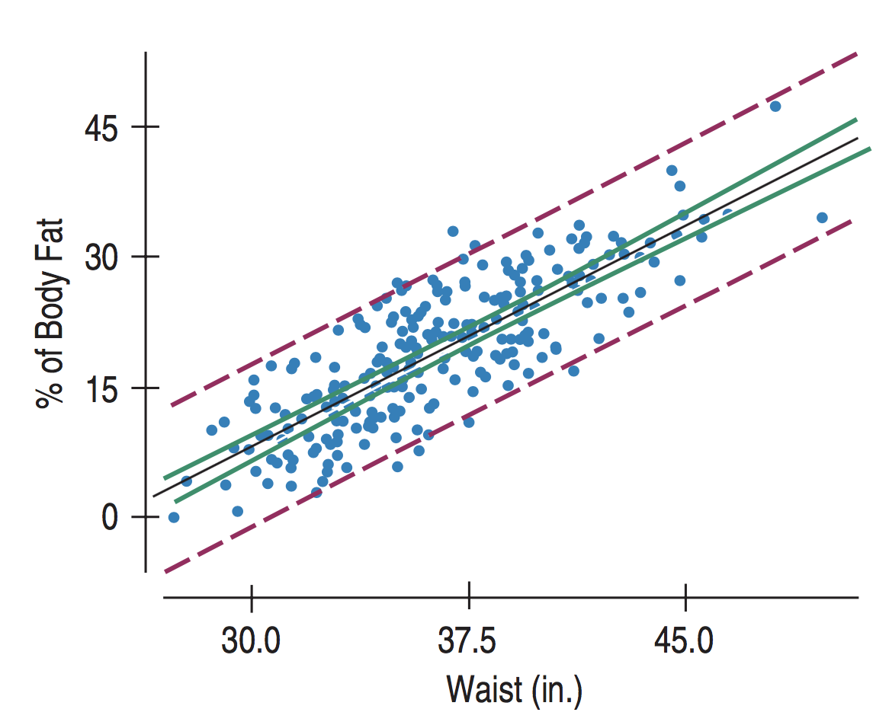
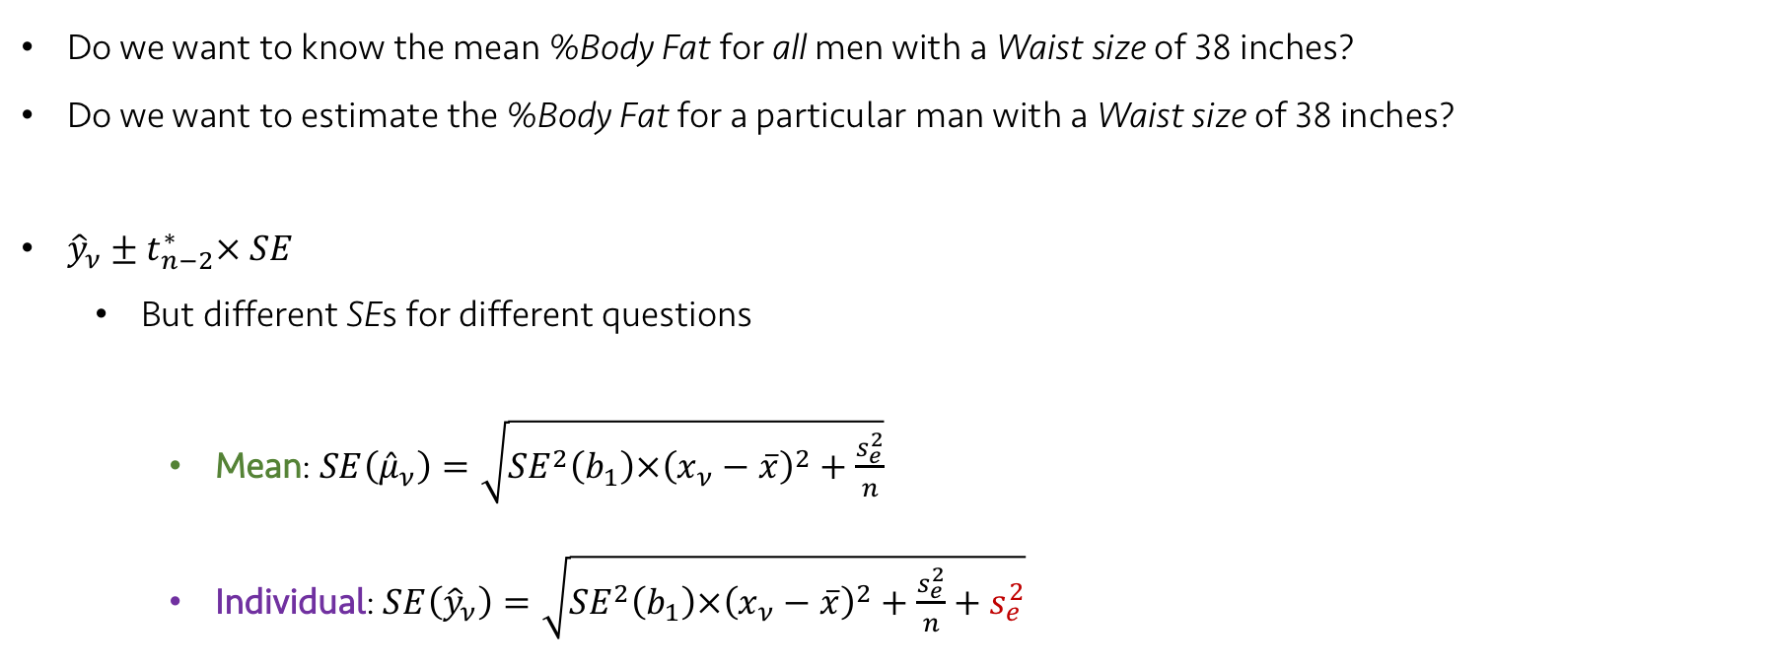
Lecture 22
Standard Errors for Predicted Values
Do we want to know the mean %Body Fat for all men with a Waist size of 38 inches?
Do we want to estimate the %Body Fat for a particular man with a Waist size of 38 inches?
${\hat{y}}_{ν}±t_{n−2}^{∗}× SE$
But different SEs for different questions
Mean: $SE\left({\hat{μ}}_{ν}\right)=\sqrt{{SE}^{2}\left(b_{1}\right)×{\left(x_{ν}−\overline{x}\right)}^{2}+\frac{s_{e}^{2}}{n}}$
Individual: $SE\left({\hat{y}}_{ν}\right)=\sqrt{{SE}^{2}\left(b_{1}\right)×{\left(x_{ν}−\overline{x}\right)}^{2}+\frac{s_{e}^{2}}{n}+s_{e}^{2}}$
The variation of individuals around the predicted mean
CHOONG-WAN WOO | COCOAN lab | http://cocoanlab.github.io

Slide 12
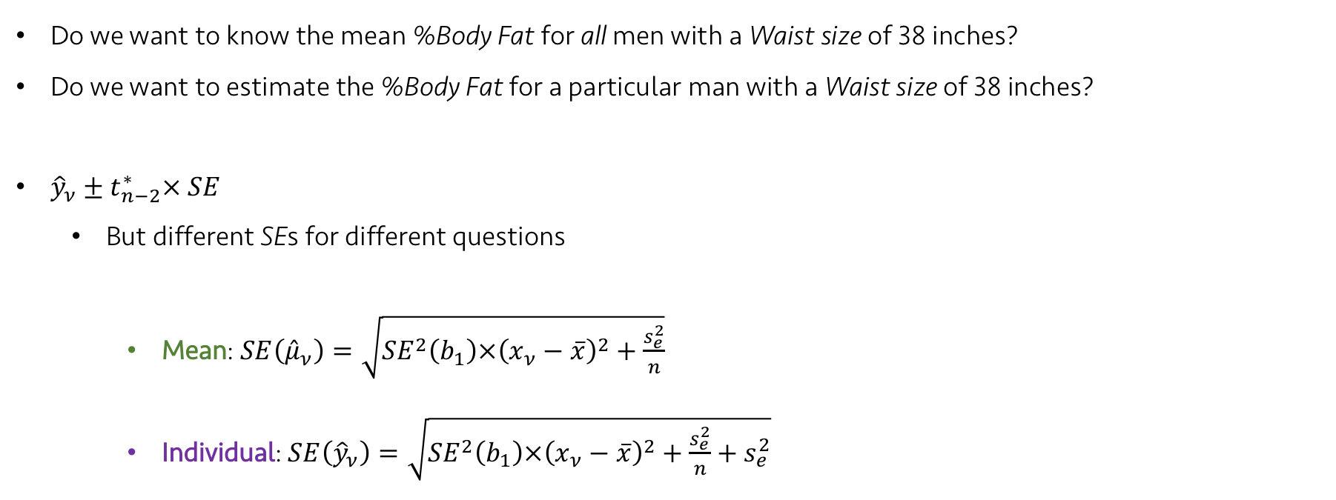
Lecture 22
Standard Errors for Predicted Values
Do we want to know the mean %Body Fat for all men with a Waist size of 38 inches?
Do we want to estimate the %Body Fat for a particular man with a Waist size of 38 inches?
${\hat{y}}_{ν}±t_{n−2}^{∗}× SE$
But different SEs for different questions
Mean: $SE\left({\hat{μ}}_{ν}\right)=\sqrt{{SE}^{2}\left(b_{1}\right)×{\left(x_{ν}−\overline{x}\right)}^{2}+\frac{s_{e}^{2}}{n}}$
Individual: $SE\left({\hat{y}}_{ν}\right)=\sqrt{{SE}^{2}\left(b_{1}\right)×{\left(x_{ν}−\overline{x}\right)}^{2}+\frac{s_{e}^{2}}{n}+s_{e}^{2}}$
CHOONG-WAN WOO | COCOAN lab | http://cocoanlab.github.io

Slide 13
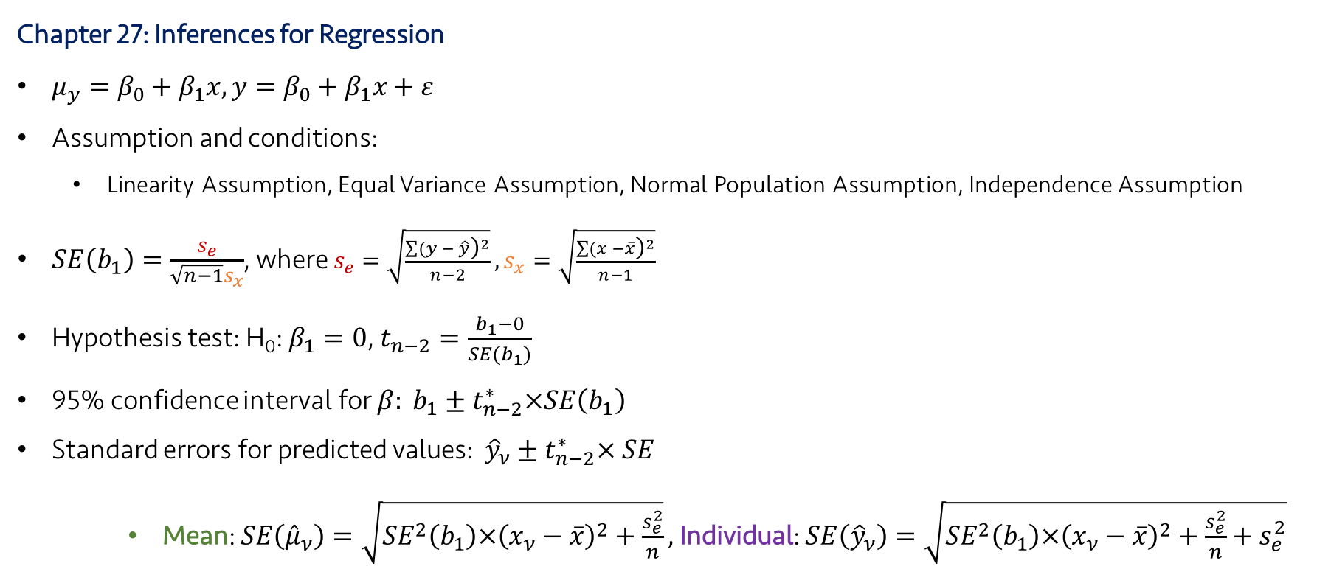
Lecture 22
Key Points
Chapter 27: Inferences for Regression
$μ_{y}=β_{0}+β_{1}x,y=β_{0}+β_{1}x+ε$
Assumption and conditions:
Linearity Assumption, Equal Variance Assumption, Normal Population Assumption, Independence Assumption
$SE\left(b_{1}\right)=\frac{s_{e}}{\sqrt{n−1}s_{x}}$, where $s_{e}=\sqrt{\frac{\sum{{(y − \hat{y}\text{)}}^{2}}}{n−2}},s_{x}=\sqrt{\frac{\sum{{(x −\overline{x}\text{)}}^{2}}}{n−1}}$
Hypothesis test: H₀: $β_{1}=0$, $t_{n−2}=\frac{b_{1}−0}{SE(b_{1})}$
95% confidence interval for $β: b_{1}±t_{n−2}^{∗}×SE\left(b_{1}\right)$
Standard errors for predicted values: ${\hat{y}}_{ν}±t_{n−2}^{∗}× SE$
Mean: $SE\left({\hat{μ}}_{ν}\right)=\sqrt{{SE}^{2}\left(b_{1}\right)×{\left(x_{ν}−\overline{x}\right)}^{2}+\frac{s_{e}^{2}}{n}},$Individual: $SE\left({\hat{y}}_{ν}\right)=\sqrt{{SE}^{2}\left(b_{1}\right)×{\left(x_{ν}−\overline{x}\right)}^{2}+\frac{s_{e}^{2}}{n}+s_{e}^{2}}$
CHOONG-WAN WOO | COCOAN lab | http://cocoanlab.github.io

