Slide 1


GBME Probability and Statistics
Lecture 25
Lecture 25
Multiple Regression
CHOONG-WAN WOO | COCOAN lab | http://cocoanlab.github.io

Slide 2

Lecture 25
Review: Key Points
Chapter 29: Multifactor Analysis of Variance
Multifactor ANOVA model without interaction
$y_{ijk}=μ+τ_{j}+γ_{k}+ε_{ijk}$
$y_{ijk}=\overset{̿}{y}+\left({\overline{y}}_{j}−\overset{̿}{y}\right)+\left({\overline{y}}_{k}−\overset{̿}{y}\right)+({y_{ijk}−\overline{y}}_{j}{− \overline{y}}_{k}+ \overset{̿}{y})$
Multifactor ANOVA model with interaction
$y_{ijk}=μ+τ_{j}+γ_{k}+ω_{jk}+ε_{ijk}$
$ω_{jk}$: interaction term,$\left({{\overline{y}}_{jk}−\overline{y}}_{j}{− \overline{y}}_{k}+ \overset{̿}{y}\right)$
Important plots:
Partial boxplot, interaction plot
CHOONG-WAN WOO | COCOAN lab | http://cocoanlab.github.io

Slide 3
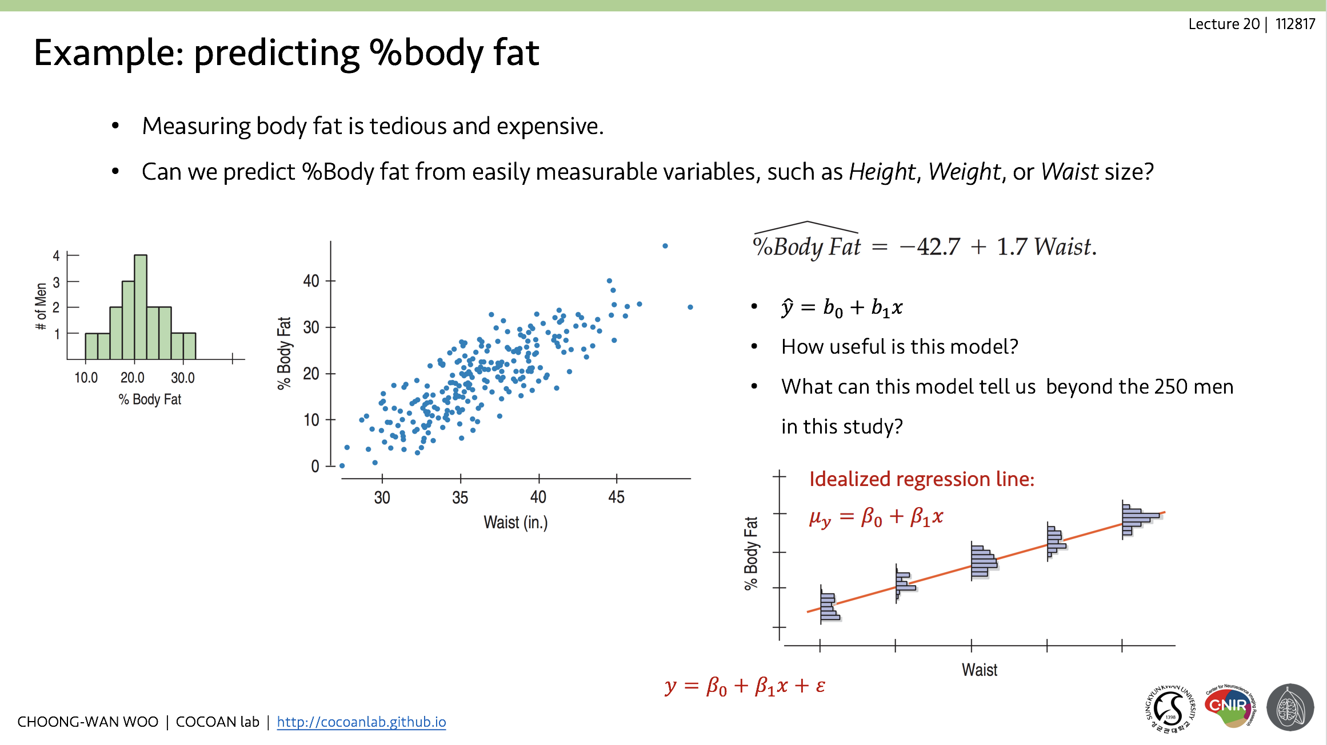
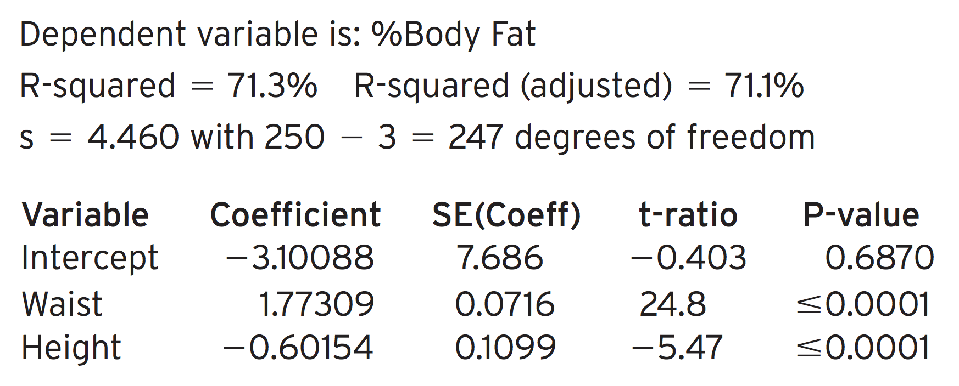
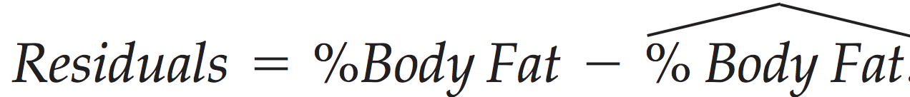
Lecture 25
Example: body fat
How about Height?
Regression table:
Revised equation:
Residuals:
Procedures and calculations for multiple regression are same with the simple regression. Then, what’s different?
CHOONG-WAN WOO | COCOAN lab | http://cocoanlab.github.io

Slide 4
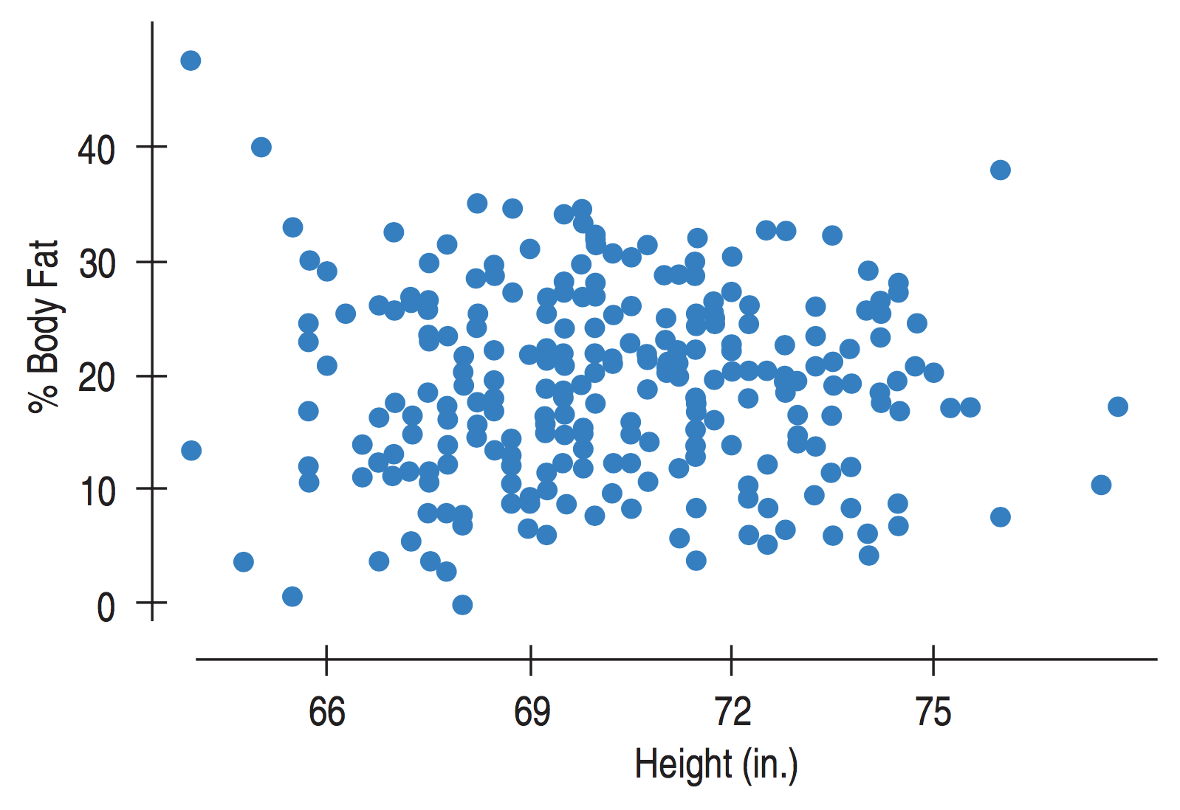
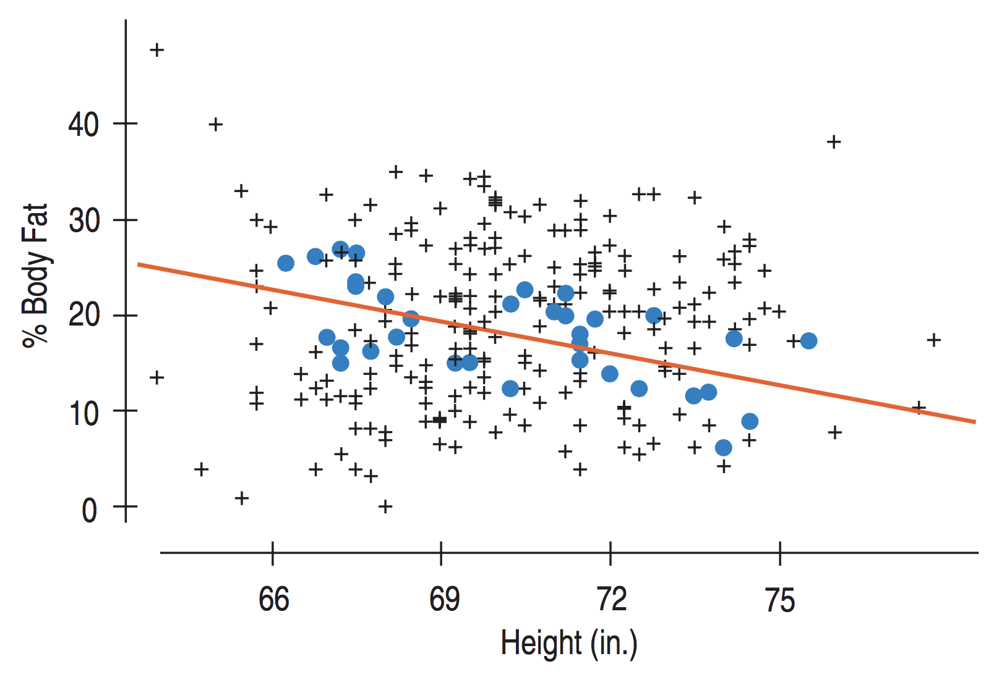
Lecture 25
Interpreting multiple regression coefficients
Scatter plot between %body fat and height
Looks like no relationship, but...
If we restrict our attention to the men with waist sizes between 36~38 inches:
A negative association appears.
The relationship between %Body fat and Height is conditional on Waist size.
CHOONG-WAN WOO | COCOAN lab | http://cocoanlab.github.io

Slide 5
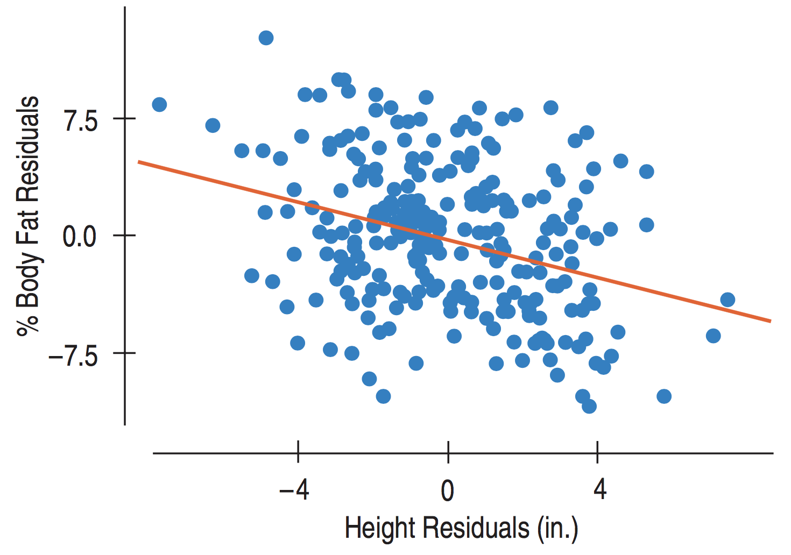
Lecture 25
Partial regression plot
Plot both residuals after a regression on Waist size
Body fat residuals against Height residuals
CHOONG-WAN WOO | COCOAN lab | http://cocoanlab.github.io

Slide 6
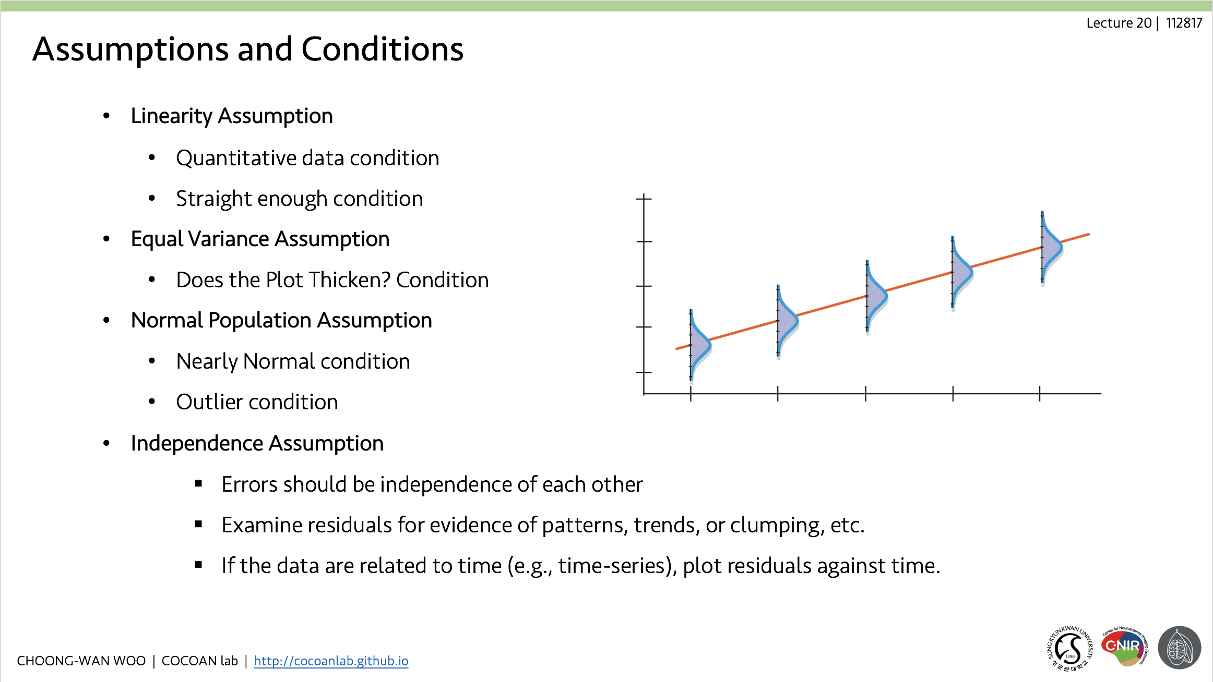
Lecture 25
Assumptions and Conditions
Really same with the simple regression
CHOONG-WAN WOO | COCOAN lab | http://cocoanlab.github.io

Slide 7
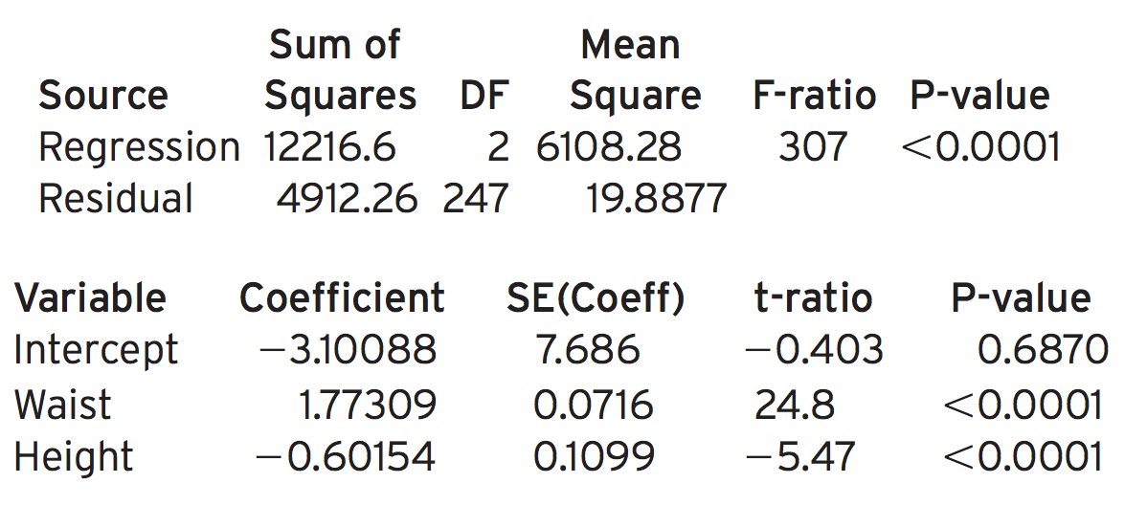
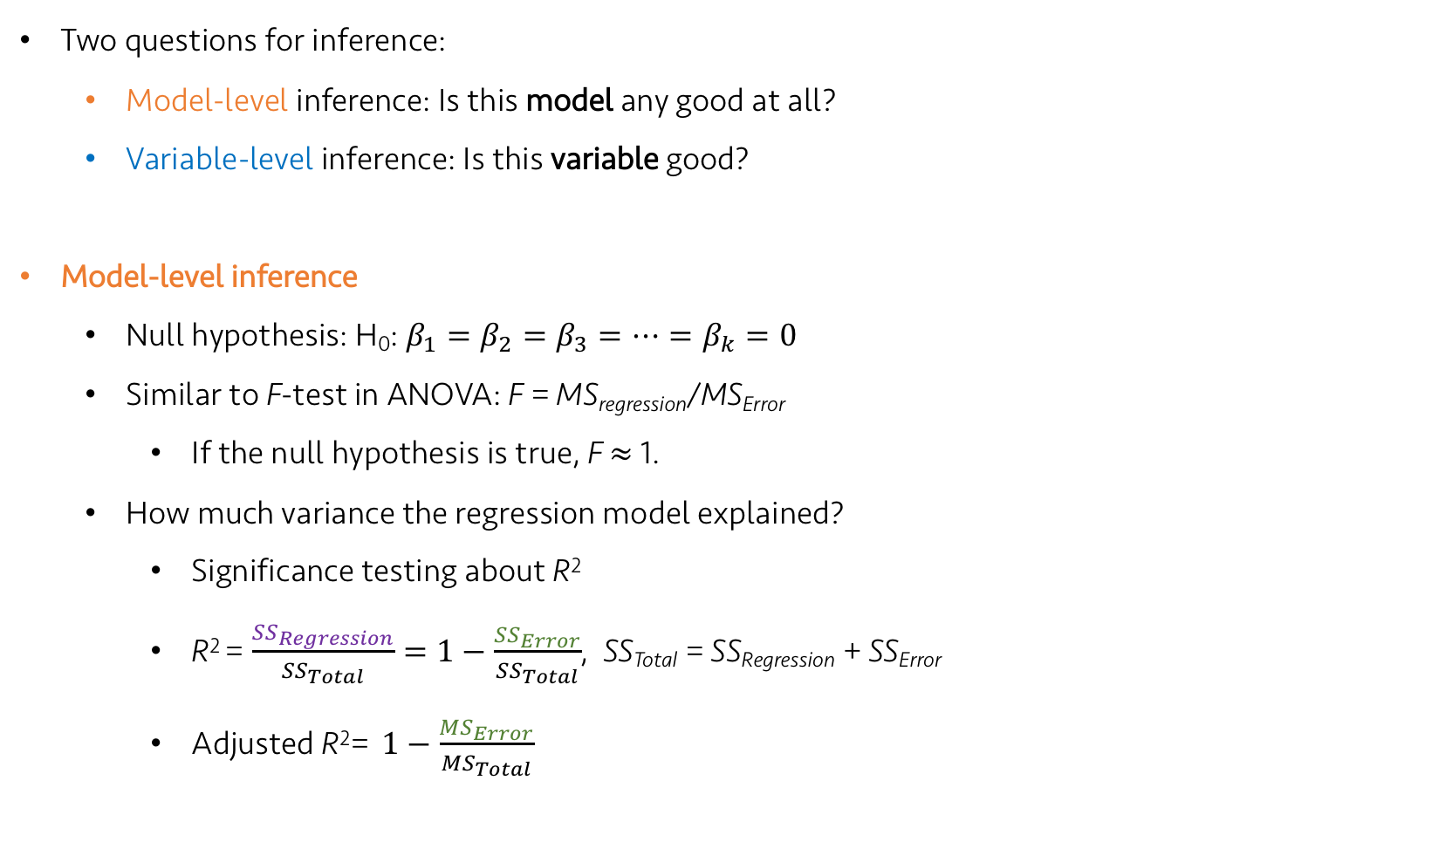
Lecture 25
Multiple Regression Inference
SS_{Regression}
MS_{Regression}
Regression plot
SS_{Error}
MS_{Error}
Two questions for inference:
Model-level inference: Is this model any good at all?
Variable-level inference: Is this variable good?
Model-level inference
Null hypothesis: H₀: $β_{1}=β_{2}=β_{3}=…=β_{k}=0$
Similar to F-test in ANOVA: F = MS_{regression}/MS_{Error}
If the null hypothesis is true, F $≈$ 1.
How much variance the regression model explained?
Significance testing about R²
R² = $\frac{{SS}_{Regression}}{{SS}_{Total}}=1−\frac{{SS}_{Error}}{{SS}_{Total}}$, SS_{Total} = SS_{Regression} + SS_{Error}
Adjusted R²= $1−\frac{{MS}_{Error}}{{MS}_{Total}}$
CHOONG-WAN WOO | COCOAN lab | http://cocoanlab.github.io

Slide 8
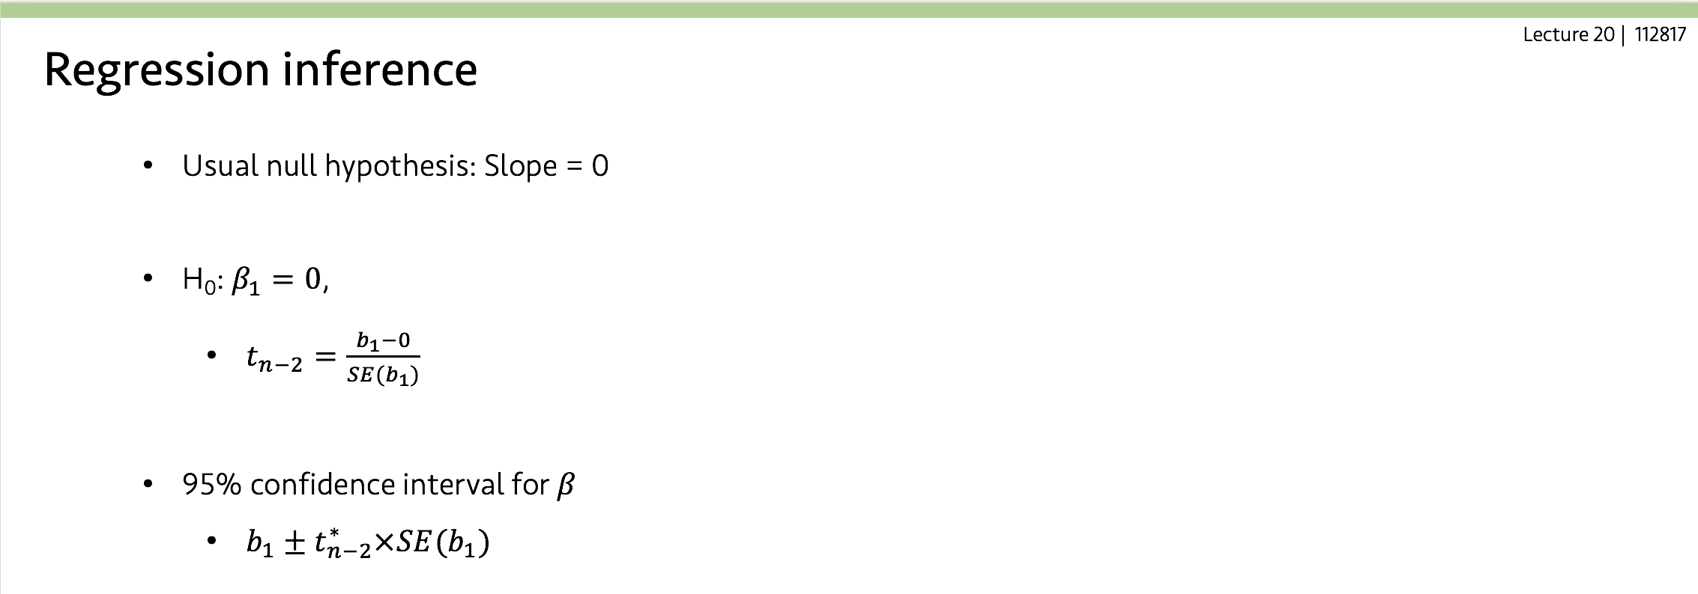

Lecture 25
Multiple Regression Inference (2)
SS_{Regression}
MS_{Regression}
Regression plot
SS_{Error}
MS_{Error}
Variable-level inference
Null hypothesis: H₀: $β_{j}=0$
Similar to the simple regression
Calculation of SE(b_{j}) is a little bit more complex than before, but conceptually similar!
Another difference: degree of freedom = n-k-1
t-value: $t_{n−k−1}=\frac{b_{j}−0}{SE(b_{j})}$, confidence interval: $b_{j}±t_{n−k−1}^{∗}×SE(b_{j})$
CHOONG-WAN WOO | COCOAN lab | http://cocoanlab.github.io

Slide 9
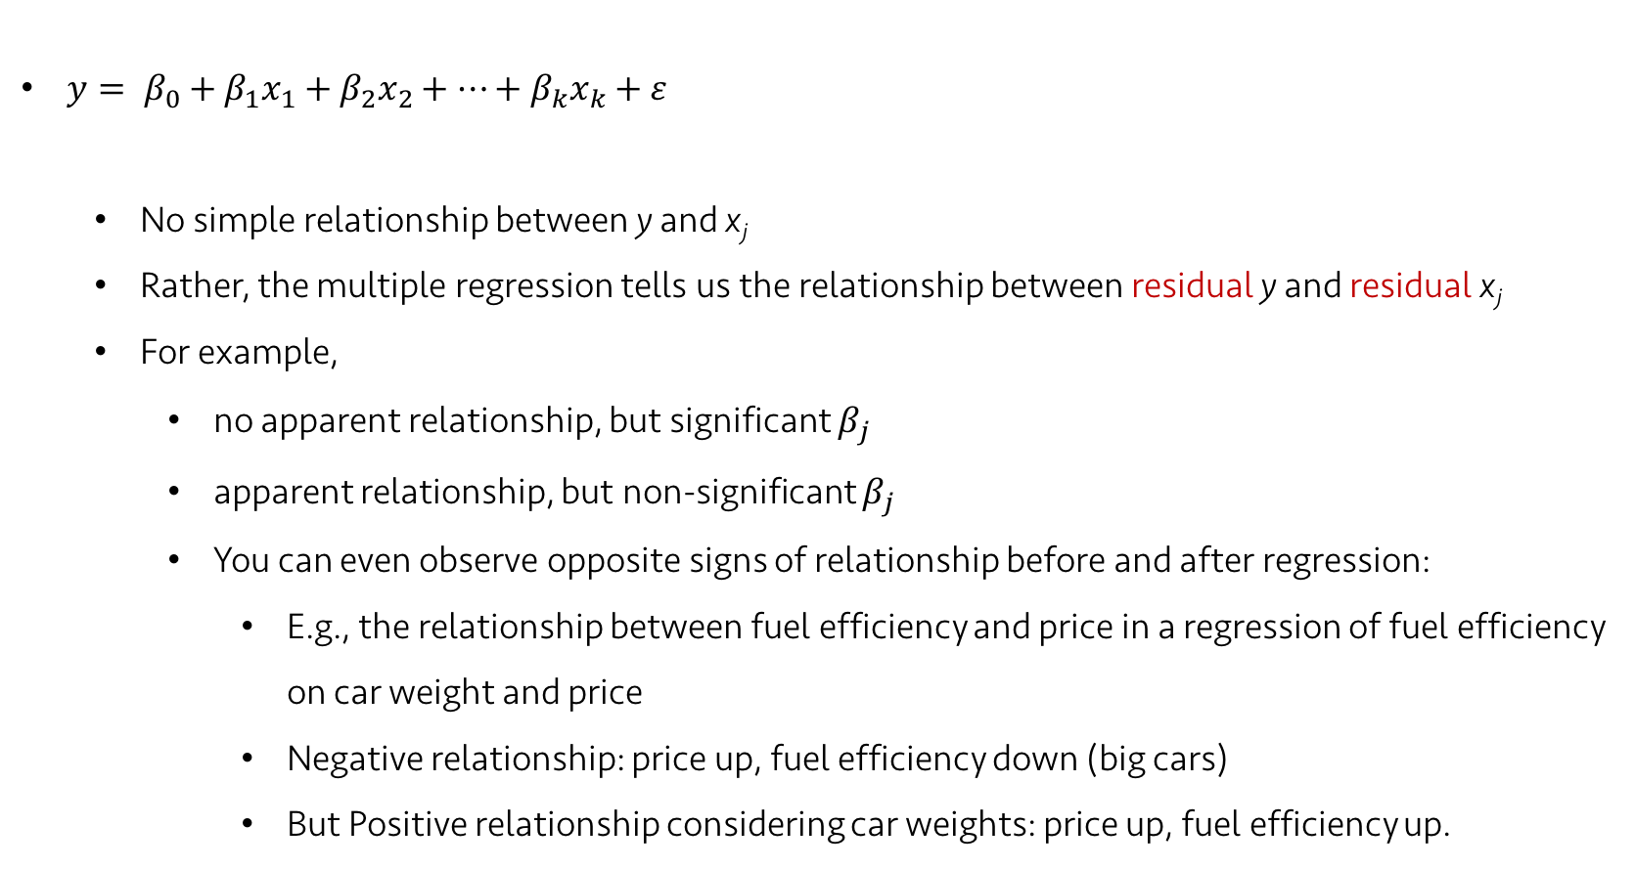
Lecture 25
Interpreting coefficients
$y= β_{0}+β_{1}x_{1}+β_{2}x_{2}+…+β_{k}x_{k}+ε$
No simple relationship between y and x_{j}
Rather, the multiple regression tells us the relationship between residual y and residual x_{j}
For example,
no apparent relationship, but significant $β_{j}$
apparent relationship, but non-significant $β_{j}$
You can even observe opposite signs of relationship before and after regression:
E.g., the relationship between fuel efficiency and price in a regression of fuel efficiency on car weight and price
Negative relationship: price up, fuel efficiency down (big cars)
But Positive relationship considering car weights: price up, fuel efficiency up.
CHOONG-WAN WOO | COCOAN lab | http://cocoanlab.github.io

Slide 10
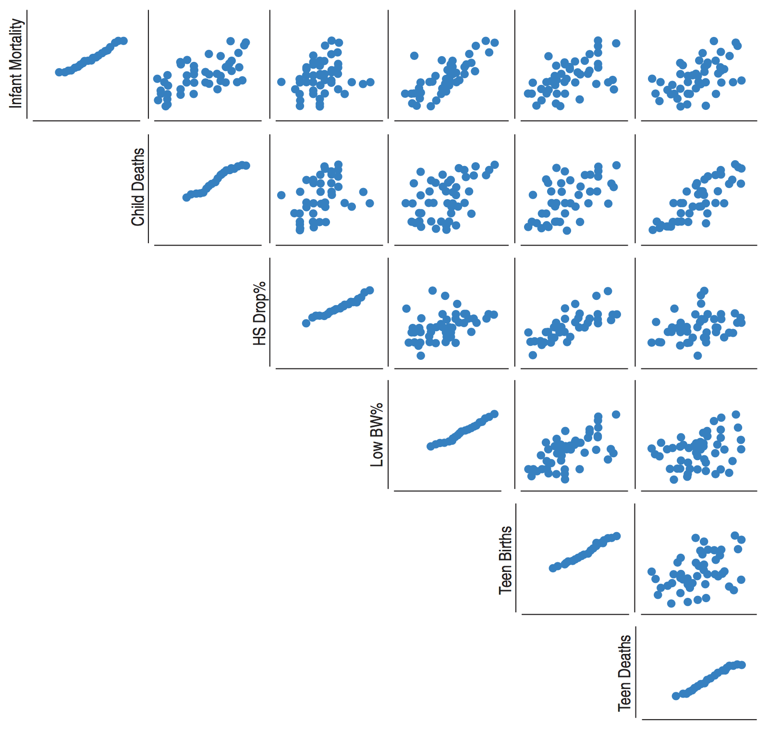
Lecture 25
Scatterplot matrix
Scatter plots
Normal probability plot
CHOONG-WAN WOO | COCOAN lab | http://cocoanlab.github.io

Slide 11
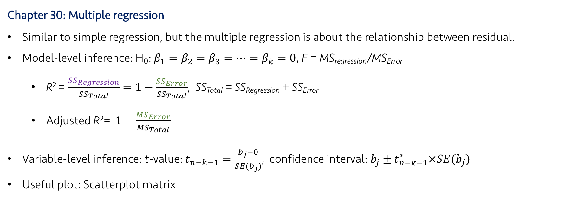
Lecture 25
Key Points
Chapter 30: Multiple regression
Similar to simple regression, but the multiple regression is about the relationship between residual.
Model-level inference: H₀: $β_{1}=β_{2}=β_{3}=…=β_{k}=0$, F = MS_{regression}/MS_{Error}
R² = $\frac{{SS}_{Regression}}{{SS}_{Total}}=1−\frac{{SS}_{Error}}{{SS}_{Total}}$, SS_{Total} = SS_{Regression} + SS_{Error}
Adjusted R²= $1−\frac{{MS}_{Error}}{{MS}_{Total}}$
Variable-level inference: t-value: $t_{n−k−1}=\frac{b_{j}−0}{SE(b_{j})}$, confidence interval: $b_{j}±t_{n−k−1}^{∗}×SE(b_{j})$
Useful plot: Scatterplot matrix
CHOONG-WAN WOO | COCOAN lab | http://cocoanlab.github.io

