Slide 1
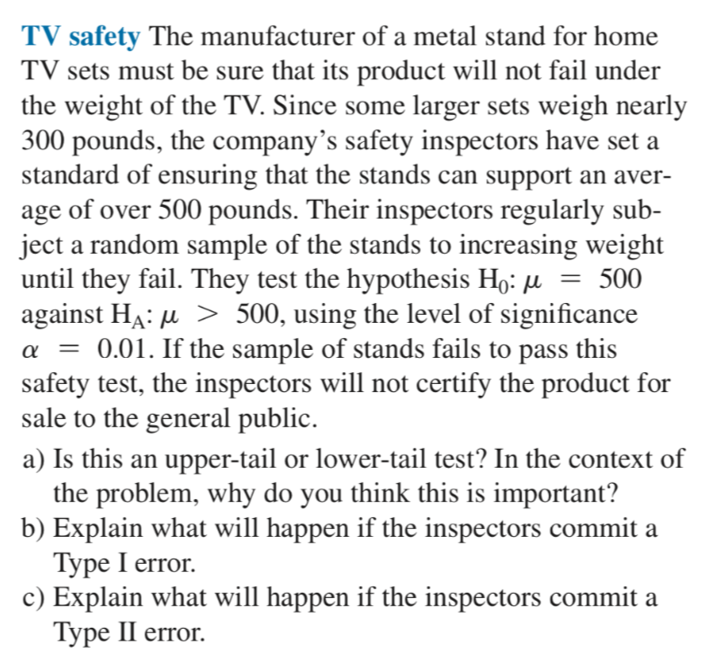
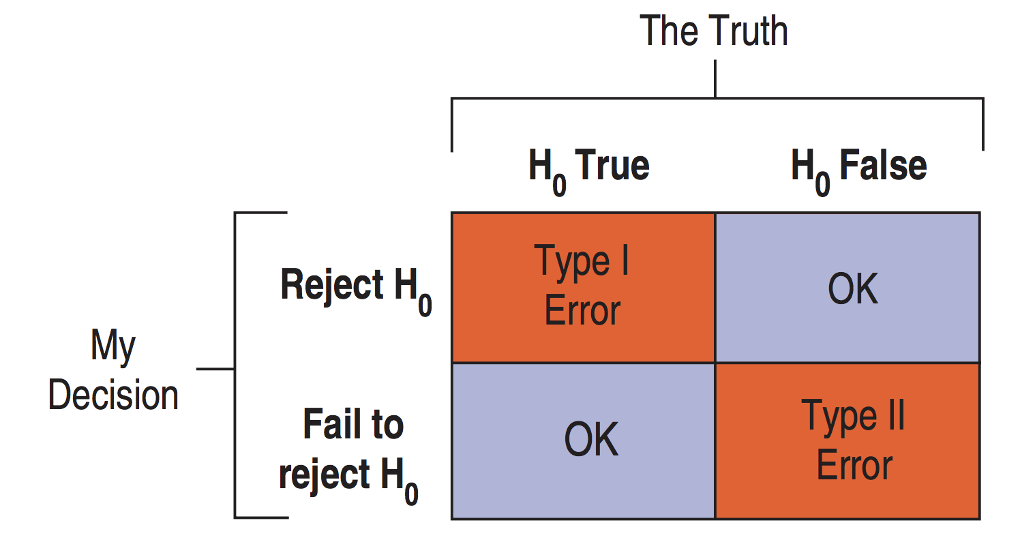
1.
Upper-tail test. This is important for the safety (e.g., Is a 525 pound TV set okay to use with this TV stand?)
Type I error: They will decide the stands are safe when they are not.
Type II error: They will decide the stands are unsafe when they are in fact safe.

Slide 2
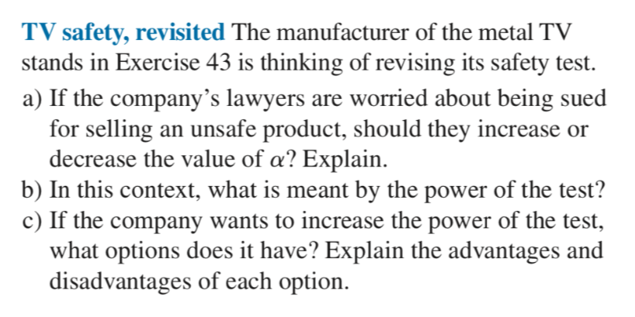
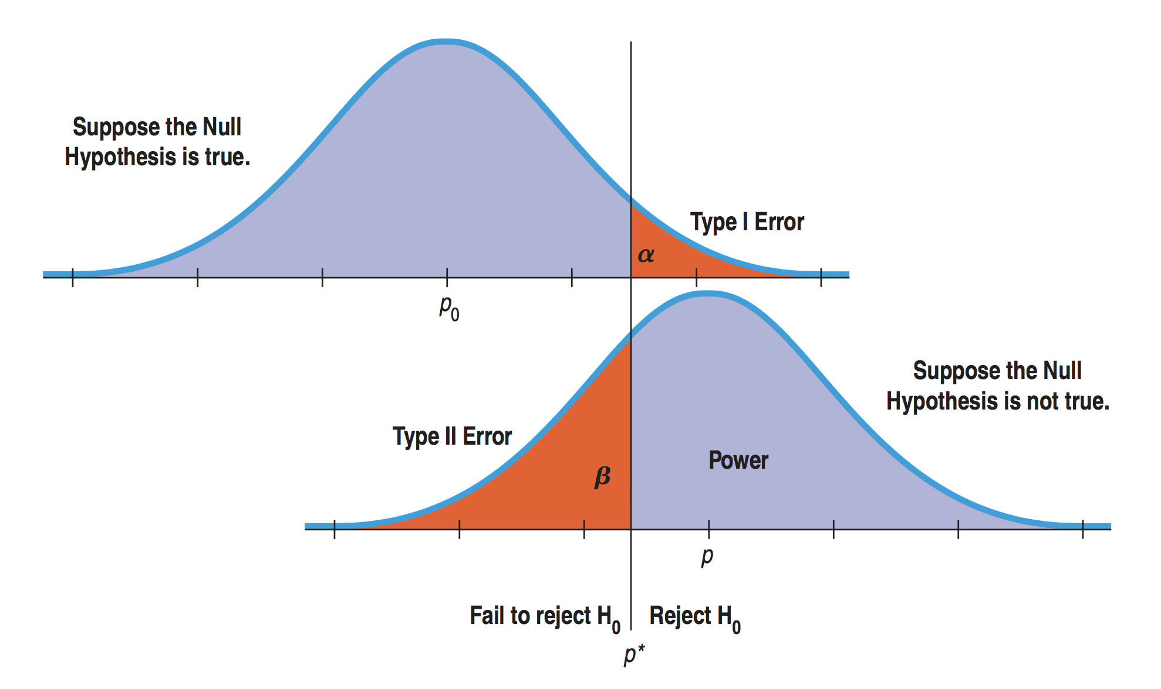
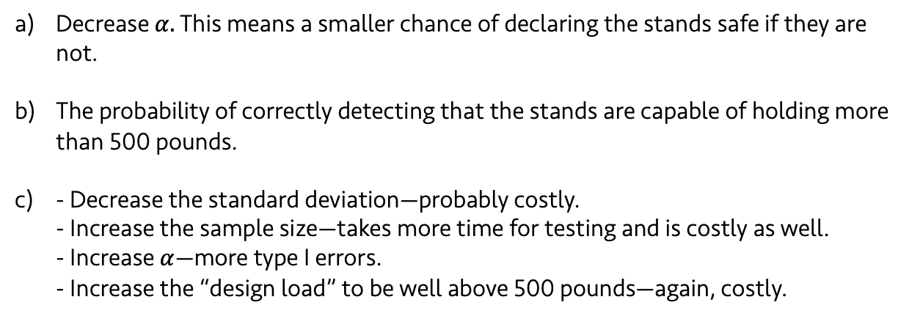
2.
Decrease $α.$ This means a smaller chance of declaring the stands safe if they are not.
The probability of correctly detecting that the stands are capable of holding more than 500 pounds.
- Decrease the standard deviation—probably costly. - Increase the sample size—takes more time for testing and is costly as well. - Increase $α$—more type I errors. - Increase the “design load” to be well above 500 pounds—again, costly.

Slide 3
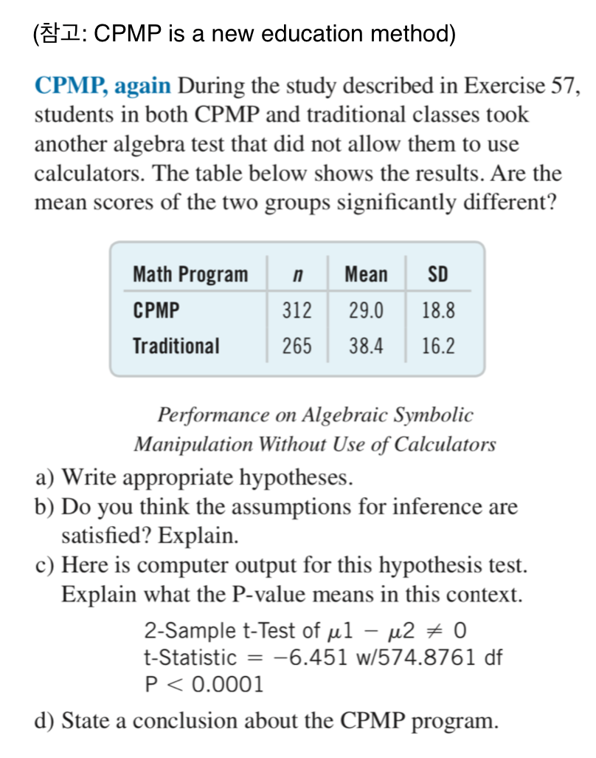
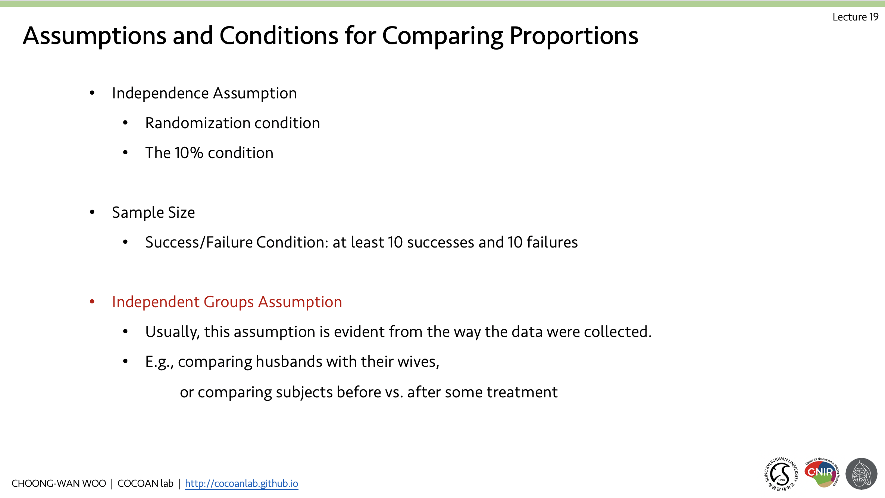
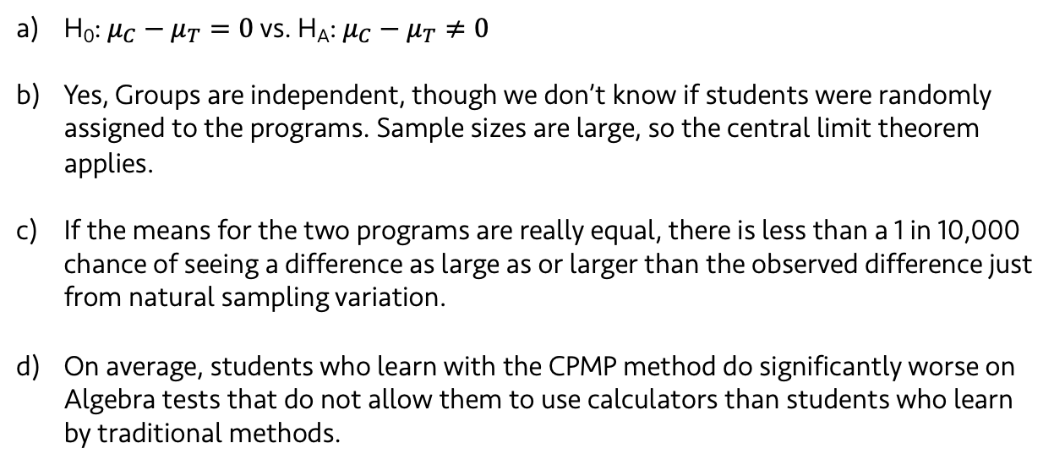
3.
H₀: $μ_{C}−μ_{T}=0$ vs. H_{A}: $μ_{C}−μ_{T}≠0$
Yes, Groups are independent, though we don’t know if students were randomly assigned to the programs. Sample sizes are large, so the central limit theorem applies.
If the means for the two programs are really equal, there is less than a 1 in 10,000 chance of seeing a difference as large as or larger than the observed difference just from natural sampling variation.
On average, students who learn with the CPMP method do significantly worse on Algebra tests that do not allow them to use calculators than students who learn by traditional methods.

Slide 4
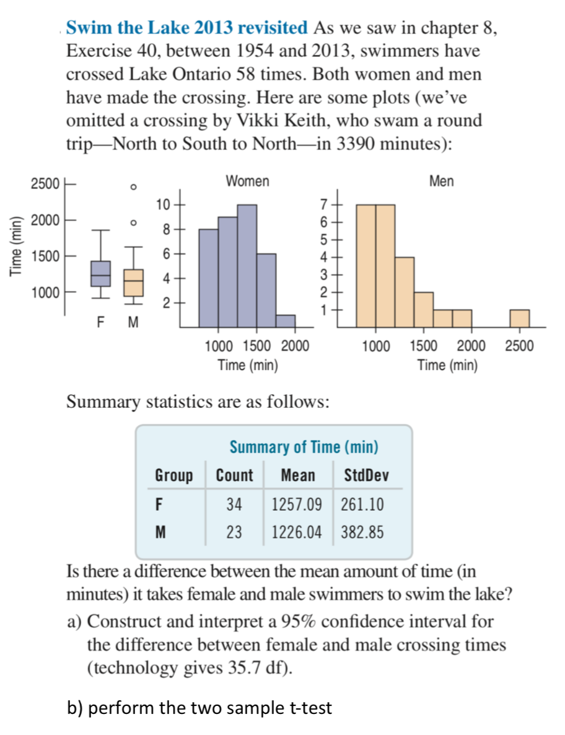
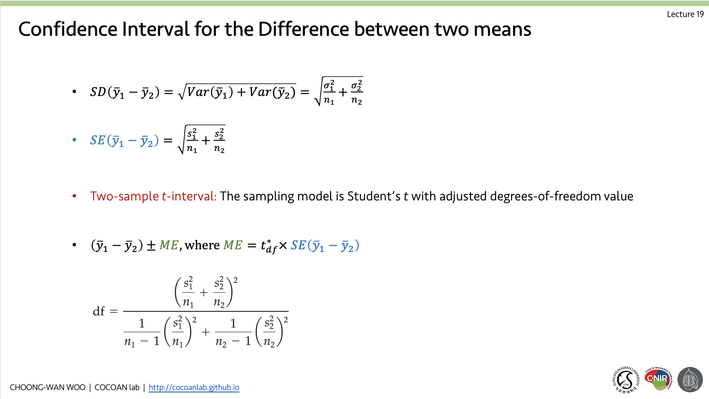
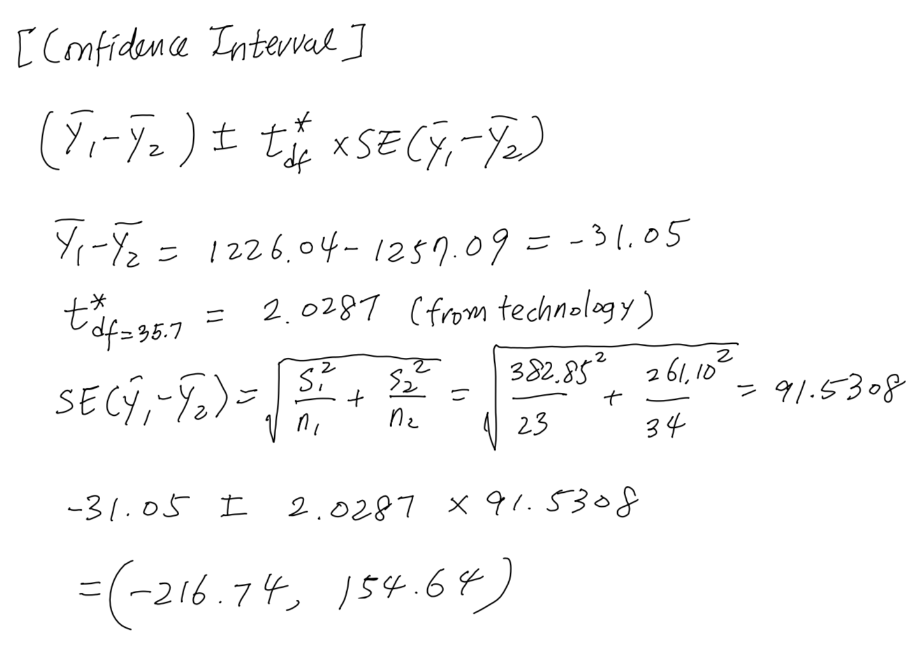
4.
If the assumptions and conditions are met, we can be 95% confident that the interval (-216.74, 154.64) minutes includes the true difference in mean cross times between men and women. Because the interval includes zero, we cannot be confident that there is any difference at all.

Slide 5
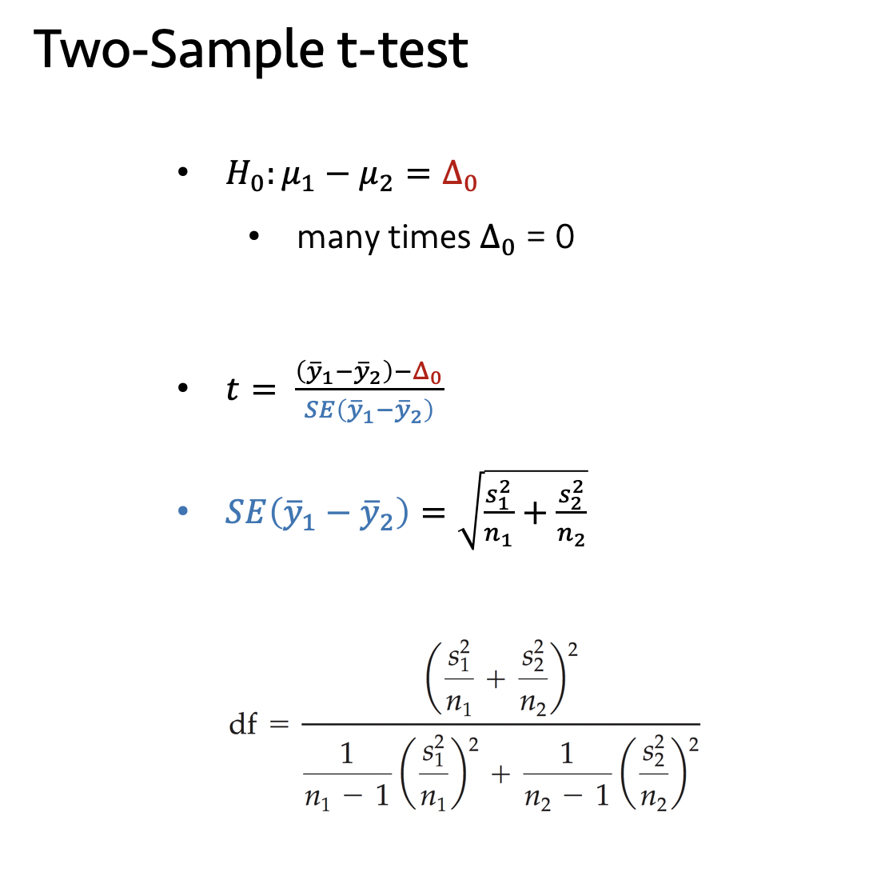
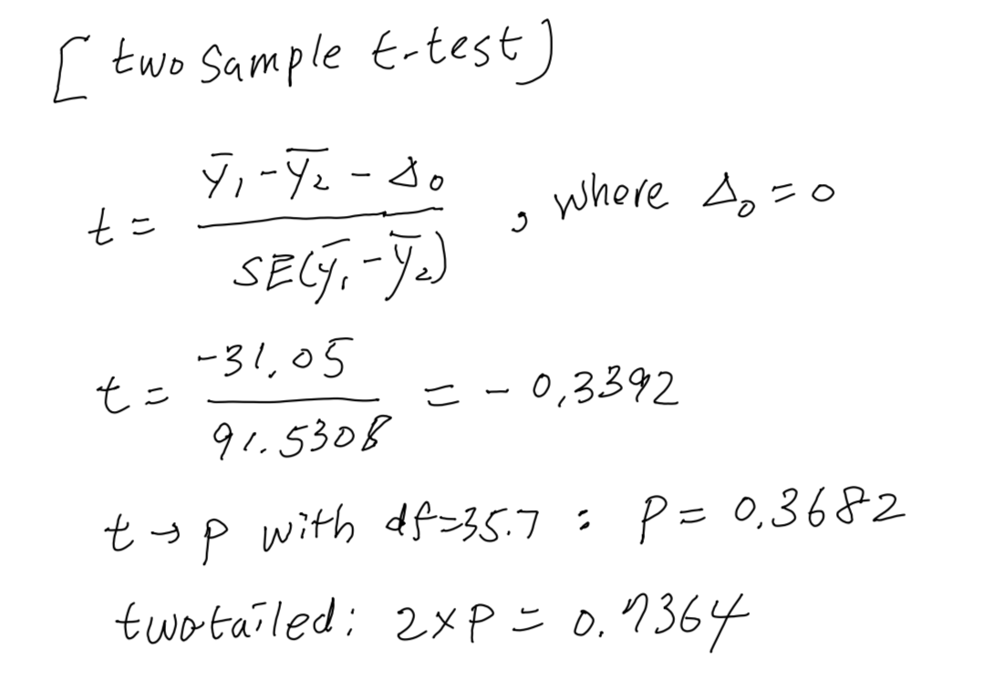
4.

Slide 6
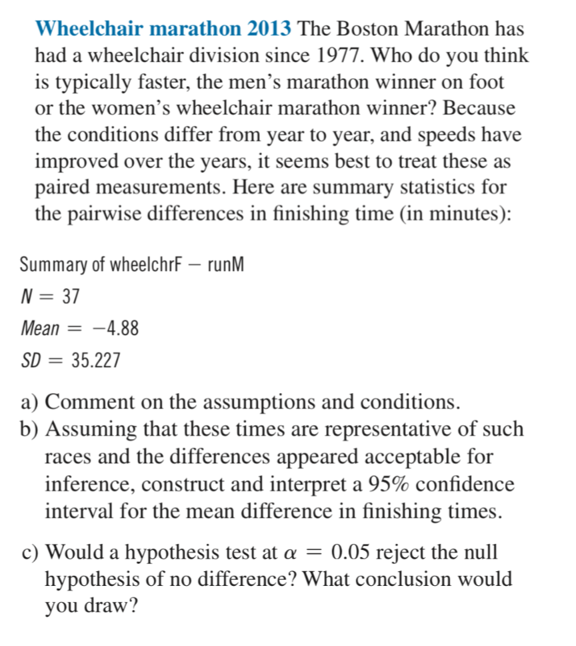
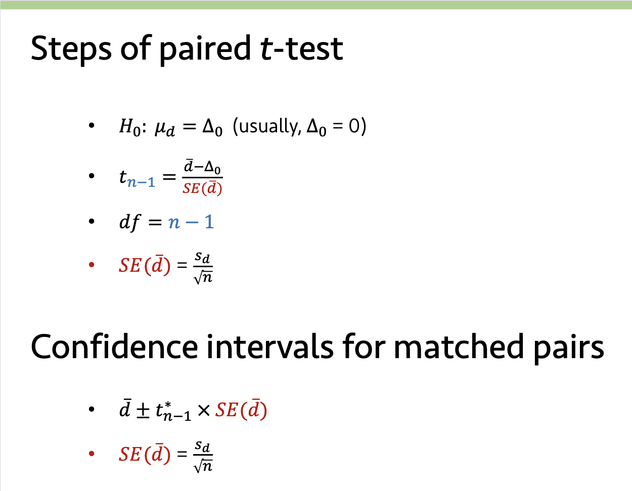
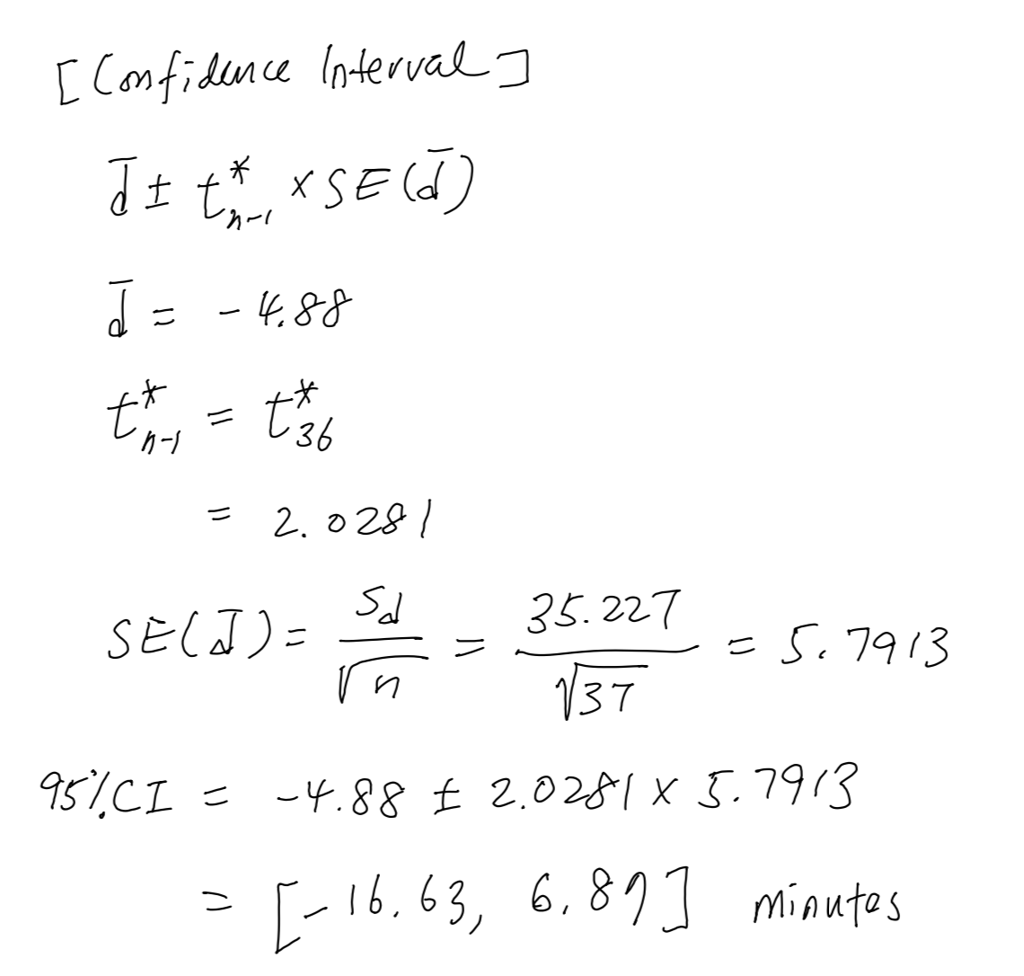
5.
The data are paired. Both races may have improved over time, but the pairwise differences are likely to be independent. We can only check the Nearly Normal Condition by using a computer (not shown here)
With 95% confidence, we can say the mean time difference is between -16.63 minutes (men are faster) and +6.87 minutes (women are faster)

Slide 7
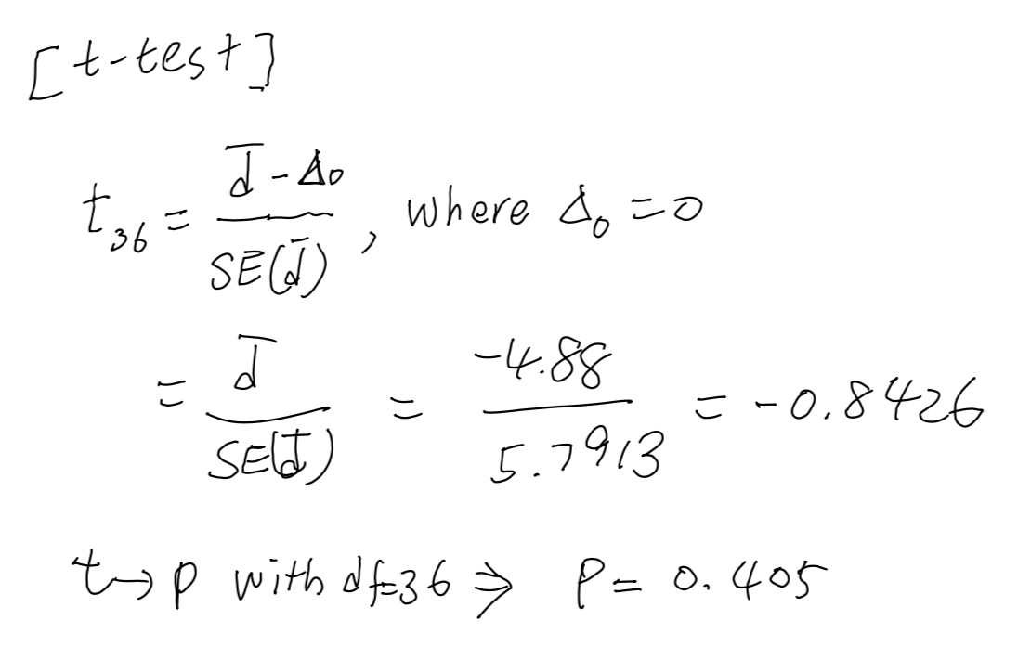
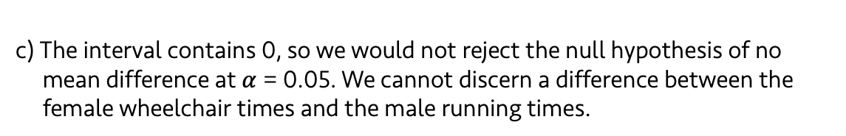
5.
c) The interval contains 0, so we would not reject the null hypothesis of no mean difference at $α$ = 0.05. We cannot discern a difference between the female wheelchair times and the male running times.

