Slide 1


Fall 2020
SKKU Biostats and Big data II
CHOONG-WAN WOO | COCOAN lab | http://cocoanlab.github.io

Slide 2
Biostats and Big Data 2
Lecture 21
Lecture 21
Statistics in laboratory
CHOONG-WAN WOO | COCOAN lab | http://cocoanlab.github.io

Slide 3
Lecture 21
Survey for 12/10 computer labs
https://forms.gle/c4EDNap14o1guBiM6
CHOONG-WAN WOO | COCOAN lab | http://cocoanlab.github.io

Slide 4
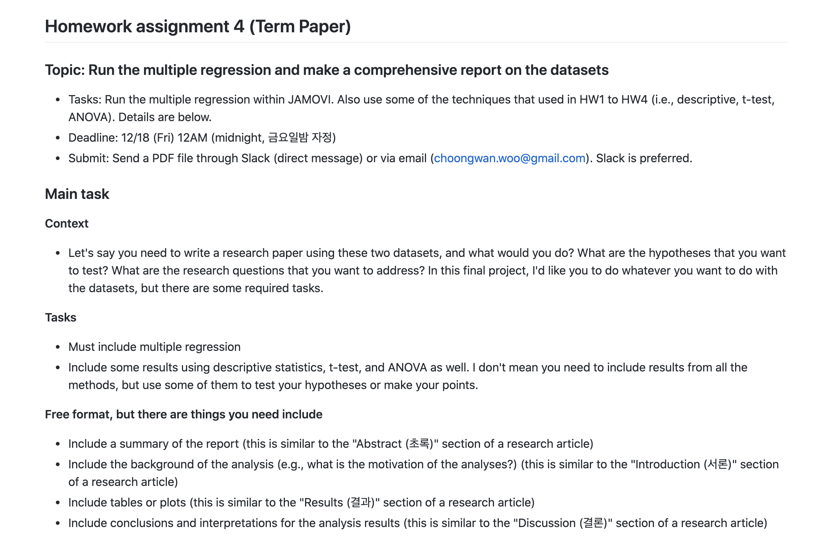
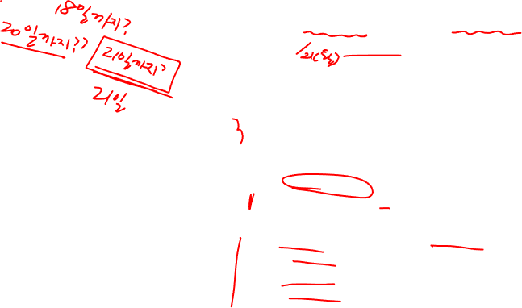
Lecture 21
Reminder: Homework 4
https://github.com/wanirepo/Stats2_2020Fall/blob/master/hw_assignment/hw04.md
CHOONG-WAN WOO | COCOAN lab | http://cocoanlab.github.io

Slide 5
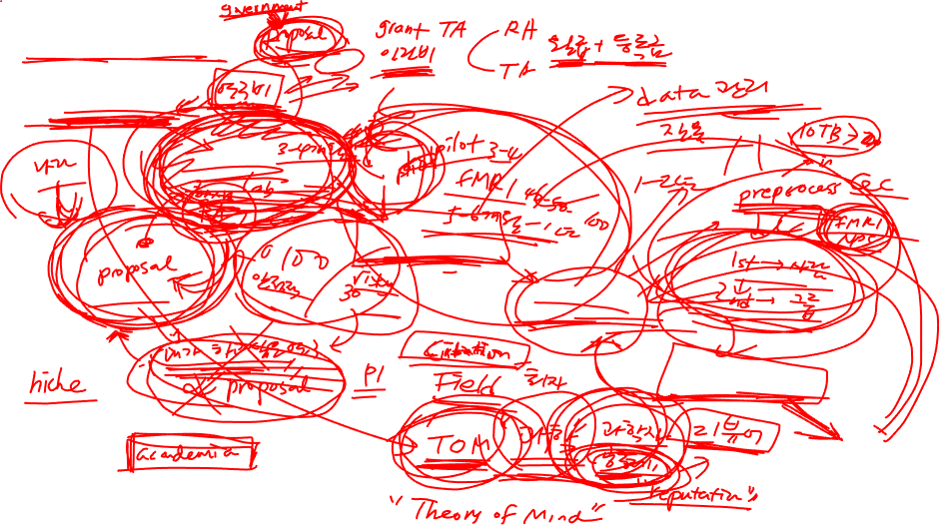
Lecture 21
Research in the lab
Research idea
Experimental design
Data collection
Data analysis
Writing & Figures
Submission
CHOONG-WAN WOO | COCOAN lab | http://cocoanlab.github.io

Slide 6
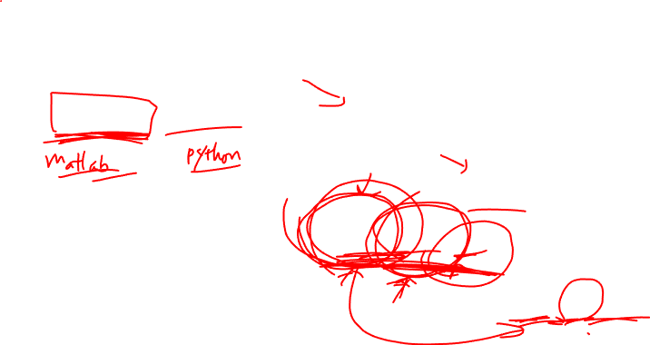
Lecture 21
Research tools for each stage
Research idea
Experimental design
Psychtoolbox, Psychopy, etc.
Data collection
Data analysis
Matlab, Python, R, etc.
Writing & Figures
Word, PPT, latex, etc.
Submission
CHOONG-WAN WOO | COCOAN lab | http://cocoanlab.github.io

Slide 7
Lecture 21
Let’s see an example analysis (fMRI data)
CHOONG-WAN WOO | COCOAN lab | http://cocoanlab.github.io

