Slide 1


Fall 2020
SKKU Biostats and Big data II
CHOONG-WAN WOO | COCOAN lab | http://cocoanlab.github.io

Slide 2
Biostats and Big Data 2
Lecture 05
Lecture 05
JAMOVI – Wrangling data
CHOONG-WAN WOO | COCOAN lab | http://cocoanlab.github.io

Slide 3
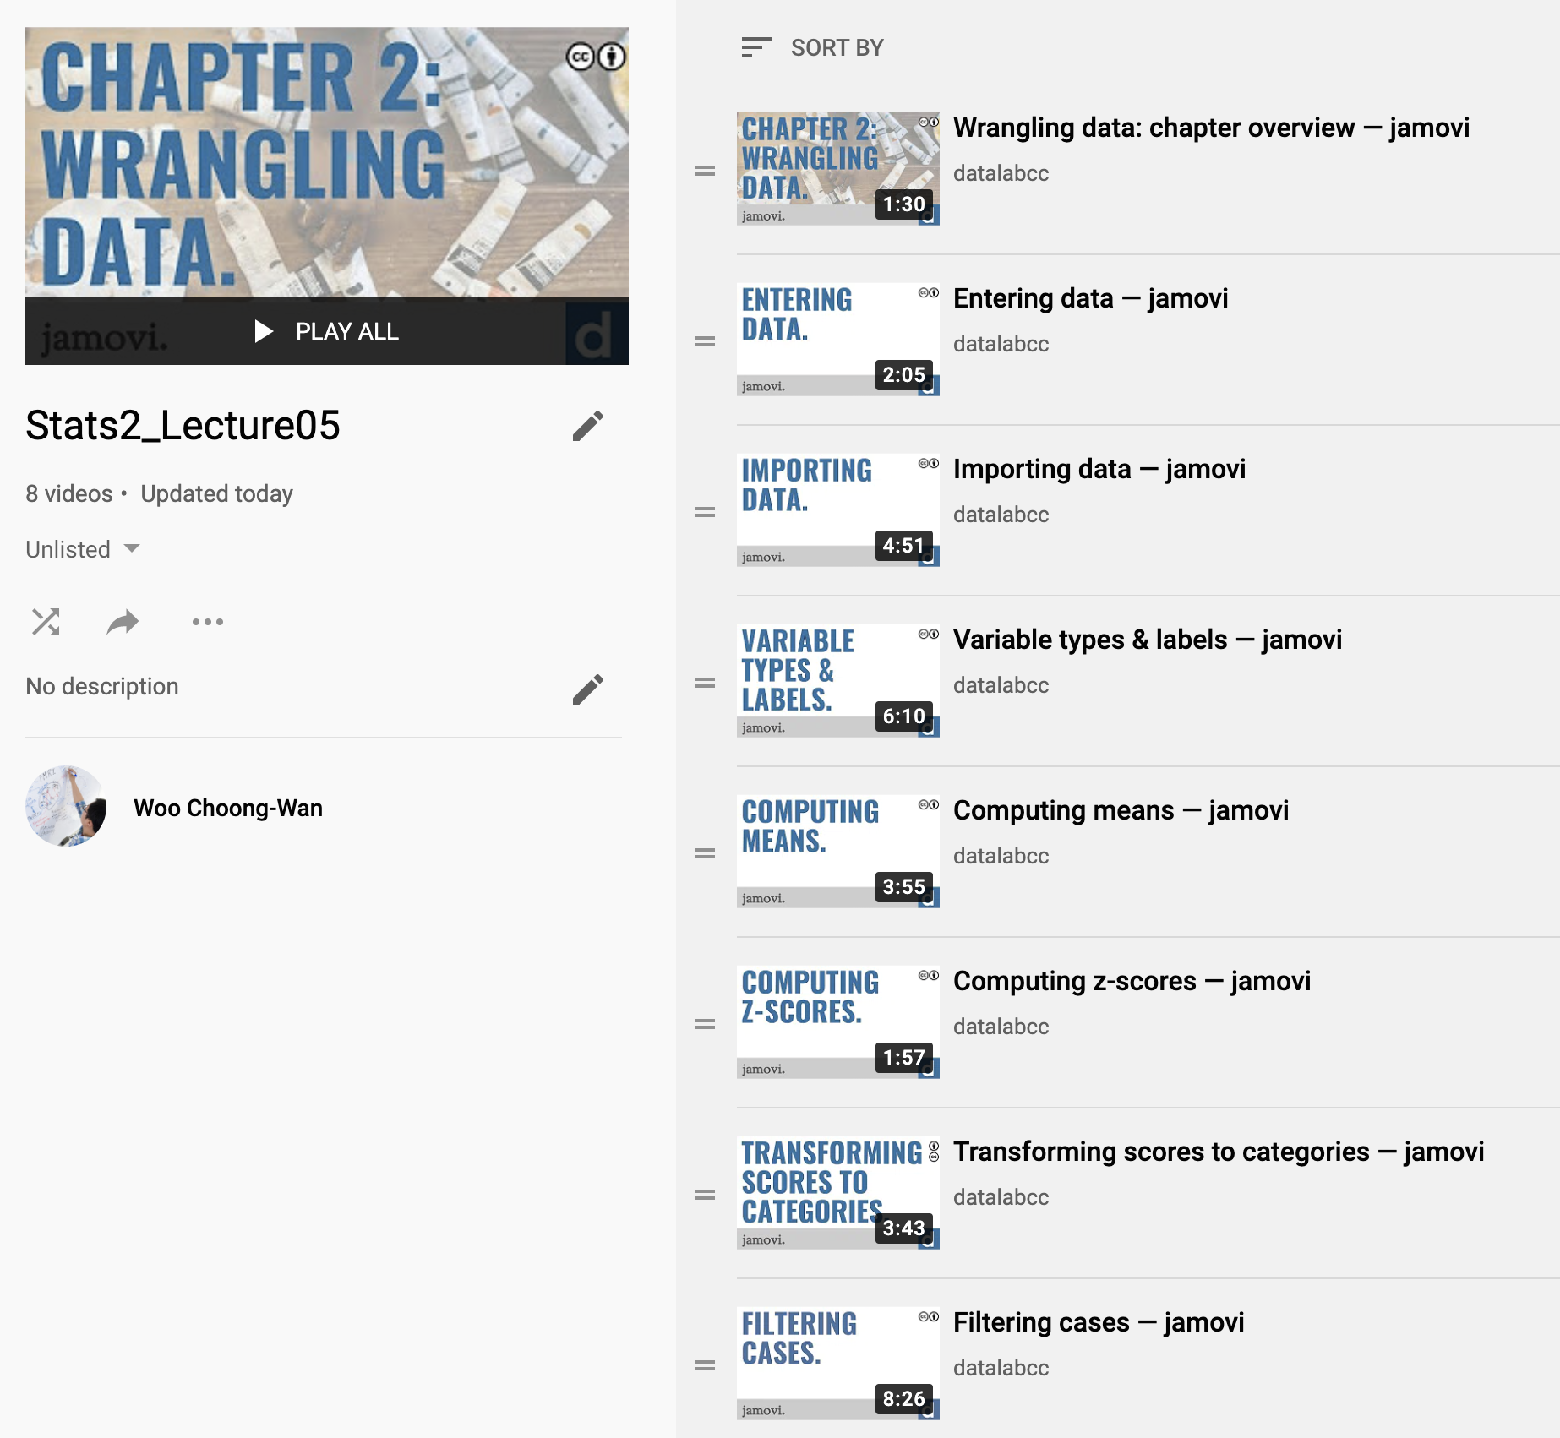
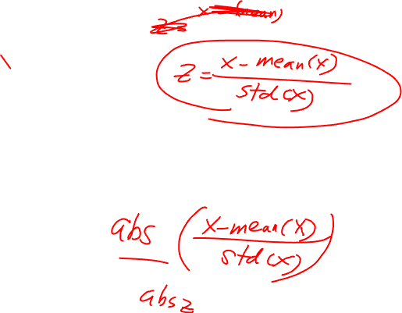
Lecture 05
Let’s watch the video for Lecture 05
https://www.youtube.com/playlist?list=PLXCuLG6zw7mLKkpNr85n3CVwsl4HzGltP
CHOONG-WAN WOO | COCOAN lab | http://cocoanlab.github.io

Slide 4
Lecture 05
Quiz
https://forms.gle/SsgFQxRfUuh4Yd826
CHOONG-WAN WOO | COCOAN lab | http://cocoanlab.github.io

