Slide 1


Fall 2020
SKKU Biostats and Big data II
CHOONG-WAN WOO | COCOAN lab | http://cocoanlab.github.io

Slide 2
Biostats and Big Data 2
Lecture 07
Lecture 07
JAMOVI –Exploring data (finishing)
CHOONG-WAN WOO | COCOAN lab | http://cocoanlab.github.io

Slide 3
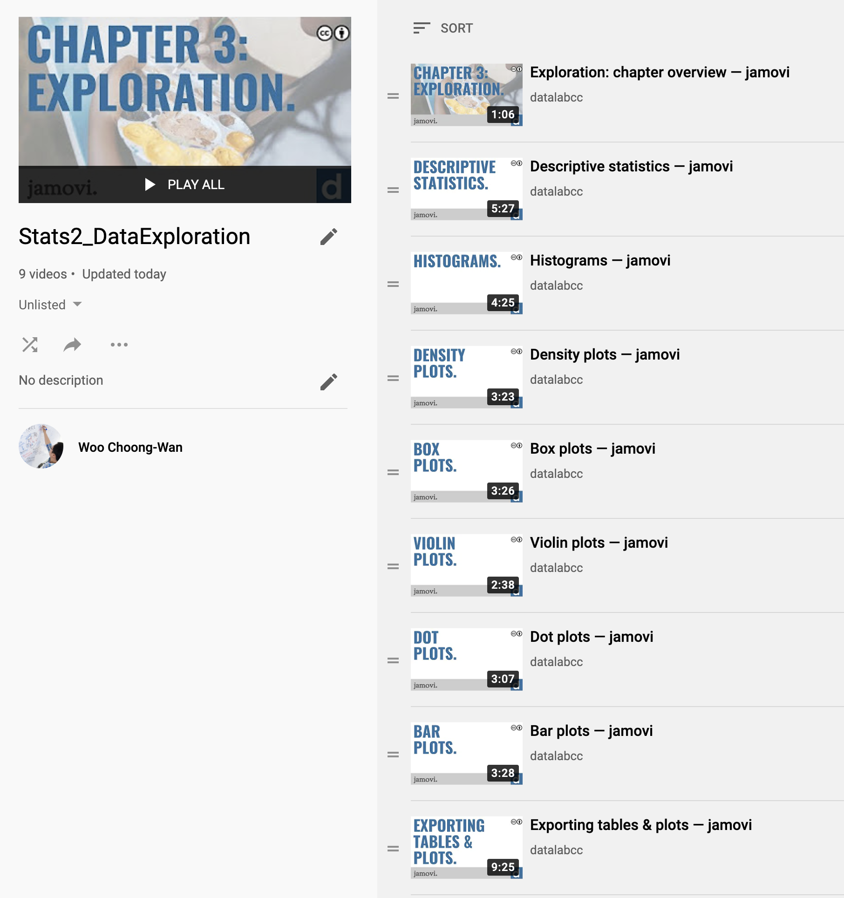

Lecture 07
We will start the Data Exploration
https://www.youtube.com/playlist?list=PLXCuLG6zw7mLDwCCQRn4x75DxyzfU_mLg
CHOONG-WAN WOO | COCOAN lab | http://cocoanlab.github.io

Slide 4
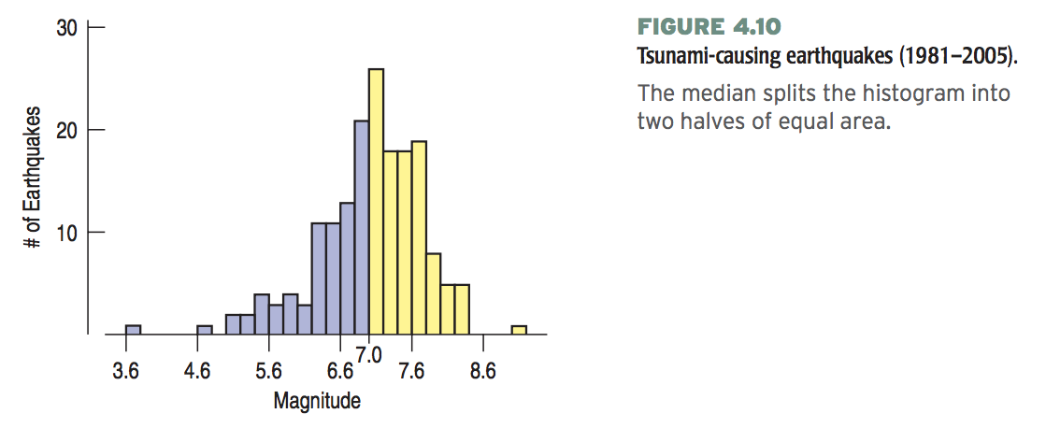
Lecture 03
Center
Median
176 earthquakes
Median: (176+1)/2 = 88.5th value in the sorted data
“.5” = average of the two values (88th and 89th)
If there was 221 earthquakes
Median: (221+1)/2 = 111th value in the sorted data
CHOONG-WAN WOO | COCOAN lab | http://cocoanlab.github.io

Slide 5
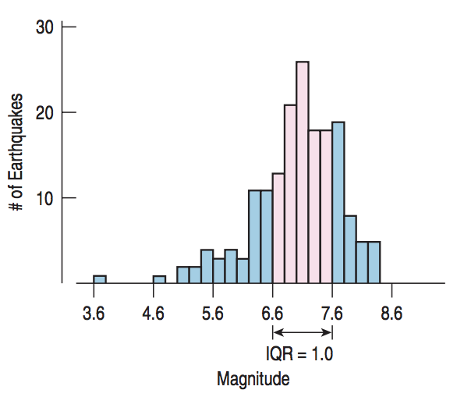
Lecture 03
Spread
Range
Range = max – min
Interquartile range
Interquartile range (IQR) = upper quartile – lower quartile
50%
CHOONG-WAN WOO | COCOAN lab | http://cocoanlab.github.io

Slide 6
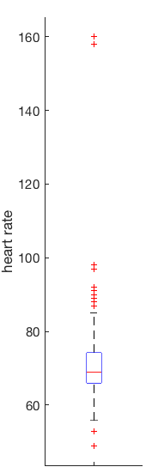
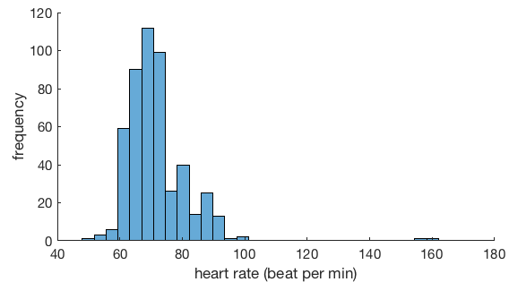
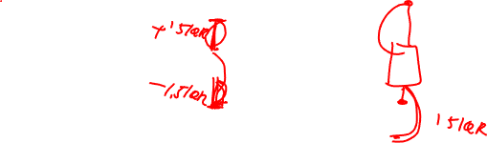
Lecture 03
Boxplots and 5-Number Summaries
far outliers
My heart rate data for a week (7/10-7/14)
Max | 160
Q3 | 74
Median | 69
Q1 | 66
Min | 49
outliers
Q3 + 1.5 IQR
Q3
Median
Q1
Q1 - 1.5 IQR
CHOONG-WAN WOO | COCOAN lab | http://cocoanlab.github.io

Slide 7

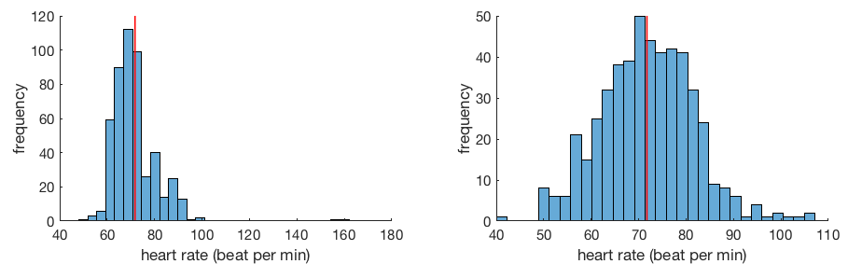
Lecture 03
Center of Symmetric Distribution: Mean
If the histogram is symmetric and there are no outliers, the mean will be preferable.
However, if the histogram is skewed or has outliers, the median might be better.
CHOONG-WAN WOO | COCOAN lab | http://cocoanlab.github.io

Slide 8

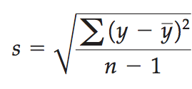
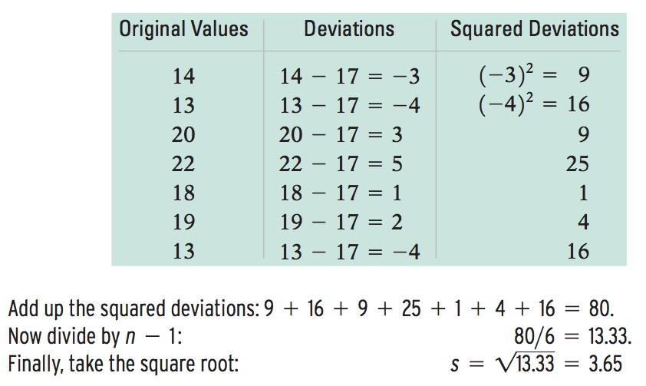
Lecture 03
Spread of Symmetric Distribution: Standard Deviation
Variance
Standard Deviation
Mean = 17
CHOONG-WAN WOO | COCOAN lab | http://cocoanlab.github.io

Slide 9
Lecture 07
Quiz
https://forms.gle/RKZoC638Qoy8Zp1R7
CHOONG-WAN WOO | COCOAN lab | http://cocoanlab.github.io

