Slide 1


Fall 2020
SKKU Biostats and Big data II
CHOONG-WAN WOO | COCOAN lab | http://cocoanlab.github.io

Slide 2
Biostats and Big Data 2
Lecture 15
Lecture 15
ANOVA & HW2
CHOONG-WAN WOO | COCOAN lab | http://cocoanlab.github.io

Slide 3
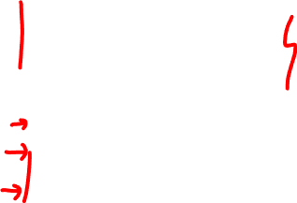
Lecture 15
What we learned…
Sampling distribution
Standard error of the mean
Confidence interval
One-sample t-test
Paired t-test
Independent samples t-test
Resampling (bootstrap, permutation tests)
Binomial test
Chi-square test
CHOONG-WAN WOO | COCOAN lab | http://cocoanlab.github.io

Slide 4
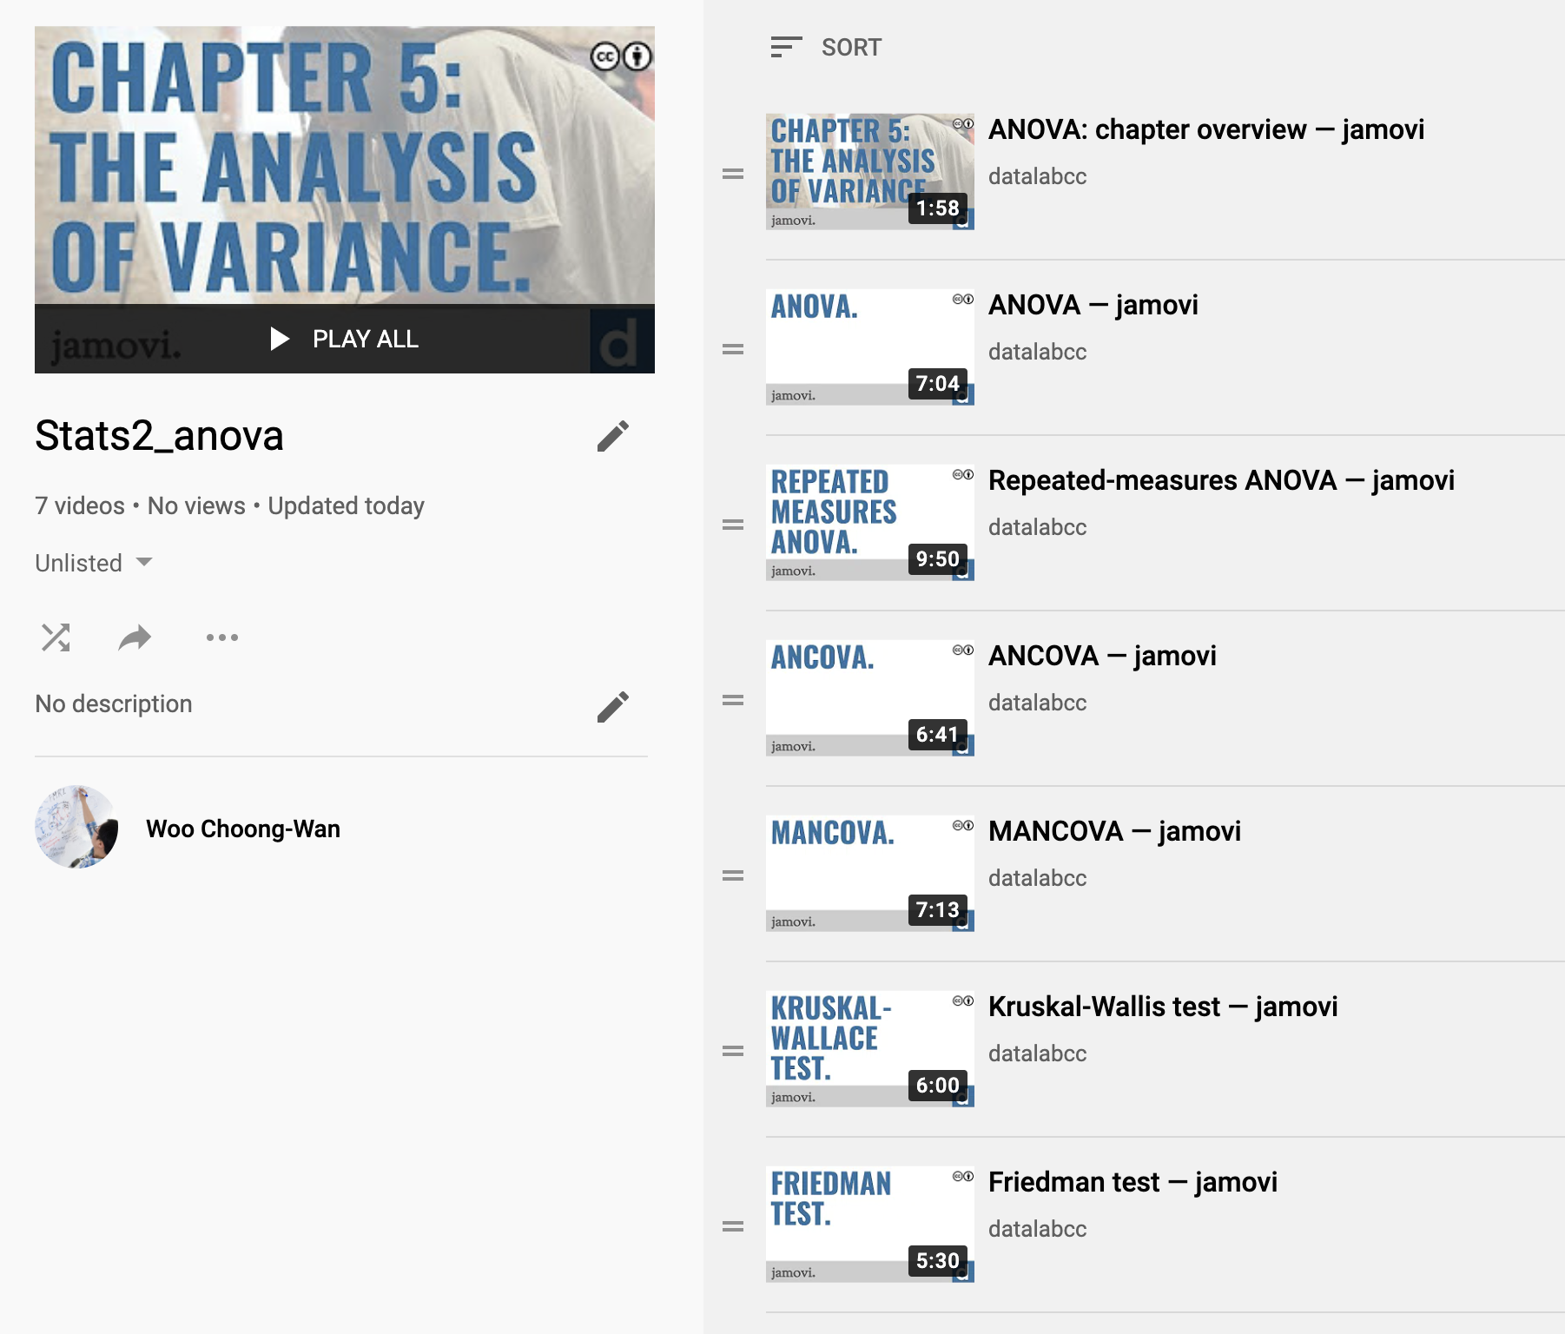
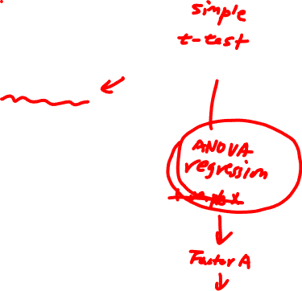
Lecture 15
ANOVA
https://www.youtube.com/playlist?list=PLXCuLG6zw7mLmslikvkrA4H0i5vNv4tBp
CHOONG-WAN WOO | COCOAN lab | http://cocoanlab.github.io

Slide 5
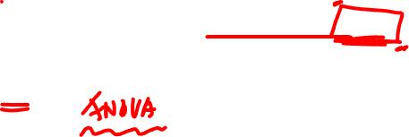
Lecture 15
Before going deep into ANOVA
I recommend you watching the previous lecture on ANOVA that I re-edited for you
Why?
CHOONG-WAN WOO | COCOAN lab | http://cocoanlab.github.io

Slide 6
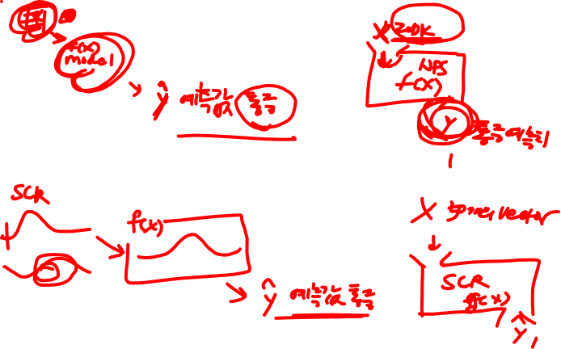
Lecture 15
HW2
https://github.com/wanirepo/Stats2_2020Fall/blob/master/hw_assignment/hw02.md
CHOONG-WAN WOO | COCOAN lab | http://cocoanlab.github.io

