Slide 1


Fall 2020
SKKU Biostats and Big data II
CHOONG-WAN WOO | COCOAN lab | http://cocoanlab.github.io

Slide 2
Biostats and Big Data 2
Lecture 12
Lecture 12
T-test on the real data
CHOONG-WAN WOO | COCOAN lab | http://cocoanlab.github.io

Slide 3
Lecture 12
Survey for the offline computer lab for 10/22
https://forms.gle/eY25nWobFdTaWTC7A
CHOONG-WAN WOO | COCOAN lab | http://cocoanlab.github.io

Slide 4
Lecture 12
What we learned…
Sampling distribution
Standard error of the mean
Confidence interval
One-sample t-test
Paired t-test
Independent samples t-test
CHOONG-WAN WOO | COCOAN lab | http://cocoanlab.github.io

Slide 5
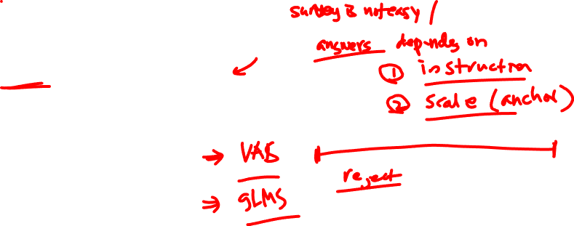
Lecture 12
One sample t-test
Study 2
gLMS (general labelled magnitude scale)?
Whether the lv 1 different from very weak? Etc.
Whether the lv 4 different from strong? Etc.
CHOONG-WAN WOO | COCOAN lab | http://cocoanlab.github.io

Slide 6
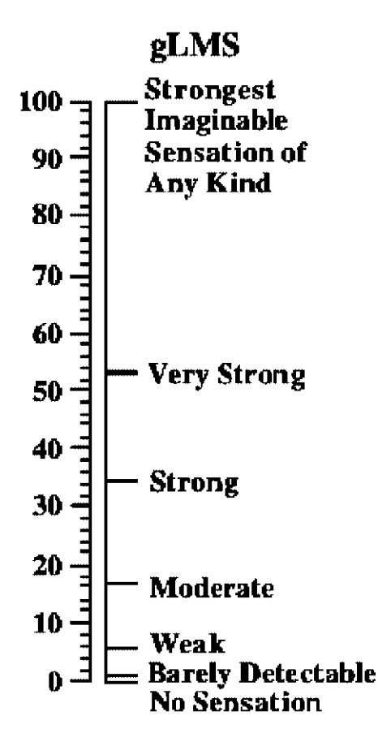
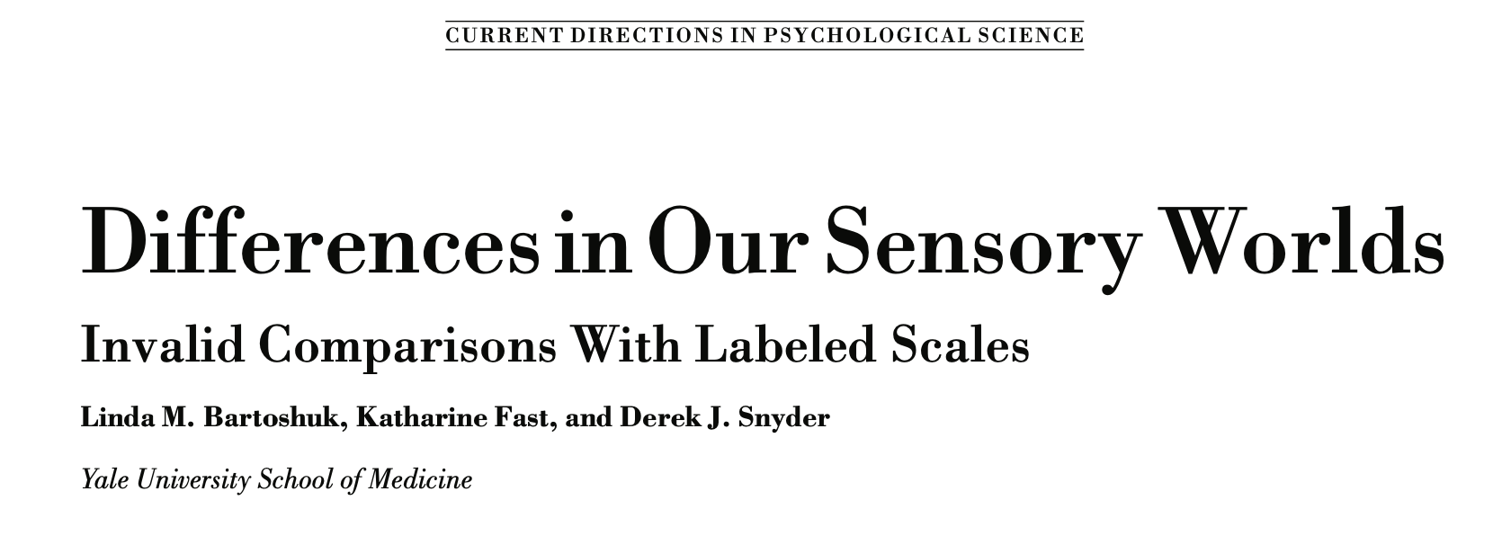
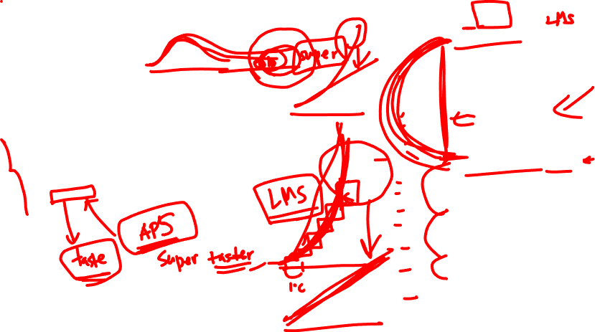
Lecture 12
One sample t-test
= 53.3
= 35.4
= 17.2
= 6.1
CHOONG-WAN WOO | COCOAN lab | http://cocoanlab.github.io

Slide 7
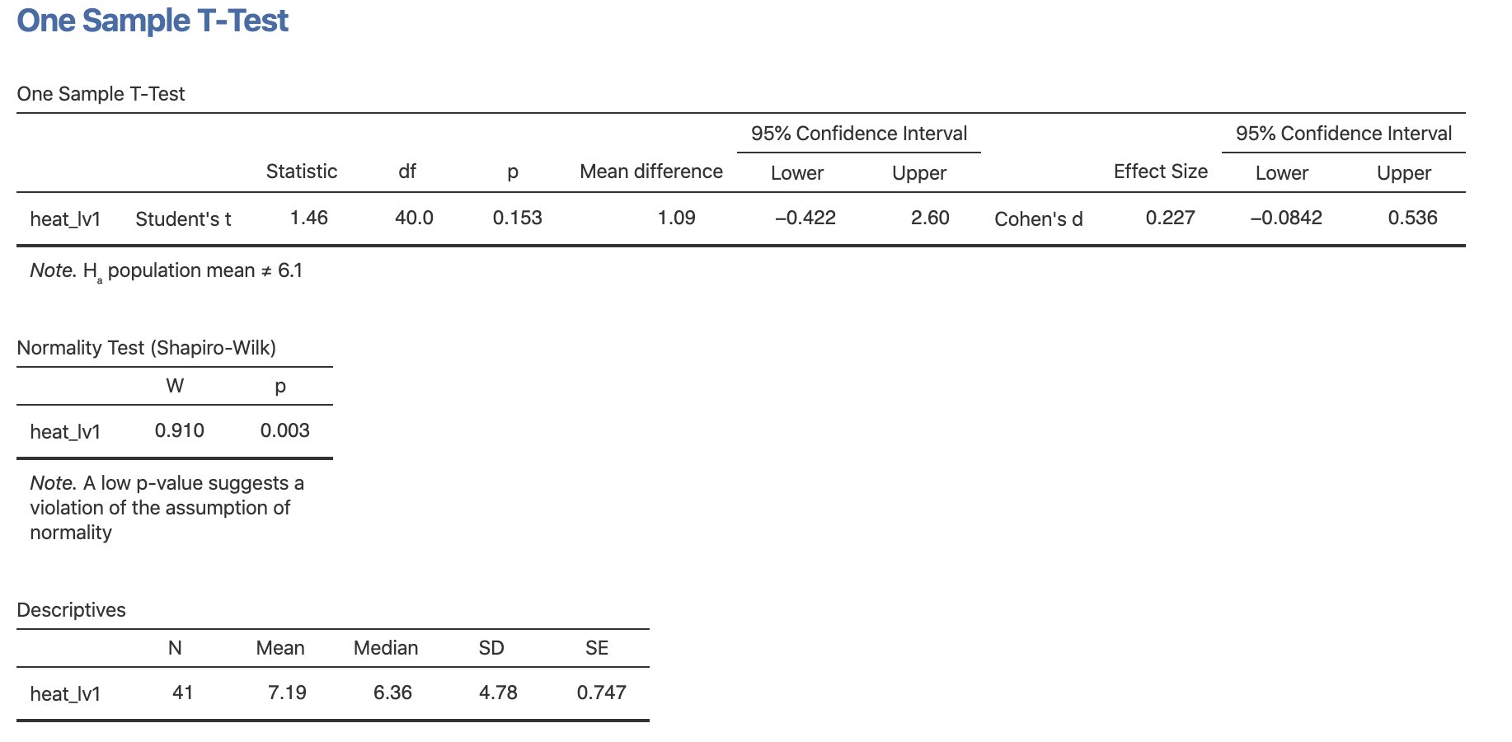
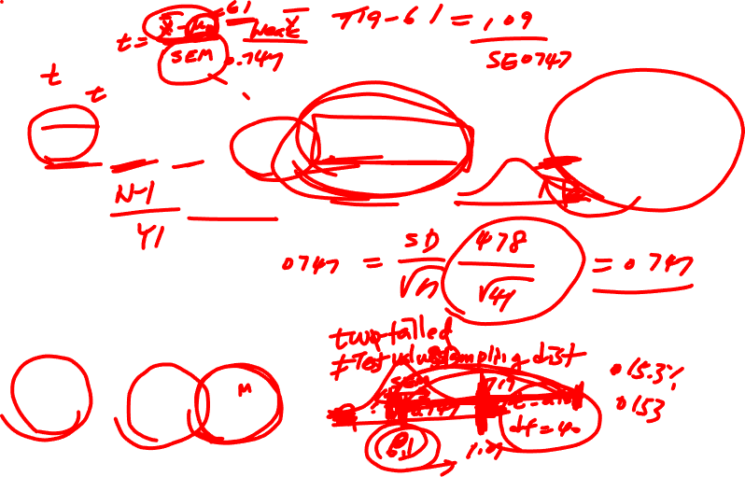
Lecture 12
One sample t-test
Let’s do run the analysis:
CHOONG-WAN WOO | COCOAN lab | http://cocoanlab.github.io

Slide 8
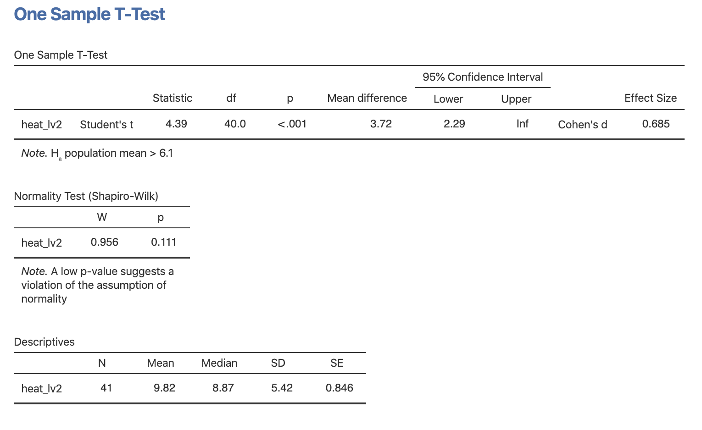
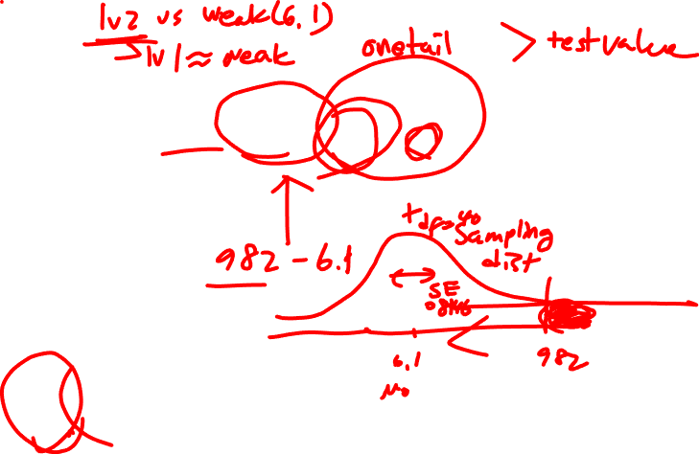
Lecture 12
Let’s do run the analysis:
CHOONG-WAN WOO | COCOAN lab | http://cocoanlab.github.io

Slide 9
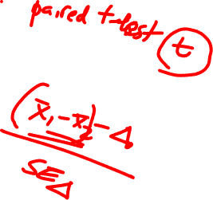
Lecture 12
Paired sample t-test
Study 1
Pain ratings diff between levels?
Study 2
Pain ratings diff between levels?
CHOONG-WAN WOO | COCOAN lab | http://cocoanlab.github.io

Slide 10
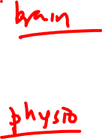
Lecture 12
Paired sample t-test
Study 1
Pain ratings diff between levels?
Differences in the Neurologic Pain Signature response between levels?
Study 2
Pain ratings diff between levels?
Differences in physiological response to pain between levels?
CHOONG-WAN WOO | COCOAN lab | http://cocoanlab.github.io

Slide 11
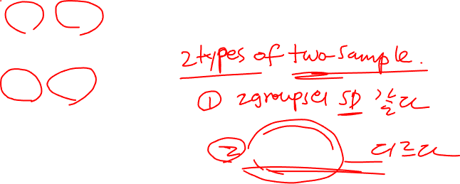
Lecture 12
Two samples t-test
Study 1
Pain difference between male vs. female for each level?
Study 2
Pain difference between male vs. female for each level?
CHOONG-WAN WOO | COCOAN lab | http://cocoanlab.github.io

Slide 12
Lecture 12
Two samples t-test
Study 1
Pain difference between male vs. female for each level?
Differences in the NPS response between male vs. female for each level?
Study 2
Pain difference between male vs. female for each level?
Difference in the physiological response to pain between male vs. female?
CHOONG-WAN WOO | COCOAN lab | http://cocoanlab.github.io

Slide 13
Lecture 12
Attendance check
https://forms.gle/Bpdcd2BFnuhe8rWW8
CHOONG-WAN WOO | COCOAN lab | http://cocoanlab.github.io

Slide 14
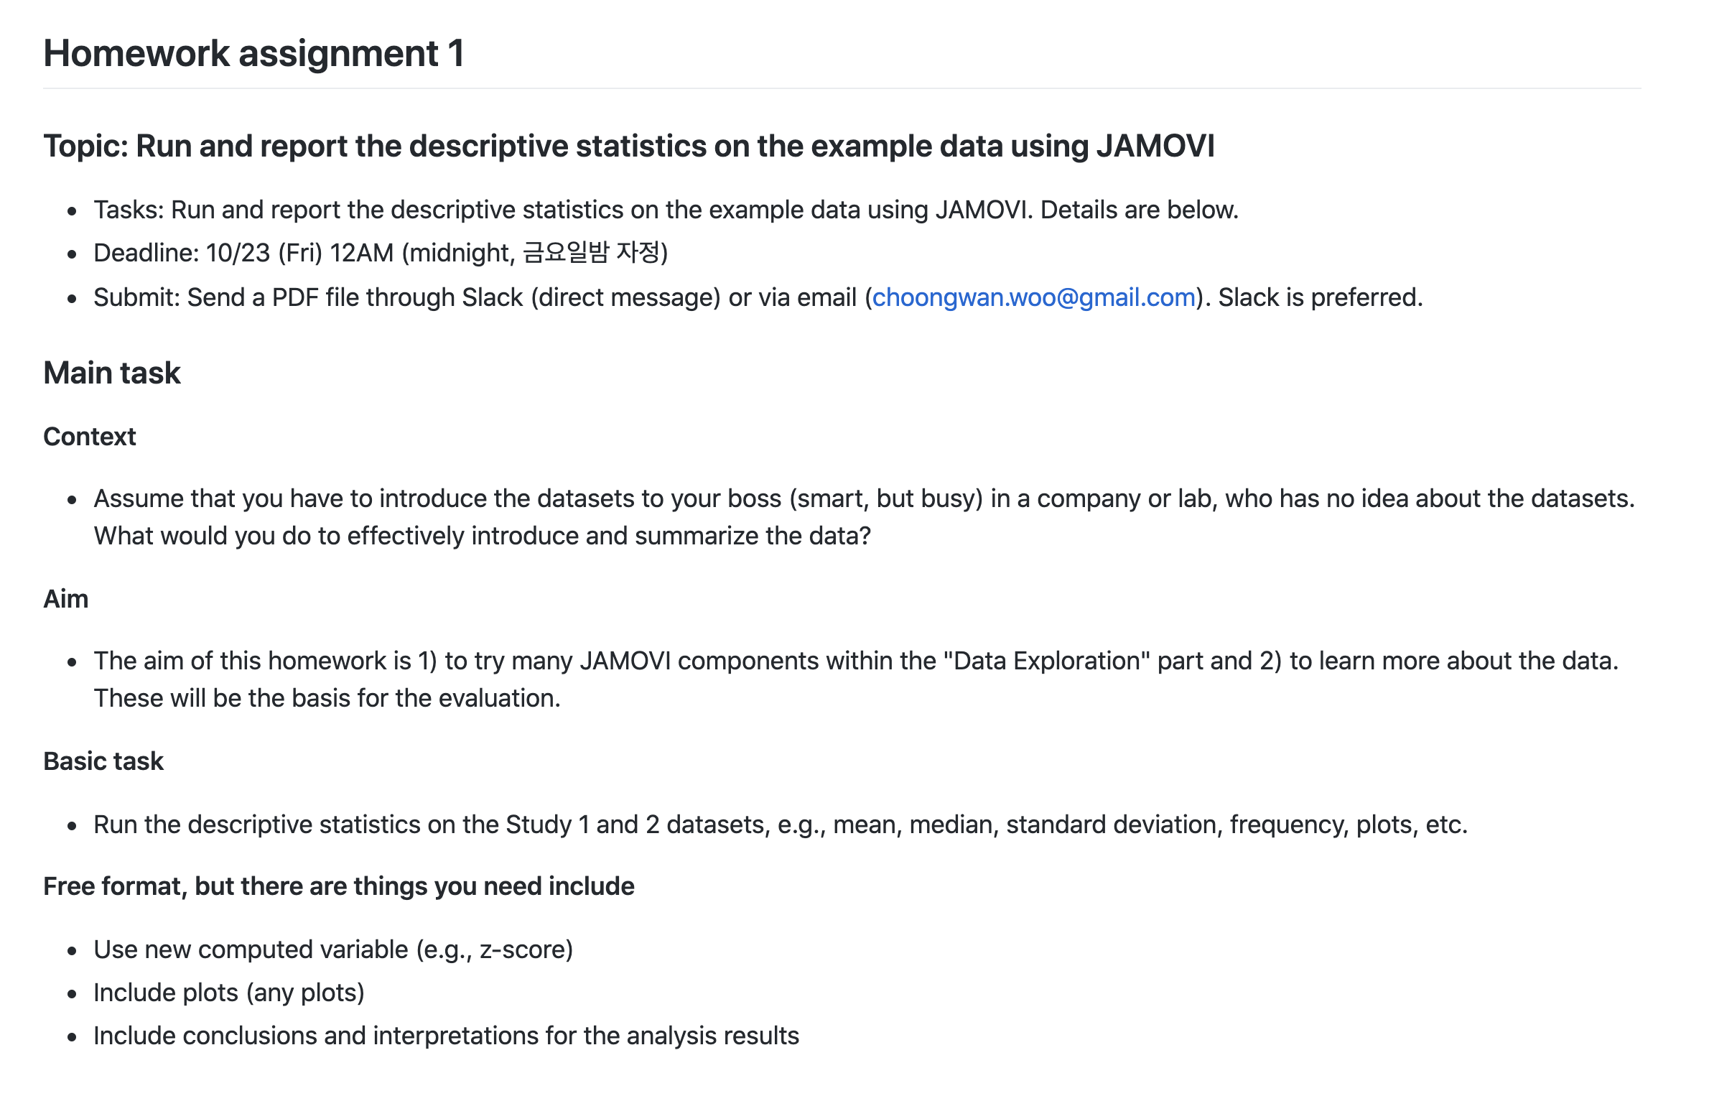
Lecture 12
HW1
https://github.com/wanirepo/Stats2_2020Fall/blob/master/hw_assignment/hw01.md
CHOONG-WAN WOO | COCOAN lab | http://cocoanlab.github.io

