Slide 1
01-Practice Programming Basics and Practice
Sep. 10, 2018
professor:
Younghoon Kim (kyhoon@gmail.com)

Slide 2
Quiz-01 [1/2]
Goal
Programming “Opening Bank Account System”
Content
Choose bank name: (e.g. Woori, Nonghyup, IBK, etc.)
Input a ‘bank_name‘ variable using “scanf()“ Func.
Input bank account what you want
A bank account consists of three positive numbers (begin, mid, final numbers) including zero: (e.g. 1002 536 256102)
Input variables using “scanf()” Func.
Print your bank account information
Print ‘bank name‘ and ‘bank account‘ using “printf()“ Func.

Slide 3
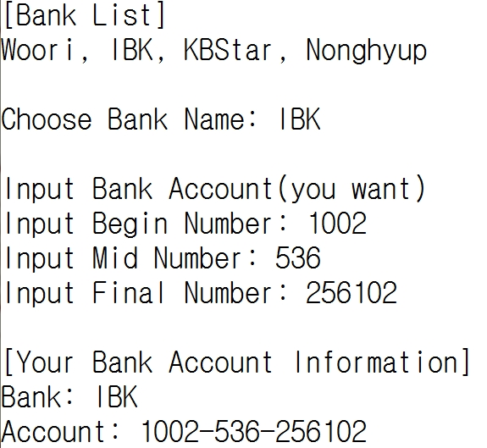
Quiz-01 [2/2]
Skeleton Code
Result
/* */
/* Opening a bank account */
/* */
#include<stdio.h>
int main(){
char bank_name[100];
int begin_account, mid_account, final_account;
printf("[Bank List]\n");
printf("Woori, IBK, KBStar, Nonghyup\n\n");
return 0;
}
Blank

Slide 4
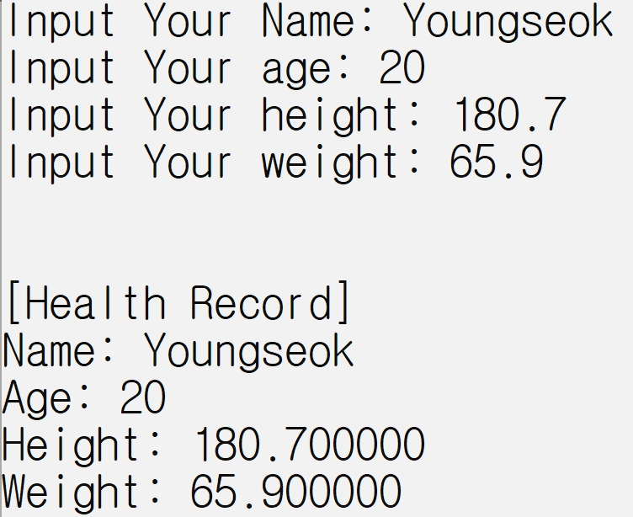
Health Record
Content
Declare one character array, one integer, and two double variables
Input your name, age, height, and weight and assign the values into the variables one-variable-at-a-time
Print your health information
Result

Slide 5
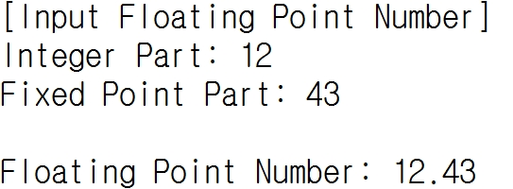
Floating point number input program
Content
Declare two integer variables which are a integer part and fixed input part, respectively
Input two integer values and assign the values into the variables
Print a floating point number
Result

