Slide 1
02-Practice Programming Basics and Practice
Sep. 17, 2018
professor:
Younghoon Kim (kyhoon@gmail.com)

Slide 2
Quiz-02 [1/2]
Goal
Programming “Comparison with the number 25”
Content
Choose the number: (e.g. 5, 17, 42, etc.)
Input a ‘input_number‘ variable using “scanf()“ Func.
Compare whether the input number is greater or smaller than 25.
After comparison, print the comparison result (e.g. 39 is bigger than 25)
Using “if - else” condition statement.
Repeat the question five times.
Using “while” Loop statement.

Slide 3
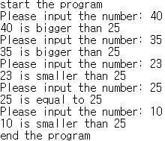
Quiz-02 [2/2]
Skeleton Code
Result
/* */
/* Comparison to 25 between input number */
/* */
#include <stdio.h>
int main()
{
int input_number;
int num=0;
printf("start the program\n");
printf("end the program");
return 0;
}
User Input
Blank

Slide 4
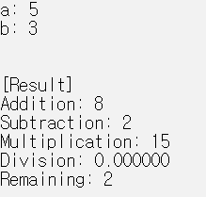
Arithmetic and remaining operations
Contents
Declare two integer variables named ‘a’, ‘b’
Input two integer values and assign the values into ‘a’, ‘b’
Get the result values of addition, subtraction, multiplication, division, remaining
Result

Slide 5
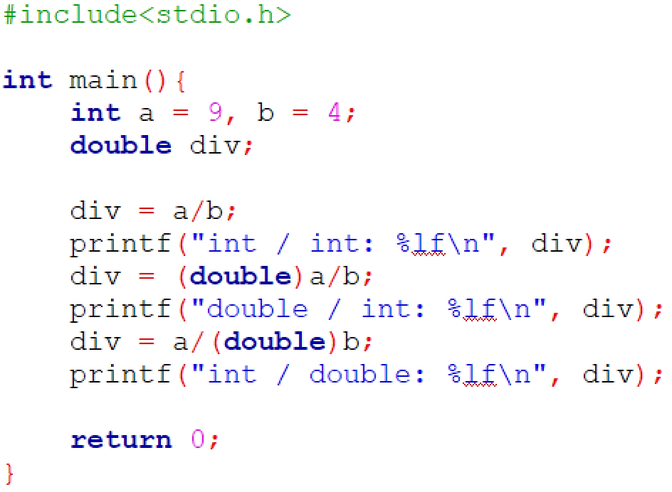
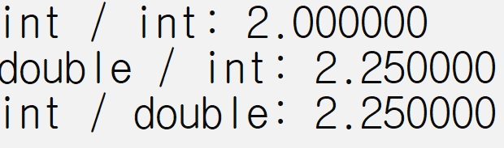
Advanced: Type Casting
Result

Slide 6
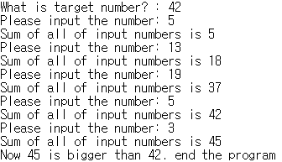
Add number cumulatively to target number
Content
Declare two integer variables which are target number and input number, respectively
First Input integer values and assign the values into the target number.
Secondly, repeatedly input a number, and then print the sum of the numbers.
Repeat until the sum of the numbers is greater than the target number
Result

