Slide 1
03-Practice Programming Basics and Practice
Oct. 8, 2018
professor:
Younghoon Kim (kyhoon@gmail.com)

Slide 2
Quiz-03 [1/2]
Goal
Programming “Calculate odd number range summation”
Content
Input the Range : (e.g. 10 50, 0 39, 10 10, etc.)
Input ‘min’ and ‘max’ variables using “scanf()“ Func.
If ‘min’ and ‘max’ are different, Calculate the summation of odd numbers in the input range.
Define “odd_number_range_summation” function and use it.
Repeat the question until ‘min’ and ‘max’ are the same.
Using “while” Loop statement with “if-else” statement.

Slide 3
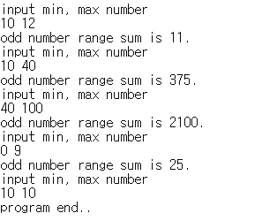
Quiz-03 [2/2]
Skeleton Code
Result
/* */
/* Odd number Range Summation */
/* */
#include <stdio.h>
int odd_number_range_summation(int min, int max){
}
int main()
{
char select;
int min, max;
while(1){
printf("input min, max number\n");
scanf("%d %d", &min, &max);
}
printf("program end..\n");
}
Blank
User Input
Blank

Slide 4
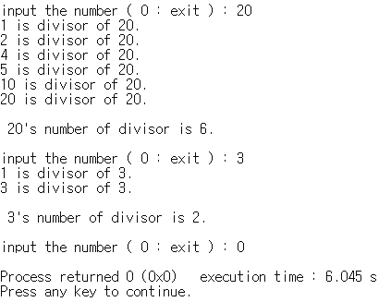
Number of Divisors
Content
Declare one integer variable named ‘number’
Input one integer value and assign into ‘number’
Print all divisor of ‘number’ and total number of divisors
Repeat questions until input number is 0
Result

Slide 5


Calculate greatest common divisor
Content
Declare two integer variables ‘num1’, ‘num2’
Input two integer values and assign into ‘num1’ and ‘num2’
Print GCD(Greatest Common Divisor) of two values.
For all numbers less than the two numbers entered, check them whether they are the common divisor of the two numbers or not.
And print the biggest one.
Result

Slide 6
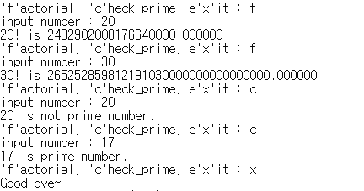
Factorial & Prime number check calculator
Content
Declare one character variable named ‘select’ , one integer value named ‘num’
Input one character, integer values and assign the values into the variables
Using ‘while’ and ‘switch-case’ statement, implement 3 functions below repeatedly.
If ‘select’ is ‘f’, print the factorial of input ‘num’. Result should be declared as float.
If ‘select’ is ‘c’, print input ‘num’ is prime number or not.
If ‘select’ is ‘x’, exit the program.
Result

