Slide 1
04-Practice Programming Basics and Practice
Oct. 15, 2018
professor:
Younghoon Kim (kyhoon@gmail.com)

Slide 2
Quiz-04 [1/2]
Goal
Programming “The Summation of Maximum and Minimum Value”
Content
First, input five numbers using array (e.g. 1 2 3 4 5, 1 7 5 3 7, etc.)
Input variables in array using “scanf()“ Func. iteratively.
Then, print out the summation value of maximum and minimum number.
Define “sum_of_max_min_value()” and use it.

Slide 3
Quiz-04 [2/2]
Skeleton Code
Result
#include<stdio.h>
int sum_of_max_min_value(int arr[],int num){
}
int main(){
int arr[5];
printf("Input the numbers : ");
return 0;
}
Blank
User Input
Blank

Slide 4


Index of number
Content
Declare a integer array named ‘arr’ whose size is 5
Declare a integer value named ‘input_number’
Using rand() function, assign five random values in range of 1~20 to arr
Print out the first index of input_number if it is in the arr or print out -1
Result
User Input

Slide 5
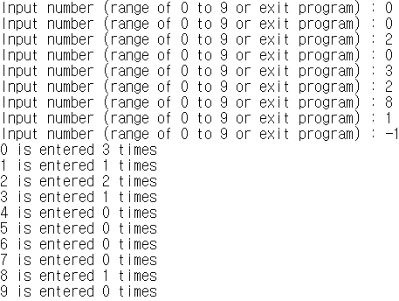
Calculate frequencies of input numbers
Content
Declare one integer array named ‘freq’ whose size is 10
Enter a positive single-digit integer and add 1 to the value of freq whose value is the index
Print out how often each number is entered.
Result
User Input

