Slide 1

Application of Medical Statistics : A Short Example via Original Study
Sangjun Park, MS
Korea University, College of Medicine
October 2020

Slide 2
Outline of Statistics
Data handling techniques → Proof of Concept
Major Fields
Design of Experiments – Randomization, Blinding, Sample size determination
Clinical Trials (RCT)
Sampling - Distribution estimation, Bayesian Statistics
Quality control
Survey methodology
Descriptive Statistics – Exploratory data analysis (EDA)
Inferential Statistics – Point/Interval Estimation, Hypothesis Rejection
Predictive Modeling - Classical regression w/ variants, Clustering, Multivariate analysis, Forecasting, Classification, Clustering, Machine learning, etc.
Theoretical Statistics – Matrix calculus, Linear algebra, Probability theory, Mathematical Statistics, Real analysis, Measure theory, Differential equations, Numerical Analysis, etc.
Know your tools before using them!

Slide 3
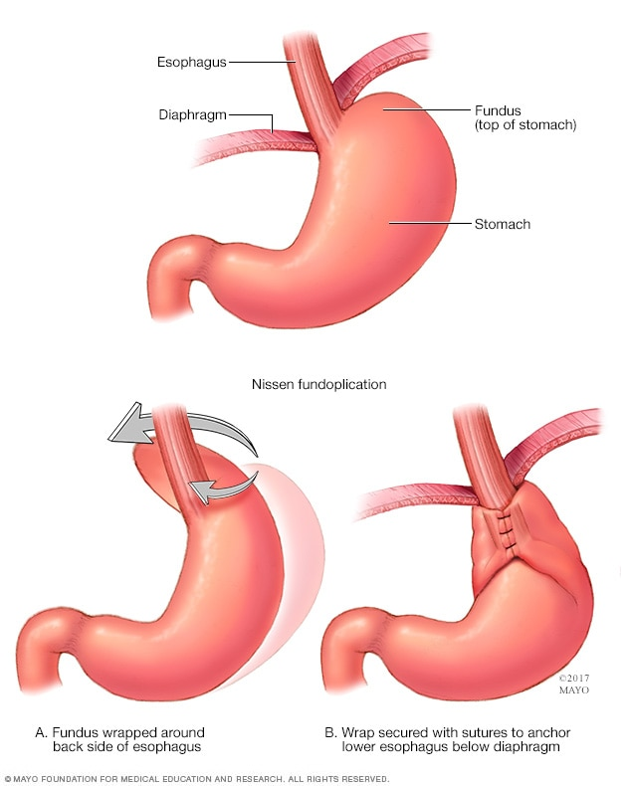
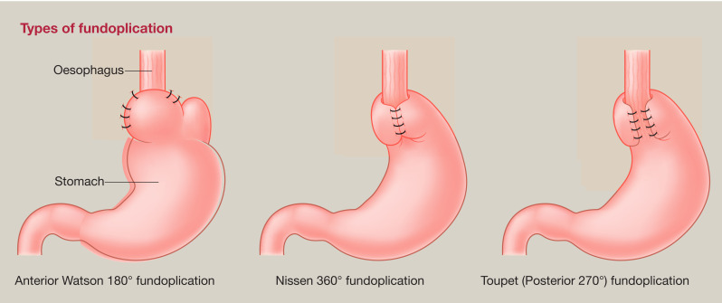
Motive Background
GERD (Gastroesophageal Reflux Disease)
Medical Tx. Proton-Pump Inhibitor
Surgical Tx. Laparoscopic Nissen Fundoplication

Slide 4
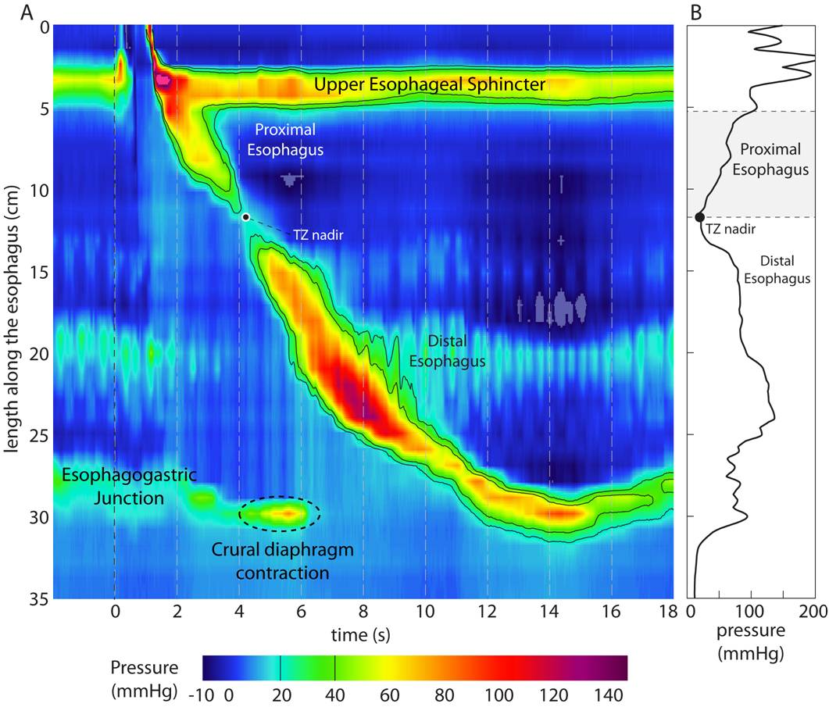
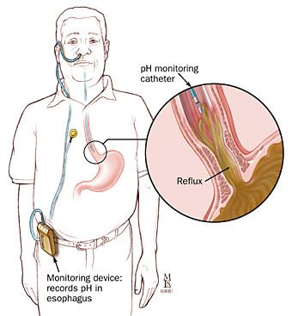
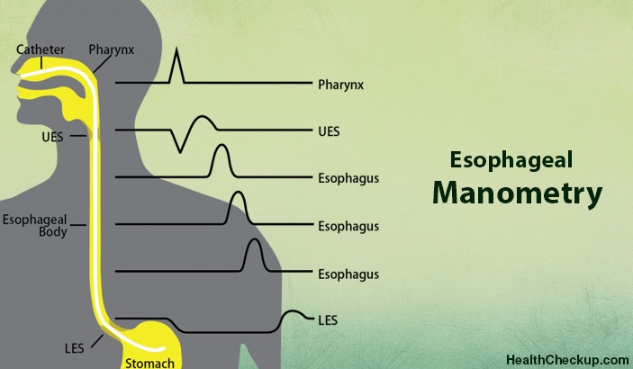
Motive Background
Upper GI Endoscopy
24h pH Monitoring
Esophageal Manometry -> Is it worth it?

Slide 5
Data Preprocessing
Tedious but inevitable
No turning back from here. Make sure no mistakes happen!

Slide 6
Exploratory Data Analysis (EDA)

Slide 7
Statistical Assumptions

Slide 8
Hypothesis Testing and their Results

Slide 10
The Whole Flow

Slide 11
Statistical Softwares
SPSS
Propriety Software – Use portal or get the student discount version
“Clickable”, Easy-to-use, No programming language needed!
Frequently used in the medical field
SAS
Mostly used in corporate settings
R
Open-source software with various pre-made packages
Has extreme popularity due to its fast computing ability and flexibility (with programming skills)
Install with Rstudio (GUI)
Python?
Pandas (Raw Data Handling)
Numpy (Matrix Calculation)
Scipy, PyStan, PyTorch (Machine Learning)

Slide 12
Recommendation of Reference Materials
Matrix Calculus – Magnus
Linear Algebra – Lay (Introductory), Strang (Moderate), Friedberg (Slightly advanced, For mathematics majors), Hoffman (Hard-core with abstract algebra)
Probability Theory – Ross (Introductory), Billingsley (Graduate, Measure-theory, Extremely rigorous, Prereq. Real Analysis)
Mathematical Statistics – Hogg (Moderate), Casella (Graduate)
Exploratory Data Analysis – Tukey (Old but classic)
Categorical Data Analysis – Agresti (Two versions, Introductory and Advanced)
Nonparametric Statistics – Conover
Regression Analysis – Chatterjee (Moderate)
Experimental Design – Montgomery (Moderate)
Survival Analysis – Kleinbaum, Collett
Meta-Analysis – Borenstein
Multivariate Statistics – Johnson (Moderate provided that one is already familiar with linear algebra and matrix calculus)
Bayesian Statistics (Learn sampling methods first) – Gelman (Bible of BDA), Hoff
Machine Learning – An introduction to statistical learning (G. James, Moderate), The elements of statistical learning (Hastie, Graduate)

Slide 13

Good Luck!
All models are wrong, but some are useful.
- George E. P. Box (1919-2013)

