Slide 1
GPA1-B
18 January 2026
Josue Junior Fleuridor

Slide 2
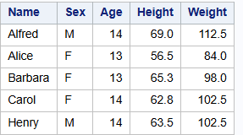

Slide 3
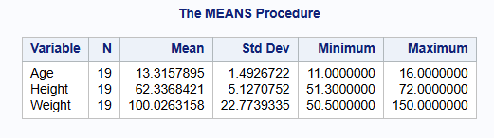

Slide 4
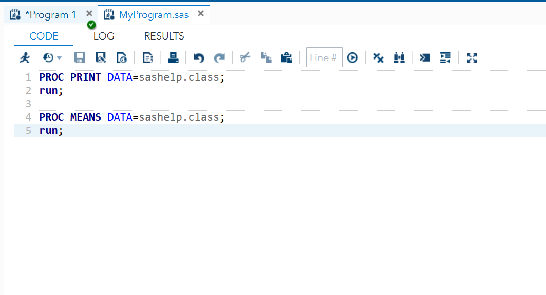

Slide 5
GPA1-B
4 April 2026
New Slide added for Git

