Slide 1
Emergency Splint For Open Fracture Wounds Using Laminar Jamming
Jung Hur
Bioengineering
Robert D. Howe
Buse Atkas
Notes:
All caps might be too much

Slide 2
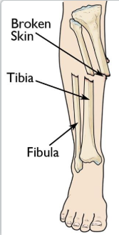
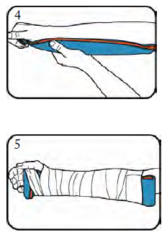
Open fracture wounds
Background
Problem
System Specification
Ideation
Design
Material Selection
Experiment
Measure
Next step
Problem: Higher rates of infection and nonunion
Emergency situation: Stop bleeding, immobilize area, relieve pain.
Current solution: Rigid splints such as SAM splint or traction splints
Dunbar, R. P., MD, & Cannada, L. K., MD. (2017, March). Open Fractures. Retrieved from https://orthoinfo.aaos.org/en/diseases--conditions/open-fractures/
Schienberg, S. “SAM splint User’s Guide” Product Manual (2005) SAM Medical Products.
Notes:
Add figures of sam splint or splints in general to convince people that there’s a problem

Slide 3
problem
Background
Problem
System Specification
Ideation
Design
Material Selection
Experiment
Measure
Next step
The emergency splints on the market today provide skeletal stability using rigid materials.
This makes it inefficient in emergency treatment of open fracture wounds because it does not provide soft tissue coverage and causes unnecessary pain during application.

Slide 4
System specifications
Background
Problem
System Specification
Ideation
Design
Material Selection
Experiment
Measure
Next step
How the splint should function
Criteria | Value | Reason | Test
Application time | < 2 minutes | Professionals must be able to use quickly in emergency situations | EMT usage test
Usability time | > 30 minutes | Typical time in an ambulance | Leak pressure and bubble test
Reusability | 5 times | Typical SAM splint reusability | Leak pressure and bubble test after reapplications
Radiolucent | - | Characteristic of typical splints on the market | X-ray
Cost | < $10 | Typical SAM splint value | -
Thickness | 4-6 mm | SAM splint is 4 mm thick | -
Impact resistance | 1 J | Approximately 1/3 of energy needed to break a wrist bone | Impact resistance testing
Notes:
SAM splint fatigues but is technically reusable but this splint can be reset with no fatigue

Slide 5
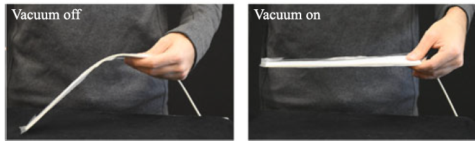
Using Laminar Jamming
Background
Problem
System Specification
Ideation
Design
Material Selection
Experiment
Measure
Next step
Flexible materials under vacuum becomes stiff
Apply to wound on vacuum-off state
Flexible → Less pain
Wrapped splint → soft tissue coverage
Apply vacuum to material
Skeletal immobilization
Narang, Y.S., Vlassak, J.J., and Howe, R.D. “Mechanically VersatileSoft Machine through Laminar Jamming” Advanced Functional Materials 28 (2018)
Notes:
Change these picture

Slide 6
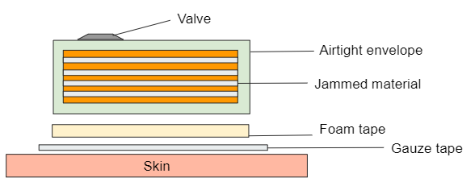
Splint design
Background
Problem
System Specification
Ideation
Design
Material Selection
Experiment
Measure
Next step
Gauze tape → Soft tissue coverage
Foam tape → Comfort
Laminar jammed material → Skeletal immobilization
Airtight envelope
10-30 layers of jamming material
Check valve
Notes:
Check the smaller font and make sure it’s visible
Qualitative data with different geometries being used
I used this prototype for these reasons
Then

Slide 7
Material selection for gauze tape
Background
Problem
System Specification
Ideation
Design
Material Selection
Experiment
Measure
Next step
Criteria | Weight | Tegaderm Film Dressing | Hydrocolloid adhesive | Medipore adhesive
Barrier | 3 | 3 | 3 | 2
Absorbency | 3 | 0 | 1 | 3
Waterproof | 2 | 3 | 2 | -1
Cost | 1 | -1 | 1 | 1
Size | 1 | -1 | 1 | 0
Total | 10 | 4 | 7 | 5

Slide 8
Laminar jammed system specifications
Background
Problem
System Specification
Ideation
Design
Material Selection
Experiment
Measure
Next step
Specification for the inner layers that will be laminar jammed
Criteria | Value | Reason | Test
Vacuum-on stiffness | 540 N/m | Measures stiffness of SAM splint | Three point bending
Vacuum-off stiffness | - | - | Force needed to move joint at rest
Notes:
Citations are options with references in the back. Be consistent
Full structure/system specification and
Material specifications → system specification
*** How force needed to move a joint at rest → joint stiffness ***
Talk about SAM splint → improving upon SAM splint → Need something to be flexible → Introduce laminar jamming as a solution (bc of biorobtics) → if this is the solution then the material specifications need to be met → this is what a laminar jamming solution might look like (drawing. Very elementary)

Slide 9
Material specifications
Background
Problem
System Specification
Ideation
Design
Material Selection
Experiment
Measure
Next step
Specification for the inner layers that will be laminar jammed
Criteria | Value | Reason | Test
Coefficient of Friction (affects the point of yield) | .5-.6 | Higher end of achievable friction from fibers | Friction testing
Linear density | > 100 gram/km | Characteristic of cotton | Spec sheet
Tensile strength | 100 MPa | Typical value of textile fibers | Tensile Testing
Thickness | .01 mm | Thinner material means more layers in 5 mm total thickness | Caliper
Notes:
Citations are options with references in the back. Be consistent
Full structure/system specification and
Material specifications → system specification
*** How force needed to move a joint at rest → joint stiffness ***
Talk about SAM splint → improving upon SAM splint → Need something to be flexible → Introduce laminar jamming as a solution (bc of biorobtics) → if this is the solution then the material specifications need to be met → this is what a laminar jamming solution might look like (drawing. Very elementary)

Slide 10
Material selection for jamming
Background
Problem
System Specification
Ideation
Design
Material Selection
Experiment
Measure
Next step
Material used for jamming
 | Weight | Cotton | Tensile Fabric | Sandpaper | Wax | PVC film
Conformability | 4 | + | + | - | + | +
Tensile strength | 4 | 0 | + | + | - | -
Friction | 4 | 0 | 0 | + | + | +
Cost | 2 | + | - | 0 | + | -
Thickness | 3 | + | - | - | - | +
Weight | 1 | + | - | - | - | +
Laser cut | 1 | + | - | + | 0 | -
Total | 19 | 11 | 1 | 8 | 2 | 10
Notes:
Recheck math
Iteration pictures + materials tried out

Slide 11
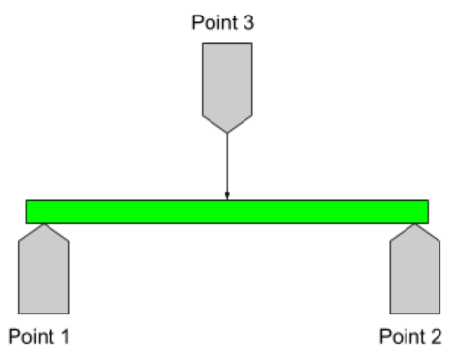
3 point bending test
Background
Problem
System Specification
Ideation
Design
Material Selection
Experiment
Measure
Next step
ASTM D790-17
Test samples
20 layers of cotton
40 layers of PVC + cotton
20 layers of wax + cotton
SAM splint
Deflection of 4.5 mm
5 trails each
Span of 12 cm
Results: stiffness

Slide 12
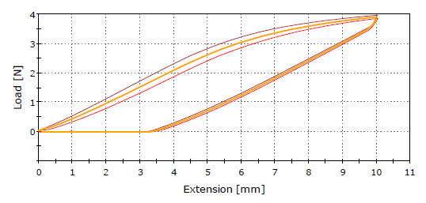
Sample: SAM splint
Background
Problem
System Specification
Ideation
Design
Material Selection
Experiment
Measure
Next step
Stiffness ~400 N/m
Plastic deformation ~3.5 mm
Yield ~3N

Slide 13
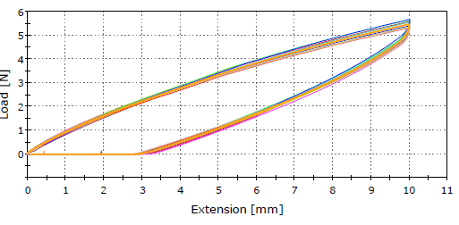
Sample: Cotton + pvc
Background
Problem
System Specification
Ideation
Design
Material Selection
Experiment
Measure
Next step
Stiffness ~550 N/m
Plastic deformation ~3mm
No yield
Notes:
Might want to put this on the same plot

Slide 14
Next step
Background
Problem
System Specification
Ideation
Design
Material Selection
Experiment
Measure
Next step
Material selection
Envelope
Stability
Reusability
Airtight
Foam tape
Modeling
COMSOL
Testing
Testing for impact resistance
Testing for tensile strength of materials
Notes:
Experiement vs theory for modeling

Slide 15
Sources
ASTM D790-17, Standard Test Methods for Flexural Properties of Unreinforced and Reinforced Plastics and Electrical Insulating Materials, ASTM International, West Conshohocken, PA, 2017, www.astm.org
Blanc, L., Delchambre, A., and Lambert, P. “Flexible Medical Devices: Review of Controllable Stiffness Solutions” Actuators 6 (2017)
Boyd, A. S., Benjamin, H.J., Asplund, C. “Splints and Casts: Indications and Methods” American Family Physician 80 (2009): 491-499. NCBI. Web 8 Sept 2018
Brown, A.S. “The Vac Pac” Plastics and Reconstructive Surgery (1988) 81(2) 301-302
Bureau, Maxime et al. “Element with Variable Stiffness Controlled by Negative Pressure” Patent application EP2796114 A1, Textia Innovative Solutions, S.L.
Chudnofsky, C. R., Byers, S. E. “Splint Techniques” Clinical Procedures in Emergency Medicine 5th ed. (2010)
Cross, W.W., and Swiontkowski, M.F. “Treatment Principles in the Management of Open Fractures.” Indian Journal of Orthopaedics 42.4 (2008): 377–386. PMC. Web. 8 Sept. 2018
Diwan, A., Eberlin, K. R., Smith, R. M. “The Principles and Practice of Open Fracture Care, 2018” Chinese Journal of Traumatology 21 (2018): 187-192. ScienceDirect Web 8 Sept. 2018
Gaston, R. G., Loeffler, B. J., “Sports-specific injuries of the hand and wrist” Clinical Sports Medicine (2015) 34(1): 1-10.
Halawai, M. J., Morwood, M.P. “Acute Management of Open Fractures: An Evidence-Based Review” Orthopedics (2015) 38: 1025-1033.
Kharkova, G., Kononova, O., et al. “Elastic Properties of Cotton Fabric Based Polymer Composities” Engineering For Rural Development (2011): 402- 407.
Letts, R.M., and Hobson, D.A. “The Vacuum Splint: An Aid in Emergency Splinting of Fractures” Canadian Medical Association Journal 109 (1973): 599-600.
McGrath, T., Murphy, C. “Comparison of a SAM Splint-Molded Cervical Collar with a Philadelphia Cervical Collar” Wilderness and Environmental Medicine (2009) 166-168
Narang, Y.S., Vlassak, J.J., and Howe, R.D. “Mechanically Versatile Soft Machine through Laminar Jamming” Advanced Functional Materials 28 (2018)
Narang, Y.S., Degirmenci, A., Vlassak J.J., and Howe, R.D. “Transforming the Dynamic Response of Robotic Structures and Systems through Laminar Jamming” IEEE Robotics and Automation Letters 3
O’Brien, P.J., Mosheiff, R., “Open Fractures – Stages of Care” AO Principles of Fracture Management. AO Publishing, 2007.
Orgill, Dennis, MD, PhD. Professor of Surgery, Harvard Medical School, Principle Investigator, Wound Healing & Tissue Engineering Laboratory. Private communications 09/29/18.
Prokuski, L. “Negative Pressure Dressings for Open Fracture Wounds.” The Iowa Orthopaedic Journal 22 (2002): 20–24. Print.
Ryan, S. P., Pugliano, V. “Controversies in Initial Management of Open Fractures” Scandinavian Journal of Surgery 103 (2014): 132-137. SagePub. Web. 8 Sept. 2018.
Schienberg, S. “SAM splint User’s Guide” Product Manual (2005) SAM Medical Products.
Veneman, J.F., et al. “Varstiff, An Innovative Variable Stiffness Material, Applied in a Wheelchair Positioning Device.” Available online: https://www.ige.tu-berlin.de/fileadmin/fg176/IGE_Printreihe/TAR_2015/Session_order/Postersession_Event_6_paper_Veneman_Jan_.pdf
Werner, F., Sort, W., Green, J., et. al “Severity of Scapholunate Instability IS Related to Join Anatomy and Congruency” The Journal of Hand Surgery (2006) 32(1) 55-60
Wood, A.M., Robertson, G.A.J., et al “Epidemiology of Open Fractures in7Sport: One Centre’s 15-year Retrospective Study” World Journal of Orthopedics (2017) 8(7): 545-552.

Slide 16
THANK YOU
Questions?
Notes:
Clinical tests for sterilization for medical equipment
Vinyl cutter

