Slide 1

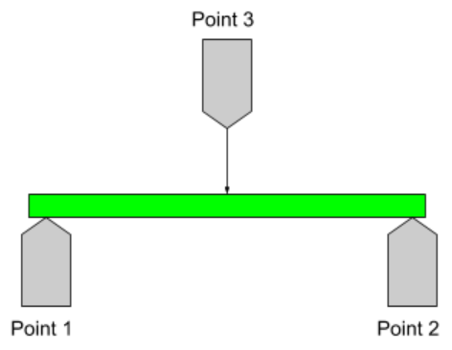
3 point bending test
Get load (N)
10 mm extension
12 cm support distance
~.2” x 2” x 6” samples
Stiffness = load/extension
Young’s modulus = slope

Slide 2

Final design: Cotton + PVC film
Cotton thickness = .01”
Wax thickness = .01”
PVC film thickness = .001”
Could have more layers with PVC film

Slide 3
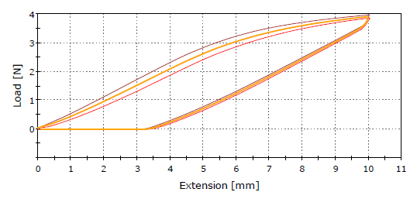
SAM splint
Stiffness ~ 400N/m
Plastic deformation ~3.5mm
Yield ~3N

Slide 4
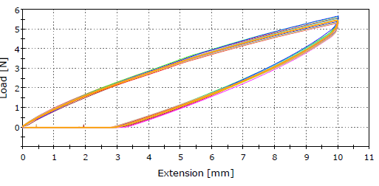
Cotton + PVC
Stiffness ~ 550 N/m
Plastic deformation ~3 mm
No yield?

