Slide 1
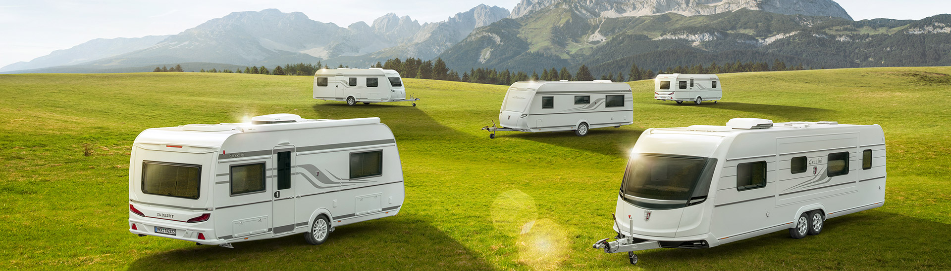
Predicting Caravan Insurance Policy Ownership
Erik Carrion, Juna Iafelice, John Makhijani
December 13, 2021

Slide 2
Caravan Dataset Description
Goal - Predict who would be interested in buying a caravan insurance policy
Data Breakdown
Sample Size (n) – 5822 | Predictors (p) – 86
Predictors include product usage data and socio-demographic data derived from zip area codes
Response Variable (Binary) – Caravan insurance policy owner
Predictors – Multinomial with a varying number levels 2-40
Data Source – http://kdd.ics.uci.edu/databases/tic/tic.html

Slide 3
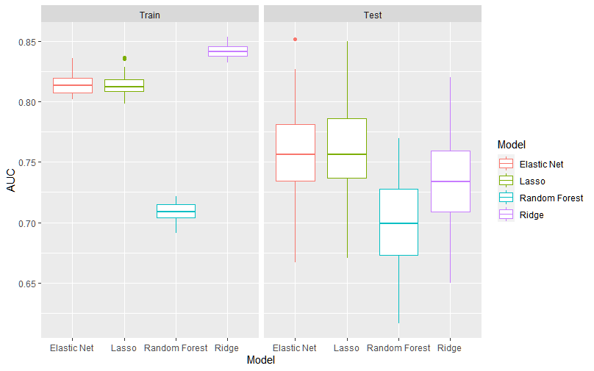
AUC_{test} and AUC_{train} by Method

Slide 4
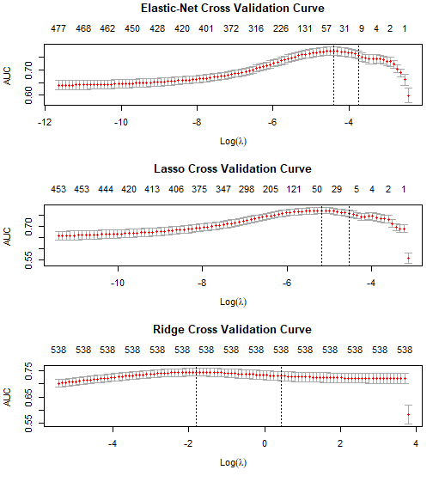
Cross Validation Curves
CV TIME | CV TIME(SECS)
ELASTIC NET | 112 secs
LASSO | 134 secs
RIDGE | 64 secs

Slide 5
Model Performance / Time Tradeoff
 | Test AUC (median) | Time
ELASTIC NET | 0.76 | 129 secs
LASSO | 0.76 | 146 secs
RIDGE | 0.73 | 57 secs
RANDOM FOREST | 0.70 | 155 secs

Slide 6
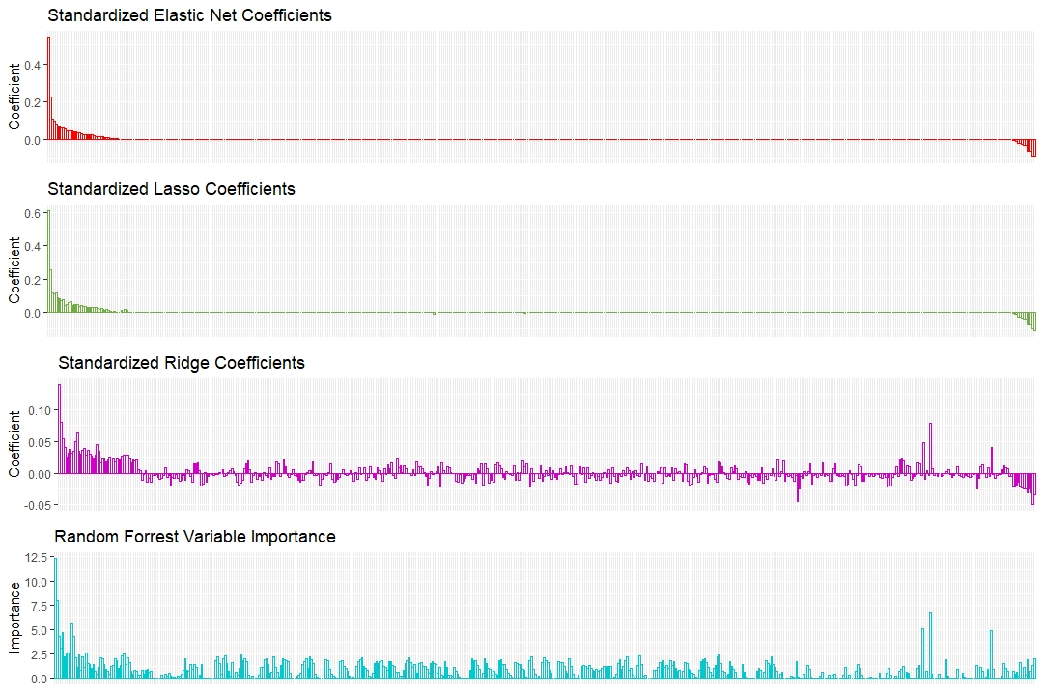

Slide 7
Conclusion
Important Features: PPERSAUT6 Contribution Car Policies, L6 PBRAND4 Contribution Fire Policies, 3 policies APLEZIER1 No. of Boat Policies, 1 policy PBRAND3 Contribution Fire Policies, 2 policies MKOOPKLA7 Purchasing Power Class, level 7
Time vs Performance: Elastic Net or Lasso are both parsimonious and give us approximately the same median AUC.
Best Model: Elastic Net

