Slide 1
CAPSTONE PROJECT 1 · STRAIVE DATA ANALYST PROGRAMME
Payment Profitability,
Data Trust & Executive Decision
Why is payment contribution profit per successful transaction falling even though payment volume is increasing, and what should AstraPay change in the next 60 days?
The answer, in one line
Dilution, not deterioration. 88.6% of the fall is the mix of ticket sizes moving.
Junaid Mustafa · Data Analyst Trainee · Technical and executive walkthrough · Tasks 1–8

Slide 2
EXECUTIVE SUMMARY
Three true statements that look like a contradiction
Every stakeholder can cite a number and be right. That is what makes this a diagnosis problem, not a reporting problem.
Volume is up
Total profit is up
Profit per transaction is down
+70.1%
+13.6%
−32.8%
16,400 → 27,903 attempts per month
$23,974 → $27,227 per month
$1.620 → $1.089 per successful txn
The resolution
Dilution, not deterioration
88.6% of the fall is ticket-size mix shifting. Almost every segment held its own economics or improved.
Growth landed in the wrong place
A $14-median digital-goods cohort went 8.1% → 33.9% of successful transactions, while TRAVEL, ELECTRONICS and GROCERY lost share.
We routed and priced it as if it were large
Sub-$90 traffic drifted onto the provider whose fixed fee is built for $500 tickets — and that fee rose 50.6% mid-year.
Three of four stakeholder theories are wrong
Pricing, fraud and chargebacks were each tested and disproved. One was disproved by a data-quality artefact, not a business fact.
Sections follow the eight tasks: framing, data contract, quality, model, root cause, diagnosis, dashboard, decision.

Slide 3
TASK 1 · FRAMING
The business, the question, and the KPI it is asked in
AstraPay is a cross-border payments company in India, Singapore and the UAE. It earns a fee from merchants and pays a fee to providers.
Who pays whom
The executive KPI
SMART, in short
Merchant
the shop — our customer
pays us
Size the drivers of the decline across 2025, separating business performance from data artefacts.
Attribute at least 90% of the fall to named drivers in USD per txn, residual stated.
Five-day diagnostic; actions startable and measurable inside 60 days.
contribution per successful txn
= ( merchant revenue
− processing cost
− risk cost )
/ successful transactions
USD at the SETTLEMENT rate
AstraPay
the platform in between
keeps the gap
Provider
the rails — our supplier
we pay them
KPI element | Defined to the row
Numerator | Merchant revenue − processing cost − risk cost, in USD
Denominator | Count of transactions with status CAPTURED
Date basis | transaction.created_at — the month we transacted, not the month cash settled
Exclusions | REVERSED out of both sides; negatives on CAPTURED with no parent quarantined; declined attempts leave the denominator
Four competing explanations, offered before anyone looked at the data
CFO
Head of Payments
Risk Head
Data Head
"Merchants negotiated us down on price."
"Provider latency is destroying conversion."
"The new fraud model declines good payments."
"None of the reporting can be trusted anyway."
H1b
H2 / volume
H3b
H0 — the gate

Slide 4
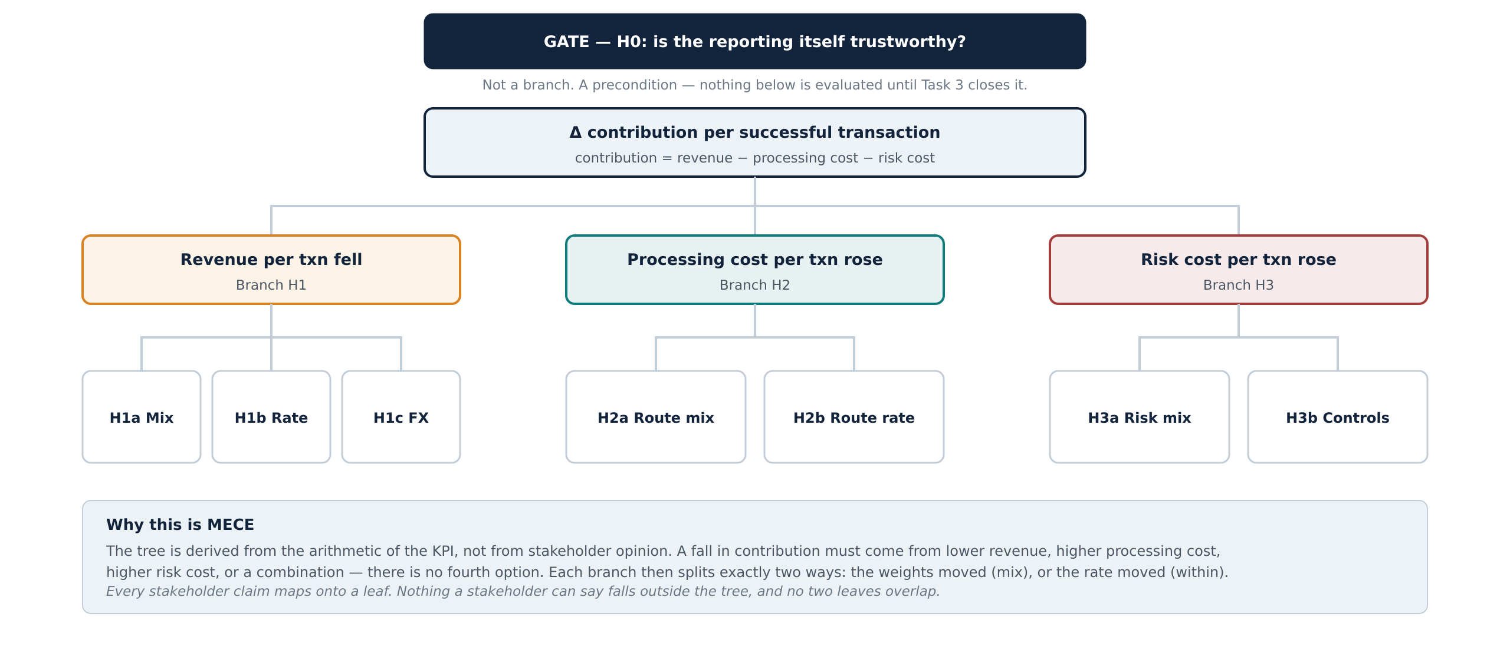
TASK 1 · HYPOTHESIS STRUCTURE
The hypothesis tree comes from the arithmetic, not from the room
Deriving the tree from the KPI formula is what makes it mutually exclusive and collectively exhaustive.

Slide 5
TASK 1 · HYPOTHESES
Seven hypotheses, each with its falsification condition written first
Stating what would reject a hypothesis before running the test is what stops the analysis becoming a search for confirmation.
ID | Hypothesis | Confirms if | Rejects if
H0 | The deterioration is partly a data artefact | Transaction and settlement totals fail to reconcile | Reconciliation closes and the defect log explains the gap
H1a | Revenue per txn fell because the book shifted | Segment weights shift materially across the period | Weights are stable, or reweighting removes the fall
H1b | Merchants were repriced downward | Take rate falls within a pricing plan | Take rate within every plan is flat or rising
H1c | Currency translation eroded revenue | Constant-FX contribution diverges from actual | The two series track closely
H2a | Route mix moved to a costlier provider | Route mix shifts and fixed-fee share rises | Route mix is stable
H2b | A provider raised its own unit cost | Holding route and ticket band fixed, cost per txn rises | Within route and band, cost per txn is flat
H3a | Risk mix moved to higher-risk bands | Risk-band weights shift upward | Risk-band weights are stable
H3b | Fraud controls decline good payments | At a comparable threshold, decline rates rise | Decline rates at a comparable threshold are flat
H3b carries a warning from the framing document: fraud scores come from more than one model version, so any comparison of score distributions across the cutover is invalid until the scales are normalised. That warning turned out to be the whole answer to Task 6.

Slide 6
TASK 1 · SCOPE
What is out of scope, and the six assumptions that could be argued with
Each assumption is a decision with a defensible alternative. Naming them lets a reviewer disagree precisely instead of vaguely.
Out of scope
Stated up front so an absent finding is not read as a null result
Fixed and overhead cost — contribution margin, not a full P&L.
Acquisition and merchant onboarding cost.
Settlement records with no matching transaction — reported as a reconciliation break, not analysed.
Any period outside 2025.
Causation between latency and merchant churn — no retention data exists.
Whether a declined payment was lost revenue or a customer who retried — retry linkage is not in the data.
Merchant profitability net of relationship and support cost.
Price elasticity — no historical price change exists to estimate it from.
# | Assumption | Why, and the alternative that was rejected
A1 | FX uses the SETTLEMENT rate on the transaction date | MID is quoted, not realised. The spread widens 0.35% → 0.60% in Q4, so the error grows over exactly the period under investigation.
A2 | Settlement fees attributed to the transaction month | Keeps revenue and cost in one period. Settlement-month attribution would smear the August incident across two months.
A3 | Captured transactions with no settlement row are retained | 4.77% of rows, weighted to December. Dropping them deletes the newest month's revenue and exaggerates the decline.
A4 | Missing merchant_id rows stay in the executive KPI | They are real payments. Excluded only from merchant-level breakdowns, where they would bias the answer.
A5 | Negative amounts with status REVERSED are legitimate | A reversal is a business event. Only negatives on CAPTURED with no parent are impossible.
A6 | Route costs are read as-of the transaction date | PROV_ORBIT reprices on 1 July. A single latest-rate join would erase the step change entirely.

Slide 7
TASK 2 · SOURCES
Eleven files, and the grain of each one
Grain is the first question, not a detail. Six of these carry more than one row per transaction, and every one of those is a way to inflate the answer.
File | Rows | Grain | What it carries | Join hazard
transaction | 260,287 | 1 per payment attempt | amount, currency, channel, status, route_id | — the spine
payment_event | ~1.00M | 2–4 per transaction | lifecycle events, processing_ms, ingestion_time | FAN-OUT
fraud_decision | 466k | 1–4 per transaction | risk_score, decision, model_version | FAN-OUT ×1.8
settlement | 224k | 1–2 per transaction | fee_amount = AstraPay's revenue | FAN-OUT
chargeback | 721 | 1 per dispute | disputed amount, reason, opened_at | one-to-many
merchant_risk_snapshot | 7,200 | 12 per merchant | risk_score, risk_band by month | FAN-OUT ×11.9
route_cost | dated | 1 per route per rate_date | fixed_fee, variable_fee_pct | dated — as-of join
fx_rate | dated | 1 per date × currency × rate_type | rate_to_usd, MID or SETTLEMENT | two rate types
merchant | 600 | 1 per merchant | category, country, pricing_plan, risk_tier | safe
customer | 15,000 | 1 per customer | segment, country, kyc_status | safe
pricing_plan | 4 | 1 per plan | rate_pct, fixed_fee_usd, billing_basis | safe
settlement.fee_amount is the fee AstraPay charges the merchant — revenue. The fee AstraPay pays the provider is a different number and lives in route_cost. Reading fee_amount as cost makes contribution zero by construction.

Slide 8
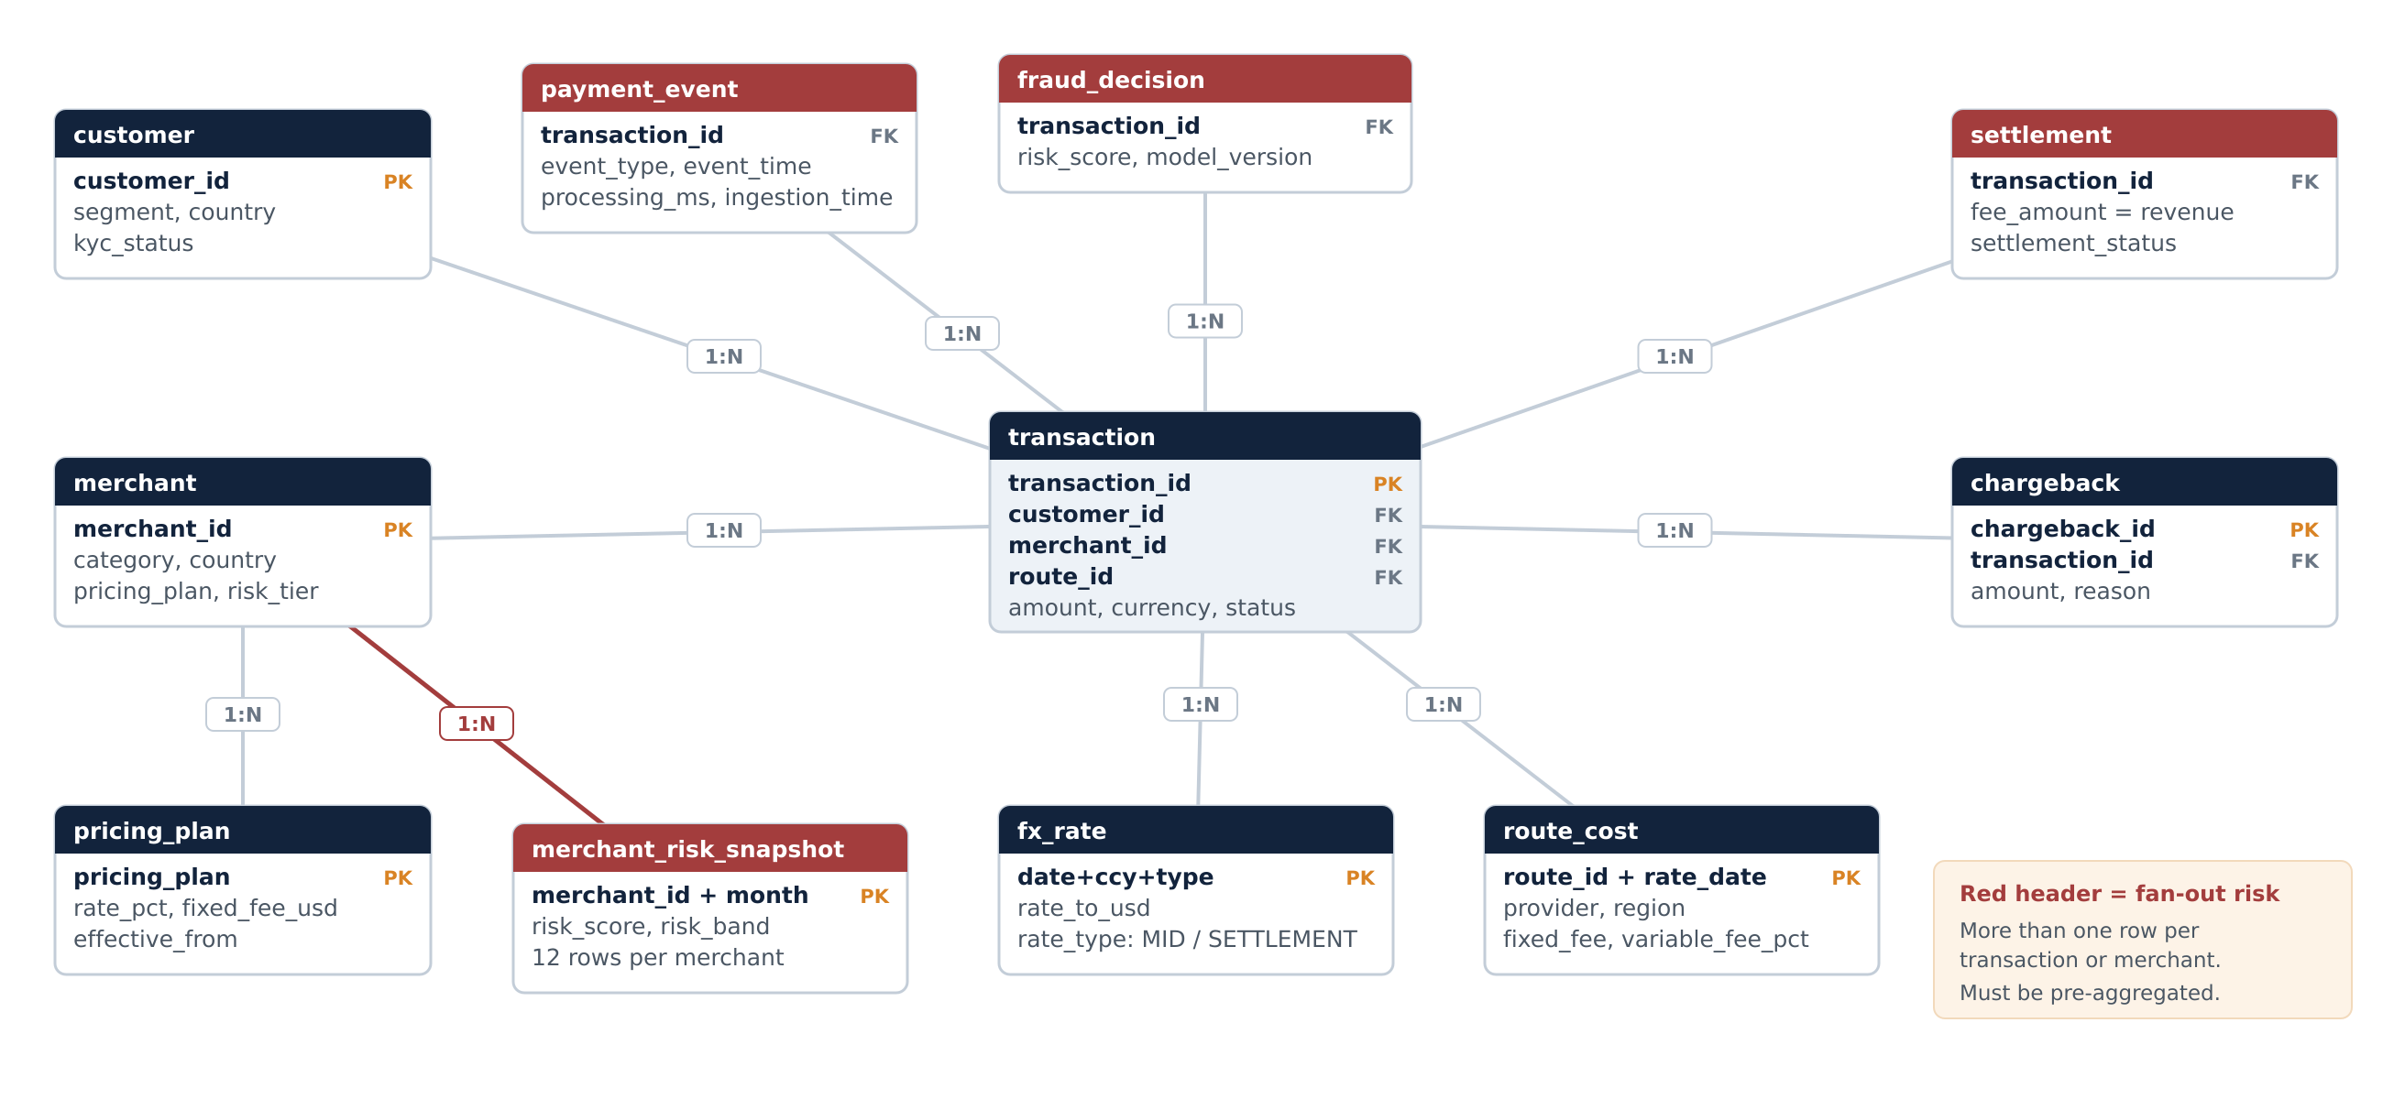
TASK 2 · ER DIAGRAM & JOIN RISK
How the eleven files relate, and the three controls that keep them honest
Red headers carry more than one row per key. Every one of them is pre-aggregated before it touches the fact table.
As-of join
Pre-aggregate first
Dated join, explicit rate type
merchant_risk_snapshot → latest snapshot at or before the transaction month. Naive: ×11.92 GPV inflation.
fraud_decision, payment_event, settlement, chargeback all collapsed to one row per transaction_id before joining. Naive fraud join: ×1.79.
route_cost and fx_rate joined on the transaction date, with rate_type = SETTLEMENT. Key-only joins multiply by every rate date.

Slide 9
TASK 2 · THE MESS
Thirteen defects, and why "drop the bad rows" is the wrong instinct
Three remediation verbs, applied deliberately: quarantine, repair, or retain-with-flag. Deletion is the option that silently changes the answer.
# | Defect | Measured | Severity | Remediation
1 | Missing merchant_id | 0.68% overall — but WALLET 2.10% vs 0.41% elsewhere | WARNING | Retain with flag. Not uniform, so dropping biases channel analysis
2a | Reversals: negative amount, status REVERSED | 1,952 rows | INFO | Legitimate business event — net them, do not drop
2b | Orphan negatives on CAPTURED, no parent | 390 rows | BLOCKING | Quarantine — an impossible state
3 | risk_score > 1 | 37.9% of fraud rows, all model_version v3.0 | WARNING | Normalise by version before any threshold comparison
4 | Latency deterioration | PROV_MERIDIAN, 1 Aug – 24 Sep | WARNING | Flag as an incident, exclude from trend fitting
5 | Late-arriving events | 4.44% ingested >2 days late, max 9 days | WARNING | event_time drives KPIs; ingestion_time measures reporting lag
6a | Captured transactions with no settlement row | 4.77%, weighted to December | BLOCKING | Retain with flag; impute from the rate card, never treat as zero
6b | Transactions with two settlement rows | 1,334 (partial + CORRECTION) | BLOCKING | Sum to transaction grain before joining
6c | Settlement rows with no matching transaction | 447 rows | BLOCKING | Exclude and report to Finance Ops as a reconciliation break
7 | Two FX rate types | MID and SETTLEMENT for every date | WARNING | Pick one, state why, sensitivity-test the other
8 | merchant_risk_snapshot fan-out | 12 rows per merchant — ×11.9 inflation | BLOCKING | As-of join on snapshot_month
9 | fraud_decision fan-out | 1–4 rows per txn — ×1.8 inflation | BLOCKING | Pre-aggregate to transaction grain
9b | payment_event fan-out | 2–4 rows per transaction | BLOCKING | Pivot before joining
Note the asymmetry in defect 1: the missing merchant rate is five times higher on WALLET than anywhere else. A defect that is not uniformly distributed cannot be dropped without biasing whatever dimension it correlates with.

Slide 10
TASK 3 · DATA QUALITY
Twenty-six checks across six dimensions: 10 failed, 16 passed
The gate from Task 1: until H0 is closed, no other hypothesis is worth testing. This is how it was closed.
26
10
16
5
3,038
0
checks
FAIL
PASS
Blocking
rows quarantined
unexplained
Completeness
Validity
Uniqueness
Consistency
Timeliness
Reconciliation
4 checks
6 checks
4 checks
5 checks
4 checks
3 checks
Is the value there?
Is the value possible?
Does the key hold?
Do the tables agree?
Did it arrive on time?
Do the totals close?
Dimension | Check that failed | Failed | Severity | Consequence if ignored
Uniqueness | more than one settlement row per transaction | 1,334 | Blocking | Merchant revenue double-counts on those transactions
Uniqueness | merchant_risk_snapshot composite key not unique | 12 / merchant | Blocking | ×11.92 inflation on every merchant-level measure
Validity | risk_score outside 0 to 1 | 37.9% | Blocking | The fraud hypothesis looks true when it is not
Validity | negative amount with status CAPTURED | 390 | Blocking | Contribution understated by an impossible state
Consistency | settlement.transaction_id not found in transaction | 447 | Blocking | Revenue attributed to payments that do not exist
Completeness | transaction.merchant_id is null | 0.68% | Warning | Channel analysis biases if dropped — WALLET is 2.10%
Reconciliation | captured transaction with no settlement row | 4.77% | Warning | December revenue disappears if treated as zero
Verdict on H0: the reporting is not trustworthy as delivered, and it is repairable. The Data Head is right about the symptom and wrong about the conclusion — the gate opens once these ten are remediated, it does not stay shut.

Slide 11
TASK 3 · CODE & PROOF
Run the wrong join on purpose, then show the right one
A control that is asserted can be wrong. A control that is demonstrated numerically cannot be waved away in a review.
# deliberately naive — the join a hurried analyst writes
naive = tx.merge(risk_snap, on="merchant_id", how="left")
print(naive.amount_usd.sum() / tx.amount_usd.sum())
# -> 11.92 twelve snapshots per merchant
# correct: as-of join, latest snapshot at or before the month
snap = (risk_snap[risk_snap.snapshot_month <= tx_month]
.sort_values("snapshot_month")
.groupby("merchant_id").tail(1))
# -> 1.00 grain preserved
×11.92
×1.79
GPV inflation, risk snapshot
GPV inflation, fraud join
Why this matters more than it looks
An inflated total is obvious. An inflated total that is inflated EVENLY is not — ratios still look sane, trends still point the same way, and the error survives review. ×11.92 on gross value with the transaction count untouched is exactly that shape.
Quarantine reconciliation — nothing disappears silently
=
+
+
3,038
2,668
370
0
rows excluded from the KPI
duplicate settlement rows
impossible negative amounts
unexplained
# every check emits the same seven fields, so the scorecard is a table, not a paragraph
add("Uniqueness", "more than one settlement row per transaction", "settlement",
(s.groupby("transaction_id").size() > 1).sum(), s.transaction_id.nunique(),
"Blocking", "Sum fee_amount to transaction grain before joining") # + 25 more

Slide 12
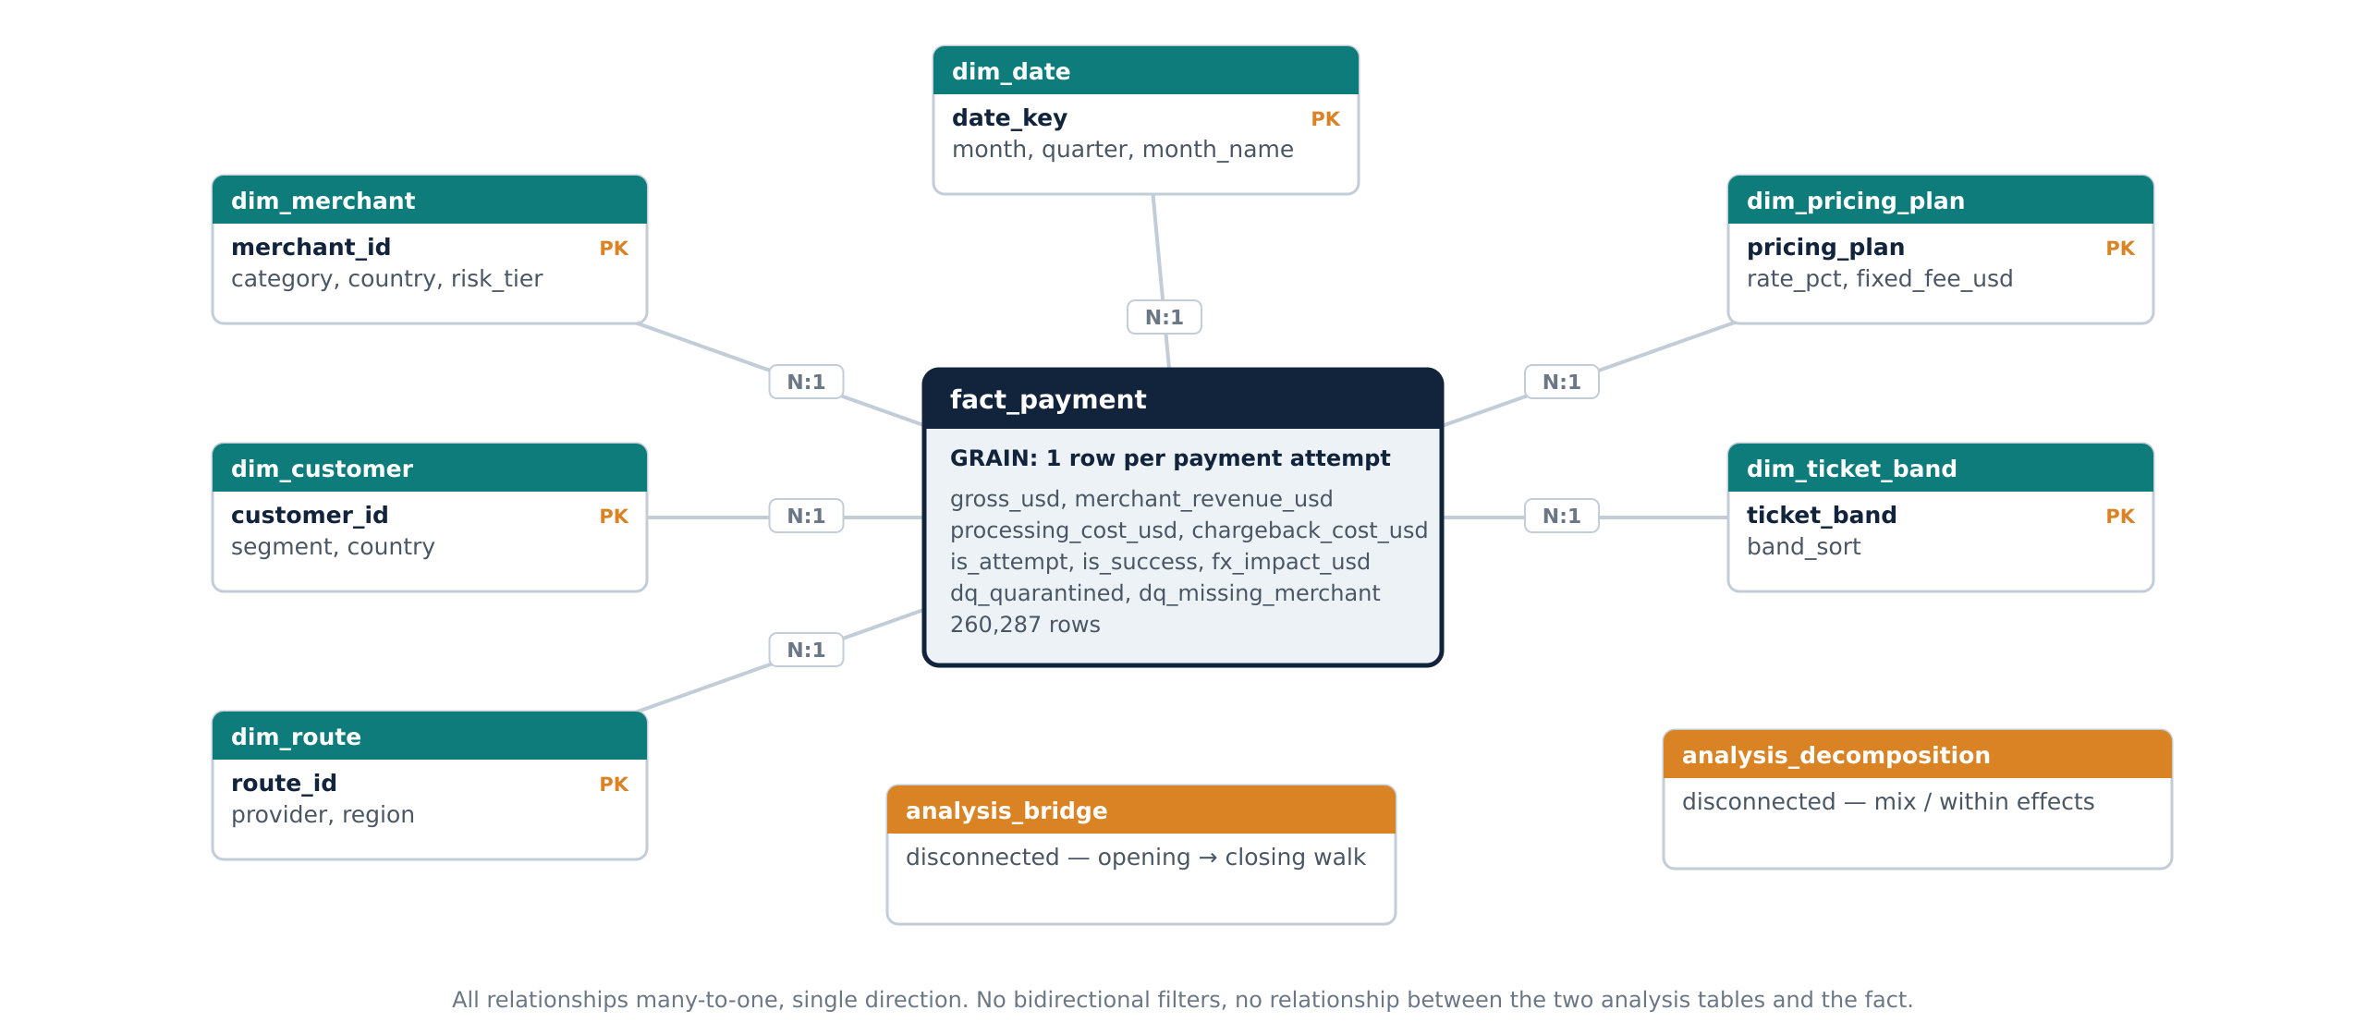
TASK 4 · THE MODEL
One fact, six conformed dimensions, two disconnected analysis tables
Everything downstream — the notebooks, the dashboard, this deck — reads from this model and nothing reads from the raw files.
The rule the whole pipeline is built around
Every one-to-many source is collapsed to one row per transaction BEFORE it is joined to the spine — not after, not with a DISTINCT, not with a window function at query time. Each staging function carries a GRAIN docstring, and that docstring is the contract: if a function claims one row per transaction_id, a single assertion proves it. This is the difference between a model that is correct and a model that happens to give the right answer on this month's data.

Slide 13
TASK 4 · CODE
Staging, the contribution formula, and the row type that nearly broke it
t4_core.py — four staging functions collapse the hazardous sources; the fact build encodes every Task 1 decision as a line of code.
def stg_settlement(s):
"""GRAIN: 1 row per transaction_id.
Collapses partial + correction pairs."""
return (s.groupby("transaction_id")
.agg(merchant_fee_usd=("fee_amount", "sum")))
def stg_fraud(f): # GRAIN: 1 row per transaction_id
f["score_norm"] = np.where(
f.model_version.str.startswith("v3"),
f.risk_score / 100.0, f.risk_score) # two scales
def stg_event(e) # pivots lifecycle, keeps latency
def stg_chargeback(c) # sums disputes to txn grain
The decisions encoded above
Sum, never first
A partial settlement plus a CORRECTION row are two halves of one fee. First loses the correction, max loses the partial — only the sum is the fee.
Normalise at the boundary
If the score scale is fixed downstream, someone eventually queries the raw column and gets a different answer. Fix it once and never expose the raw value.
Dated joins, explicit rate type
fx_sel = fx[fx.rate_type == RATE_TYPE] \
.set_index(["currency", "rate_date"]).rate_to_usd
t["gross_usd"] = t.amount * t.fx_rate_to_usd
t["contribution_usd"] = ( t.merchant_revenue_usd
- t.processing_cost_usd
- t.chargeback_cost_usd )
# no merchant -> no plan -> no rate -> NaN contribution
portfolio_rate = (t.loc[settled, "merchant_fee_usd"].sum()
/ t.loc[settled, "gross_usd"].sum())
imputed_rev = np.where(np.isnan(imputed_rev),
t.gross_usd * portfolio_rate, imputed_rev) # flagged
SETTLEMENT FX on the transaction date; route cost as-of the transaction date. PROV_ORBIT steps $0.35 → $0.52 on 1 July — a key-only join averages that away.
Quarantine means flagged, not deleted
The 390 impossible rows stay in the fact table with dq_quarantined = TRUE. Measures filter them; the count stays reportable.
The NaN that broke the decomposition
Rows with no merchant had no imputable revenue, so contribution was NaN and the residual was non-zero. The portfolio-rate fallback — flagged, never silent — took it to exactly 0.

Slide 14
TASK 4 · OUTPUT
Validation, and the monthly series the whole case rests on
validation_checks() is the proof that the model does not double count. It runs every time the notebook runs.
Validation checks that must pass before any analysis
Fact row count = transaction row count
PASS
260,287 = 260,287
transaction_id unique in the fact
PASS
0 duplicates
Gross USD equals the source total
PASS
ratio 1.000
Every staged table is at txn grain
PASS
4 of 4 assertions hold
Revenue − cost − risk = contribution
PASS
residual 0.00
Jan $1.620 → Dec $1.089 −32.8%
A smooth twelve-month decline — not a step. There is no single break date to find, which is precisely why ranking segments fails and decomposition is required.

Slide 15
TASK 5 · METHOD
Ranking segments cannot answer this question. Decomposition can.
Two questions a ranked table never answers: how much of the fall does a segment contribute, and is that its weight moving or its own economics moving?
The identity
MIX effect
The segment's weight changed. Its own economics may be untouched — the portfolio average moves because the composition moved.
Δc = Σ (w₁ − w₀) · c₀ <-- MIX
+ Σ w₁ · (c₁ − c₀) <-- WITHIN
w = segment share of successful txns
c = contribution per txn in that segment
the two terms sum to Δc with NO residual
Commercial question: what are we selling, and to whom?
WITHIN effect
The segment's own contribution per transaction changed. Same customers, same products, worse or better unit economics.
Operational question: what changed in how we run it?
def _effects(f, dim, first, last):
a, b = f[f.txn_month == first], f[f.txn_month == last]
idx = sorted(set(a[dim]) | set(b[dim])) # union!
w0 = a[dim].value_counts(normalize=True).reindex(idx).fillna(0)
w1 = b[dim].value_counts(normalize=True).reindex(idx).fillna(0)
c0 = a.groupby(dim).contribution_usd.mean().reindex(idx).fillna(0)
c1 = b.groupby(dim).contribution_usd.mean().reindex(idx).fillna(0)
return (w1 - w0) * c0, w1 * (c1 - c0) # mix, within
Union of both indexes
A segment present in December but absent in January must appear with weight 0, not be dropped — otherwise the weights stop summing to 1 and the residual stops being zero.
Rounding is display-only
Rounding inside the calculation is how a residual of 0 becomes 0.0003 and a reviewer stops trusting the identity.
Missing merchants get their own segment
"(unknown)" is a segment, not a dropped row. Dropping it breaks the identity and quietly deletes 0.68% of real payments.
If the fall were a within effect the plan would be operational: fix the process, retune the model, escalate to the provider. If it is mix, none of that helps — every segment could be performing perfectly and the average would still fall.

Slide 16
TASK 5 · OUTPUT
Nine dimensions decomposed. One of them answers the question.
Every row sums to the same actual change of −$0.5310, with residual zero. That is the check that the arithmetic is right before the interpretation starts.
Dimension | Mix effect | Within effect | Sum | Mix share | Residual | Reading
Ticket size band | −$0.4719 | −$0.0609 | −$0.5310 | 88.6% | 0.000000 | The answer. Small tickets took over the book.
Category × country cohort | −$0.4296 | −$0.1014 | −$0.5310 | 80.9% | 0.000000 | Same story named differently — DIGITAL_GOODS in SG and AE
Merchant category | −$0.41 | −$0.12 | −$0.5310 | ~77% | 0.000000 | Consistent; the cohort view is sharper
Provider | small | moderate | −$0.5310 | mixed | 0.000000 | Routing drift shows up here as a within effect
Payment channel | moderate | small | −$0.5310 | mostly mix | 0.000000 | WALLET grows with the small-ticket cohort
Merchant country | moderate | small | −$0.5310 | mostly mix | 0.000000 | SG and AE gain share
Customer segment | small | small | −$0.5310 | — | 0.000000 | Not where the story lives
Merchant risk band | small | small | −$0.5310 | — | 0.000000 | Disproves H3a — risk weights are stable
Pricing plan | moderate | ≈ 0 | −$0.5310 | ~all mix | 0.000000 | Disproves H1b — no plan's own rate fell
Ticket band and the category-country cohort are two views of one phenomenon, which is why they agree: the cohort that grew is the cohort with a $14 median ticket. Reporting both is the honest thing to do — reporting only the higher number would be shopping for a headline.

Slide 17
TASK 5 · OUTPUT
What grew, what shrank, and which part of the formula actually moved
Decomposing the same fall a second way — by formula component rather than by segment — and getting a consistent answer is the cross-check.
Cohort | Weight Jan | Weight Dec | Contrib/txn Jan | Contrib/txn Dec
DIGITAL SME, SG+AE | 8.1% | 33.9% | $0.083 | −$0.138
TRAVEL | 12.4% | 9.0% | $5.06 | $4.72
ELECTRONICS | 7.1% | 5.2% | $4.09 | $4.66
GROCERY | 30.2% | 21.6% | $1.20 | $1.03
SERVICES | 18.9% | 13.2% | $1.16 | $1.23
GAMING | 15.0% | 11.2% | $0.44 | $0.37
DIGITAL_GOODS (other) | 8.3% | 5.9% | $0.57 | $0.71
Revenue did all the damage
−$0.744 per transaction. A percentage fee returns about $0.48 on a $14 ticket and $12 on a $600 one.
Costs actually improved
Processing cost per txn fell $1.08 → $0.97, chargeback cost $0.25 → $0.15. Both are positive bars, so the cost story is dead.
Three of seven cohorts improved
Exactly one goes negative — and it is the one that quadrupled its share. That is what a mix problem looks like from the inside.
FX is the memo line: drag widens −$0.01 → −$0.09, about 16% of the fall. Real, secondary, and already inside the revenue bar — not added on top of it.

Slide 18
TASK 6 · DIAGNOSIS
Six hypotheses tested. Three of the four in the room are wrong.
Every test holds composition constant — without that, a segment gaining share looks exactly like a segment getting worse.
Driver | Type | Claimed by | Test result | Effect / txn | Verdict
Merchant pricing | Commercial | CFO | No pricing plan's take rate fell. FLAT_2_0 rose 0.2247pp. Blended rate falls only because plan mix moved. | $0.000 | DISPROVED
Fraud controls | Risk | Risk Head | On the normalised score, decline rate moves −0.014pp. The apparent spike is a score-scale artefact at the v2.1 → v3.0 cutover. | ≈ $0.000 | DISPROVED
Chargebacks | Risk | Risk Head | Chargeback cost per successful txn falls $0.2515 → $0.1495. Rate ranks high, impact ranks last. | +$0.102 | DISPROVED
Provider latency | Operational | Head of Payments | PROV_MERIDIAN p95 227 → 1,517ms, success 90.3% → 82.5% for eight weeks. Roughly 698 transactions lost. | ≈ $0.000 | REAL, WRONG KPI
FX translation | External | — | Drag widens −$0.01 → −$0.09 as the settlement spread goes 0.35% → 0.60% in Q4. | −$0.08 | SECONDARY
Routing drift + Orbit repricing | Operational | Our finding | Cohort share on PROV_ORBIT climbs 28% → 89% across the year while Orbit's fixed fee rises 50.6% on 1 July. | −$0.10 | CONFIRMED
Ticket-size mix | Commercial | Our finding | Mix −$0.4719 against within −$0.0609 on ticket band; −$0.4296 / −$0.1014 on the cohort view. | −$0.43 | CONFIRMED
Sizing beats ranking. Chargebacks rank near the top on rate and last on impact; latency is the most dramatic operational event of the year and contributes almost nothing to this KPI. A ranked list would have put both at the top of the plan.

Slide 19
TASK 6 · DEEP DIVE
The fraud hypothesis is disproved by a data defect, not a business fact
The most important finding in Task 6 — and it is a data-quality finding that happens to answer a commercial question.
model_version | Share of fraud rows | min score | max score | Scale | What a naive reading says
v2.1 | 62.1% | 0.00 | 1.00 | 0 – 1 | Baseline
v3.0 (from 1 Sep) | 37.9% | 0.00 | 100.00 | 0 – 100 | "Risk scores exploded in September"
The trap
After normalising
Compare score distributions across 1 September and the mean risk score rises roughly a hundredfold. Compare decline rates at a fixed threshold of 0.8 and everything above 0.8 after the cutover is a v3.0 score — which is almost all of them. The evidence for "the new model is rejecting good payments" is overwhelming, internally consistent, and entirely an artefact of two scales sharing one column.
Divide v3.0 scores by 100 and the distributions line up. Decline rate at a comparable threshold moves −0.014pp across the cutover — declines fall very slightly. Chargeback rate does not rise, which it would if controls had loosened, and does not fall, which it would if they had tightened. The model is behaving.
Why this belongs in an executive deck and not a data-quality appendix
Without Task 3, this hypothesis is confirmed with a chart any reviewer would accept, and the 60-day plan contains a fraud-model rollback that costs engineering time and raises genuine fraud losses. The check that prevents it — "is risk_score inside its declared range?" — takes one line to write and is exactly the kind of check that gets skipped.

Slide 20
TASK 6 · DEEP DIVE
One real incident, correctly parked. One real driver, correctly promoted.
The discipline being tested here is sizing an effect rather than reacting to its severity.
PROV_MERIDIAN latency incident — 1 Aug to 24 Sep
Routing drift + the 1 July Orbit repricing
 | Jul | Aug | Sep | Oct
p95 processing_ms | 227 | 1,517 | 1,417 | 227
Success rate | 90.3% | 82.5% | 84.2% | 89.9%
Small-ticket cohort | Q1 | Q2 | Q3 | Q4
Share routed to ORBIT | 28% | 47% | 67% | 89%
Severe, genuine, worth roughly 698 lost transactions. It costs VOLUME. It barely touches contribution per SUCCESSFUL transaction, because a failed attempt never enters the denominator and incurs almost no cost. If a decomposition assigns this a slice of the −$0.53, the model is wrong.
The routing table keys on merchant COUNTRY, not ticket size. As the small-ticket cohort grows in SG and AE, more micro-payments land on the provider with the highest fixed fee — and that fee rose from $0.35 to $0.52 on 1 July, visible as a dated step in route_cost.csv.
The break-even that turns this into a routing rule
Provider | Fixed fee | Variable | Cost on a $14 ticket | Cost on a $600 ticket | Where it wins
PROV_NORTH | $0.05 | 0.60% | $0.13 | $3.65 | Everything below ~$147
PROV_MERIDIAN | $0.15 | 0.45% | $0.21 | $2.85 | Middle of the range
PROV_ORBIT | $0.52 (was $0.35) | 0.28% | $0.56 | $2.20 | Large tickets only
Break-even between NORTH and ORBIT: about $94 before the repricing, about $147 after. The cohort that grew has a $14 median ticket and was being routed to the provider that only wins above $147.

Slide 21
TASK 7 · DASHBOARD MODEL
Power BI consumes the governed star, never the raw files
Ten tables from powerbi_model/. Six many-to-one single-direction relationships. Two analysis tables deliberately disconnected.
Measure | DAX | Additive?
Attempted / Successful Volume | SUM(fact_payment[is_attempt]) / SUM(fact_payment[is_success]) | Yes
Gross Payment Value | SUM(fact_payment[gross_usd]) | Yes
Merchant Revenue | SUM(fact_payment[merchant_revenue_usd]) | Yes
Processing / Chargeback Cost | SUM(fact_payment[processing_cost_usd]) / SUM(...[chargeback_cost_usd]) | Yes
Contribution Profit | [Merchant Revenue] - [Processing Cost] - [Chargeback Cost] | Yes
Success Rate | DIVIDE([Successful Volume], [Attempted Volume]) | NO
Contribution per Successful Txn | DIVIDE([Contribution Profit], [Successful Volume]) | NO
Cost per Successful Txn | DIVIDE([Processing Cost], [Successful Volume]) | NO
Quarantined Rows | CALCULATE(COUNTROWS(fact_payment), fact_payment[dq_quarantined] = TRUE()) | Yes
The non-additive rule
Five build errors worth writing down
Every ratio is a DIVIDE of two additive measures, so it recomputes at any filter level instead of aggregating a pre-computed value.
No ratio goes in a stacked visual, where a reader reads the parts as summing to the whole.
Anything containing "per" or "Rate" is non-additive — the naming carries the signal.
Columns as Column1..Column5 — header row not promoted.
DataFormat.Error on "True" — boolean flags arrive as text; convert Text → True/False → Whole Number.
Circular dependency ticket_band ↔ ticket_band_sort — the sort column read the band it sorts.
Blank KPI card — created as a calculated column, not a measure ("Sum of..." gave it away).
Processing Cost $91K instead of $234K — a visual-level filter left over from an earlier experiment.

Slide 22
TASK 7 · DASHBOARD
Page 1 — Executive overview
Five KPI cards plus the scissors chart
How to read this page
1
Attempted Volume, Successful Volume, Success Rate, Contribution Profit, and Contribution per Successful Txn — the last sized to dominate, because it is the KPI the executive question is asked in.
[ PASTE POWER BI SCREENSHOT HERE ]
2
Visual 1: line and clustered column. Columns are Contribution Profit (rising). The line on the secondary axis is Contribution per Successful Txn (falling). The two crossing is the paradox in one picture.
Page 1 — Executive overview — full page capture
3
Slicers for quarter, merchant category and provider, synced across all three pages.
Placeholder — replace the dashed frame with the Power BI screenshot of this page before submitting.

Slide 23
TASK 7 · DASHBOARD
Page 2 — Diagnostic
Where the decline comes from, and whether it is mix or performance
How to read this page
1
Visual 2: stacked bar from analysis_decomposition filtered to "Ticket size band", showing mix_effect against within_effect per band. The bars are almost entirely mix — that is the finding.
[ PASTE POWER BI SCREENSHOT HERE ]
2
Visual 3: matrix of Cost per Successful Txn, provider on rows and ticket band on columns, with Successful Volume as a second value so the reader sees where volume sits. ORBIT $0.53 under $25 against NORTH $0.14 is visible in one cell.
Page 2 — Diagnostic — full page capture
3
Supporting: ticket-band share over time, cohort economics crossing zero, and effective take rate by pricing plan — the last disproves the CFO at a glance.
Placeholder — replace the dashed frame with the Power BI screenshot of this page before submitting.

Slide 24
TASK 7 · DASHBOARD
Page 3 — Action
The bridge and the 60-day plan
How to read this page
1
Visual 4: waterfall from analysis_bridge. Opening $1.613, merchant revenue −$0.744, processing cost +$0.109, chargeback cost +$0.102. No closing row is supplied — Power BI computes its own total, so a hand-written closing row is counted twice.
[ PASTE POWER BI SCREENSHOT HERE ]
2
The Task 6 verdict table beside it as a supporting table: driver, type, claimed by, result, verdict. It is the audit trail for the three disproved hypotheses.
Page 3 — Action — full page capture
3
Below: the five-action 60-day table imported from actions_60day.csv, so deck, dashboard and repository all quote the same five actions.
Placeholder — replace the dashed frame with the Power BI screenshot of this page before submitting.

Slide 25
TASK 8 · DECISION
Price the floor, route the floor, defend the top
Small tickets are not the problem. Small tickets priced and routed like large ones are.
PRICE
ROUTE
DEFEND
$0.35 minimum fee on FLAT_2_0
Sub-$90 volume to PROV_NORTH
Over-$500 volume, and renegotiate Orbit
2.00% + $0.20 returns ~$0.48 on a $14 ticket against $0.56 of Orbit cost — loss-making by design.
Break-even against ORBIT is ~$147 after the July repricing. Below it, NORTH costs $0.13 where ORBIT costs $0.56.
TRAVEL and ELECTRONICS improved their own economics while losing share. Orbit's fixed fee rose 50.6% with no repricing on our side.
# | Action | Owner | Risk | Success metric | Window
1 | Route transactions under $90 to PROV_NORTH | Head of Payments | Capacity limits at North; needs a volume commitment check first | Cost per successful txn by ticket band | Days 1–20
2 | Minimum per-transaction fee of $0.35 on FLAT_2_0 | CFO | Merchant churn among DIGITAL_GOODS SME accounts | Contribution per txn, DIGITAL_GOODS SG and AE | Days 1–30
3 | Renegotiate the PROV_ORBIT fixed fee | Procurement | Orbit may refuse; contract may have no reopener until renewal | Fixed fee recorded in route_cost | Days 10–60
4 | Protect large-ticket volume in TRAVEL and ELECTRONICS | Commercial | Slower headline growth; incentives reward count, not value | Share of successful volume above $500 | Days 15–60
5 | Fix the wallet integration dropping merchant_id | Data Head | Engineering capacity; competing roadmap items | Missing merchant_id rate by channel | Days 20–45
Day-60 test: contribution per successful transaction stops falling and recovers toward $1.30, with the under-$25 cohort back above zero. If it has not moved, actions 1 and 2 were not the binding constraint and the pricing-plan analysis is re-opened. Not recommended: a fraud-model rollback, a chargeback programme, or a pricing renegotiation — all three were tested and none moves this KPI.

Slide 26
CONCLUSION
Dilution of a high-value book, not deterioration of it
Situation
Volume grew 70% across 2025, from 16,400 attempts in January to 27,903 in December, and total contribution profit grew 14%. On those two numbers the year was a success.
What could make this wrong
Elasticity is unmeasured
Complication
Contribution per successful transaction fell 33%, $1.620 → $1.089. Every additional transaction is worth a third less — and four stakeholders each had a different explanation, three of which were wrong.
No historical price change exists to estimate churn from. Launch the fee floor on the top 50 merchants and track churn weekly first.
Question
Is this a performance problem or a composition problem, and what should change in the next 60 days?
Capacity at PROV_NORTH
The routing shift assumes NORTH absorbs ~34% more volume at the quoted rate. Confirm a volume commitment and re-quote before moving traffic.
Answer
Composition. 88.6% of the decline is ticket-size mix shifting, not any segment performing worse — three of seven cohorts improved. A $14-median digital-goods cohort went 8.1% → 33.9% of the book while TRAVEL, ELECTRONICS and GROCERY lost share. We then routed it down a pipe priced for large tickets and let its fixed fee rise 50.6% mid-year. The fix is a fee floor, a routing rule keyed on ticket size rather than country, and a defence of large-ticket volume.
A blind spot in the data
2.1% of wallet transactions carry no merchant, so cohort figures are computed on the remainder. Action 5 restores attribution; the decomposition is re-run when it lands.
Causality is inferred, not tested
The decomposition is exact arithmetic on what happened, not an experiment. Actions 1 and 2 launch on a subset so the effect is measured, not assumed.
Volume growth is not the same thing as value growth. This year AstraPay bought a lot of the first and sold some of the second.
Every figure is reproducible from the notebooks: 03 data quality · 04 model · 05 root cause · 06 diagnosis. Deterministic on seed 42.

