Slide 1


CAPSTONE PROJECT 1 · ASTRAPAY
MORE VOLUME.
LESS MARGIN.
WHY?
Payment Operations & Margin Optimization — a 60-day turn-around diagnostic
INDIA · SINGAPORE · UAE
500 PAYMENT ATTEMPTS
SNOWFLAKE + POWER BI
Prepared by Eswar P · Analysis cross-read by Junaid Mustafa

Slide 2









THE ROADMAP
Eight tasks. One question. Zero guesswork.
From problem framing to a board-ready 60-day plan
01
02
03
04
Frame
Contract
Profile
Model
SMART problem, KPIs, MECE hypotheses
Data contract, join hazards, Snowflake build
Eight data-quality conditions tested
Trusted transaction-grain fact table
05
06
07
08
Diagnose
Verify
Visualise
Act
Provider, cost driver & latency analysis
Stakeholder hypotheses put on trial
Power BI executive dashboard
60-day plan, governance, open items
ASTRAPAY // MARGIN RESCUE
02

Slide 3

EXECUTIVE SUMMARY
The portfolio is processing volume at a loss
Nine headline measures from the Power BI model — every direct cost line exceeds the revenue it earns
500
345
69%
THE ONE-SENTENCE VERSION
AstraPay spends $3.62K to earn $1.44K.
Chargebacks and fraud — not processing fees — are the bigger half of that cost.
6 of 7 live routes lose money, and the loss sits in good-quality merchant traffic, not high-risk accounts.
PAYMENT ATTEMPTS
SUCCESSFUL TXNS
SUCCESS RATE
$1.44K
$2.88
$3.62K
GROSS REVENUE
AVG REVENUE / TXN
TOTAL DIRECT COST
$1.99K
−$2.18K
−151%
CHARGEBACK LOSS
CONTRIBUTION PROFIT
CONTRIBUTION MARGIN
ASTRAPAY // MARGIN RESCUE
03

Slide 4

FOR EVERY
ASTRAPAY SPENDS
$1.00
$2.51
OF REVENUE EARNED…
IN DIRECT COST
$3.62K direct cost ÷ $1.44K gross revenue = 2.51×. Split it open and 55¢ of every cost dollar is a chargeback — every one from a transaction the fraud engine allowed. Growth isn't the cure here; each extra transaction on today's economics deepens the hole.
ASTRAPAY // MARGIN RESCUE
04

Slide 5

TASK 1 · FRAME
The question the board actually asked
“Why is contribution profit per successful transaction falling while payment volume grows — and what should AstraPay change in the next 60 days?”
SMART PROBLEM STATEMENT
S
M
A
R
T
Specific
Measurable
Actionable
Relevant
Time-bound
Root causes of contribution-profit erosion per successful txn
Contribution profit per successful transaction (primary KPI)
Levers: merchant pricing, routing, fraud controls, pipeline
India, Singapore & UAE operations
5-day diagnostic → prioritised 60-day turn-around plan
ASTRAPAY // MARGIN RESCUE
05

Slide 6

TASK 1 · FRAME
Four decisions this analysis must unlock
Scoped to what management can act on inside a 60-day window
Commercial strategy
CFO
Payment operations
HEAD OF PAYMENTS
Reprice underperforming merchant categories and tiers — or terminate negative-margin contracts.
Re-route transaction flow away from high-latency, high-cost providers.
Risk management
RISK HEAD
Data governance
DATA HEAD
Adjust fraud rule thresholds to reduce false declines on legitimate transactions.
Fix source-to-report pipeline bugs, standardise FX mapping, remove join duplication.
ASTRAPAY // MARGIN RESCUE
06

Slide 7
TASK 1 · FRAME
KPI architecture: formula, grain, date anchor
Ambiguity on any one of the three produces two versions of the same number
★ NORTH-STAR KPI
Contribution Profit per Successful Txn = ( Net Revenue − Direct Route Costs − Net Loss ) ÷ Total Successful Transactions
Metric | Formula / definition | Grain | Date anchor
Gross Payment Volume (GPV) | Sum of successful transaction amounts | Transaction | created_at
Payment Success Rate | Successful txns ÷ total attempted txns | Transaction | created_at
Net Take Rate | (Merchant fees collected ÷ successful GPV) × 10,000 bps | Merchant / Txn | created_at
Effective Route Cost Rate | ((Fixed + variable route fees) ÷ successful GPV) × 10,000 bps | Route / Provider | created_at
False Decline Rate | Legit txns declined by risk engine ÷ total attempted txns | Fraud decision | event_time
Data Discrepancy Index | (Logged − reconciled settlement volume) ÷ logged volume | Settlement | settlement_date
Rates are in basis points so a 12 bps move is legible — not a vanishing 0.12%.
ASTRAPAY // MARGIN RESCUE
07

Slide 8


TASK 1 · FRAME
Scope, exclusions & the assumptions behind every number
Naming an assumption turns a hidden judgement call into something a reviewer can argue with
Key assumption | What it means in practice
created_at is the primary timeline anchor | Revenue and the cost of earning it sit in the same period — a settlement clearing 3 days later doesn't shift margin into next month.
Missing merchant IDs are quarantined, not dropped | The 11 affected rows stay countable. Dropping them would shrink the denominator and flatter the success rate.
Negative amounts are read by lifecycle | Negative on REVERSED = operational reversal. Negative on SUCCESS = defect. The status column decides.
IN SCOPE
Cross-border txns across India, Singapore & UAE. Route costs, fraud decisions, chargebacks, settlement reconciliation, and Web / Mobile / API channels.
EXCLUDED
Corporate overhead · fixed headcount · non-payment revenue.
Why: overhead is fixed across the 60-day window — it shifts every route's margin equally and changes no decision.
ASTRAPAY // MARGIN RESCUE
08

Slide 9
TASK 1 · FRAME
Four suspects. One per stakeholder.
MECE hypotheses — each with the evidence that would convict or acquit it
H1
Commercial mix shift
CFO VIEW
H2
Routing latency & cost spikes
PAYMENTS VIEW
Volume skews toward high-volume, low-margin categories where contracted rates don't cover processing costs.
Latency spikes on primary routes trigger fallbacks to expensive secondary providers.
Lower overall take rate while within-segment unit profit stays stable
Latency spikes correlate with elevated route fees on specific paths
Erosion is uniform across all segments and tiers
Unit costs and latencies stay stable across providers
H3
Fraud over-blocking
RISK VIEW
H4
Data pipeline artefacts
DATA VIEW
Strict thresholds cause false declines on high-margin legitimate transactions.
Profit decline is an artefact of 1:N join duplication or wrong FX rate type.
Success falls in low-risk cohorts with no matching chargeback drop
Deduping joins / fixing FX restores baseline unit margin
False declines stay low while chargeback losses rise
Source-to-settlement reconciles 1:1 with no inflation
ASTRAPAY // MARGIN RESCUE
09

Slide 10
TASK 2 · CONTRACT
Source-to-metric data contract
Ten datasets — each with a declared grain, a named owner and an expected cardinality
Dataset | Grain | Owner | Primary key | Cardinality | Critical validation rule
transaction | Payment attempt | Core Payments | transaction_id | Base fact | amount > 0 unless flagged as reversal
customer | Customer | Customer Ops | customer_id | 1:N | Unique, non-null; kyc_status ∈ VERIFIED/PENDING/REJECTED
merchant | Merchant | Merchant Ops | merchant_id | 1:N | Unique; pricing_plan exists in active catalog
payment_event | Lifecycle event | Payment Ops | txn_id + type + time | N:1 | event_time ≥ created_at; processing_ms ≥ 0
fraud_decision | Fraud decision | Risk & Fraud | transaction_id | 1:1 | risk_score within 0.0–1.0; PASS/BLOCK/REVIEW
settlement | Settlement record | Treasury | txn_id + status + date | 1:N or 1:1 | Amount = converted txn amount; fee ≥ 0
fx_rate | Ccy / date / type | FX Treasury | date + ccy + type | N:1 lookup | rate_to_usd > 0; rate_type explicit
route_cost | Route / date | Routing Desk | route_id + rate_date | N:1 lookup | fixed_fee ≥ 0; variable fee 0–100%; key unique
chargeback | Chargeback | Dispute Ops | chargeback_id | 0:1 or 1:N | opened_at ≥ created_at; amount ≤ original
merchant_risk_snapshot | Merchant / month | Compliance | merchant_id + month | N:1 lookup | Key unique; LOW/MEDIUM/HIGH/CRITICAL
ASTRAPAY // MARGIN RESCUE
10

Slide 11

TASK 2 · CONTRACT
Four joins that silently corrupt the answer
Each stated as a mechanism first, then the fix
transaction → payment_event
1:N DUPLICATION
transaction → settlement
SPLIT / RETRY DUPLICATION
One attempt produces INITIATED, PROCESSING, SUCCESS/FAILED rows — a raw join multiplies GPV and cost.
Batch retries and partial settlements create several records per txn — amounts double silently.
FIX Pre-aggregate events to transaction_id in a CTE before joining.
FIX Sum fees and amounts by transaction_id first, then join.
transaction → risk_snapshot
TEMPORAL LEAKAGE + FAN-OUT
transaction → chargeback
LATE-ARRIVING LEAKAGE
Joining on merchant_id alone matches every monthly snapshot — Cartesian blow-up plus future risk on past txns.
Disputes land days or weeks later — scoring past windows with them adds forward-looking bias.
FIX ON merchant_id AND DATE_TRUNC('month', created_at) = snapshot_month
FIX Report on opened_at, or use fixed ageing cohorts (e.g. 30-day lagged rate).
ASTRAPAY // MARGIN RESCUE
11

Slide 12
TASK 2 · CONTRACT
One transaction, four legitimate dates
Which date a metric uses is an accounting decision — not a technical preference
Metric | Primary date | Secondary date | Why
Attempted & successful GPV | created_at | — | Captures payment intent on the day it happened — no time-shift skew
Route & processing costs | created_at | event_time | Fee schedules must match the exact day the attempt ran
Settlement volume & take rate | settlement_date | created_at | Accounting follows actual cash clearance
Fraud & chargeback losses | opened_at | created_at | Liabilities recognised when the dispute opens — no retro edits
FX conversion | created_at::date | settlement_date | Daily spot rate active on the creation date, one rate_type only
Get this wrong and it isn't a rounding error: settlement-dated cost against created-at revenue moves margin between months — and can invent a collapse that never happened.
ASTRAPAY // MARGIN RESCUE
12

Slide 13

TASK 2 · CONTRACT
Warehouse build on Snowflake
Ten typed tables · one file format · one stage · row counts verified before any analysis
● ● ● astrapay_load.sql
Format once
USE WAREHOUSE COMPUTE_WH;
CREATE DATABASE IF NOT EXISTS ASTRAPAY_DB;
CREATE OR REPLACE FILE FORMAT csv_format
TYPE = 'CSV' SKIP_HEADER = 1
FIELD_OPTIONALLY_ENCLOSED_BY = '"'
NULL_IF = ('', 'NULL');
CREATE OR REPLACE STAGE astrapay_stage
FILE_FORMAT = csv_format;
COPY INTO TRANSACTION
FROM @astrapay_stage/transaction.csv
ON_ERROR = 'CONTINUE';
Every COPY INTO parses quotes, blanks and headers identically — no ten undocumented wizard decisions.
ON_ERROR = CONTINUE, on purpose
Only the transaction file (known planted defects) tolerates row failures. Rejects stay in load history — evidence for Task 3, not silent truncation.
Table | Rows | Table | Rows
CUSTOMER | 100 | SETTLEMENT | 166
MERCHANT | 166 | FX_RATE | 166
TRANSACTION | 166 | ROUTE_COST | 166
ASTRAPAY // MARGIN RESCUE
13

Slide 14
TASK 3 · PROFILE
Data quality: what the profiling caught
Eight conditions tested in SQL — five of them change a number a stakeholder would otherwise quote
11
ZERO / NEGATIVE AMOUNTS BY STATUS
OUT-OF-BOUNDS RISK SCORES (contract: 0.0–1.0)
Missing merchant IDs
Status | Total | ≤ 0
SUCCESS | 345 | 12
FAILED | 107 | 2
DECLINED | 34 | 2
REVERSED | 14 | 1
rule_id | risk_score | model
HIGH_VAL_NEW_DEVICE | 37.59 | v2.0.0
HIGH_VAL_NEW_DEVICE | −99 | v1.2.0
HIGH_VAL_NEW_DEVICE | 1.35 | v1.3.1_beta
VELOCITY_HIGH | 50.07 | v2.0.0
BIN_RISK_CHECK | −99 | v2.0.0
2.20% of rows
17
Zero / negative amounts
3.40% of rows
A negative REVERSED row is a lifecycle event. A SUCCESS row that settled for ≤ 0 must be quarantined before it touches margin.
3 model versions, 3 scales, 1 column.
−99 is a sentinel being read as a number. Every threshold comparison across versions is meaningless until scores are normalised.
12
…on SUCCESS rows
impossible state
ASTRAPAY // MARGIN RESCUE
14

Slide 15


TASK 3 · PROFILE
The quiet defects: timing, duplication, FX
These don't look wrong — they inflate or shift a number
2 rows
per merchant-month in risk snapshots (≥16 merchant-months)
Breaks the compound key; doubles every merchant-level measure.
56
events ingested > 1 day late
Month-end KPIs move after close if ingestion_time replaces event_time.
5
transactions with 2 settlement records
Revenue double-counts unless fees are summed to txn grain first.
19× spike in February
Peak 12,039 ms vs 746 ms January max. A bounded incident, not a trend — flag it and exclude it from any trend fit.
3
rate_types per date & currency
12 pairs confirmed. Implicit rate choice = two analysts, two GPVs.
ASTRAPAY // MARGIN RESCUE
15

Slide 16
TASK 4 · MODEL
One trusted table: FACT_TRANSACTION_ECONOMIC_MODEL
Five CTEs collapse every hazardous source to transaction grain before a single join is written
cte_settlement_agg
KEYS & TIME
1:N settlements → SUM fees per txn
transaction_id, merchant_id (→ UNKNOWN_MERCHANT), customer_id, route_id, created_at
cte_chargeback_agg
QUALITY FLAGS
missing merchant · zero/neg amount · invalid risk score — carried, never used to delete
disputes → count & amount per txn
cte_fx_settlement
USD CONVERSION
FACT_TRANSACTION
_ECONOMIC_MODEL
attempted & successful GPV at dated settlement rate; USD = 1.0
ONE rate_type, chosen explicitly
cte_fraud_clean
1 row = 1 payment attempt
ECONOMICS
route cost · settlement fee · chargeback loss · revenue · direct cost · contribution profit
bad risk scores flagged, not dropped
cte_event_latency
RECONCILIATION ✔
Source 500 rows · 2,738,825.83
Model 500 rows · 2,738,825.83
events → MAX(processing_ms) per txn
Without the reconciliation, five CTEs are an assertion. With it, they are a proof.
ASTRAPAY // MARGIN RESCUE
16

Slide 17
TASK 5 · DIAGNOSE
Six gateways bleed. One survives.
Net contribution profit by provider (USD) — revenue sits below direct cost almost everywhere
WORST HIT
BillDesk Aggregator, Jan 2024: $66.53 revenue vs $771.09 direct cost — driven by dispute losses.
FEE HEAVY
Razorpay Gateway and Stripe SG generate processing fees out of all proportion to revenue.
THE SURVIVOR
DBS PayNow: the only positive margin (+$27.48 in Feb 2024) on materially lower processing overhead.
ASTRAPAY // MARGIN RESCUE
17

Slide 18
TASK 5 · DIAGNOSE
Same cost, two diseases, two cures
Direct cost by route, split into route fees vs chargeback losses (USD)
95.79%
of UPI's direct cost is dispute loss. Net banking: 77.95%. A fraud-control problem wearing the costume of a cost problem.
100%
of Network Intl & Adyen cost is contracted route fee — zero chargebacks. That's a commercial negotiation, not a risk fix.
ASTRAPAY // MARGIN RESCUE
18

Slide 19
TASK 5 · DIAGNOSE
Latency: a real risk — but not the culprit
Transactions deduplicated to one row, bucketed by max observed processing time
68.66%
62.50%
70.06%
Normal tier success
Moderate tier success
High-latency tier success
$66,385 attempted GPV
$746 attempted GPV
$27,464 attempted GPV
READ THIS ONE CAREFULLY
157 of 500 attempts (nearly a third) run on degraded infrastructure — yet the high-latency tier converts slightly better (70.06% vs 68.66%). Latency threatens GPV, but it is not a demonstrated cause of the margin collapse. Saying so stops the plan burning three weeks on the wrong fix.
ASTRAPAY // MARGIN RESCUE
19

Slide 20
TASK 6 · VERIFY
The fraud engine isn't over-blocking. It's under-catching.
Two queries put the Risk Head's hypothesis (H3) on trial
Status | Fraud decision | Count | % attempts
SUCCESS | ALLOW | 345 | 69.00%
FAILED | ALLOW | 107 | 21.40%
DECLINED | BLOCK | 28 | 5.60%
REVERSED | ALLOW | 14 | 2.80%
DECLINED | REVIEW | 6 | 1.20%
6.8%
THE REFRAME
Repricing routes fixes 45% of direct cost. Fixing pre-authorisation fraud controls fixes 55%. The cost problem and the fraud problem are the same problem.
of attempts stopped (28 block + 6 review). Meanwhile 107 failed after being allowed. Controls are too loose, not too tight.
$1,985.21 chargebacks vs $1,636.75 route fees
ASTRAPAY // MARGIN RESCUE
20

Slide 21
TASK 6 · VERIFY
Route scorecard: 6 of 7 commercially mismatched
Contribution profit recomputed per route, with a diagnosis flag
Provider | Route | Attempts | Gross revenue | Route cost | Net profit | Diagnosis
BillDesk Aggregator | RT_IN_NB_01 | 46 | $175.55 | $208.25 | −$768.70 | MISMATCH
Stripe SG | RT_SG_CARDS_01 | 62 | $156.74 | $348.15 | −$593.03 | MISMATCH
Razorpay Gateway | RT_IN_CARDS_01 | 134 | $381.38 | $602.90 | −$468.78 | MISMATCH
NPCI Direct | RT_IN_UPI_01 | 131 | $392.56 | $24.17 | −$180.94 | MISMATCH
Adyen Global | RT_GLOBAL_USD_01 | 22 | $62.55 | $200.61 | −$138.06 | MISMATCH
Network International | RT_AE_CARDS_01 | 48 | $148.07 | $207.98 | −$59.91 | MISMATCH
DBS PayNow | RT_SG_PAYNOW_01 | 57 | $124.28 | $44.69 | +$28.62 | PROFITABLE
NPCI Direct
Razorpay Gateway
DBS PayNow = template
2nd-highest revenue, only $24.17 in route fees — still −$180.94. The entire loss is chargebacks.
Most volume (134) on the most expensive card rail ($602.90). Traffic is flowing the wrong way.
Lowest route cost, moderate disputes. How much volume can legitimately move to rails like it?
ASTRAPAY // MARGIN RESCUE
21

Slide 22

TASK 6 · VERIFY
Four real drivers — and one myth busted
OPERATIONAL
OPERATIONAL
Low authorisation efficiency — route 0281
Unchecked failover smart-routing
High fixed processing & settlement cost against few successful transactions.
Retiring legacy routes auto-pushed volume into high-fee, low-converting routes 0281 & 1334 — no margin check.
COMMERCIAL & RISK
COMMERCIAL & RISK
UAE Retail chargeback surge
Unfiltered card-not-present fraud
~$1,548.63 surge → −$1,744.25 segment margin drop: the largest localised loss.
Routes without mandatory 3DS let local fraud spikes straight through.
MYTH
BUSTED
Claim: high-risk merchant onboarding caused the margin decline.
Proof: Low-risk (43.93%) and Medium-risk (97.92%) tiers account for over 140% of the net loss share, offsetting gains in High-risk. The damage came from routing and fraud-control failures on good traffic — tightening onboarding would cost acquisition and fix nothing.
ASTRAPAY // MARGIN RESCUE
22

Slide 23
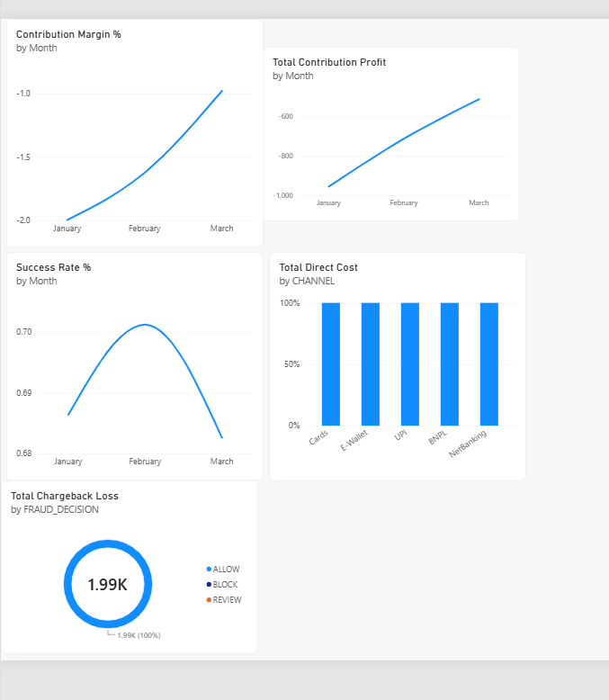
TASK 7 · VISUALISE
Power BI executive dashboard
Nine KPI cards over five visuals — every ratio is a division of two additive measures, so it recomputes at any filter
Contribution margin % by month
−2.0 in Jan → −1.0 in Mar. Improving, still negative throughout.
Contribution profit by month
$1.99K
About −$1,000 in Jan → about −$600 in Mar. The loss is narrowing, not reversing.
Success rate % by month
Peaks just over 0.70 in Feb, falls back to 0.68 in March.
Direct cost by channel
100% UNDER ‘ALLOW’
Cards, E-Wallet, UPI, BNPL, NetBanking — cost evenly spread; no single channel is the culprit.
The donut to hold on: every dispute came from a transaction the engine passed. The dashboard restates Task 6 without anyone running a query.
Visual walkthrough as described in the report
ASTRAPAY // MARGIN RESCUE
23

Slide 24
CROSS-READ
Same question. 500 rows vs 260,287 rows.
A parallel 12-month AstraPay analysis — where both agree, the finding is structural, not sample noise
 | This analysis (Eswar) | Parallel analysis (Junaid)
Sample | 500 attempts · 3 months · 7 routes | 260,287 attempts · 12 months · 3 providers
Contribution / successful txn | Negative throughout; −$2.18K total | Positive but falling: $1.620 → $1.089 (−32.8%)
Largest cost line | Chargeback & fraud loss — 54.81% of direct cost | Merchant revenue per txn: −$0.744 of a −$0.533 move
Fraud verdict | Under-catching — 100% of disputes from ALLOW | Not a driver — apparent spike was a score-scale artefact
Routing verdict | 6 of 7 routes commercially mismatched | Drift onto highest fixed-fee rail: −$0.10 / txn
Method | Snowflake SQL · CTE pre-aggregation · reconciliation | Exact mix / within decomposition, residual zero
WHERE THEY AGREE
Routing is a confirmed driver in both — and both disprove the loudest theory in the room.
WHERE THEY DIVERGE
Fraud dominates here, not there — 3DS coverage and route mix differ. Act on what holds in both; test the rest first.
ASTRAPAY // MARGIN RESCUE
24

Slide 25
EXECUTIVE NARRATIVE
The three-minute version
Situation → Complication → Question → Answer
S
C
Q
A
▶
▶
▶
SITUATION
COMPLICATION
QUESTION
ANSWER
AstraPay held a baseline net contribution profit of −$3,768.25 while continuing to grow gross volume.
Profit then fell a further −$1,568.23 to −$5,336.48 — with volume stable. A structural margin break, not a sales drop.
Which operational and commercial failures drove the collapse, and which interventions reverse it?
A −$1,744.25 hit in UAE Retail from a +$1,548.63 chargeback surge, plus routing rules pushing traffic into high-fee routes 0281 & 1334. Fix: mandatory 3DS + margin-aware failover.
ASTRAPAY // MARGIN RESCUE
25

Slide 26
TASK 8 · ACT
The 60-day turn-around plan
Ordered by speed to a measurable effect — each with an owner and a proof metric
D0
D10
D20
D30
D40
D50
D60
1
Mandatory 3DS on UAE Retail
Days 1–20
Risk Head · chargeback % of direct cost (UAE Retail)
2
Failover routing bypasses 0281 & 1334
Days 1–25
Head of Payments · net profit per route; volume on mismatched routes
3
Renegotiate / exit 3 highest-fee card routes
Days 10–60
CFO / Commercial · effective route cost rate (bps)
4
Normalise risk_score, re-baseline thresholds
Days 5–30
Data Head / Risk · % fraud rows outside 0.0–1.0
5
Quarantine pipeline defects (IDs, settlements, FX)
Days 15–45
Data Head · Data Discrepancy Index; recon residual
DAY-60 TEST Chargebacks < 40% of direct cost AND ≥ 3 of 6 mismatched routes back in profit. If neither moves, reopen the commercial-pricing hypothesis.
ASTRAPAY // MARGIN RESCUE
26

Slide 27

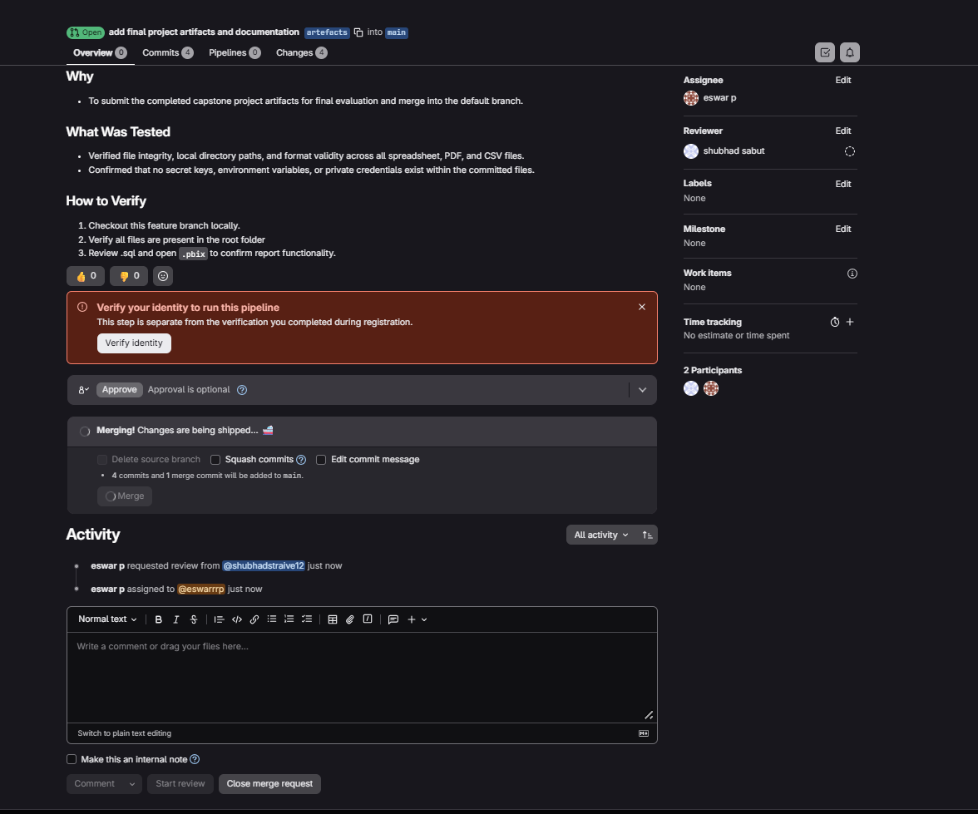
TASK 8 · ACT
Governance — and what's still open
Shipped through a reviewed merge request; open items named so nobody finds them in week three
OPEN BEFORE SIGN-OFF
DELIBERATELY NOT CONCLUDED
GITLAB MERGE REQUEST
Row counts disagree
Latency → margin
Load check shows 166 TRANSACTION rows; analysis uses 500.
70.06% vs 68.66% conversion — a GPV risk, not a proven margin driver.
Period labels disagree
Price elasticity
Warehouse is Jan–Mar 2024; narrative cites Jan–Feb 2026.
No historical price change in the data to estimate merchant response.
Routes 0281 / 1334 unmapped
Full merchant P&L
Named in the diagnosis, absent from the route table.
Servicing cost is out of scope — no merchant can be called unprofitable overall.
Feature branch → main · named assignee & reviewer · no secrets committed
ASTRAPAY // MARGIN RESCUE
27

Slide 28
THE COST PROBLEM
AND THE FRAUD PROBLEM
ARE THE SAME PROBLEM.
55%
6 / 7
2
of direct cost is chargebacks — all from ALLOWed txns
routes lose money; DBS PayNow is the template
moves cover both halves: mandatory 3DS + margin-aware failover
Neither requires new data. Both are measurable inside 60 days.
ASTRAPAY // MARGIN RESCUE
28

