Slide 1



HR_Analytics_Dashboard
View in Power BI
Last data refresh:
20/05/2023 07:18:42 UTC
Downloaded at:
20/05/2023 07:25:12 UTC

Slide 2
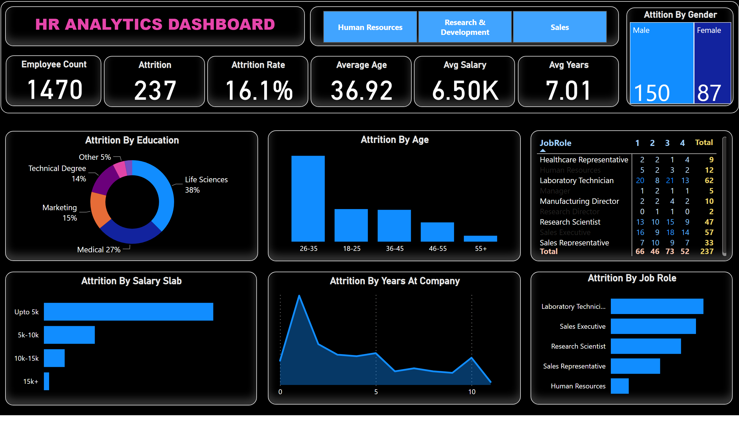
Attrition
Notes:
Attrition By Education
No alt text provided
Attrition By Age
No alt text provided
pivotTable
No alt text provided
Attrition By Salary Slab
No alt text provided
Attrition By Years At Company
No alt text provided
Attrition By Job Role
No alt text provided
textbox
No alt text provided
slicer
No alt text provided
Attition By Gender
No alt text provided
Avg Years
No alt text provided
Avg Salary
No alt text provided
Average Age
No alt text provided
Attrition Rate
No alt text provided
Attrition
No alt text provided
Employee Count
No alt text provided
shape
No alt text provided

