Slide 1



What is Lie Detection?
Understanding the science of deception through micro-expressions
Definition
Lie detection involves identifying deceptive behavior by analyzing subtle facial micro-expressions.
Micro-expressions
Involuntary facial movements lasting <0.5s that reveal genuine emotions, often betraying deception.
Detection Modalities
Uses video analysis, facial landmarks, and temporal modeling to distinguish truth from deception.
Notes:
Lie detection isn't just for interrogations—it's a multidisciplinary domain combining psychology, computer vision, and machine learning. At its core, it's about analyzing the smallest clues: micro-expressions. These are fleeting facial expressions that last less than half a second and are almost impossible to fake or control consciously.
Detecting lies through these expressions allows us to peer into a person's true emotions, offering a powerful tool for law enforcement, security, and even corporate settings. While traditional polygraphs rely on physiological responses, facial micro-expressions provide a non-invasive, behavior-based method of deception detection.
The field has seen a significant boost with advances in machine learning, enabling systems to process video frames and recognize patterns that the human eye might miss. This presentation explores our novel approach to enhance lie detection accuracy using deep learning and vision transformers.

Slide 2

Why is Lie Detection Important?
Critical applications across high-stakes domains
Legal Testimony: Ensures credibility in courtrooms by analyzing suspect and witness expressions.
Border Security: Enhances screening by identifying deceptive behavior during immigration checks.
Corporate Integrity: Used in high-stakes interviews and fraud investigations to verify honesty.
Photo by David Veksler on Unsplash
Notes:
Lie detection technologies are increasingly vital across domains where truth has significant implications. In the legal system, micro-expression analysis provides an additional layer of scrutiny during testimony, helping courts evaluate the credibility of defendants and witnesses.
At border security and customs checkpoints, non-invasive real-time analysis of facial expressions can flag suspicious behavior. This supports human officers in identifying deception without physical intervention.
Corporates are also adopting these techniques during high-stakes hiring, internal investigations, and compliance checks. In each case, automated lie detection tools act as decision support systems, providing objective cues that complement human judgment.

Slide 3

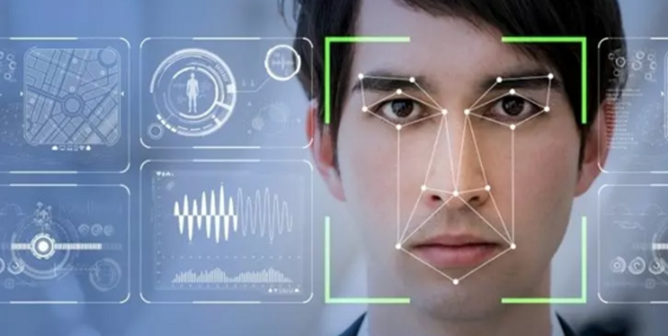
Art of Detecting Lies

Slide 4
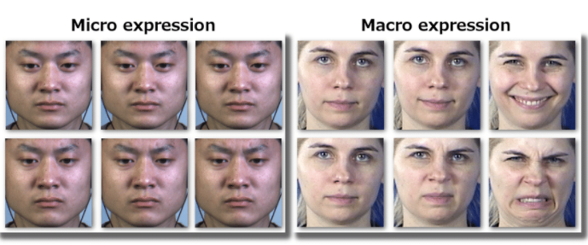
Macro vs Micro Expressions

Slide 5



Datasets for Lie Detection
Real-world and benchmark sources for training and evaluation
Real-Life Court Trials
High-stakes, low-quality video data with authentic deception scenarios.
Silesian Dataset
High-quality, low-stakes facial micro-expression dataset ideal for training.
Data Diversity Challenge
Combining varied quality datasets necessitates robust model generalization.
Notes:
The backbone of any machine learning system is data—and in lie detection, acquiring reliable, labeled datasets is uniquely challenging. Our research utilizes two contrasting datasets: real-life court trial videos and the Silesian micro-expression dataset.
Courtroom footage is invaluable for its authenticity. These clips, often recorded in poor lighting and resolution, depict real human emotions under legal pressure. However, their low quality presents significant pre-processing and modeling challenges.
On the other hand, the Silesian dataset, collected in controlled environments, offers high-resolution imagery and precise annotations, but lacks the high-stakes realism. Balancing these datasets allows us to train models that generalize across domains and perform robustly in both simulated and practical scenarios.

Slide 6



Base Architecture: LSTM + Action Units
Leveraging temporal dynamics and facial muscle coding
LSTM Network
End-to-end temporal model capturing micro-expression dynamics across video frames.
Facial Action Units
Facial muscle movements (AUs) serve as interpretable features derived from expert systems.
Integration Pipeline
Pre-extracted AUs feed into LSTM, enabling time-sensitive classification of deception.
Notes:
The baseline approach in our research is built upon a combination of two powerful elements: Long Short-Term Memory (LSTM) networks and facial Action Units (AUs). LSTMs are recurrent neural networks tailored for sequence data. They're ideal for modeling temporal patterns in video sequences, particularly for micro-expressions that unfold over time.
On the feature side, AUs provide structured, interpretable cues about facial muscle movements. These are extracted using pre-trained models, acting as a bridge between raw visual data and psychological indicators of deception. AUs such as AU12 (lip corner puller) and AU4 (brow lowerer) are especially diagnostic.
This combination—feeding AU time series into an LSTM—forms a strong baseline architecture. However, the two-step nature (feature extraction then learning) creates a bottleneck, motivating our exploration of end-to-end transformer models. Let's next look at how we expanded this baseline using ensemble LSTMs.

Slide 7


Our Approach: Ensemble LSTM
Stacking, bagging, and boosting for robust deception detection
Stacked LSTMs
Deep sequential layers increase representational power over complex temporal patterns.
Bagging Strategy
Training multiple LSTM instances on bootstrapped datasets to reduce variance.
Boosting Integration
Sequential model tuning to emphasize misclassified deception patterns.
Notes:
We extended the base LSTM+AU architecture using ensemble learning techniques—specifically, stacking, bagging, and boosting—to enhance performance and generalizability.
Stacked LSTMs involve layering multiple LSTM blocks, allowing the model to learn deeper and more nuanced temporal dependencies. This depth improves sensitivity to subtle temporal cues in facial expressions. Bagging then comes into play by training multiple such models on bootstrapped subsets of the data. This reduces overfitting and increases stability, especially important given the variability in video quality and expression intensity.
Lastly, boosting is used to sequentially refine model weights based on classification errors. By focusing on hard-to-classify instances, the ensemble becomes more precise in identifying deceptive behavior. Collectively, these methods outperform single-model baselines on both real and synthetic datasets.

Slide 8


Vision Transformers for Deception Detection
End-to-end spatio-temporal modeling with K600 and custom MLP head
End-to-End Architecture
Directly models video frames using ViTs, bypassing manual feature extraction.
K600 Pretraining
Meta’s Kinetics-600 provides rich video representation learning for spatio-temporal data.
Custom MLP Head
We fine-tuned a Multi-Layer Perceptron head on top of ViT outputs to classify truth vs. deception.
Notes:
Expanding on our transformer-based approach, we utilize a Vision Transformer (ViT) architecture pre-trained on Meta’s Kinetics-600 (K600) dataset. This extensive pretraining enables our model to capture intricate spatio-temporal facial patterns essential for micro-expression analysis.
Instead of relying on intermediate features like Action Units, our method feeds raw video frames into a ViT backbone. On top of this, we developed a custom Multi-Layer Perceptron (MLP) head tailored for binary classification of deceptive vs. truthful expressions. This MLP head is fine-tuned specifically on our dataset, allowing the model to adapt its representations to the unique patterns of human deception.
This end-to-end setup dramatically reduces feature engineering overhead and leverages the hierarchical feature extraction capacity of transformers, leading to improved accuracy and robustness in real-world applications.

Slide 9

Conclusion & Future Work
Toward smarter, scalable lie detection systems
Summary of Findings: Transformer models outperform traditional LSTM-based architectures in spatio-temporal learning.
Real-World Deployment: Future systems must adapt to varied video quality and diverse deception contexts.
Research Roadmap: Focus on model generalization, multimodal fusion, and ethical considerations.
Photo by Paul Frenzel on Unsplash
Notes:
In summary, our study demonstrates that Vision Transformers, particularly when combined with robust pretraining on Kinetics-600 and fine-tuned MLP heads, significantly outperform conventional LSTM-based approaches in micro-expression based lie detection.
However, transitioning from controlled experiments to real-world deployment remains a key challenge. Future systems must handle variability in video quality, cultural diversity in expressions, and nuanced contexts of deception.
Our next steps include enhancing model generalization across datasets, integrating multimodal signals (voice, gaze), and rigorously addressing privacy and ethical implications. With continued progress, AI-powered deception detection could revolutionize security, legal, and organizational decision-making frameworks.

