Slide 1
Secure VPN Management System
Certificate-based OpenVPN with Admin Panel & Threat Monitoring
Presented By - Jyoti Prakash
Ujjwal Agarwal
Ashay Sonak
Riyansh Sachan

Slide 2
Overview
Topics We’ll Be Covering In This Presentation
Objectives
Tools & Technologies Used
System Architecture
Workflow Overview
Admin Panel Features
Client Panel Features
TLS Session Monitoring
Snort Panel features
Security Considerations
Challenges & Learnings
Real-World Use Cases
Conclusion & Future Scope

Slide 3
Objectives
Establish a secure VPN using OpenVPN with certificate-based client authentication
Implement an internal Certificate Authority (CA) for issuing and managing certificates
Enable admin control over certificate lifecycle: request, sign, revoke
Provide a user-friendly web interface for both clients and admin
Integrate Snort IDS for real-time monitoring of VPN traffic and client activity
Ensure encrypted communication within the VPN using TLS and secure ciphers

Slide 4
Tools and Technologies Used
OpenVPN
Easy-RSA
Flask (Python)
Core VPN software; creates secure tunnels between client and server using TLS and certificatesOpenVPN
CLI utility for managing certificate creation, signing, and revocation; used to build CA and issue certs.
Web framework for building client and admin UI; handles HTTP requests and integrates system commands.
Snort IDS
Bootstrap
systemd
Monitors VPN traffic in real-time to detect suspicious activity or intrusion attempts.
Provides responsive styling for Flask UI, improving layout, accessibility, and user experience.
Manages OpenVPN service lifecycle (start/stop/restart) via systemctl on Linux.

Slide 5
Tools and Technologies Used
Bash (Shell scripting)
Jinja2
HTML/CSS/JS
Used for system-level tasks such as key generation, OpenVPN service management, file handling, and executing Easy-RSA scripts through subprocess.
Flask templating engine; dynamically renders HTML pages using backend-passed data.
Used in the frontend to design, style, and enhance interactivity of web pages.
Python subprocess
tcpdump
net-tools / iproute2
Executes shell commands (e.g., Easy-RSA scripts, OpenVPN commands) from Flask backend securely.
Network packet analyzer; helps verify OpenVPN traffic during testing and debugging.
Provides commands like ifconfig, ip, and netstat to monitor routes and interfaces.

Slide 6
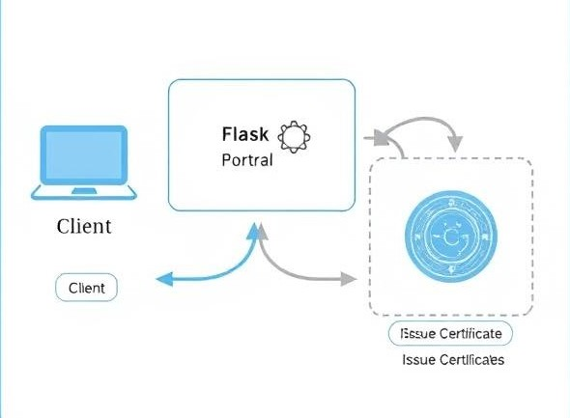
System Architecture
Clients generate CSR using Flask UI
Admin signs certificates using internal CA
Signed certificates sent back to client
UI provides easy access for both client and admin
All certificate lifecycle managed centrally

Slide 7
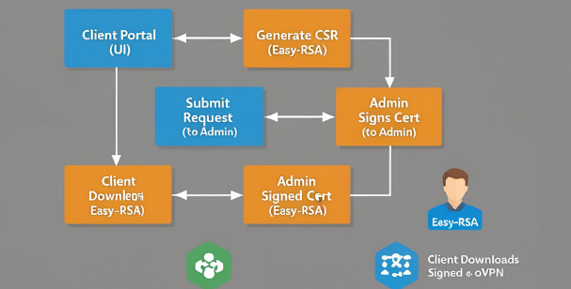
Workflow Overview
Client initiates certificate request via web UI
Flask backend calls Easy-RSA to generate CSR
Admin reviews and signs request using internal CA
Signed certificate is generated and stored
Client downloads ready-to-use .ovpn file

Slide 8
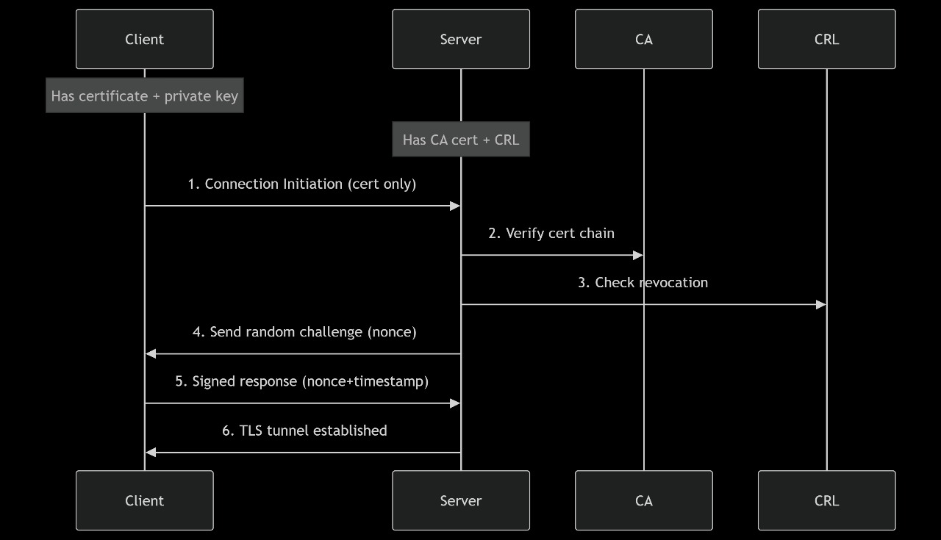
Workflow Overview
Client connects using signed certificate
TLS handshake authenticates identity
Encrypted VPN tunnel established securely
Snort IDS monitors VPN traffic for threats
Logs & alerts are shown in admin UI

Slide 9
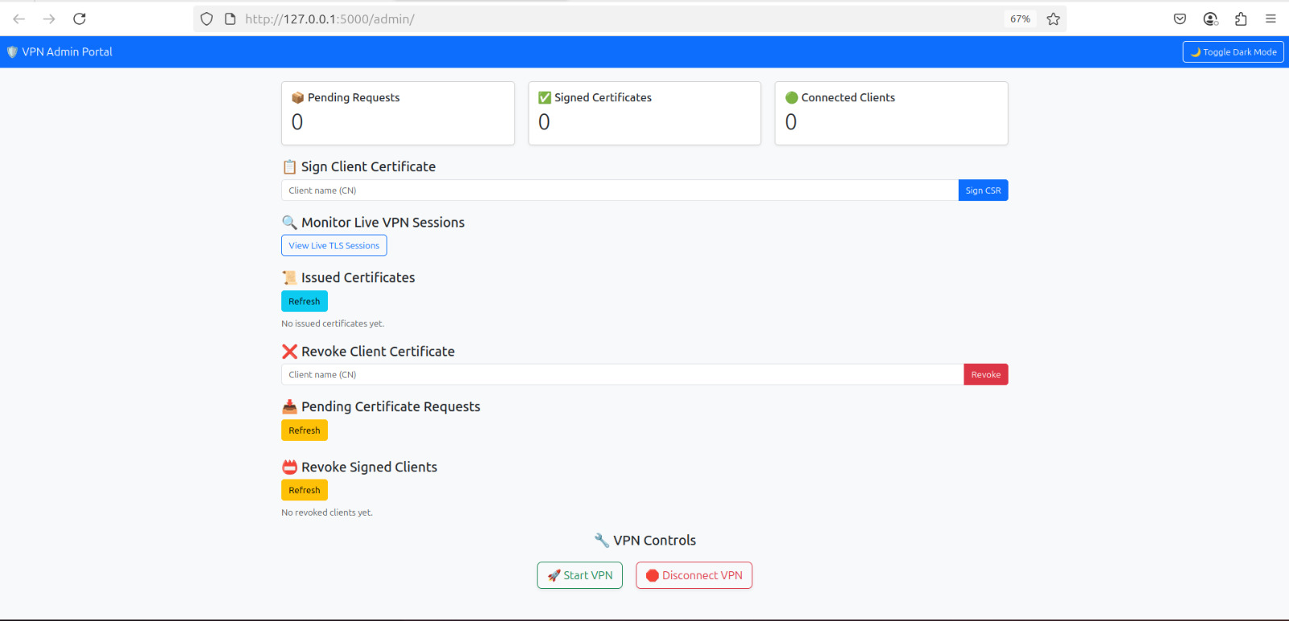
Admin Panel Features

Slide 10
Admin Panel Features
The Admin Portal serves as the centralized control panel for managing all critical VPN operations securely and efficiently. Built using Flask and Bootstrap, it offers the following core functionalities:
View & Sign Certificate Requests Easily review pending CSRs (Certificate Signing Requests) and sign them with the CA's private key using Easy-RSA tools.
Revoke Client Certificates Administrators can revoke any issued certificate with a single action to immediately cut off client access.
Download Signed Certificates Automatically generate and deliver certificate files for verified clients.
Monitor Live VPN Sessions Real-time session tracking with detailed TLS connection info, client IPs, cipher suites, and handshake status.
Monitor Threats via Snort IDS Integrated threat monitoring through log analysis powered by Snort to detect anomalies and suspicious activity.
This portal empowers the admin to control the certificate lifecycle, enforce policy, and monitor the network — all through a clean web UI.

Slide 11
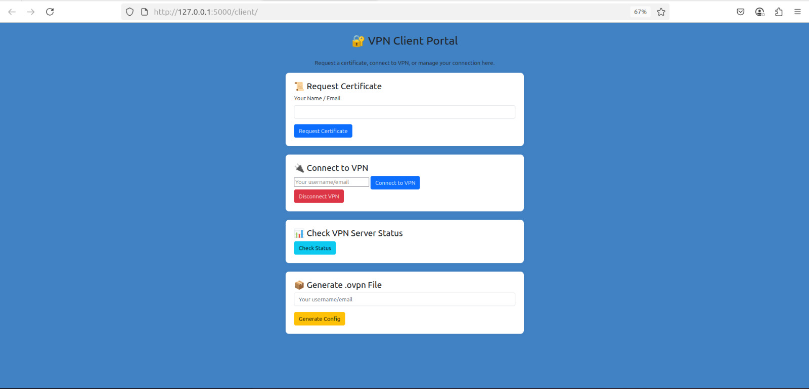
Client Panel Features

Slide 12
Client Panel Features
The Client Portal provides a user-friendly interface for end users to securely connect to the VPN. Built using Flask and Bootstrap, this portal enables:
Request Certificate Users can initiate a Certificate Signing Request (CSR) by providing their Common Name (typically email/username). The admin then reviews and signs it.
Connect to VPN Once the signed certificate is obtained, the user can initiate a secure VPN connection using OpenVPN in the backend.
Check VPN Server Status Displays whether the client is currently connected, based on real-time parsing of the OpenVPN status file.
Generate .ovpn File Automatically creates a ready-to-use OpenVPN configuration file (.ovpn) including embedded certificates and keys.
This portal simplifies the VPN onboarding process and empowers non-technical users to manage secure connectivity with ease.

Slide 13
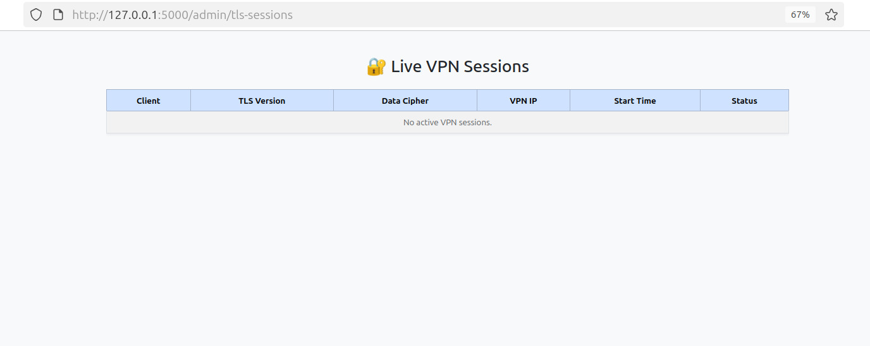
TLS Session Monitoring

Slide 14
TLS Session Monitoring
The TLS Session Monitoring interface allows the VPN administrator to track active VPN connections in real-time. It provides an at-a-glance view of all connected clients and their cryptographic session details. The table displays the following key columns:
Client Common Name (CN) of the connected user.
TLS Version TLS protocol version used in the control channel (e.g., TLSv1.3).
Data Cipher Symmetric cipher negotiated for the data channel (e.g., AES-256-GCM).
VPN IP Virtual IP address assigned to the client (e.g., 10.8.0.6).
Start Time Timestamp indicating when the session was established.
Status Indicates if the client is currently active or disconnected.
This live session table is dynamically updated by parsing OpenVPN’s status log and offers visibility into security posture, connection health, and session duration—making it vital for VPN operations and auditing.

Slide 15
Challenges & Learnings
• TLS/Certificate Errors - Faced issues with certificate signing, including missing CA passphrase prompts and improper client CSR generation from the UI.
• File Permission Conflicts - Permission denied while accessing `/run/openvpn/server.status` and generated files from Flask—required careful use of `sudo` and directory permissions.
• Understanding OpenVPN Internals - Had to deeply understand server logs, TLS handshake steps, and configuration file structure to debug issues like “cannot locate HMAC” and route conflicts.
• Route & Socket Bind Errors - Encountered "address already in use" due to overlapping server instances—learned about proper service management via `systemctl`.
• Learning Outcome - Gained strong hands-on with VPN concepts, OpenVPN internals, certificate lifecycle, Flask-based fullstack development, and log-based live monitoring.

Slide 16
Real-World Use Cases
• Remote Workforce Access - Enable employees to securely access internal company resources over public networks using certificate-authenticated VPN tunnels.
• Healthcare & Government - Secure communication between sensitive endpoints (e.g., hospitals, municipal offices) with admin-controlled certificate-based access.
• Developer/Tester VPN Access - Provide individual, time-bound VPN credentials to developers for accessing cloud infrastructure with minimal manual overhead.
• Education/Research Networks - Allow remote students and collaborators to securely join university networks via authenticated VPN with dynamic monitoring.
• Enhanced Security Architecture - Layered security with TLS, mutual certificate auth, and IDS (Snort) integration for intrusion detection in high-risk environments.

Slide 17
Conclusion and Future Scope
Conclusion -
• Successfully implemented a secure VPN solution using OpenVPN with certificate-based authentication.
• Developed a dual-portal web UI (Client & Admin) for certificate lifecycle management and VPN control.
• Integrated real-time session monitoring and Snort-based threat detection.
Future Enhancements
• Multi-user role-based access (e.g., admin assistants).
• Email-based certificate delivery & alerts.
• Snort alert dashboard integration for threat visualization.
• Integration with LDAP/Active Directory for larger deployments.
• Containerization for scalable and portable VPN infrastructure.

Slide 18
Thankyou!

