Slide 1
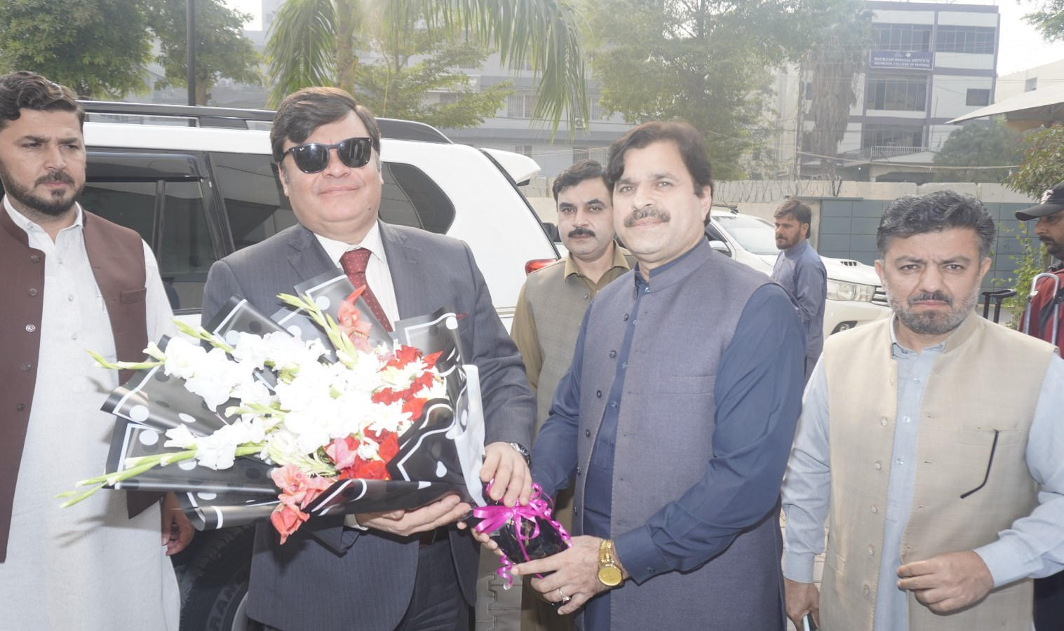
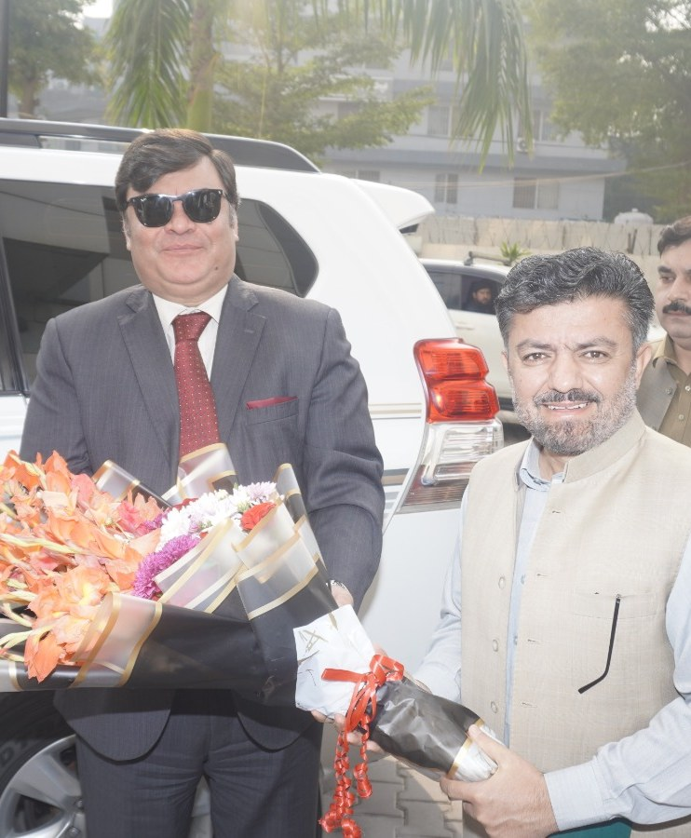
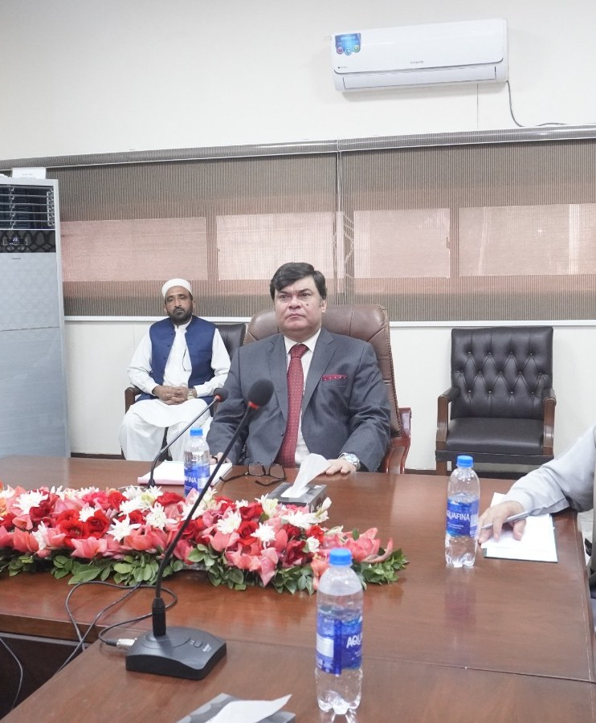
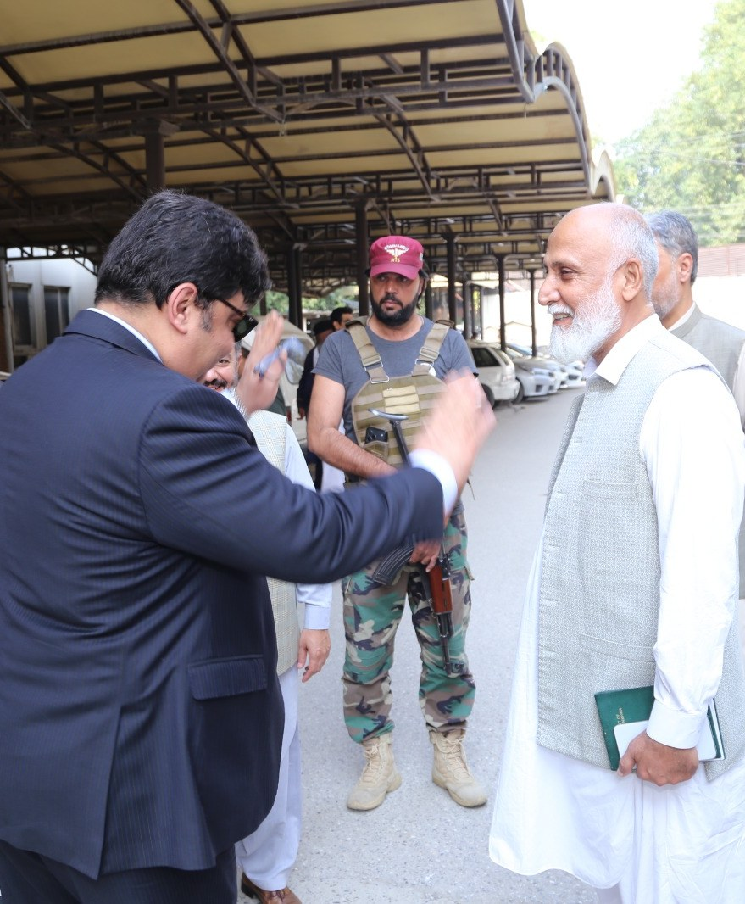
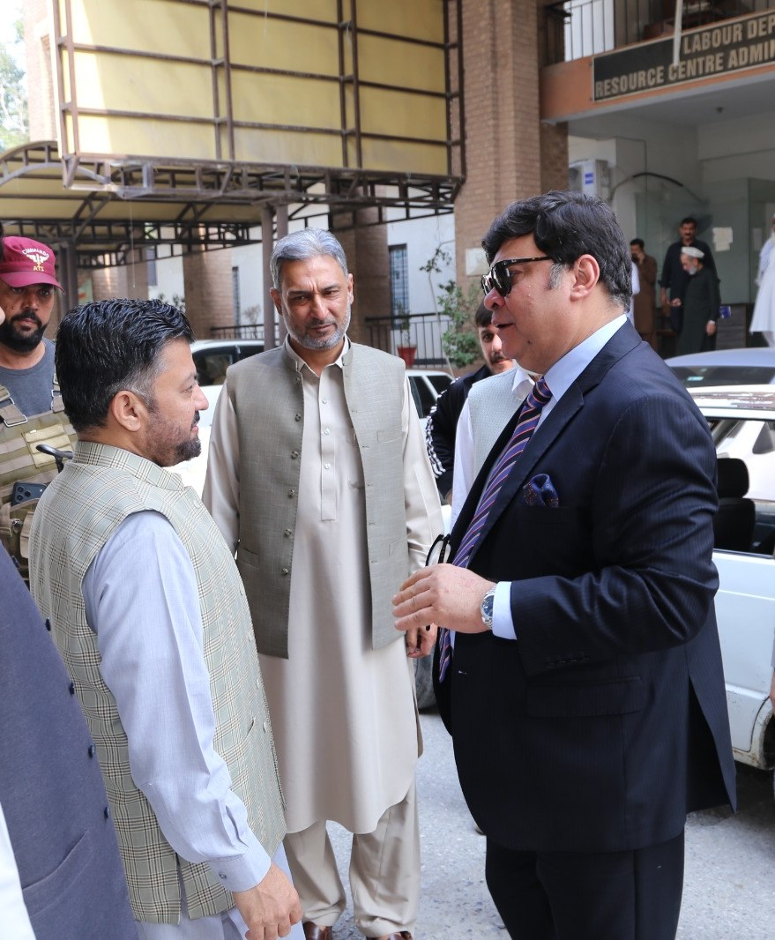
PHOTO REPORT
Field Visits & Inspections
Arrival, welcome and briefing, followed by on-site reviews of offices, workers’ colonies, schools and health facilities.
[Date] · [Location]
Notes:
Opening: the delegation is received with bouquets, exchanges greetings outside the department building and holds a briefing meeting before the tour begins.

Slide 2
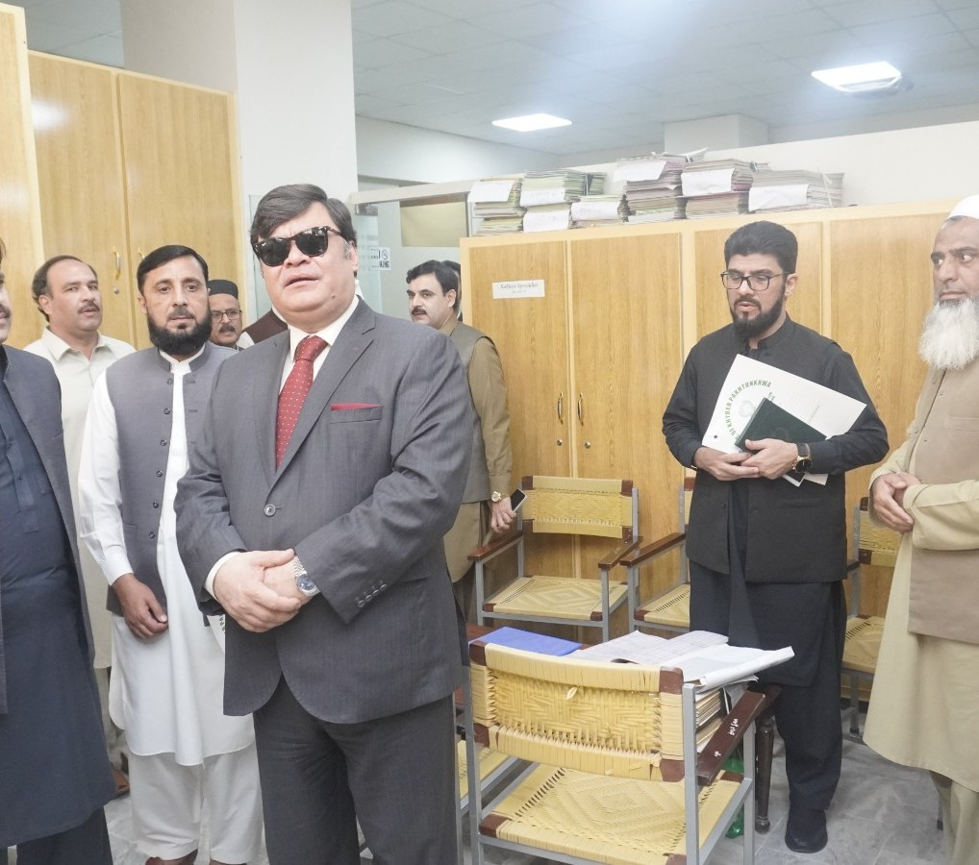
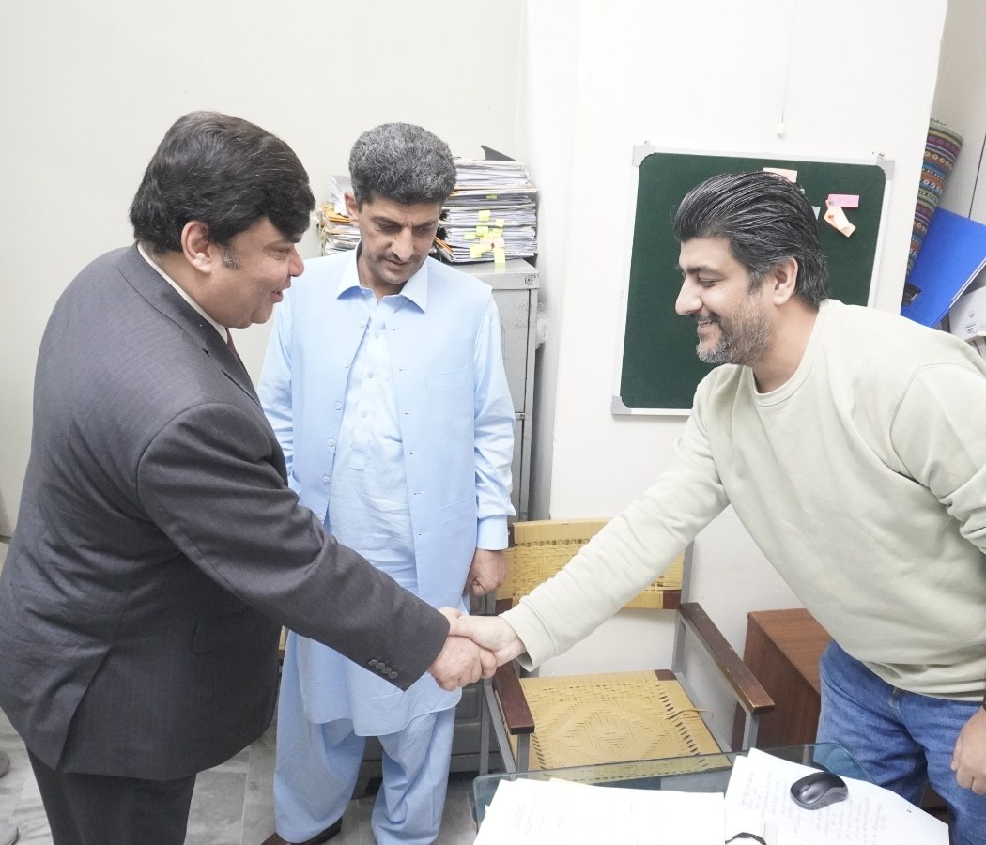
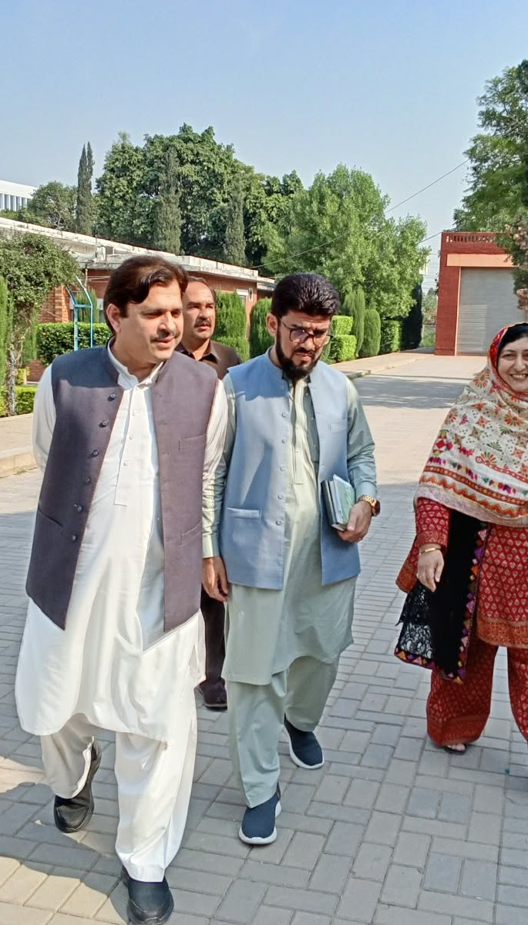
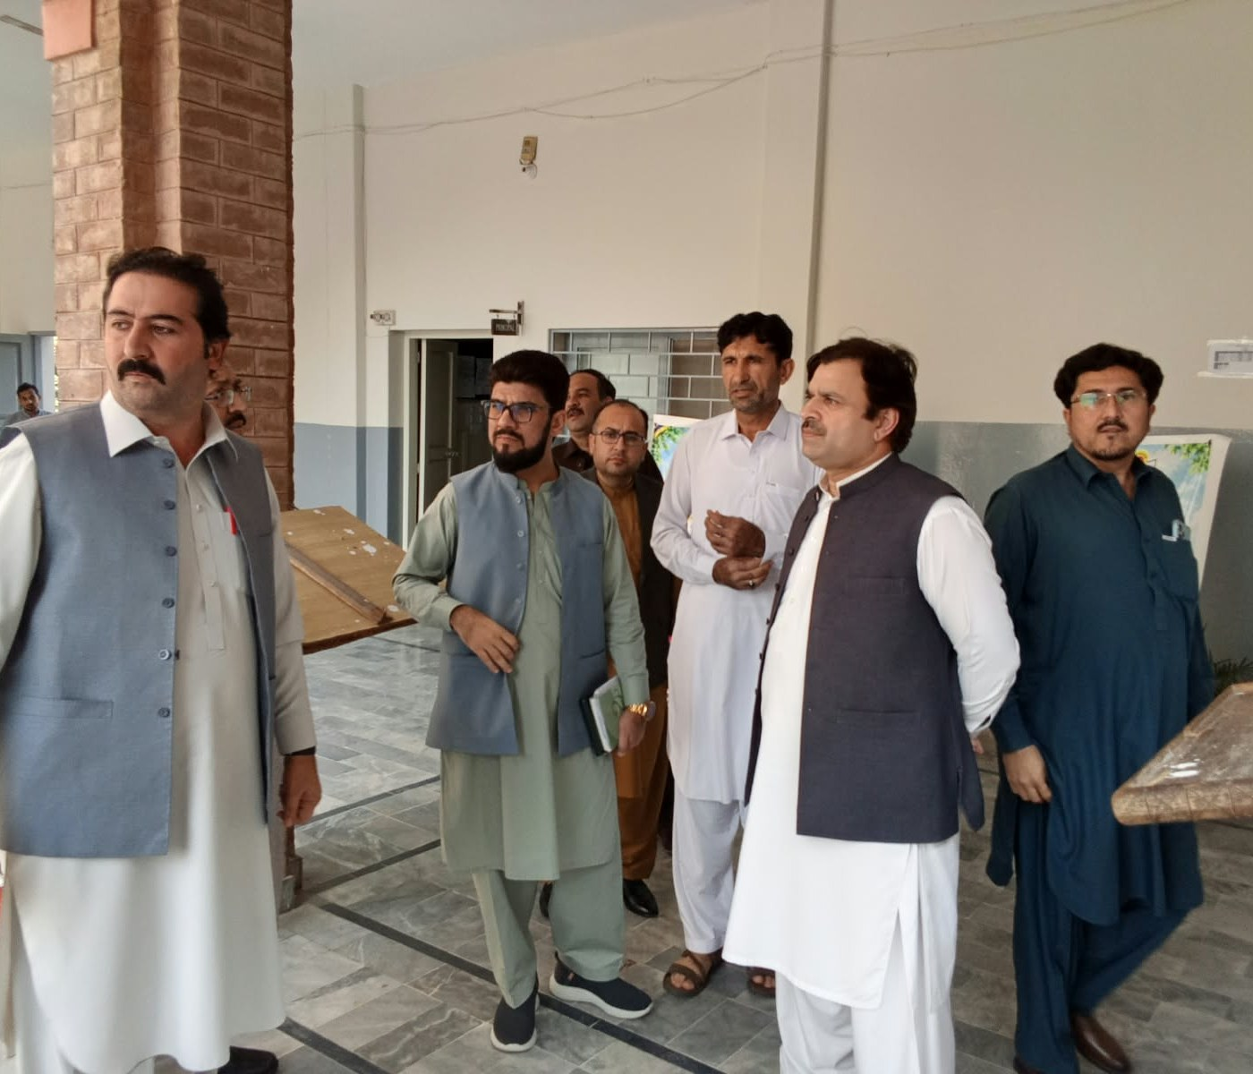
01 · OFFICES & INSTITUTIONS
Inspection of offices, records and campuses
Notes:
Inside the offices: records rooms, meetings with staff, and a walk through an educational campus and its main hall.

Slide 3
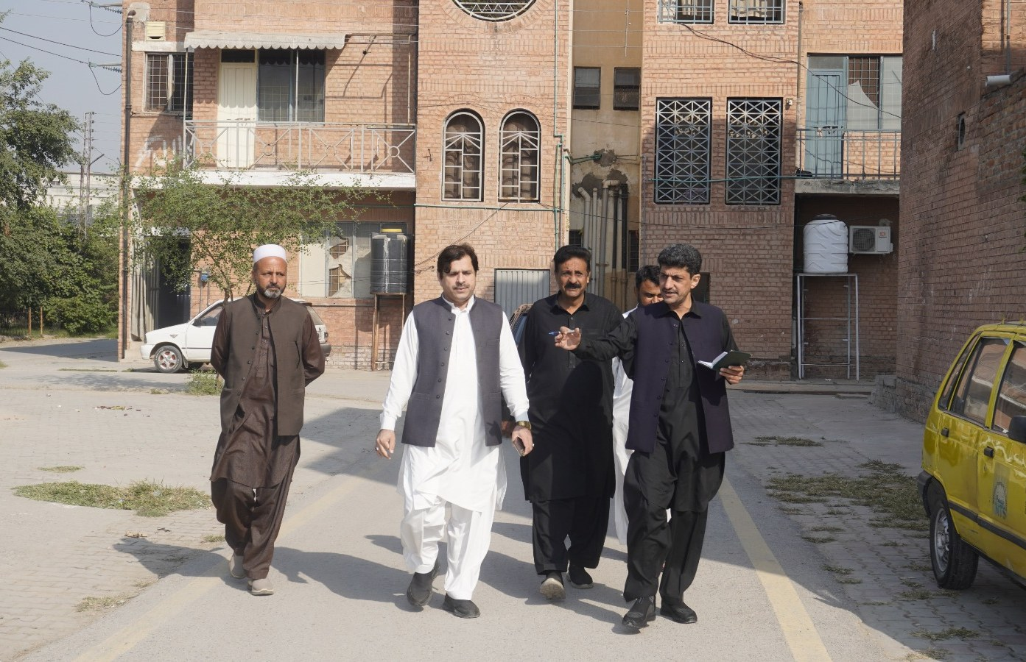
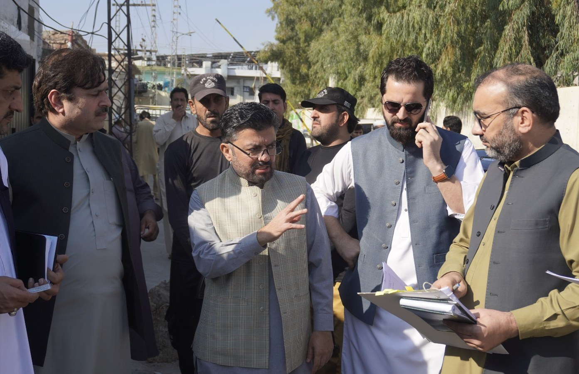
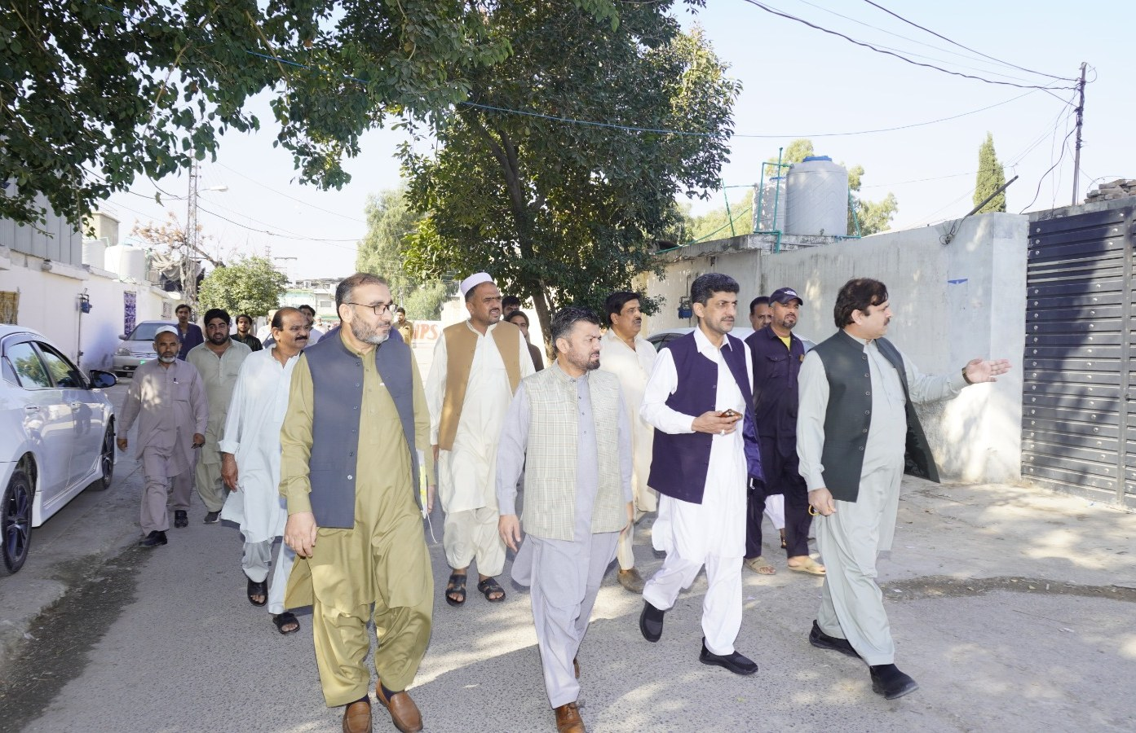
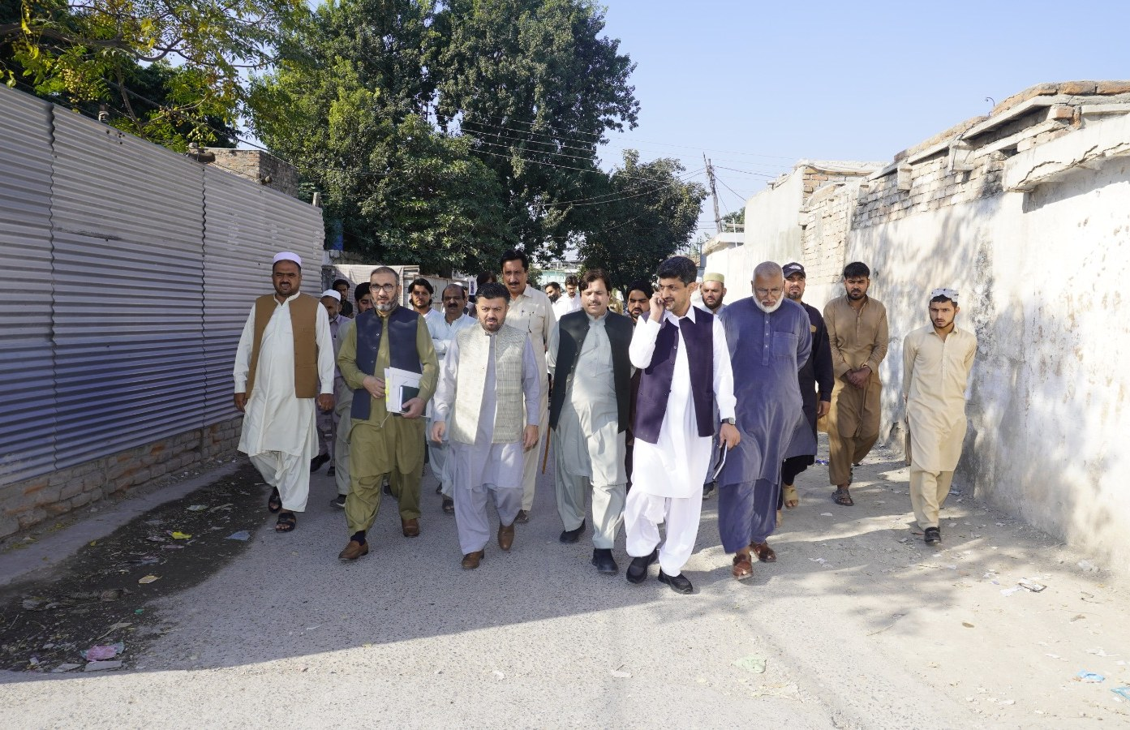
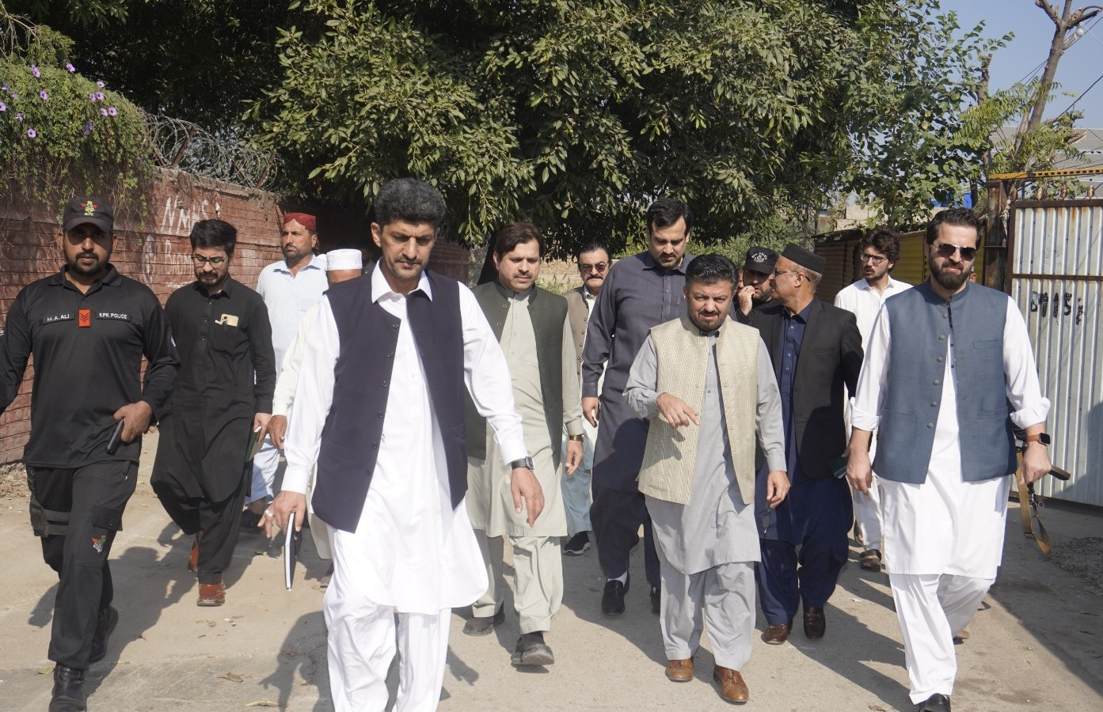
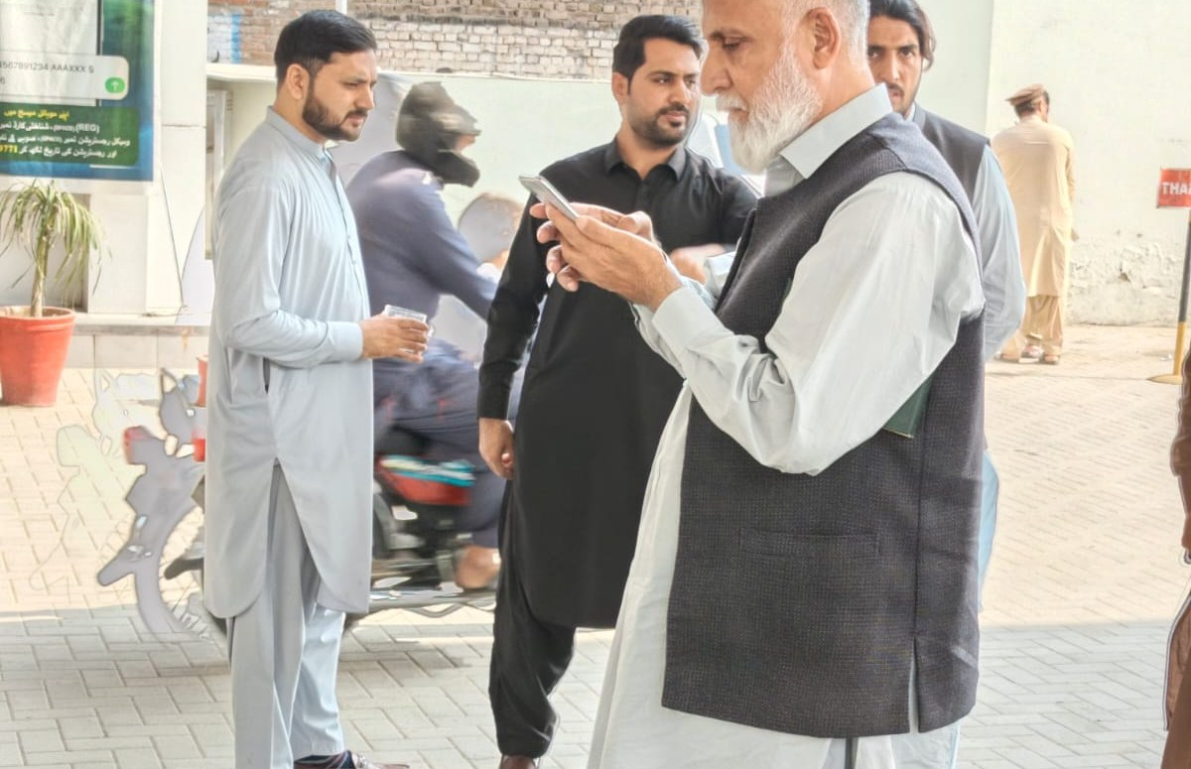
02 · ON THE GROUND
Field visits to workers’ colonies and streets
Notes:
Walk-throughs of workers’ colonies and surrounding streets to see living conditions and infrastructure first-hand.

Slide 4
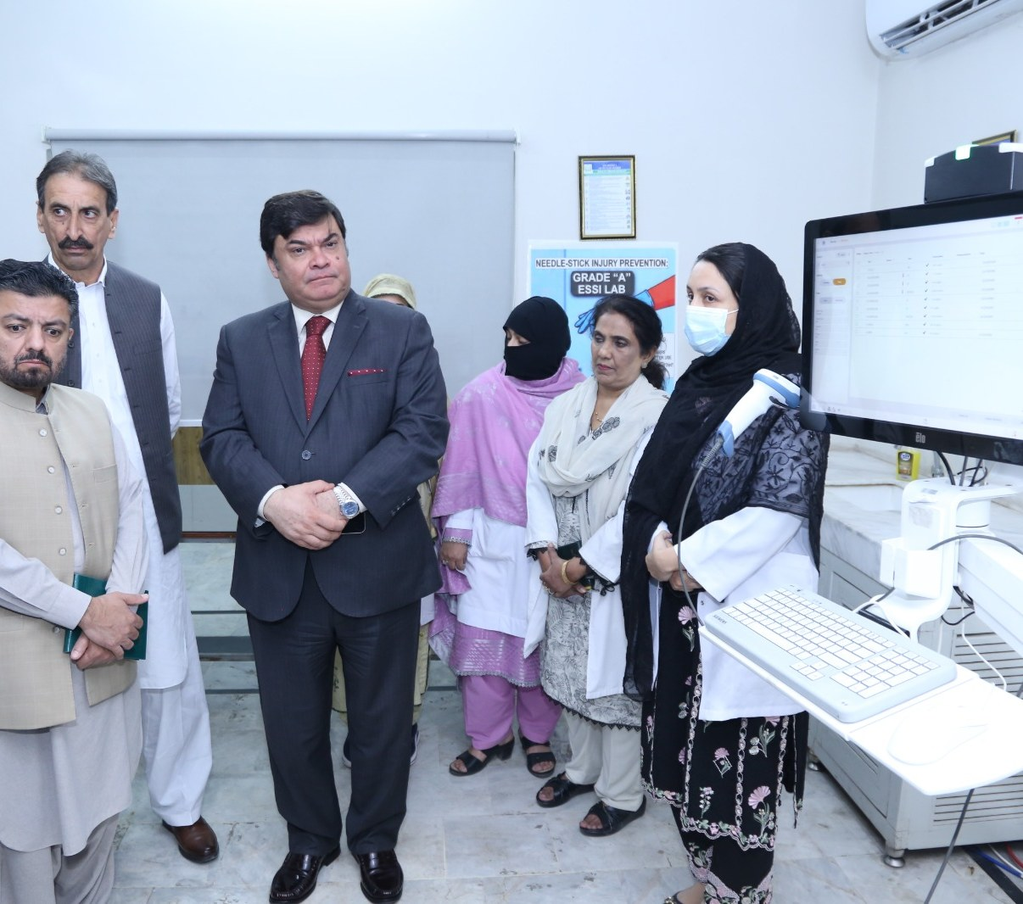
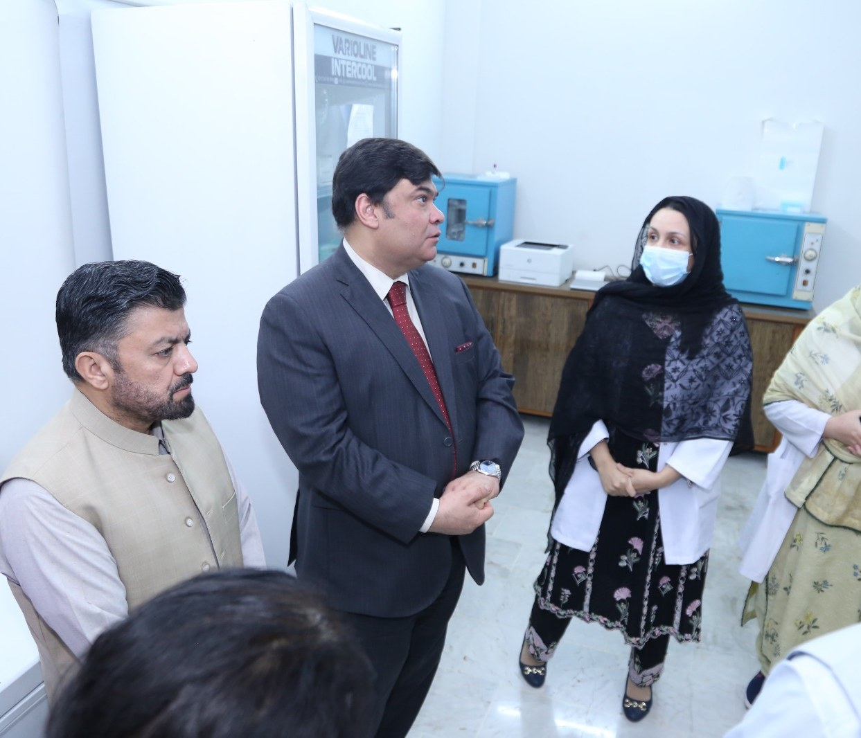
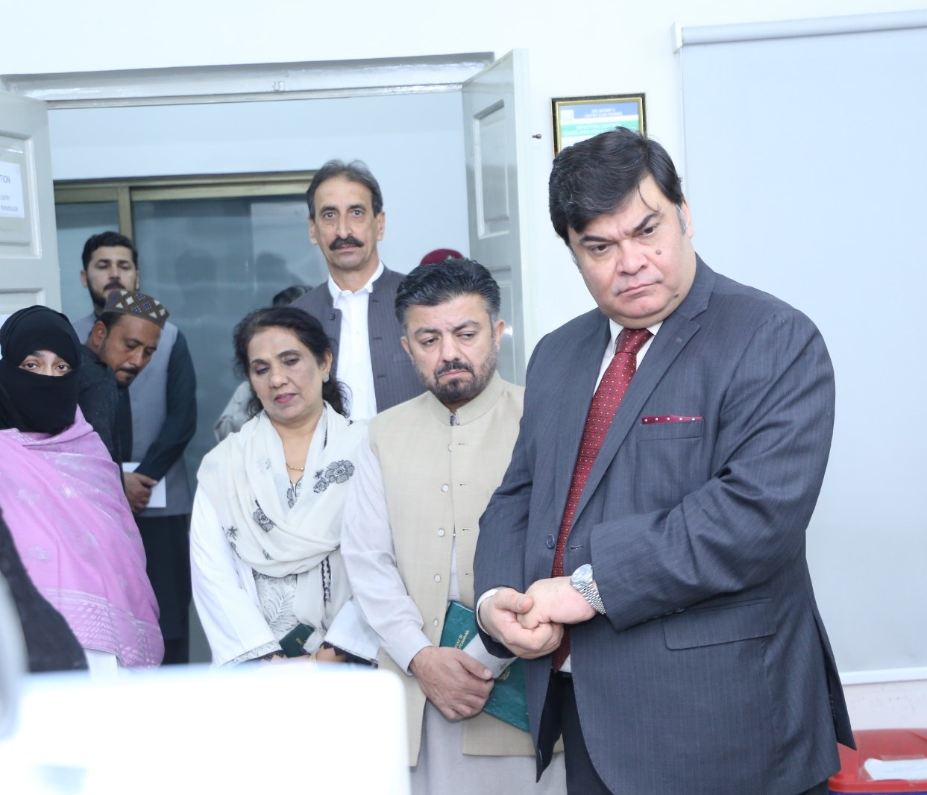
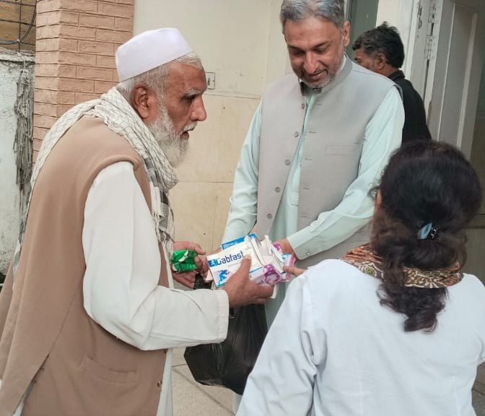
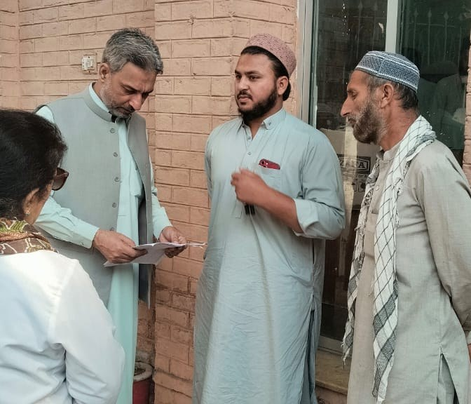
03 · HEALTH SERVICES
Review of the laboratory and dispensary
Notes:
Health facilities: the laboratory’s systems and equipment, followed by the dispensary where medicines were distributed and patient feedback heard.

