Slide 1
On page seo
Sahar andaleeb
Week # 03
On Page SEO
By: Sahar Andaleeb

Slide 2
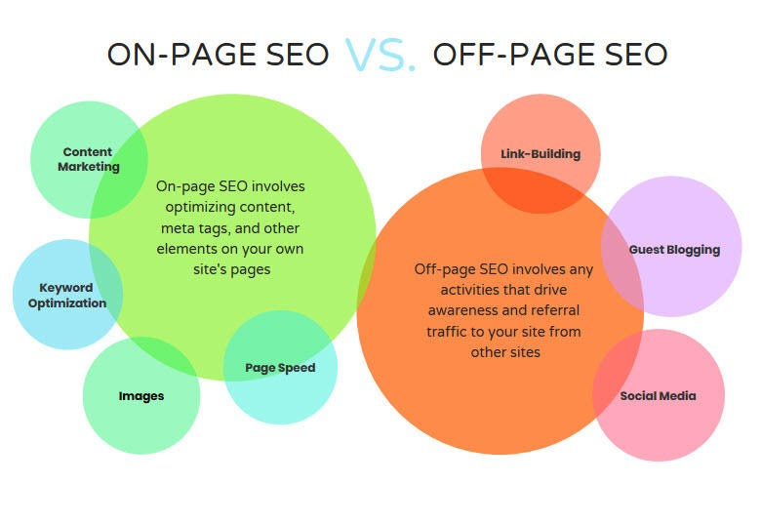
On page vs off page seo
On page SEO is the practice of optimizing directly on a website where as, off page SEO involves strategies performed outside the website to boost authority and visibility

Slide 3
On page
On Page SEO:
“On page SEO is the practice of optimizing elements on a website, for search engine and users, in order to rank higher in SERPs and derive more traffic.”
Also known as On Site SEO
To enhance individual page visibility and relevance

Slide 4
Success Factors of on-page SEO
Keyword Research
URL Optimization
Tags (title, header and meta)
Images and videos
Internal linking
Week # 03
On Page SEO
By: Sahar Andaleeb

Slide 5
What is Domain and hosting?
Domain:
“A domain is the unique address of a website on the internet.”
combination of letters, numbers, and hyphens
Allows visitors to find your website online.
Domains are purchased or registered from domain registrars, and they must be renewed periodically to maintain ownership.
Hosting:
“Hosting refers to the service that provide storage space for your website data.”
Web hosting providers offer various types of hosting plans, including shared hosting, dedicated hosting, and cloud hosting.
Hosting providers manage server maintenance, security, and technical support.

Slide 6
How are Domain and hosting related
When a website is created, it requires both a domain and hosting to be accessible on the internet.
The domain serves as the website's address, while hosting provides the infrastructure to store and serve the website's files and content.
Together, they form the foundation of a web address.

Slide 7
EMD
Exact Match Domain:

Slide 8
What is URL?
URL: (Uniform Resource Locator.)
“A URL is a specific type of web address that provides the complete location of a resource on the internet.”
Resources such as, web pages, images, videos, web applications, documents, forms, etc.
Clear Page Naming is very helpful for people who are trying to understand what a specific URL is about.
Page Organization: Avoid nesting pages under irrelevant folders.
How you name your pages, and in what folders you choose to organize your pages, is an important way to clarify the topic of your page to users and search engines.
Watch out for repeat keywords in different subfolders.

Slide 9
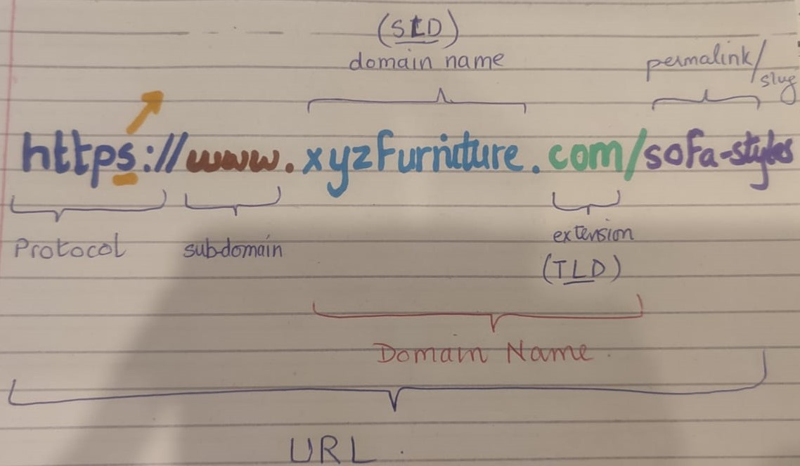
URL Structure

Slide 10
URL Structure … cont.
SLD: Second Level Domain
Unique name
TLD: Top Level Domain
Extension
SLD + TLD = Domain Name
http vs https
Secure
SSL (Secure Socket Layer)
TLDs play a crucial role in both the functionality and perception of a website.
Domain Classification: Indicates the type or category of a website
( .com, .org, .edu)
Geographical Indication: Identifies the country or region of the website
(.uk, .ca, .pk)
SEO Implications: Can influence search engine rankings based on relevance and trustworthiness associated with certain TLDs.
User Trust: Certain TLDs (like .gov or .edu) are often perceived as more trustworthy.

Slide 11
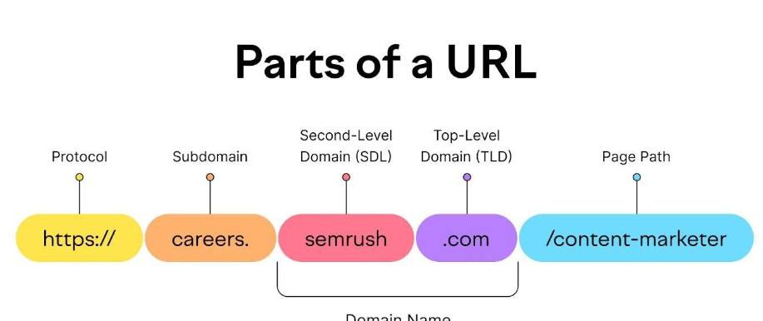
Url structure… Subdomain ?!
Subdomain: “A subdomain in a URL is a hierarchical component that precedes the main domain name and is separated by a dot.”
It allows the organization and structuring of content within a domain.
Subdomains can be used to create separate sections or branches of a website, each with its own unique content or functionality.
uk.example.com
support.example.com
store.example.com

Slide 12
Url structure… The www. Subdomain
"www" subdomain stands for "World Wide Web."
traditionally used as the default prefix for website addresses on the internet.
more of a convention rather than a requirement
"blog.xyz.com" and "www.xyz.com" are technically different subdomains.
Example:
google.com
Blog.google.com

Slide 13
URl
Relevant folders for site hierarchy & content relevancy
Keep folders shallow
Avoid repeat keywords in sub folders

Slide 14
URL Optimization
URLs help search engines to understand what the page is about.
Your URL should contain a keyword that you want your page to rank for.
Each page should have different URL, targeting relevant keywords for that page.
Similar keywords shouldn’t be used for different pages.
Factors for URL Optimization:
Use SEO-friendly URLs: SEO-friendly URLs are short, descriptive, and includes relevant keywords.
Use Hyphens In-Between Words: Use hyphens as “word separators” in your URL.
Underscores and spaces are discouraged by the Google.
https://backlinko.com/seo-site-audit

Slide 15
URL Optimization … cont.
Stick With Lowercase: Do Not Use all Capitals as it confuse search engines. here are two reasons for this:
Not all but some search engines are case-sensitive, so it is better to use lowercase letters
Avoid special characters: Stick to alphanumeric characters and hyphens to ensure compatibility across different platforms.
Be consistent: Maintain a consistent URL structure throughout your website for better organization and usability.
Keep it concise: Use short, descriptive URLs that convey the content of the page.

Slide 16
URL Optimization … cont.
Avoid dynamic parameters in URLs, as they can make indexing and ranking more difficult. Use human readable word instead.
Dynamic parameters in URLs refer to the query strings or parameters that are appended to the URL
https://example.com/products?category=electronics&page=2
Ugly URLs → Default page id by Google
www.xyzfurniture.com/page?id=1224
vs
Human Readable URLs
www.xyzfurniture.com/smart-tables
Avoid dates in URLs: Dates make your URLs longer. It also takes away the flexibility to update or repurpose content without changing the URL.

Slide 17
What are meta tags
“Meta tags are HTML elements that provide information about a webpage to search engines and website visitors.”
They are not visible on the webpage itself but are embedded within the HTML code.
Meta tags serve various purposes, from describing the content of a page to controlling how search engines index and display it in search results.
Title Tag: Defines the title of a webpage.
<title>XyzFurnitures | Smart-Minimal-Furniture</title>
Meta Description Tag: Provides brief summary of webpage content.
Influences users' decision to click through to the site.

Slide 18
Meta tags … cont.
<meta name="description" content=" Elevate your space with our collection of affordable minimalist furniture. Explore sleek designs for a modern, French-inspired aesthetic.">
Meta Keywords Tag:
Deprecated due to spamming
<meta name="keywords" content=“furniture, best minimal furniture, affordable furniture, minimal furniture">

Slide 19
Title tag optimization
Title tags optimization is crucial for improving the visibility and click-through rate of your web pages in SERPs.
Use the principle of keyword prominence
Keyword prominence means how noticeable and important a specific word or phrase is within a piece of content.
“Smart Minimal Furniture | Top 10 designs for a sleek home”
“Top 10 designs for a sleek home with modern furniture”
Relevance: Title should accurately reflect the content of the page which should also be aligned with the search intent of users.
Keyword Placement: Incorporate your target keywords naturally within the title tag.
Place the primary keyword closer to the beginning of the title for better visibility and relevance.

Slide 20
Title tag optimization .. Cont.
Length: Keep your title tag within 50-60 characters to prevent truncation in SERPs.
Unique Titles: Each page on your website should have a unique title tag.
Avoid Keyword Stuffing: Avoid overloading your title tag with keywords.
Hierarchy and Structure: Maintain a clear hierarchy and structure in your title tags.
Use separators like pipes (|) or dashes (-) to indicate different sections of the title.
Branding: A brand name mentioned in title can increase brand awareness and CTR.
Place your brand name wisely, considering other factors like brand recognition, search intent, and keyword placement.

Slide 21
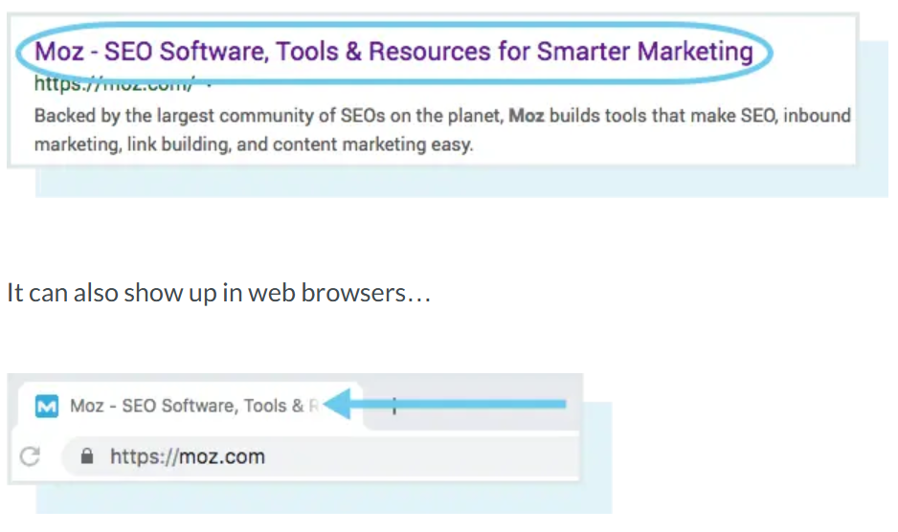
Title tags … cont.

Slide 22
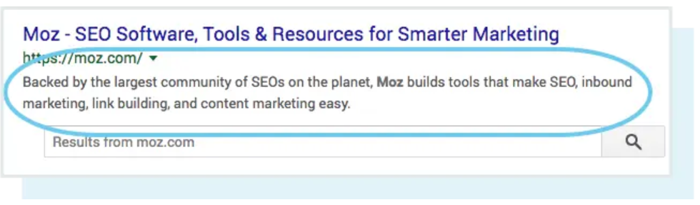
Meta Description?
“A meta description (also known as a “description tag”) is an HTML attribute designed to describe the content of a webpage.
Nested in head tag.
< meta name=”description” content=”This is meta description text” />
Meta description can lead to more clicks. → direct ranking factor.
Week # 03
On Page SEO
By: Sahar Andaleeb

Slide 23
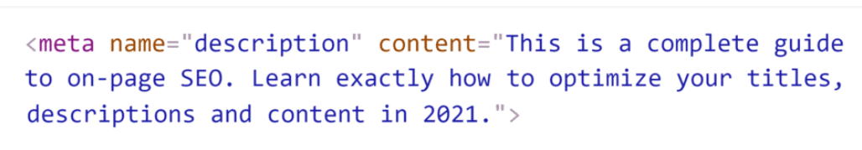
Meta tag optimization .. Cont.
Use Benefit-Driven Copy: Your meta description needs to clearly describe the BENEFIT someone will get from your page.
Stay Under 155 Characters: Google limits how much of your meta description tag they show in the SERPs.
Total characters allowed 300
Include Your Target Keywords in your meta description.
Relevance: Meta descriptions should be highly relevant to the content of your page.
Write Unique Meta Descriptions For Each Page
Week # 03
On Page SEO
By: Sahar Andaleeb

Slide 24
SEO content optimization
Copywriting vs Content writing
Copywriting primarily focuses on creating persuasive and compelling content with the intention of driving action, whereas, content writing is more about providing valuable information, entertainment, or education to the audience.
Keyword Density
“Keyword density is a measure of how frequently a specific keyword or phrase appears in a piece of content, relative to the total word count.”
It's often expressed as a percentage.
https://www.seoreviewtools.com/keyword-density-checker/
https://smallseotools.com/keyword-density-checker/

Slide 25
SEO content optimization …cont.
Keyword proximity refers to the closeness of keywords within the text. It measures the distance between two or more relevant keywords in content.
Closer proximity can indicate to search engines that the keywords are contextually related, enhancing the content’s relevance.
Focus on readability and user experience rather than just proximity; overusing keywords can lead to penalties.
Keyword cannibalization refers to a situation in which multiple pages on a website target the same or very similar keywords.”
pages end up competing with each other in search engine results, potentially harming the overall SEO performance of the website.

Slide 26
SEO content optimization …cont
No thin content
Unique page for every single iteration of your KWs
Bridal gown /wedding gown
Avoid Cloaking: “showing different content to search engines than to users”
Avoid keyword stuffing
‘including a keyword ‘x’ no. of times on a page.”
Concise and compelling introductions.
Articulate problems as well as solutions.
Paras should not be longer than 300 words with subHeadings.
Use keywords couple of times in each heading.
Always write for your users.

Slide 27
Header Tags
Header Tags: H1, H2
Header Tags are pieces of HTML Code that allow us to make certain keywords stand out on a web page.
They are Page Headings
It tells the user what the page is about and also determine whether continue to read it or not
Use multiple Headers, it helps user grasp the content easily and improve user experience. If a visitor encounters a wall of text, they are most likely going to abandon the page.

Slide 28
Images optimization
Image Size and Compression: Optimize image size and compress images without compromising quality to reduce page load times.
Image size < 100kb
Use descriptive filenames with relevant keyword
Use keywords in Alt attribute of image.
<img src="furniture.jpg" alt=“Italian minimal furniture in a modern living room">
Create unique images.
Image Sitemap: Include images in XML sitemaps to ensure they are crawled and indexed by search engines.

Slide 29
Image optimization …cont.
Image alt tag: Its role is to tell search engines about the intent of the image used.
The alt tag is also helpful f3or visually impaired people as it speaks the alt tag of the image.
Image title: It is the name of the image. Google also checks for the image title to better understand the purpose of the image.
Moreover, whenever users hover over the image on a page, the title becomes visible.
Image caption: If you want to show some text under the image on a blog post or page, the caption is used.

Slide 30
Image optimization …cont.
Use Correct image format:
GIF for image animation.
For lower resolution needs, use JPEG.
For high image resolution, use PNG.
PNG-24 for images with many colors and PNG-8 for those with fewer colors.
Image Dimensions can effect image size
Bigger than 1920 x 1080 is unnecessary
Photoshop
Resizeimage.net
Image optimization tools
Images should also be responsive.

Slide 31
Image optimization …cont.
Image Caching:
Definition: Stores images in a user’s browser or a CDN to reduce load times on repeat visits.
Benefits:
Decreases server load.
Improves page speed for returning visitors.
Enhances user experience.
Image CDN (Content Delivery Network):
Definition: A network of servers that delivers images from locations closer to the user.
Benefits:
Faster loading times by reducing latency.
Scalable bandwidth during traffic spikes.
Offloads traffic from the main server.

Slide 32
Image optimization …cont.
Image Lazy Loading
Definition: Delays the loading of images until they are in the viewport (visible area of the browser).
Benefits:
Reduces initial page load time.
Lowers bandwidth usage for users who don’t scroll down.
Example:
Imagine you have a blog post with a lot of images scattered throughout the text.
Without lazy loading; all images would load at once when the page is opened, which can slow down the loading time significantly.
With lazy loading; only the images visible in the viewport load. As the user scrolls down, images that come into view begin to load. For example, if the user scrolls down to image 3, that image will load just in time. Since not all images are loaded at once, the page appears more quickly. Users who don’t scroll down won't waste bandwidth loading images they never see.

Slide 33
Videos optimization
Videos names and file structure should contain keywords.
Video must be visible on first contentful paint.
Video you want indexed must be the first to load on the page.

Slide 34
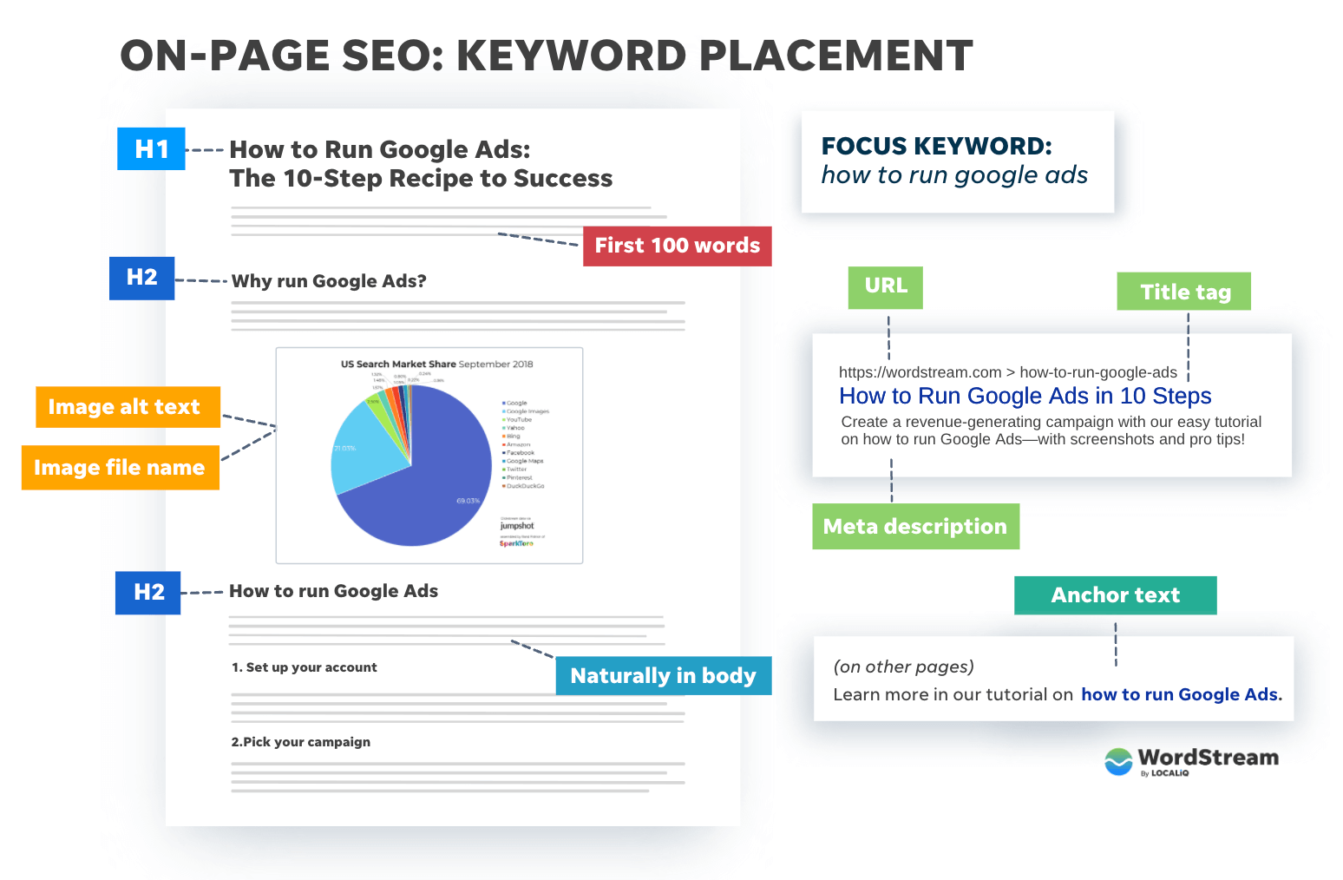
On-Page SEO Keyword Placement

Slide 35
CTR
What Is Organic Click-Through-Rate?
“Organic click-through-rate (also known as “Organic CTR”), is the percentage of searchers that click on a search engine result.”
Organic CTR is largely based on ranking position but is also influenced by a result’s title tag, description, URL and presence of Rich Snippets.

Slide 36
Internal Linking
An internal link is any link from one page on your website to another page on your website.
Both users and search engines use links to find content on website.
Users use links to navigate through the site and find content.
Search engines use links to navigate through the site. They won’t see a page if there are no links to it.
IMPORTANCE: Internal linking is an essential SEO practice that not only improves website usability and navigation but also helps to optimize content visibility, authority distribution, and overall search engine ranking potential.

Slide 37
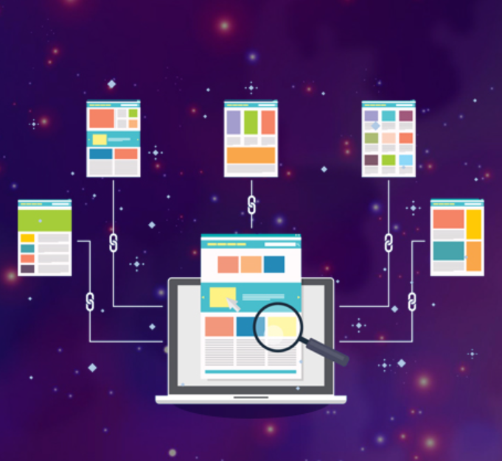
Internal Linking example

Slide 38
Anchor text
<a href =https://www.xyz.com/supplements>supplements</a>

