Slide 1

Uninformed Search - I
Breadth First Search (BFS) and Uniform Cost Search (UCS)

Slide 2
Previous Lecture
Problem Formulation
State Space / Search Space Representation
Searching for Solution

Slide 3
Today’s Lecture
Types of search Algorithms
Uninformed Search vs. Informed Search
Uniform Cost Search Algorithm
Breadth-first searching
Depth-first Search
Uniform Cost Search
Algorithm Complexity

Slide 4
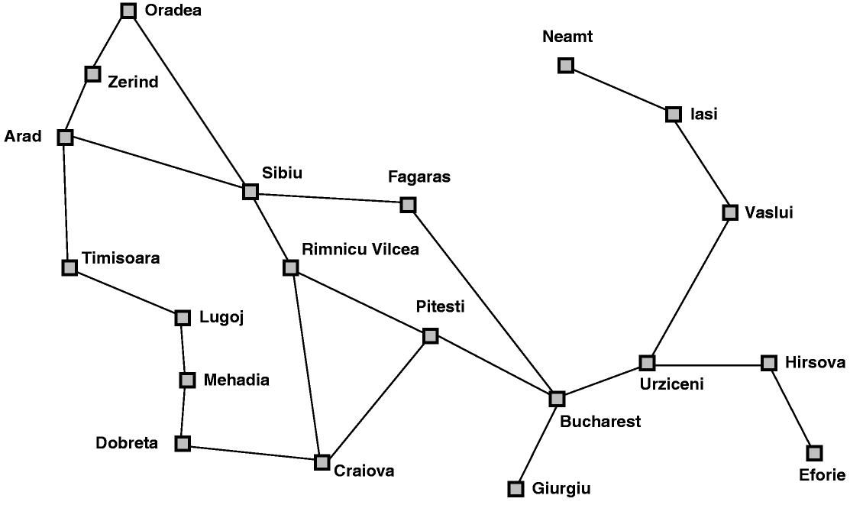
Map searching (navigation)

Slide 5
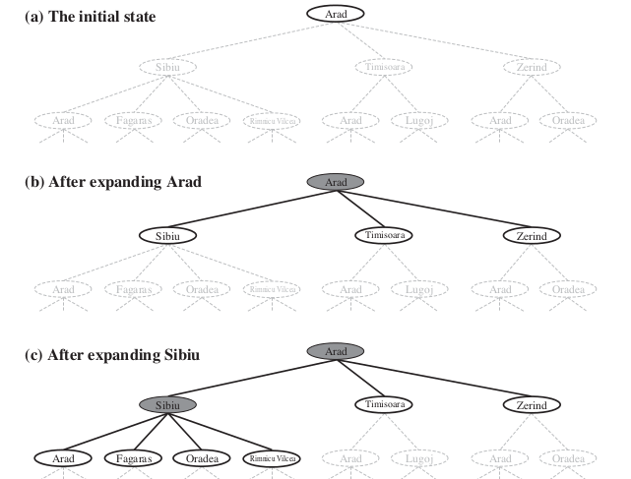
Tree search example
5

Slide 6
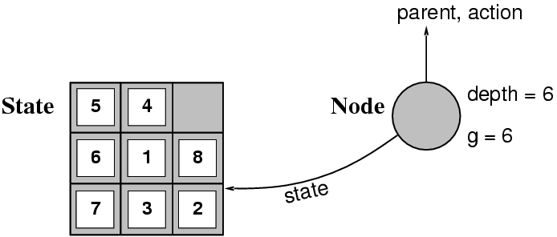
Implementation: STATES vs. NODES
A state is a (representation of) a physical configuration
A node is a data structure constituting part of a search tree includes state, parent node, action, path cost g(x), depth

Slide 7
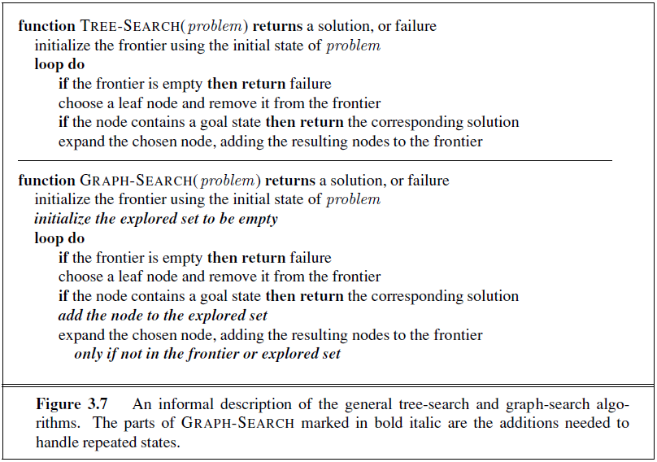
Searching for Solution

Slide 8
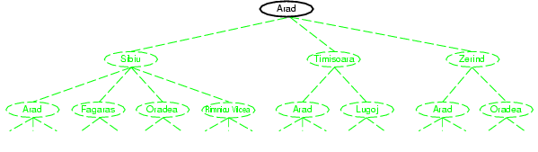
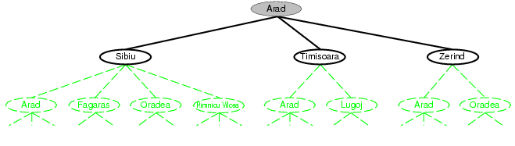
Fringe
Fringe: The collection of nodes that have been generated but not yet expanded
Each element of the fringe is a leaf node, with (currently) no successors in the tree
The search strategy defines which element to choose from the fringe
fringe
fringe

Slide 9
Example: Tree Search
a
G
b
c
e
d
e
d
f
f
S
h
p
r
q
r
S
s
s → d
s → e
s → p
s → d → b
s → d → c
s → d → e
s → d → e → h
s → d → e → r
s → d → e → r → f
s → d → e → r → f → c
s → d → e → r → f → G
d
e
p
b
c
e
h
r
q
a
a
h
r
p
q
f
p
q
f
q
c
G
q
c
G
a
a

Slide 10
Search Strategy
All search strategies are distinguished by the Order in which nodes are expanded
Uninformed search methods (Blind search) have access only to the problem definition.
No notion of the concept of the “right direction”.
Can only recognize goal once it’s achieved.
Informed search methods may have access to a heuristic function that estimate the cost of a solution from n.
uses the given heuristic information to decide whether or not to explore the current state further.

Slide 11
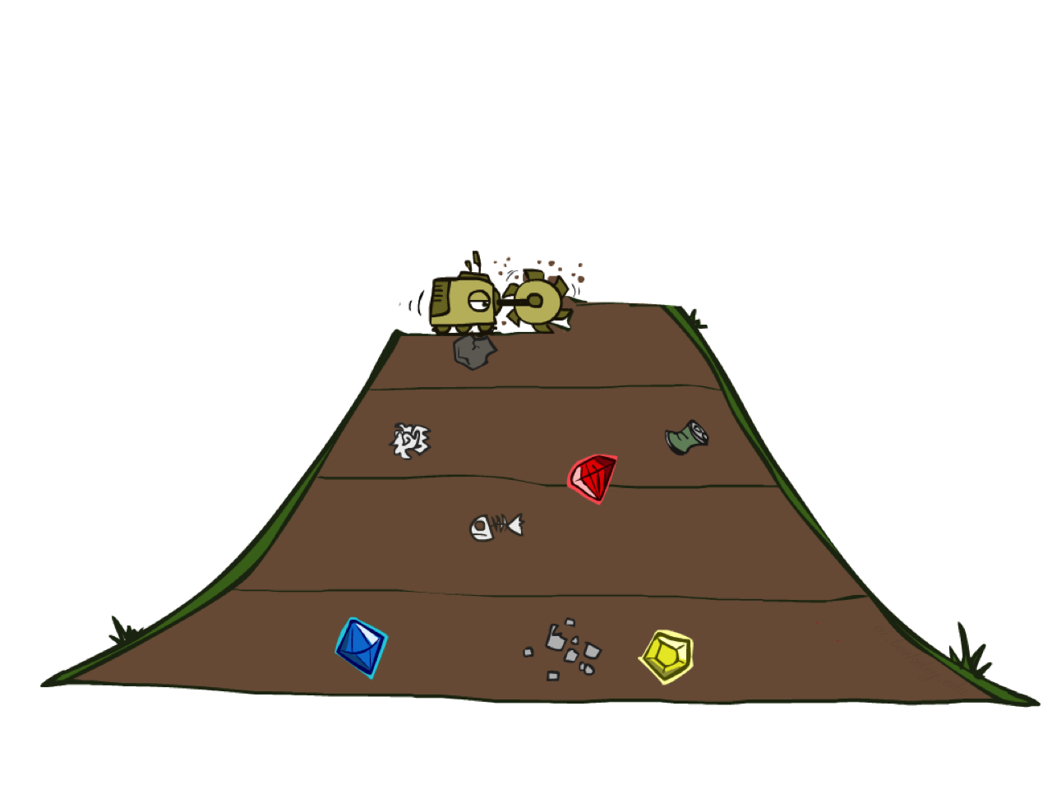
Breadth-First Search

Slide 12
Breadth-First Search
a
G
The root node is expanded first, then all the successors of the node are expanded next, then their successors, and so on.
Strategy: expand a shallowest node first
Implementation: Fringe is a FIFO queue
c
b
d
e
f
S
h
p
q
r
S
d
e
p
Search
Tiers
b
c
e
h
r
q
a
a
h
r
p
q
f
p
q
f
q
c
G
q
c
G
a
a

Slide 13
Breadth-first searching
A breadth-first search (BFS) explores nodes nearest the root before exploring nodes further away
For example, after searching A, then B, then C, the search proceeds with D, E, F, G
Node are explored in the order A B C D E F G H I J K L M N O P Q
J will be found before N
A
B
C
D
E
F
G
H
I
J
K
L
M
N
O
P
Q

Slide 14
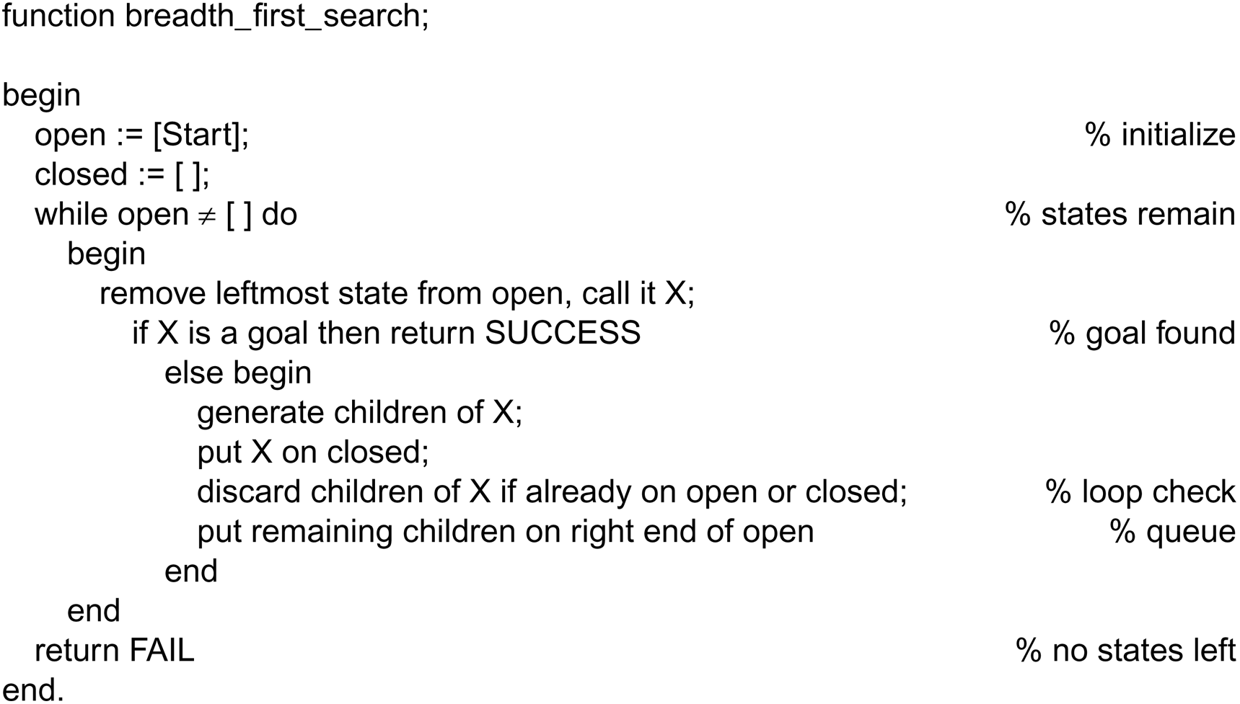
Function breadth_first search algorithm
OPEN lists states that have been generated but whose children have not yet been examined
CLOSE records states that have already been examined
Luger: Artificial Intelligence, 6th edition. © Pearson Education Limited, 2009

Slide 15
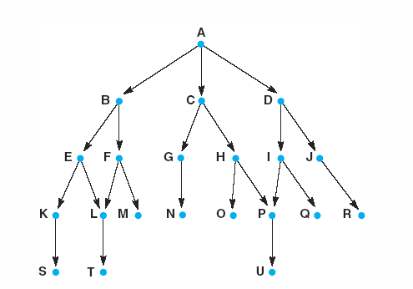
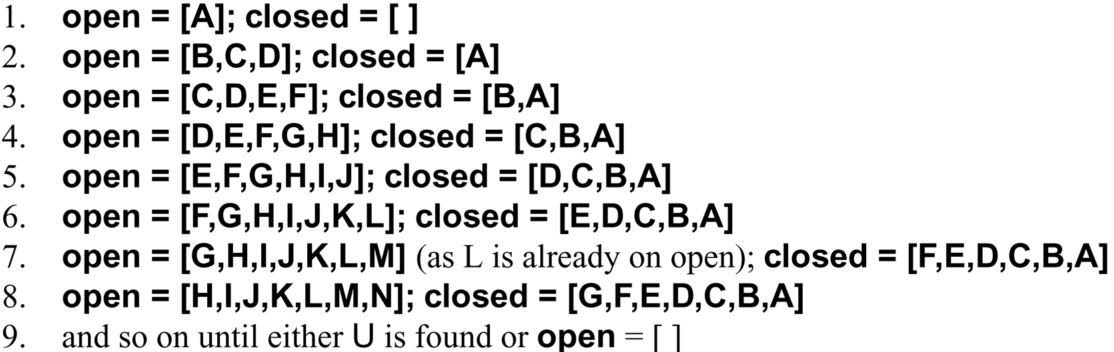
A trace of BFS

Slide 16
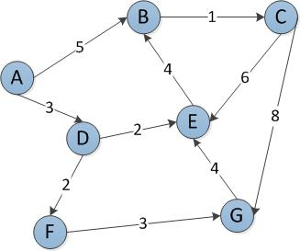
A
D
B
F
E
C
G
B
G
E
Start Node: A
Goal Node: G
Step Frontier Expand[*] Explored: a set of nodes
1 { A } A ∅
2 {(A-D), (A,B)} D {A}
3 {(A-B),(A-D-F),(A-D-E)} B {A,D}
4 {(A-D-F),(A-D-E),(A-B-C)} F {A,D,B}
5 { (A-D-E),(A-B-C), (A-D-F-G} E {A,D,B,F}
6 {(A-B-C),(A-D-F-G)}[*] C {A,D,B,F,E}
7 {(A-D-F-G), (A-B-C-G)}[+] G {A,D,B,E,F,C}
{(A-B-C-G)} G {A,D,B,E,F,C,G}
∅
Visited path: A -> D -> B -> E -> F -> C -> G.
(*B, +E) is not added to the frontier because it is found in the explored set.

Slide 17
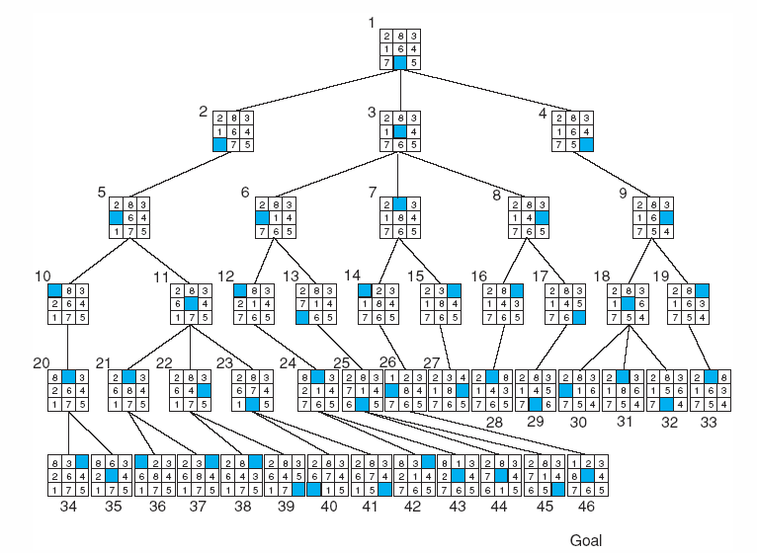
Breadth-first search of the 8-puzzle, showing order in which states were removed from open.

Slide 18
Frontier (BFS) | Expand | Explored
A | A | Empty
(A-B)(A-E) | B | A
(A-E) | E | A,B
(A-E-C)(A-E-H) | C | A,B,E
(A-E-H)(A-E-C-D) (A-E-C-F) (A-E-C-G) | H | A,B,E,C
(A-E-C-D) (A-E-C-F) (A-E-C-G) [*] (A-E-H-I) | D | A,B,E,C,H
(A-E-C-F) (A-E-C-G) (A-E-H-I) | F | A,B,E,C,H,D
(A-E-C-G) (A-E-H-I) [+] | G | A,B,E,C,H,D,F
(A-E-H-I) [-] | I | A,B,E,C,H,D,F,G
(A-E-H-I) Goal Found |  | A,B,E,C,H,D,F,G, I
B
D
A
C
E
G
F
H
I

Slide 19
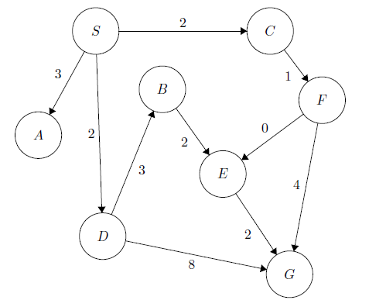
 | Frontier (BFS) | Expand | Explored
1 | S | S | Empty
2 | (S-A) (S-C) (S-D) | A | S
3 | (S-C)(S-D) | C | S,A
4 | (S-D)(S-C-F) | D | S,A,C
5 | (S-C-F)(S-D-B)(S-D-G) | F | S,A,C,D
6 | (S-D-B)(S-D-G) (S-C-F-E)[*] | B | S,A,C,D,F
7 | (S-D-G) (S-C-F-E) [+] | G | S,A,C,D,F,B
8 | (S-D-G) Goal Found |  | S,A,C,D,F,B,G

Slide 20
Search Strategies Evaluation
Strategies are evaluated along the following dimensions:
COMPLETENESS: Does it always find a solution if one exists?
OPTIMALITY: Does it always find a least-cost solution?
TIME COMPLEXITY: How long does it take to find a solution. Number of nodes generated.
SPACE COMPLEXITY: Maximum number of nodes in memory
Time and Space Complexity are measured in terms of:
The effective branching factor b:
Maximum no. of successors of any node
The average number of new nodes we create when expanding a new node
Depth d: Depth of the shallowest goal node
The length of a path to goal
m: the maximum length of any path in the state space.

Slide 21
Search Algorithm Properties
Complete: Guaranteed to find a solution if one exists?
Optimal: Guaranteed to find the least cost path?
Time complexity?
Space complexity?
Example of search tree:
b is the branching factor
m is the maximum depth
solutions at various depths
Number of nodes in entire tree?
1 + b + b² + …. b^{m} = O(b^{m})
1 node
b
…
b nodes
b² nodes
m tiers
b^{m} nodes

Slide 22
Breadth-First Search (BFS) Properties
1 node
What nodes does BFS expand?
Processes all nodes above shallowest solution
Let depth of shallowest solution be s
Search takes time O(b^{s})
How much space does the fringe take?
Has roughly the last tier, so O(b^{s})
Is it complete?
s must be finite if a solution exists, so yes!
Is it optimal?
Only if costs are all 1 (more on costs later)
b
…
b nodes
s tiers
b² nodes
b^{s} nodes
b^{m} nodes

Slide 23
BFS Branching Factor
Branching factor: number of nodes generated by a node parent (we called here “b”)
➔ Here after b=2
0 expansion
1 expansion
The root ➔ generates (b) new nodes
Each of which ➔ generates (b) more nodes
So, the maximum number of nodes expended before finding a solution at level “d”, it is :
1+b+b²+b³+….+b^{d}
Complexity is exponential = O(b^{d})
2 expansions
3 expansions

Slide 24
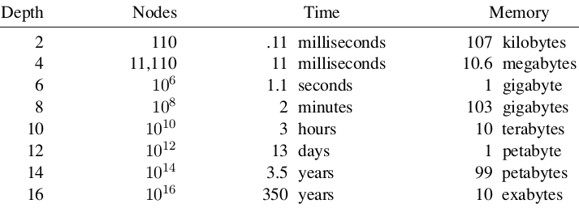
Time and memory requirement in BFS
The table assumes that 1 million nodes can be generated per second and that a node requires 1000 bytes of storage, b=10.
Many search problems fit roughly within these assumptions when run on a modern personal computer.

Slide 25
Breadth-first search: two lessons
The memory requirements are a bigger problem than is the execution time
One might wait 13 days for the solution to an important problem with search depth 12, but no personal computer has the petabyte of memory it would take.
Time is still a major factor
a solution at depth 16, (given our assumptions) it will take about 350 years for breadth-first search (or indeed any uninformed search) to find it.
Uninformed methods can solve the exponential complexity search problems only for smallest instances

Slide 26
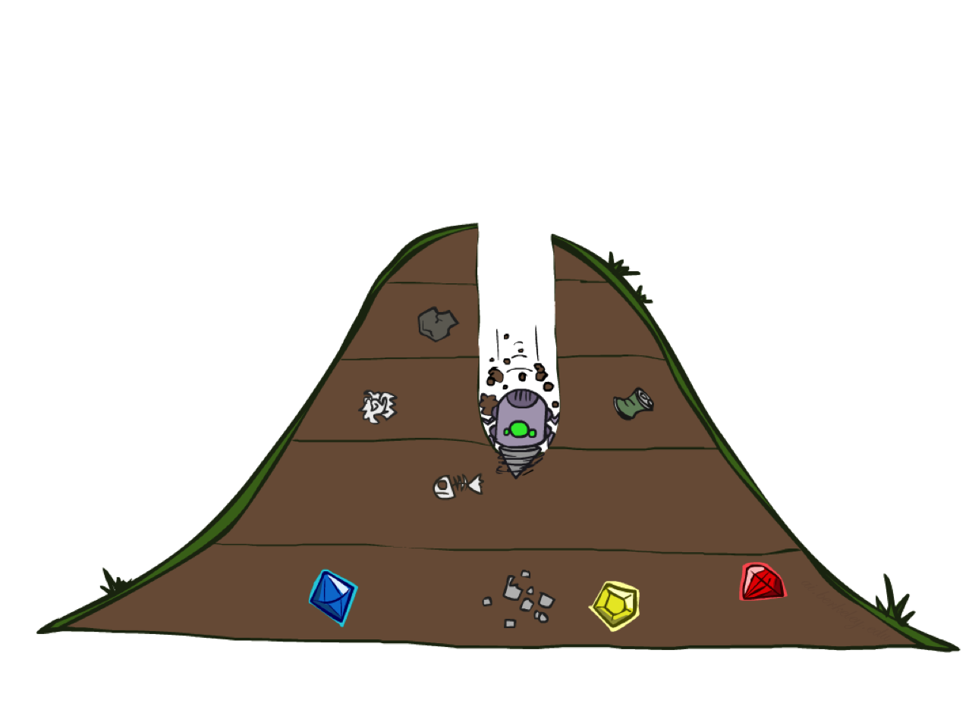
Depth-First Search

Slide 27
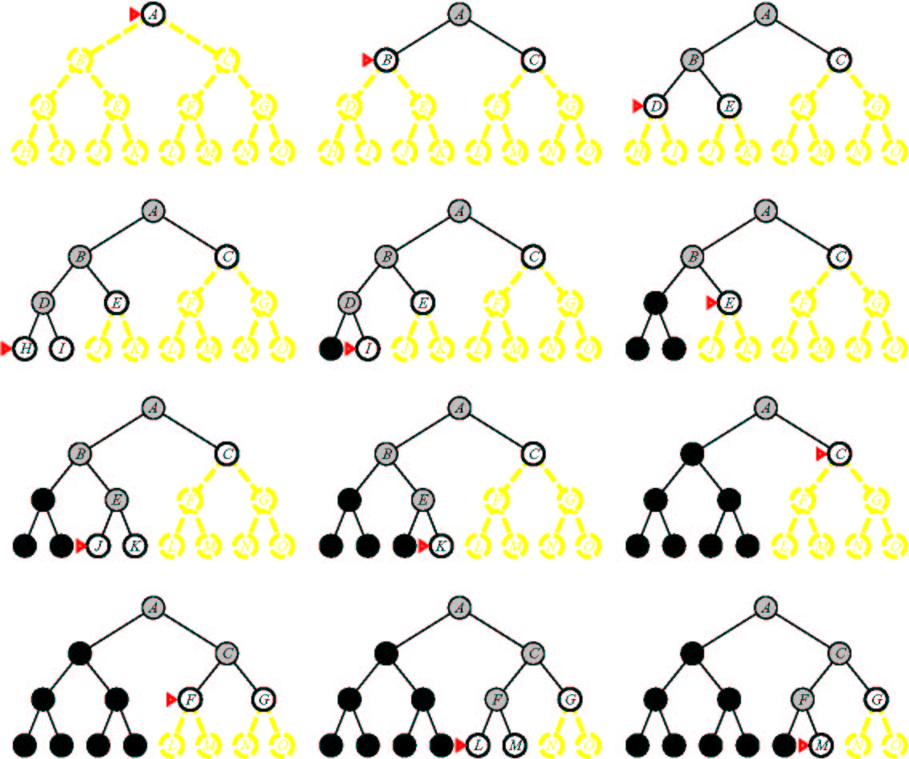
Depth First Search

Slide 28
Depth-First Search
a
G
a
Strategy: expand a deepest node first
Implementation: Fringe is a LIFO stack
c
b
c
b
e
d
e
d
f
f
S
h
h
p
p
r
q
r
q
S
d
e
p
b
c
e
h
r
q
a
a
h
r
p
q
f
p
q
f
q
c
G
q
c
G
a
a

Slide 29
Depth-first searching
A depth-first search (DFS) explores a path all the way to a leaf before backtracking and exploring another path
For example, after searching A, then B, then D, the search backtracks and tries another path from B
Node are explored in the order A B D E H L M N I O P C F G J K Q
N will be found before J
A
B
C
D
E
F
G
H
I
J
K
L
M
N
O
P
Q

Slide 30
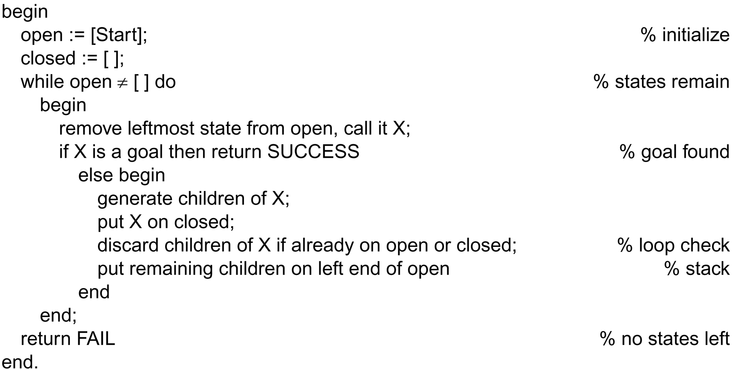
The depth-first search algorithm
This is the only difference between
depth-first and breadth-first.

Slide 31
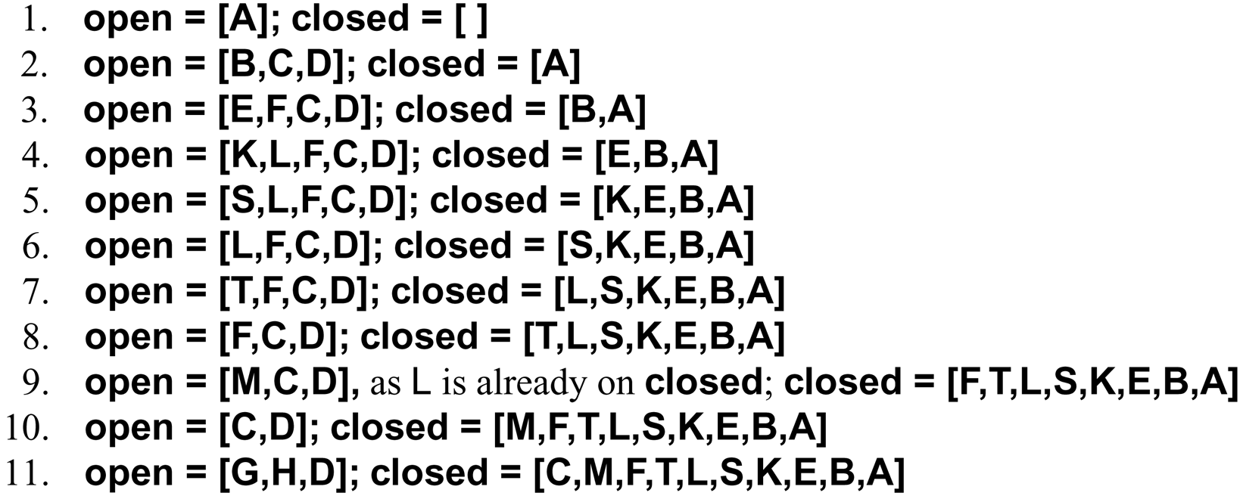
DFS Algorithm

Slide 32

DFS Algorithm
top of stack

Slide 33
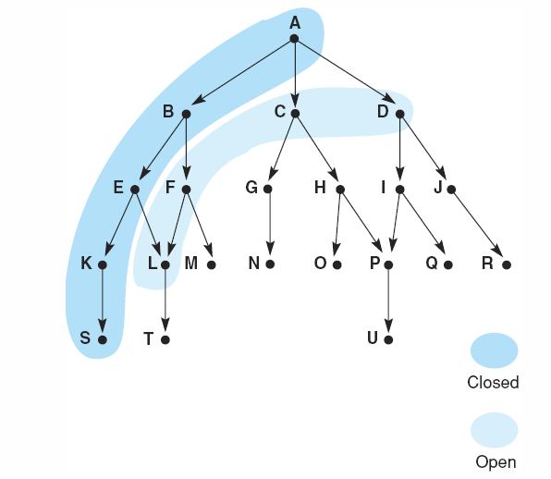
Snap shot at iteration 6
frontier
visited

Slide 34
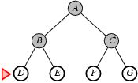
Start Node: A
Goal Node: G
Step Frontier Expand[*] Explored: a set of nodes
1 {A} A ∅
2 {(A-B),(A-C)} B {A}
3 {(A-B-D),(A-B-E),(A-C)} D {A,B}
4 {(A-B-E),(A-C)} E {A,B,D}
5 {(A-C)} C {A,B,D,E}
6 {(A-C-F),(A-C-G)} F {A,B,D,E,C}
7 (A-C-G)} G {A,D,B,E,C,F,G}
8 ∅
Found the path: A -> C -> G.

Slide 35
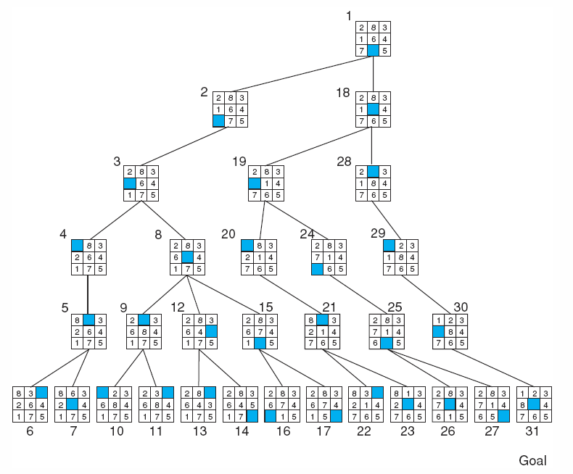
Depth-first search of the 8-puzzle with a depth bound of 5.
Luger: Artificial Intelligence, 6th edition. © Pearson Education Limited, 2009

Slide 36
Frontier (DFS) | Expand | Explored
A | A | Empty
(A-B)(A-E) | B | A
(A-E) | E | A,B
(A-E-C)(A-E-H) | C | A,B,E
(A-E-C-D) (A-E-C-F) (A-E-C-G)(A-E-H) | D | A,B,E,C
(A-E-C-F) (A-E-C-G)(A-E-H) | F | A,B,E,C,D
(A-E-C-F-I) (A-E-C-G)(A-E-H) | I | A,B,E,C,D,F
(A-E-C-F-I) Goal Found
B
D
A
C
E
G
F
H
I

Slide 37
Step | Frontier (DFS) | Expand | Explored: a set of Nodes
1 | S | S | Ø
2 | (S-A)(S-C)(S-D) | A | S
3 | (S-C)(S-D) | C | S-A
4 | (S-C-F) (S-D) | F | S-A-C
5 | (S-C-F-E)(S-C-F-G)(S-D) | E | S-A-C-F
6 | [*](S-C-F-G)(S-D) | G | S-A-C-F-E
7 | (S-C-F-G) GOAL FOUND |  | S-A-C-F-E-G

Slide 38
Depth-First Search (DFS) Properties
1 node
What nodes DFS expand?
Some left prefix of the tree.
Could process the whole tree!
If m is finite, takes time O(b^{m})
How much space does the fringe take?
Only has ancestors on path to root, so O(bm)
Is it complete?
m could be infinite, so only if we prevent cycles
Is it optimal?
No, it finds the “leftmost” solution, regardless of depth or cost
b
…
b nodes
b² nodes
m tiers
b^{m} nodes

Slide 39
DFS Branching Factor
Branching factor: number of nodes generated by a node parent (we called here “b”)
➔ Here after b=2
0 expansion
1 expansion
Let b: is the branching factor
Let d: maximum depth to find solution
So, the maximum number of nodes expended before finding a solution at level “m”, it is :
1+b+b+b+….+b (m times)
Memory need = b*d
Complexity in worst case = O(b^{d}) as “Breadth-First”
Complexity in best case = O(b*d) which is excellent!
2 expansions
4 expansions

Slide 40
Time and memory requirement in DFS
Depth | Nodes | Time (best case) | Memory
0 | 1 | 1 millisec | 100 bytes
2 | 20 | 0.02 sec | 2 Kb
4 | 40 | 0.04 sec | 4 Kb
6 | 10 * 6 | 0.06 sec | 6 Kb
8 | 10 * 8 | 0.08 sec | 8 Kb
10 | 10 *10 | 0.1 sec | 10 Kb
12 | 10 * 12 | 0.12 sec | 12 Kb
14 | 10 * 14 | 0.14 sec | 14 Kb
Assume branching factor b=10; 1000 nodes explored/sec and 100 bytes/node

Slide 41
Comparing the ordering of search sequences
Determine the order of nodes (states) to be examined
Breadth-first search
When a state is examined, all of its children are examined, one after another
Explore the search space in a level-by-level fashion
Depth-first search
When a state is examined, all of its children and their descendants are examined before any of its siblings
Go deeper into the search space where possible

Slide 42
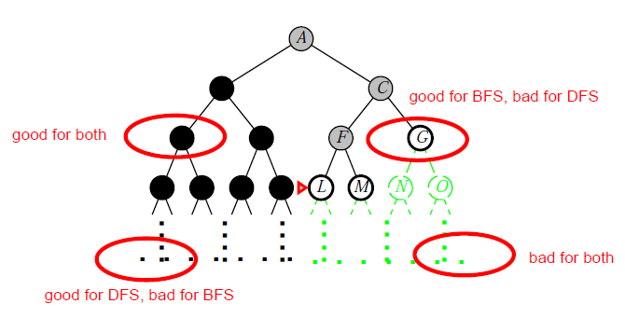
BFS or DFS

Slide 43
When to use BFS vs. DFS?
We need the shortest path to a solution
There are only solutions at great depth
There are some solutions at shallow depth

