Slide 1
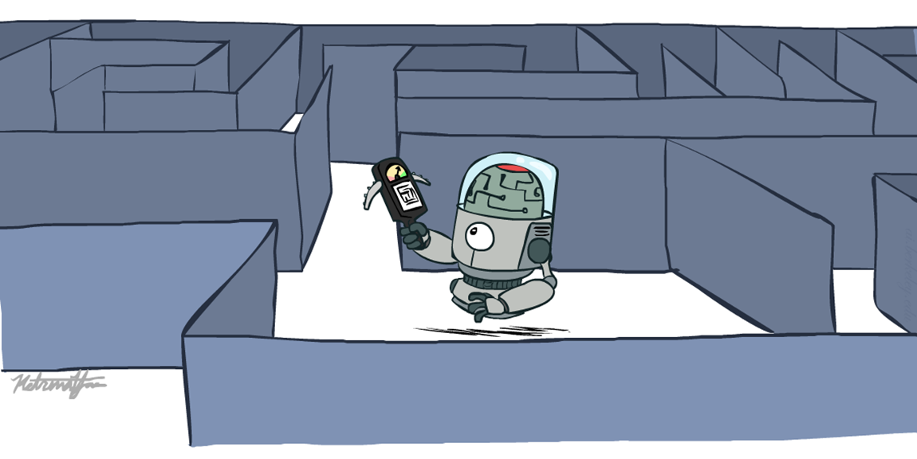
Informed Search
Heuristics Search

Slide 2
Recap: Search
Search problem:
States
Actions and costs
Start state and goal test
Search algorithm:
Systematically builds a search tree
Chooses an ordering of the fringe (unexplored nodes)
Optimal: finds least-cost plans

Slide 3
Today
Informed Search
Heuristics
Greedy Search
A* Search

Slide 4
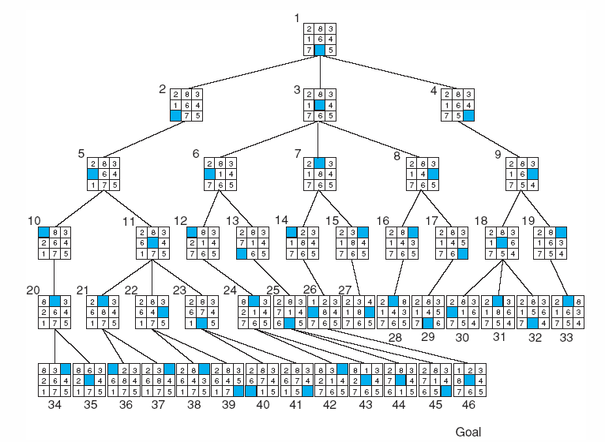
Breadth-first search of the 8-puzzle, showing order in which states were removed from open.

Slide 5
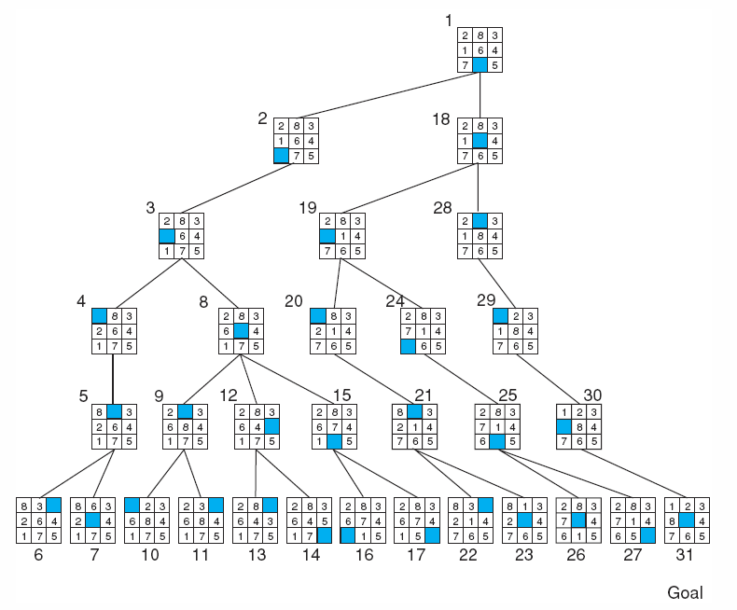
Depth-first search of the 8-puzzle with a depth bound of 5.

Slide 6
Using problem specific knowledge to aid searching
With knowledge, one can search the state space as if he was given “hints” when exploring a tree.
Heuristic information in search = Hints
Leads to dramatic speed up in efficiency.
A
B
C
D
E
Search only in this subtree!!
F
G
H
I
J
K
L
M
N
O

Slide 7
What are Heuristics?
Heuristics are know-hows obtained through a lot of experiences.
Heuristics often enable us to make decisions quickly without thinking deeply about the reasons.
The more experiences we have, the better the heuristics will be.

Slide 8
When Heuristics are used?
AI problem solvers employ heuristics in two basic situations:
A problem may not have an exact solution because of inherent ambiguities in the problem statement or available data.
Medical diagnosis: Given symptoms may have several possible causes;
Doctors use heuristics to choose the most likely diagnosis and formulate a treatment plan.
A problem may have an exact solution, but the computational cost of finding it may be prohibitive.
Chess: state space growth is combinatorically explosive, with the number of possible states increasing with the depth of the search.
Heuristics attack this complexity by guiding the search along the most “promising” path through the space.

Slide 9
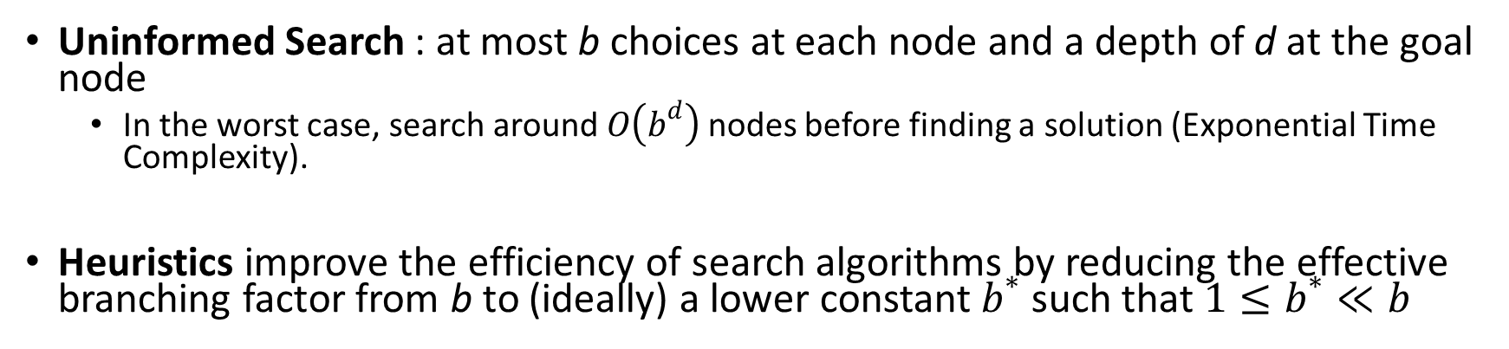
Why heuristic functions work?
Uninformed Search : at most b choices at each node and a depth of d at the goal node
In the worst case, search around $O\left(b^{d}\right)$ nodes before finding a solution (Exponential Time Complexity).
Heuristics improve the efficiency of search algorithms by reducing the effective branching factor from b to (ideally) a lower constant $b^{∗}$ such that$1≤b^{∗}≪b$
Guide search towards the goal instead of all over the place
Start
Goal
Start
Goal
Informed
Uninformed

Slide 10
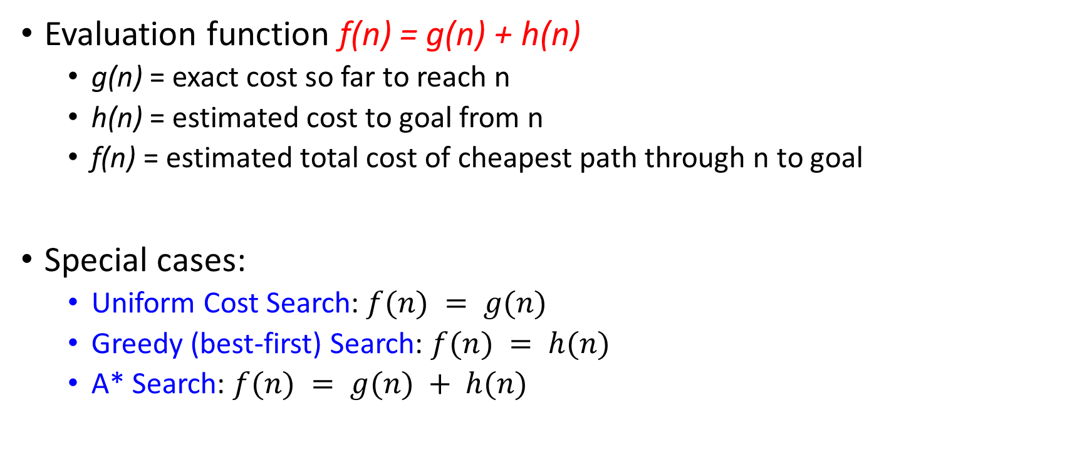
Evaluation / Heuristic Function
Evaluation function f(n) = g(n) + h(n)
g(n) = exact cost so far to reach n
h(n) = estimated cost to goal from n
f(n) = estimated total cost of cheapest path through n to goal
Special cases:
Uniform Cost Search: $f(n) = g(n)$
Greedy (best-first) Search: $f(n) = h(n)$
A* Search: $f(n) = g(n) + h(n)$

Slide 11
How it works?
Idea: use heuristic function for each node
that estimates desirability
Expands most desirable unexpanded node
Implementation:
fringe is a queue sorted in order of desirability

Slide 12
Heuristic Search
A heuristic is:
A function that estimates how close a state is to a goal
Designed for a particular search problem

Slide 13
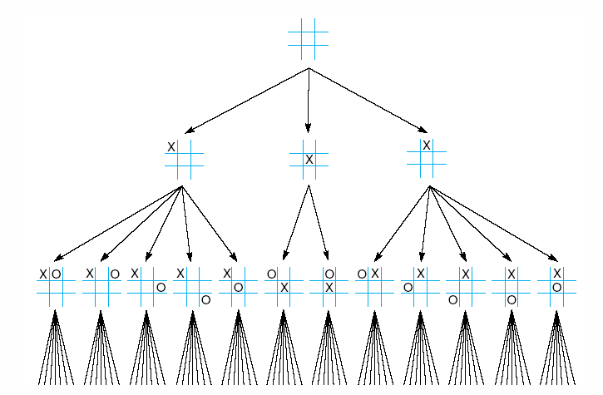
First three levels of the tic-tac-toe state space reduced by symmetry

Slide 14
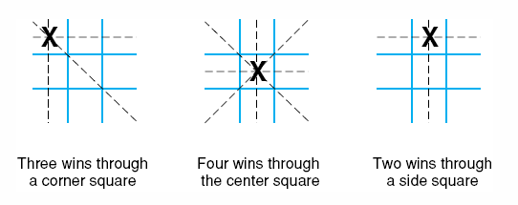
The “most wins” heuristic applied to the first children in tic-tac-toe.

Slide 15
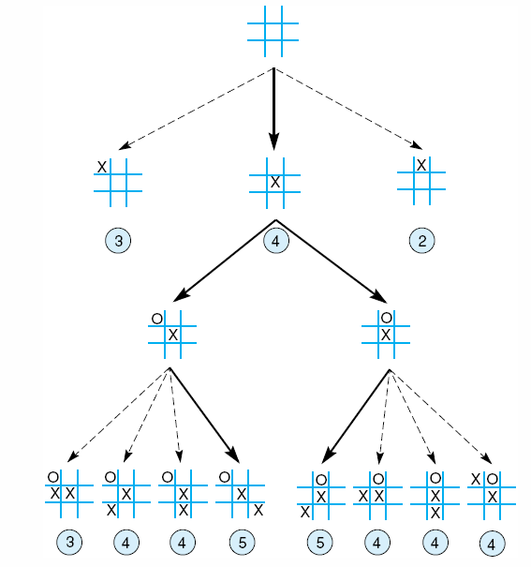
Heuristically reduced state space for tic-tac-toe.

Slide 16
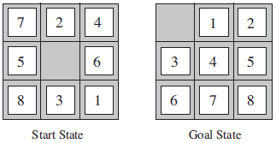
8–Puzzle: Heuristics?
h1: The number of misplaced tiles.
h2: The sum of the distances of the tiles from their goal positions.

Slide 17
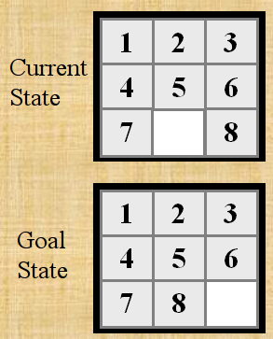

Slide 18
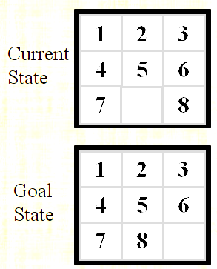
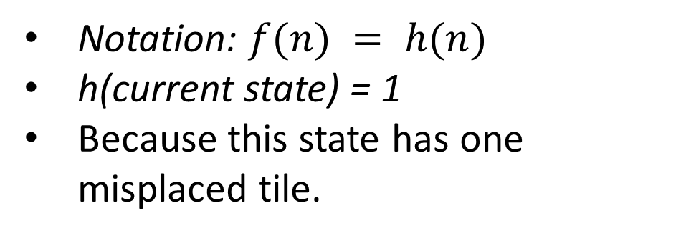
h1: The number of misplaced tiles (not including the blank)
Notation: $f(n) = h(n)$
h(current state) = 1
Because this state has one misplaced tile.
Only “8” is misplaced
So the heuristic function evaluates to 1.
The heuristic is telling us, that it thinks a solution might be available in just 1 more move.

Slide 19
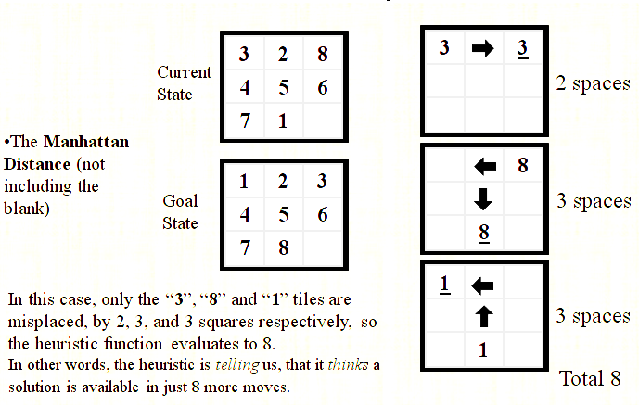
h2: The sum of the distances of tiles from goal positions
Notation: $f(n) = h(n)$, h(current state) = 8

Slide 20
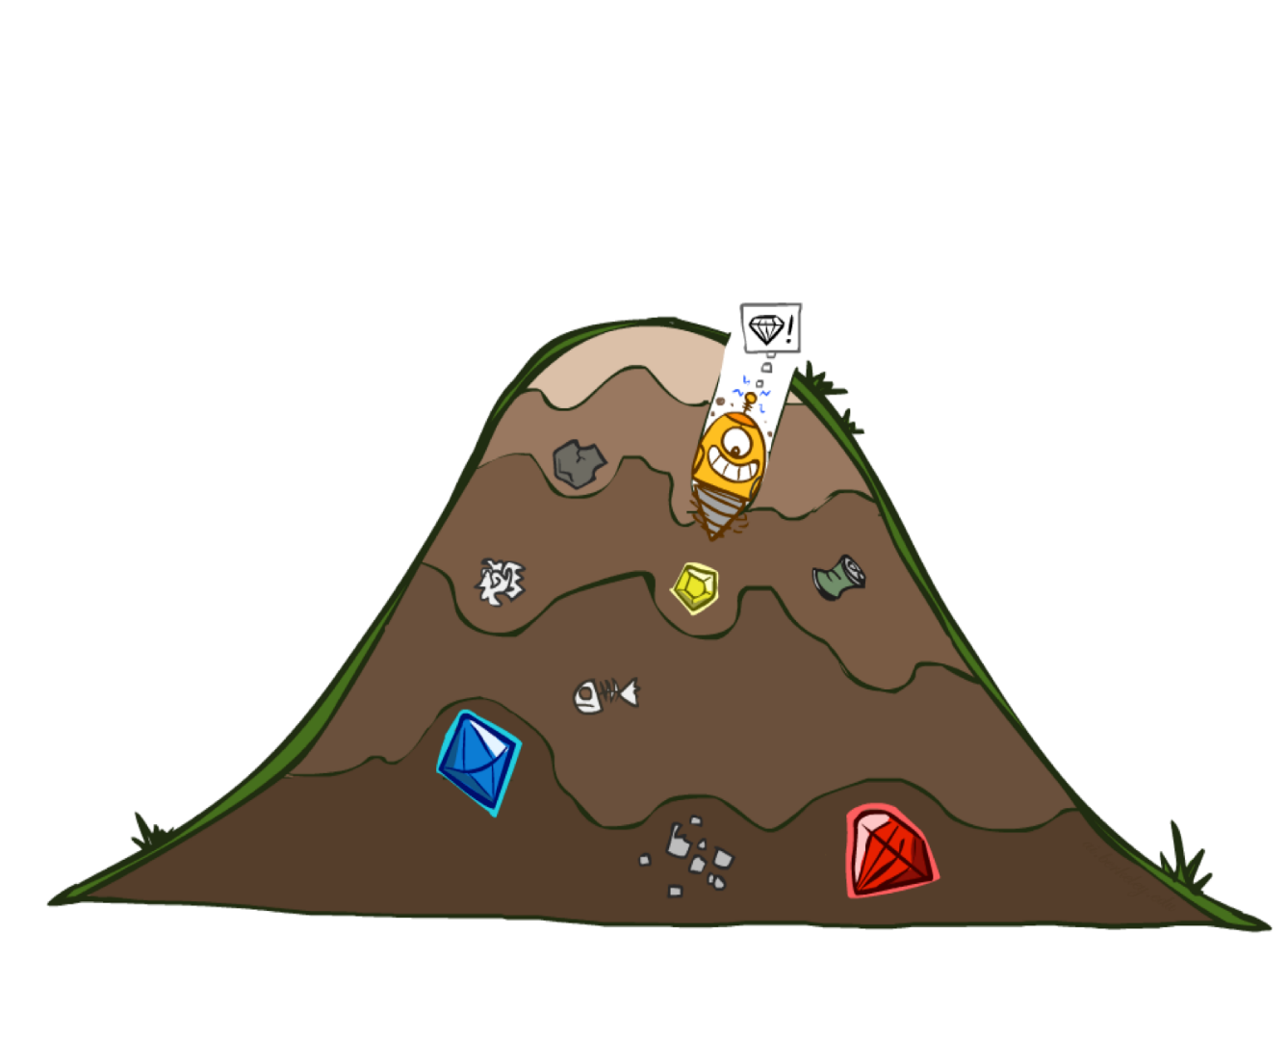
Greedy Best First Search
eval-fn: $f(n) = h(n)$

Slide 21
Greedy (Best-First) Search
Idea: Expand node with the smallest estimated cost to reach the goal.
Use heuristic function f(n) = h(n)
Best-first search tries to expand the node that is closest to the goal, on the grounds that this is likely to lead to a solution quickly.
Choose path with low heuristic value

Slide 22
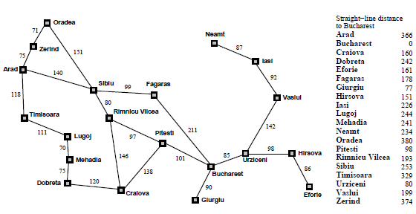
h_{SLD} (n) = straight line distance between n and goal state, given coordinates of each city

Slide 23

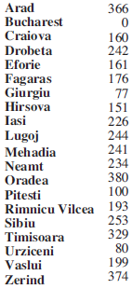
Greedy Search
Expand the node that seems closest…
What can go wrong?

Slide 24
Greedy Search
Expand the node that seems closest…(order frontier by h)
What can possibly go wrong?
Sibiu-Fagaras-Bucharest =
99+211 = 310
Sibiu-Rimnicu Vilcea-Pitesti-Bucharest =
80+97+101 = 278
h= 253
h=176
h=193
1000000
h=100
h=0

Slide 25
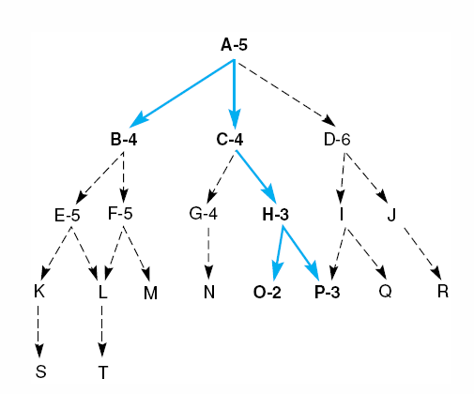
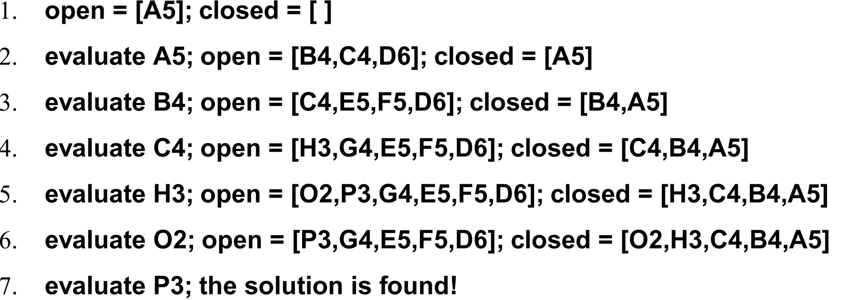
Best First Search

Slide 26
Greedy Search
State | Heuristic: h(n)
A | 366
B | 374
C | 329
D | 244
E | 253
F | 178
G | 193
H | 98
I | 0
Start
A
75
118
140
B
C
111
E
D
80
99
G
F
97
H
211
101
I
Goal
f(n) = h (n) = straight-line distance heuristic

Slide 27
Greedy Search: Tree Search
Start
A

Slide 28
Greedy Search: Tree Search
Start
A
75
118
[329]
140
[374]
B
C
[253]
E

Slide 29
Greedy Search: Tree Search
Start
A
75
118
[329]
140
[374]
B
C
[253]
E
80
99
[193]
[178]
G
F
[366]
A

Slide 30
Greedy Search: Tree Search
Start
A
75
118
[329]
140
[374]
B
C
[253]
E
80
99
[193]
[178]
G
F
[366]
A
211
[253]
I
[0]
E
Goal

Slide 31
Greedy Search: Tree Search
Start
A
75
118
[329]
140
[374]
B
C
[253]
E
80
99
[193]
[178]
G
F
[366]
A
211
[253]
I
[0]
E
Path cost(A-E-F-I) = 253 + 178 + 0 = 431
dist(A-E-F-I) = 140 + 99 + 211 = 450
Goal

Slide 32
Greedy Search: Optimal?
State | Heuristic: h(n)
A | 366
B | 374
C | 329
D | 244
E | 253
F | 178
G | 193
H | 98
I | 0
Start
A
75
118
140
B
C
111
E
D
80
99
G
F
97
H
211
101
I
Goal
f(n) = h (n) = straight-line distance heuristic
dist(A-E-G-H-I) =140+80+97+101=418
Not optimal!

Slide 33
Greedy Search: Complete ?
State | Heuristic: h(n)
A | 366
B | 374
** C | 250
D | 244
E | 253
F | 178
G | 193
H | 98
I | 0
Start
A
75
118
140
B
C
111
E
D
80
99
G
F
97
H
211
101
I
Goal
f(n) = h (n) = straight-line distance heuristic

Slide 34
Greedy Search: Tree Search
Start
A

Slide 35
Greedy Search: Tree Search
Start
A
75
118
[250]
140
[374]
B
C
[253]
E

Slide 36
Greedy Search: Tree Search
Start
A
75
118
[250]
140
[374]
B
C
[253]
E
111
[244]
D

Slide 37
Greedy Search: Tree Search
Start
A
75
118
[250]
140
[374]
B
C
[253]
E
111
[244]
D
Infinite Branch !
[250]
C

Slide 38
Greedy Search: Tree Search
Start
A
75
118
[250]
140
[374]
B
C
[253]
E
111
[244]
D
Infinite Branch !
[250]
C
[244]
D

Slide 39
Greedy Search: Tree Search
Start
A
75
118
[250]
140
[374]
B
C
[253]
E
111
[244]
D
Infinite Branch !
[250]
C
Incomplete in finite state space
Much like depth first search
[244]
D

Slide 40
Greedy Search: Time and Space Complexity ?
Start
Greedy search is not optimal.
Greedy search is incomplete
In the worst case, the Time and Space Complexity of Greedy Search are both O(b^{m})
Where b is the branching factor and m the maximum path length
A
75
118
140
B
C
111
E
D
80
99
G
F
97
H
211
101
I
Goal

Slide 41
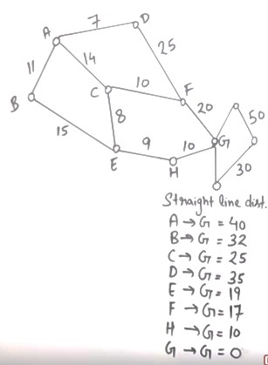
 | Frontier (Greedy) | Expand | Explored
1 | (A,40) | A | Empty
2 | (A-B,32)(A-C,25)(A-D,35) | C | A
3 | (A-B,32)(A-D,35) (A-C-E,19)(A-C-F,17) | F | A,C
4 | (A-B,32)(A-D,35) (A-C-E,19)(A-C-F-G,0) | G | A,C,F
5 | (A-C-F-G,0) Goal Found

Slide 42
 | Frontier (Greedy) | Expand | Explored
1 | (A,40) | A | Empty
2 | (A-C,25) (A-B,32)(A-D,35) | C | A
3 | (A-B,32)(A-D,35)(A-C-F,17)(A-C-E,19) | F | A,C
4 | (A-B,32)(A-D,35)(A-C-F-G,0)(A-C-E,19) | G | A,C,F
5 | (A-C-F-G) Goal Found (Cost: 44) |  | A,C,F,G
 | Frontier (UCS) | Expand | Explored
1 | (A,0) | A
2 | (A-B,11)(A-C,14)(A-D,7) | D | A
3 | (A-B,11)(A-C,14)(A-D-F,32) | B | A,D
4 | (A-B-E,26)(A-C,14)(A-D-F,32) | C | A,D,B
5 | (A-B-E,26)(A-C-F,24)(A-C-E,22) (A-D-F,32) | E | A,D,B,C
6 | (A-B-E,26)(A-C-F,24)(A-C-E-H,31) (A-D-F,32) | F | A,D,B,C,E
7 | (A-B-E,26)(A-C-F-G,44)(A-C-E-H,31) (A-D-F,32) | H | A,D,B,C,E,F
8 | (A-B-E,26)(A-C-F-G,44)(A-C-E-H-G,41) (A-D-F,32) | G | A,D,B,C,E,F,H
9 | A-C-E-H-G,41 Goal Found | G | A,D,B,C,E,F,H,G

Slide 43
Heuristics
Problem:
A heuristic is only an informed guess of the next step to be taken in solving a problem.
It is often based on experience or intuition.
Heuristics use limited information, such as knowledge of the present situation or descriptions of states currently on the open list.
They are not always able to predict the exact behavior of the state space farther along in the search.
A heuristic can lead a search algorithm to a suboptimal solution or fail to find any solution at all. This is an inherent limitation of heuristic search.

