Slide 1
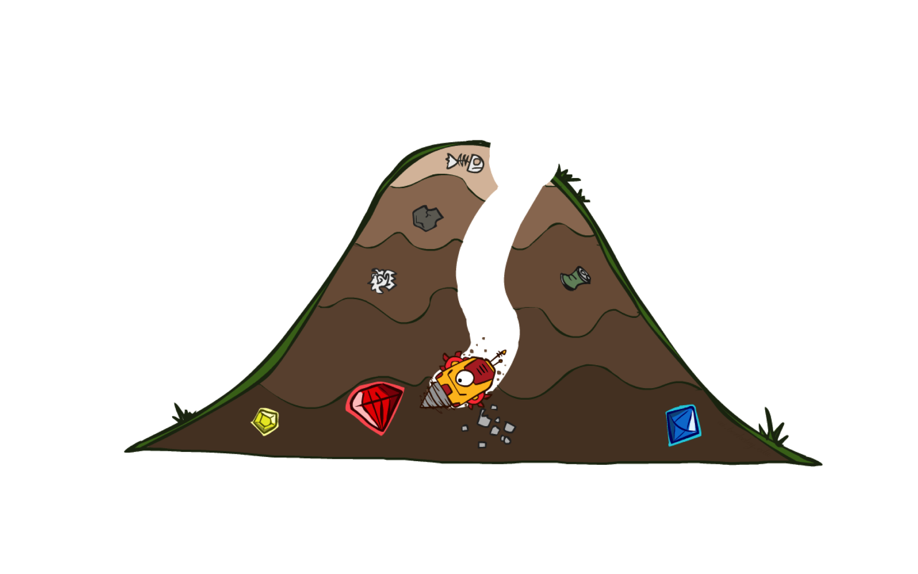
Informed Search - II
A* Search Algorithm

Slide 2
Previous Lecture
Heuristics
Greedy Search

Slide 3
A* Search
eval-fn: $f(n)=g(n)+h(n)$

Slide 4
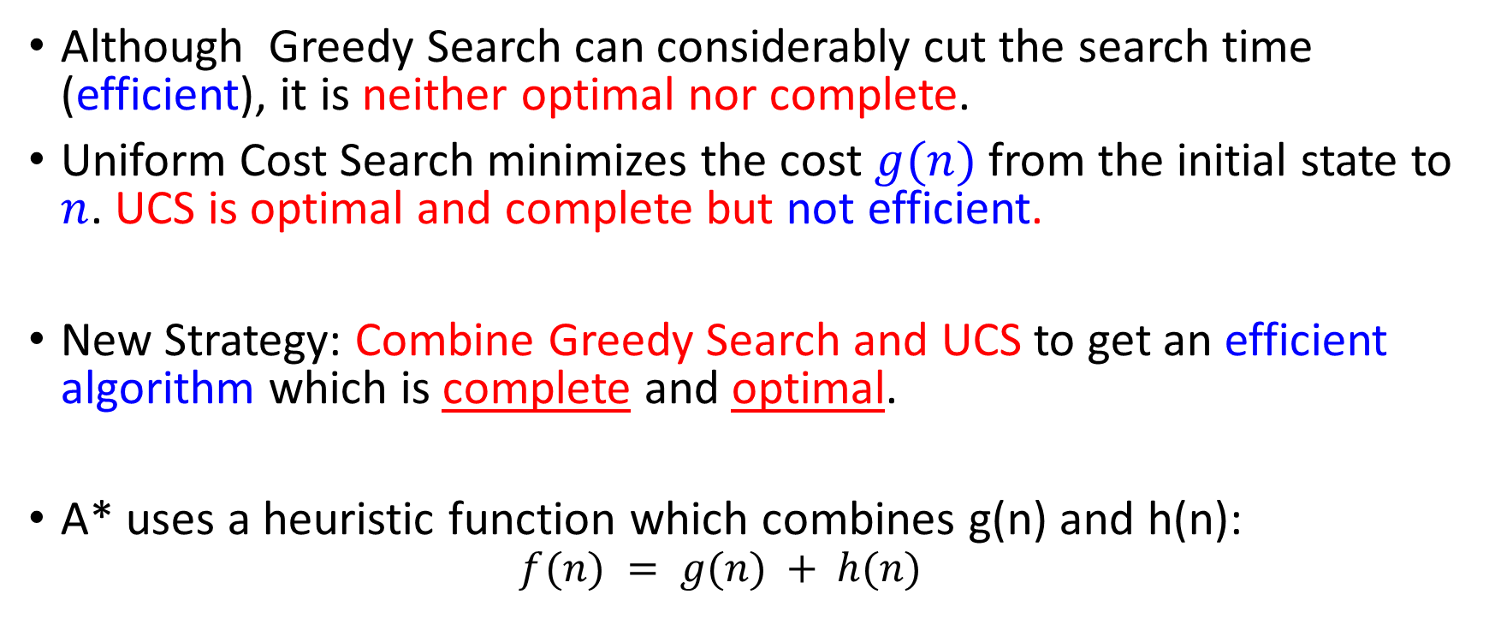
A* (A Star)
Although Greedy Search can considerably cut the search time (efficient), it is neither optimal nor complete.
Uniform Cost Search minimizes the cost $g(n)$ from the initial state to $n$. UCS is optimal and complete but not efficient.
New Strategy: Combine Greedy Search and UCS to get an efficient algorithm which is complete and optimal.
A* uses a heuristic function which combines g(n) and h(n):
$$f(n) = g(n) + h(n)$$

Slide 5
Combining UCS and Greedy
Uniform-cost orders by path cost, or backward cost g(n)
Greedy orders by goal proximity, or forward cost h(n)
A* Search orders by the sum: f(n) = g(n) + h(n)
8
g = 0 h=6
S
e
h=1
g = 1 h=5
a
1
1
3
2
g = 2 h=6
g = 9 h=1
S
a
d
G
b
d
g = 4 h=2
e
h=6
1
h=5
h=2
h=0
1
g = 3 h=7
g = 6 h=0
g = 10 h=2
c
b
c
G
d
h=7
h=6
g = 12 h=0
G

Slide 6
A* Search
Start
State | Heuristic: h(n)
A | 366
B | 374
C | 329
D | 244
E | 253
F | 178
G | 193
H | 98
I | 0
A
75
118
140
B
C
111
E
D
80
99
G
F
97
H
211
101
I
Goal
f(n) = g(n) + h (n)
g(n): is the exact cost to reach node n from the initial state.

Slide 7
A* Search: Tree Search
A
Start

Slide 8
A* Search: Tree Search
A
Start
118
75
140
E
[140+253=393]
B
[75+374=449]
[118+329=447]
C

Slide 9
A* Search: Tree Search
A
Start
118
75
140
E
[140+253=393]
B
[75+374=449]
[118+329=447]
C
80
99
G
F
[239+178=417]
[220+193=413]

Slide 10
A* Search: Tree Search
A
Start
118
75
140
E
[140+253=393]
B
[75+374=449]
[118+329=447]
C
80
99
G
F
[239+178=417]
[220+193=413]
97
[317+98=415]
H

Slide 11
A* Search: Tree Search
A
Start
118
75
140
E
[140+253=393]
B
[75+374=449]
[118+329=447]
C
80
99
G
F
[239+178=417]
[220+193=413]
97
[317+98=415]
H
101
I
[418+0=418]
Goal

Slide 12
A* Search: Tree Search
A
Start
118
75
140
E
[140+253=393]
B
[75+374=449]
[118+329=447]
C
80
99
G
F
[239+178=417]
[220+193=413]
97
211
[317+98=415]
H
I
[450+0=450]
101
I
[418+0=418]
Goal

Slide 13
A* Search: Tree Search
A
Start
118
75
140
E
[140+253=393]
B
[75+374=449]
[118+329=447]
C
80
99
G
F
[239+178=417]
[220+193=413]
97
211
[317+98=415]
H
I
[450+0=450]
101
I
[418+0=418]
Goal

Slide 14
A* Search: Tree Search
A
Start
118
75
140
E
[140+253=393]
B
[75+374=449]
[118+329=447]
C
80
99
G
F
[239+178=417]
[220+193=413]
97
211
[317+98=415]
H
I
[450+0=450]
101
I
[418+0=418]
Goal
dist(A-E-G-H-I) =140+80+97+101=418

Slide 15

A* search example

Slide 16
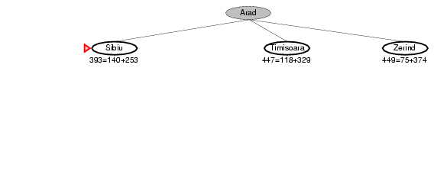
A* search example

Slide 17
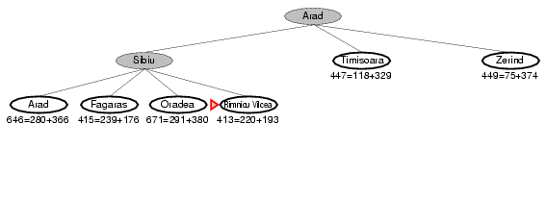
A* search example

Slide 18
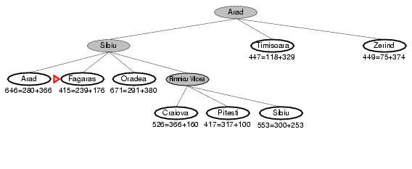
A* search example

Slide 19
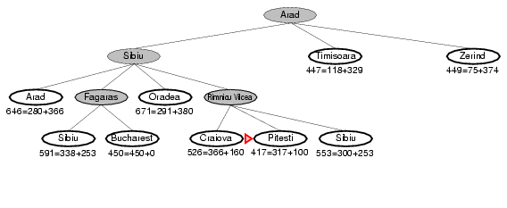
A* search example

Slide 20
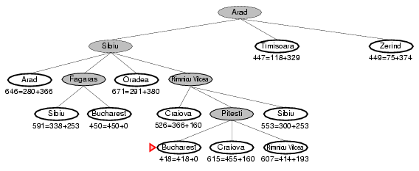
A* search example

Slide 21
Heuristic Value
S | 7
A | 6
B | 2
C | 1
D | 0
 | FRONTIER | EXPAND | EXPLORED
1 | (S,0+7=7) | S | Empty
2 | (S-A,1+6=7)(S-B,4+2=6) | B | S
3 | (S-A,7)(S-B-C,6+1=7) | A | S,B
4 | (S-A-B,3+2=5)(S-A-C,6+1=7)(S-A-D,13+0=13)(S-B-C,7) | C | S,B,A
5 | (S-A-C-D,9+0=9) | D | S,B,A,C
6 | OR (S-B-C-D,9+0=9)
7
S
1
4
2
A
B
5
12
2
C
D
3
f(n) = g(n)+h(n)

Slide 22
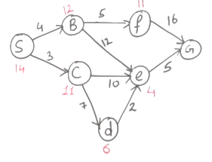

Slide 23
Is A* Optimal?
h = 6
1
A
3
S
h = 7
G
h = 0
5
What went wrong?
Actual bad goal cost < estimated good goal cost
We need estimates to be less than actual costs!

Slide 24
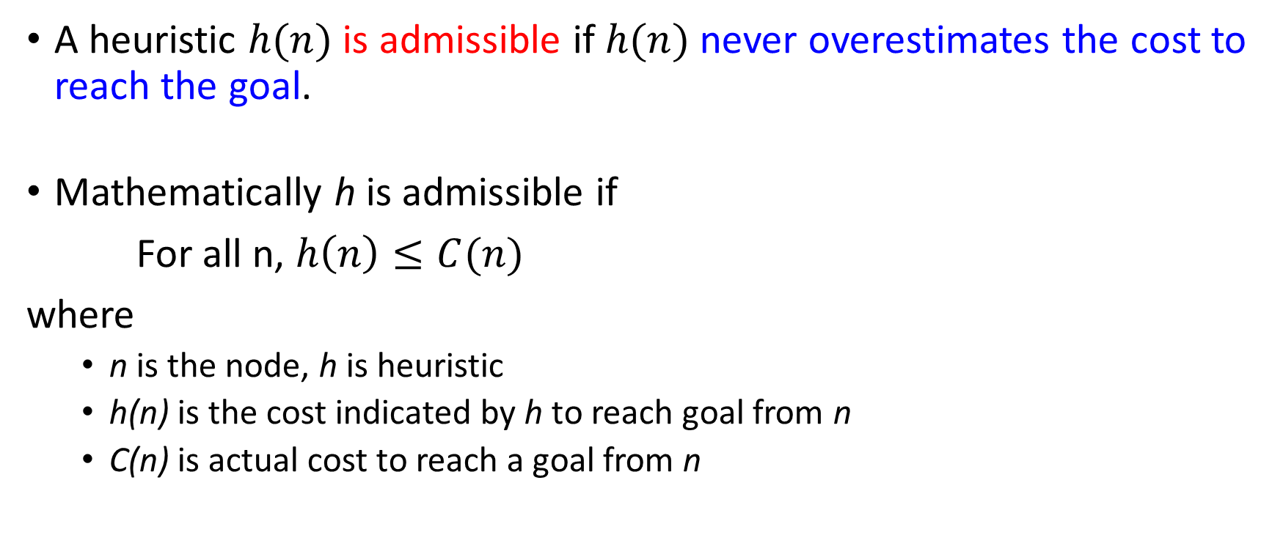
Admissible Heuristic Functions
A heuristic $h(n)$ is admissible if $h(n)$ never overestimates the cost to reach the goal.
Mathematically h is admissible if
For all n, $h\left(n\right)≤C(n)$
where
n is the node, h is heuristic
h(n) is the cost indicated by h to reach goal from n
C(n) is actual cost to reach a goal from n

Slide 25

Admissible heuristics Examples
$h_{SLD}\left(n\right)$ Straight line distance heuristic
Because it never overestimates the actual road distance.

Slide 26
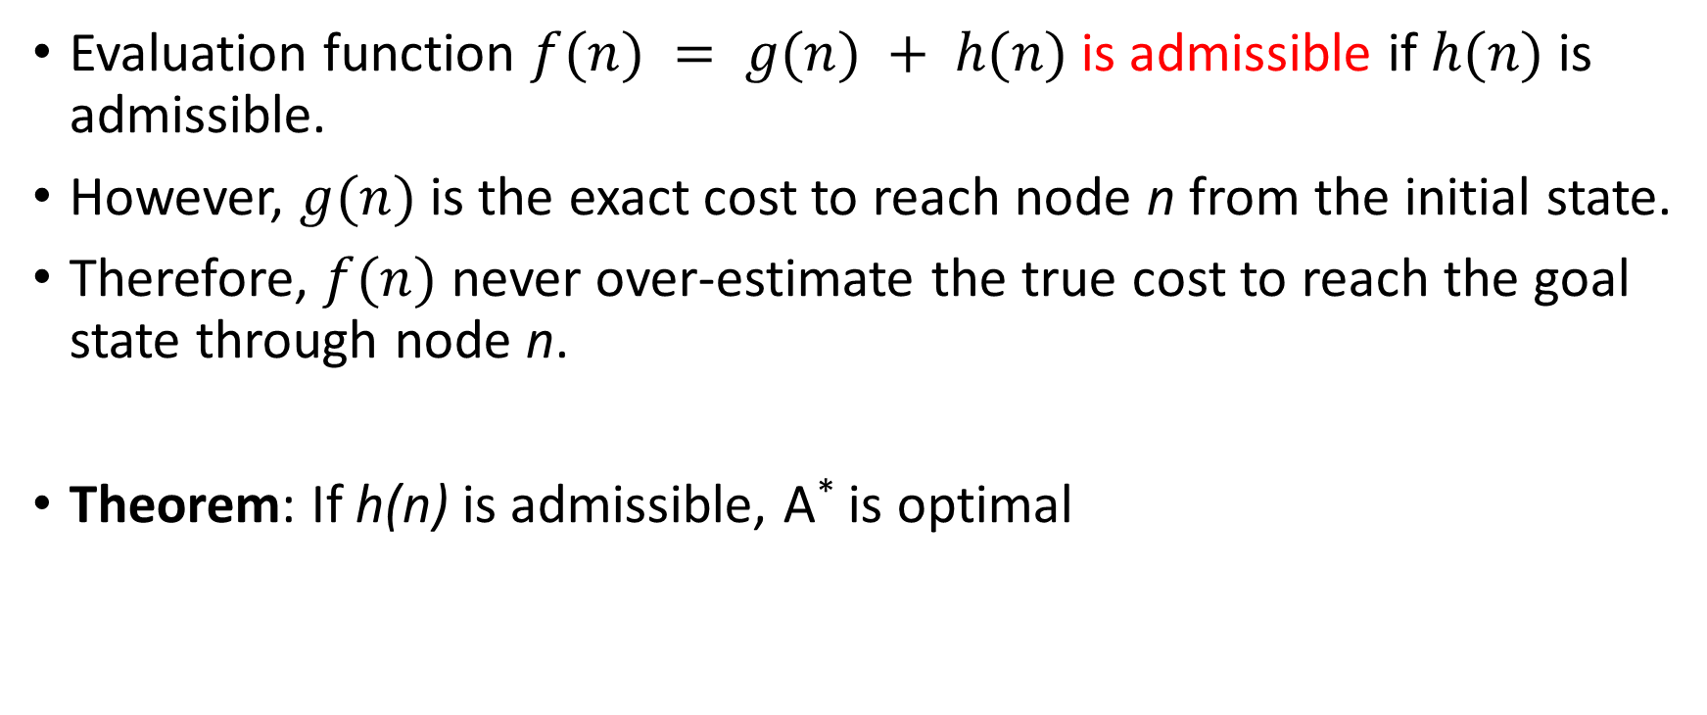
Admissible Heuristic Functions
Evaluation function $f(n) = g(n) + h(n)$ is admissible if $h(n)$ is admissible.
However, $g(n)$ is the exact cost to reach node n from the initial state.
Therefore, $f(n)$ never over-estimate the true cost to reach the goal state through node n.
Theorem: If h(n) is admissible, A* is optimal

Slide 27
A* Search: if h not admissible
State | Heuristic: h(n)
A | 366
B | 374
C | 329
D | 244
E | 253
F | 178
G | 193
H | 138
I | 0
Start
A
75
118
140
B
C
111
E
D
80
99
G
F
97
H
211
101
I
f(n) = g(n) + h (n) – (H-I) Overestimated
g(n): is the exact cost to reach node n from the initial state.
Goal

Slide 28
A* Search: Tree Search
A
Start
118
75
140
E
[393]
B
[449]
[447]
C

Slide 29
A* Search: Tree Search
A
Start
118
75
140
E
[393]
B
[449]
[447]
C
80
99
[413]
G
F
[417]

Slide 30
A* Search: Tree Search
A
Start
118
75
140
E
[393]
B
[449]
[447]
C
80
99
[413]
G
F
[417]
97
[455]
H

Slide 31
A* Search: Tree Search
A
Start
118
75
140
E
[393]
B
[449]
[447]
C
80
99
[413]
G
F
[417]
97
211
[455]
I
H
Goal
[450]

Slide 32
A* Search: Tree Search
A
Start
118
75
140
E
[393]
B
[449]
[447]
C
80
99
[473]
[413]
G
F
[417]
D
97
211
[455]
I
H
Goal
[450]

Slide 33
A* Search: Tree Search
A
Start
118
75
140
E
[393]
B
[449]
[447]
C
80
99
[473]
[413]
G
F
[417]
D
97
211
[455]
I
H
Goal
[450]

Slide 34
A* Search: Tree Search
A
Start
118
75
140
E
[393]
B
[449]
[447]
C
80
99
[473]
[413]
G
F
[417]
D
97
211
[455]
I
H
Goal
[450]

Slide 35
A* Search: Tree Search
A
Start
118
75
140
E
[393]
B
[449]
[447]
C
80
99
[473]
[413]
G
F
[417]
D
97
211
[455]
I
H
Goal
[450]
A* not optimal !!!
When heuristic h is not admissible
dist(A-E-F-I) =140+99+211=450

Slide 36
Consistency of Heuristics
A
1
Main idea: Estimated heuristic costs ≤ actual costs
Admissibility:
heuristic cost ≤ actual cost to goal
h(A) ≤ actual cost from A to G
Consistency:
“heuristic step cost” ≤ actual cost for each step
h(A) – h(C) ≤ cost(A to C)
triangle inequality
h(A) ≤ cost(A to C) + h(C)
Consequences of consistency:
A* graph search is optimal
h=4
C
h=1
h=4
h=2
G

Slide 37
A* Tree Search
State space graph
Search tree
h=4
S (0+2)
1
A
1
h=1
S
C
A (1+4)
C (3+1)
h=2
3
3
C (2+1)
G (6+0)
G (5+0)
G
h=0

Slide 38
function UNIFORM-COST-SEARCH(problem) returns a solution, or failure
initialize the explored set to be empty
initialize the frontier as a priority queue using g(n) as the priority
add initial state of problem to frontier with priority g(S) = 0 loop do
if the frontier is empty then
return failure choose a node and remove it from the frontier if the node contains a goal state then
return the corresponding solution
add the node state to the explored set
for each resulting child from node
if the child state is not already in the frontier or explored set then
add child to the frontier
else if the child is already in the frontier with higher g(n) then
replace that frontier node with child

Slide 39
function A-STAR-SEARCH(problem) returns a solution, or failure
initialize the explored set to be empty
initialize the frontier as a priority queue using f(n) = g(n) + h(n) as the priority
add initial state of problem to frontier with priority f(S) = 0 + h(S) loop do
if the frontier is empty then
return failure choose a node and remove it from the frontier if the node contains a goal state then
return the corresponding solution
add the node state to the explored set
for each resulting child from node
if the child state is not already in the frontier or explored set then
add child to the frontier
else if the child is already in the frontier with higher f(n) then
replace that frontier node with child

Slide 40
Properties of A*

Slide 41
Properties of A*
Complete? Yes
Time? Exponential
It depends on the quality of heuristic but is still exponential.
with respect to the length of the solution
better than other algorithms, but still problematic
Space? Keeps all nodes in memory
O(b^{d}) space complexity,
A* keeps all generated nodes in memory
But an iterative deepening version is possible (IDA*).
Optimal? Yes
A* is optimal if heuristic h is admissible (optimal).
Notes:
Also optimally efficient: any search based on h must expand as many nodes as A*. Reason: think of f(n) as saying: this path could lead to the goal as quickly as f(n). So must try it.

Slide 42
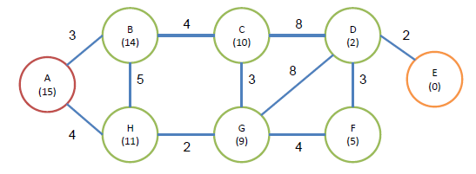
Assignment
Perform Uniform Cost Search, the Best-First Search, and the A* algorithm. Here we suppose that A is the initial node, and E is the target. The cost of each edge and the heuristic value of the each node are also given in the figure.

