Slide 1
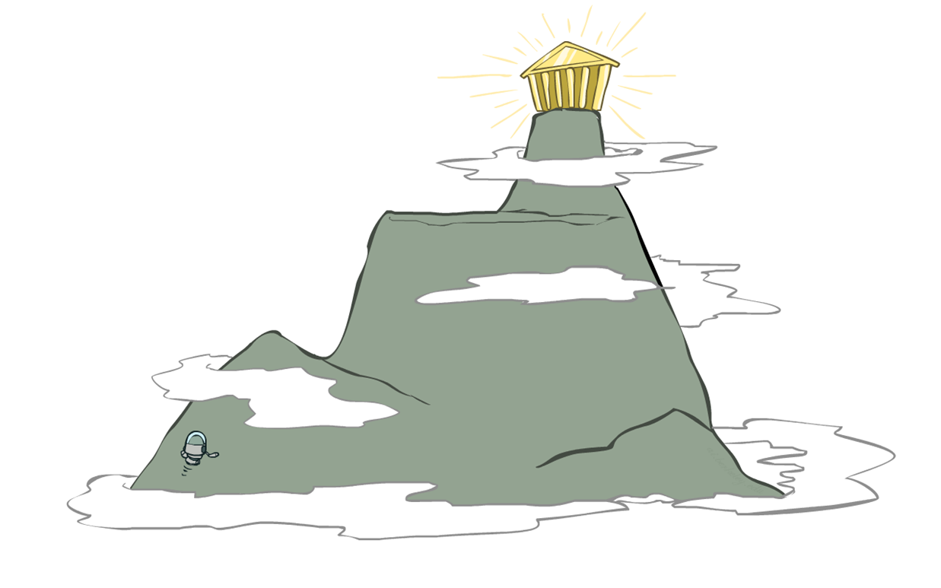
Hill Climbing Algorithm
Gradient Ascent/Descent Algorithm

Slide 2
Hill Climbing
Simple, general idea:
Start wherever
Repeat: move to the best neighboring state
If no neighbors better than current, quit
What’s bad about this approach?
Complete?
Optimal?
Hill climbing algorithm (a.k.a. greedy local search) uses a loop that continually moves in the direction of increasing values (that is uphill).
It terminates when it reaches a peak where no neighbor has a higher value.

Slide 3
Hill-Climbing Algorithm
Pick a random point in the search space
Consider all the neighbors of the current state
Choose the neighbor with the best quality and move to that state
Repeat 2 to 4 until all the neighboring states are of lower quality
Return the current state as the solution state.

Slide 4
Hill Climbing Search
Hill-climbing strategies expand the current state of the search and evaluate its children.
The “best” child is selected for further expansion; neither its siblings nor its parent are retained.
Because it keeps no history, the algorithm cannot recover from failures of its strategy.
The algorithm does not maintain a search tree, so the data structure for the current node needs to only record the state and the value of the objective function.

Slide 5
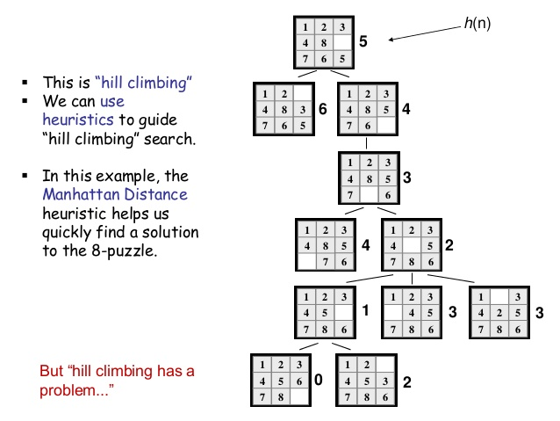

Slide 6
Hill climbing example (minimizing h)
3
1
2
1
2
start
4
5
8
h = 5
goal
3
4
5
6
7
6
7
8
h = 4
h = 0
6
5
3
1
2
3
1
2
4
5
8
4
5
6
7
6
7
8
h = 3
h = 1
5
4
3
1
2
3
1
2
4
5
h = 2
4
5
6
7
8
6
7
8
4

Slide 7
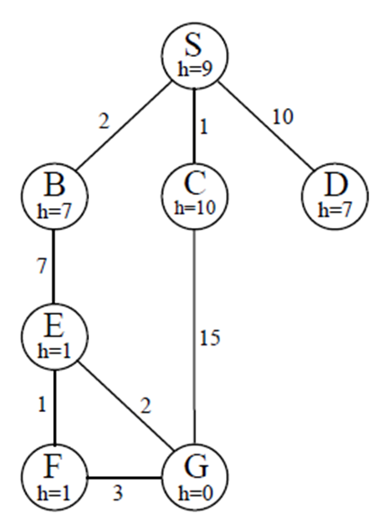
 | Frontier (Hill Climbing) | Expand | Explored
1 | (S,9) | S
2 | (S-B,7)(S-C,10)(S-D,7) | B
3 | (S-B-E,1) | E
4 | (S-B-E-F,1) (S-B-E-G,0) | G
5 | (S-B-E-G,0)

Slide 8
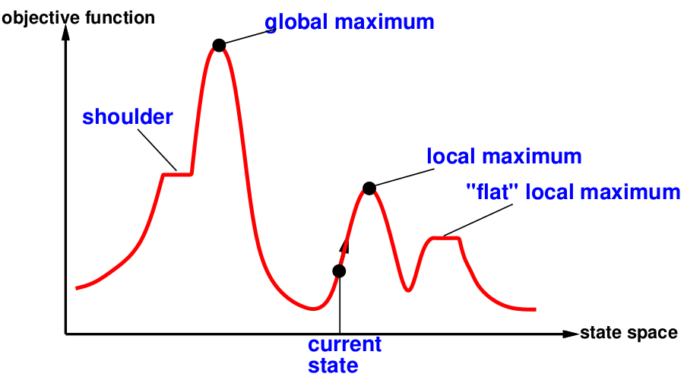
State Space Landscape
A state space landscape is a graph of states associated with their costs
A landscape has both “location” (defined by the state) and “elevation” (defined by the value of the heuristic cost function or objective function).

Slide 9
Hill Climbing
evaluation
states

Slide 10
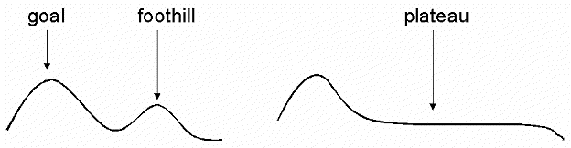
Hill-Climbing Problems
Greedy Local Search: grabs a good neighbour state without thinking about where to go next
However, greedy algos do make good progress generally towards the solution
Unfortunately, hill-climbing
Can get stuck in local maxima
Can be stuck by ridges (a series of local maxima that occur close together)
Can be stuck by plateau (a flat area in the state space landscape)
Shoulder: if the flat area rises uphill later on
Flat local maximum: no uphill rise exists.

Slide 11
Example of a local "maximum"
4
2
2
3
1
5
start
6
7
8
goal
4
1
2
4
1
2
1
2
3
5
3
7
5
2
3
4
5
0
6
7
8
6
8
6
7
8
1
4
1
2
3
5
2
6
7
8

Slide 12
Improvements
Random-restart Hill Climbing: Selects a series of initial nodes randomly until the solution is found.
Some problem spaces are great for hill climbing and others are terrible.

