Slide 1
Expert Systems and Knowledge Based Agents

Slide 2
Outline
Knowledge-based agents
Wumpus world
Logic in general

Slide 3
Logical Agents
Logical agents and environments
Agent
Environment
Sensors
Percepts
Knowledge Base
Inference
?
Actuators
Actions

Slide 4
Knowledge Based Agents
Knowledge-based agents are agents that know about their world and reason about their courses of action.
A knowledge-based agent can combine general knowledge with current percepts to infer hidden aspects of the current state prior to selecting actions.
Knowledge base, or KB is a set of sentences expressed in a language called a knowledge representation language and represents some facts about the world.

Slide 5
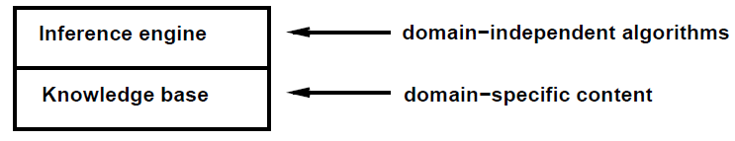
Knowledge Base
Knowledge base: Set of sentences in a formal language
A database of facts (knowledge)
Inference Engine: Set of rules for deducing conclusions
A database of rules

Slide 6
Knowledge Based Agents
It takes a percept as input and returns an action.
The agent maintains a knowledge base, KB, which may initially contain some background knowledge.
Each time the agent program is called, it does three things.
First, it TELLS the knowledge base what it perceives.
Second, it ASKS the knowledge base what action it should perform.
Reasoning may be done about the current state of the world, about the outcomes of possible action sequences, and so on.
Third, the agent records its choice and executes the action.

Slide 7


Slide 8
Logical Agents
So what do we TELL our knowledge base (KB)?
Facts (sentences)
The grass is green
The sky is blue
Rules (sentences)
Eating too much candy makes you sick
When you’re sick you don’t go to school
Percepts and Actions (sentences)
Ahmad ate too much candy today
What happens when we ASK the agent?
Inference – new sentences created from old
Ahmad is not going to school today

Slide 9
Knowledge Based Agents
Abilities of Knowledge Based Agents
The agent must be able to:
Represent states, actions, etc.
Incorporate new percepts
Update internal representations of the world
Deduce hidden properties of the world
Deduce appropriate actions

Slide 10
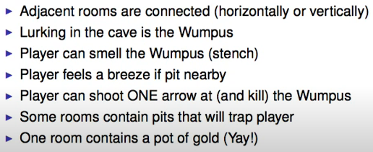
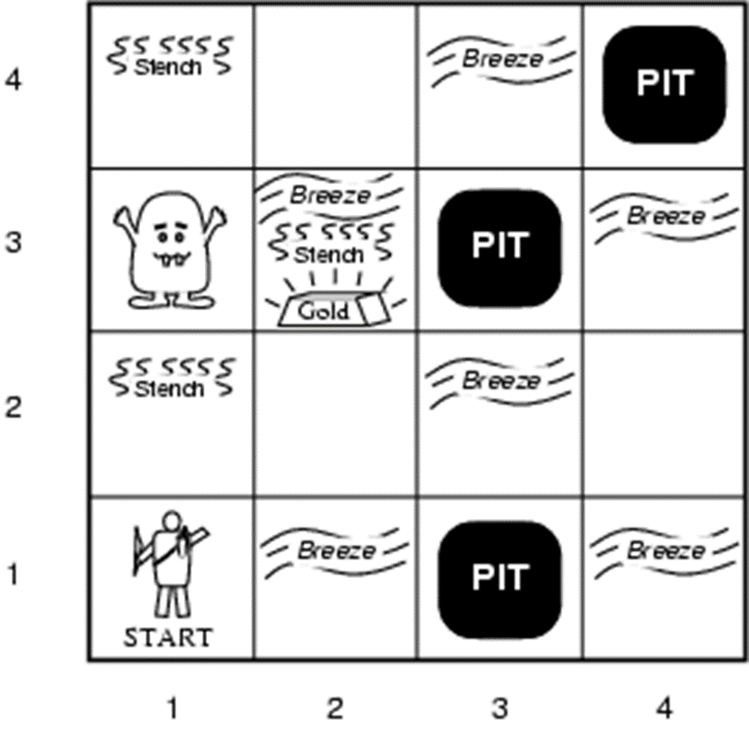
Wumpus World

Slide 11
Wumpus World
The Wumpus computer game
The agent explores a cave consisting of rooms connected by passageways
Hiding somewhere in the cave is the Wumpus, a beast that eats any agent that enters its room
Some rooms contain bottomless pits that trap any agent that wanders into the room
Occasionally, there is a heap of gold in a room.
The goal is to collect the gold and exit the world without being eaten

Slide 12
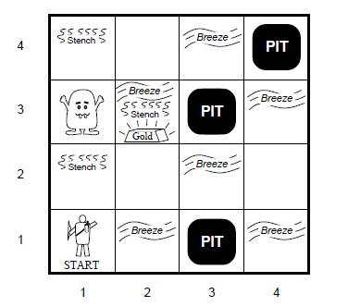
Wumpus World description
Performance measure
gold +1000, death -1000
-1 per step, -10 for using the arrow
Environment
Squares adjacent to wumpus are smelly (stench)
Squares adjacent to pit are breezy
Glitter if gold is in the same square
Shooting kills wumpus if you are facing it
Shooting uses up the only arrow
Grabbing picks up gold if in same square
Releasing drops the gold in same square
Sensors: Stench, Breeze, Glitter, Bump, Scream
Actuators: Left turn, Right turn, Forward, Grab, Release, Shoot

Slide 13

Wumpus World
The agent always starts in the field [1,1]
Agent’s task is to find the gold, return to the field [1,1] and climb out of the cave

Slide 14
Agent in a Wumpus world: Percepts
The agent perceives
a stench in the square containing the Wumpus and in the adjacent squares (not diagonally)
a breeze in the squares adjacent to a pit
a glitter in the square where the gold is
a bump, if it walks into a wall
a woeful scream everywhere in the cave, if the Wumpus is killed
The percepts are given as a five-symbol list. If there is a stench and a breeze, but no glitter, no bump, and no scream, the percept is
[Stench, Breeze, None, None, None]
The agent cannot perceive its own location

Slide 15
Agent in a Wumpus world: Actions
go forward
turn right 90 degrees
turn left 90 degrees
grab: Pick up an object that’s in the same square as the agent
shoot: Fire an arrow in a straight line in the direction the agent is facing. It continues until it hits and kills the Wumpus or hits the outer wall. The agent has only one arrow, so only the first shoot action has any effect
climb is used to leave the cave and is only effective in the start square
die: This action automatically and irretrievably happens if the agent enters a square with a pit or a live Wumpus

Slide 16
Agent in a Wumpus world : Goal
The agent’s goal is to find the gold and bring it back to the start square as quickly as possible, without getting killed
1,000 points reward for climbing out of the cave with the gold
1 point deducted for every action taken
10,000 points penalty for getting killed

Slide 17
Wumpus world characterization
Fully Observable:
No – only local perception
Deterministic:
Yes – outcomes exactly specified
Static:
Yes – Wumpus and Pits do not move
Discrete:
Yes
Single-agent:
Yes – Wumpus is essentially a natural feature

Slide 18
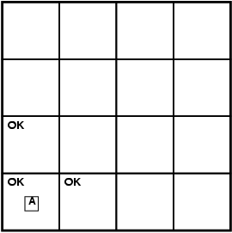
Exploring a wumpus world
A agent
B breeze
G glitter
OK safe cell
P pit
S stench
W wumpus
Agent’s initial knowledge: Agent in [1,1] ; and [1,1] is a safe square
The initial situation, after percept is [None, None, None, None, None] in (1,1)
So agent concludes that [1,2] and [2,1], are free of dangers

Slide 19
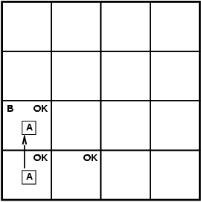
Exploring a wumpus world
A agent
B breeze
G glitter
OK safe cell
P pit
S stench
W wumpus
After one move, with percept [None, Breeze, None, None, None]

Slide 20
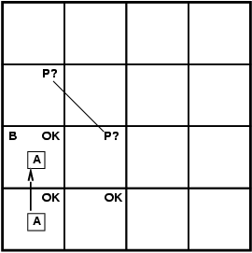
Exploring a wumpus world
A agent
B breeze
G glitter
OK safe cell
P pit
S stench
W wumpus
so there must be a pit in a neighboring square.
Either [2, 2] or [1,3]; or both

Slide 21
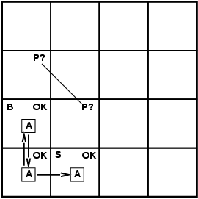
Exploring a wumpus world
A agent
B breeze
G glitter
OK safe cell
P pit
S stench
W wumpus
After the third move, with percept [Stench, None, None, None, None].
The stench in [2,1] means that there must be a wumpus nearby.

Slide 22
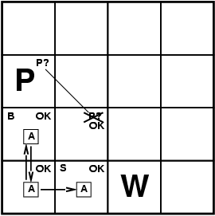
Exploring a wumpus world
A agent
B breeze
G glitter
OK safe cell
P pit
S stench
W wumpus
But Wumpus cannot be in [2,2] (the agent would have detected a stench when it was in [1,2]).
Similarly, the lack of a breeze in [2,1] implies that there is no pit in [2,2].
So pit must be in [1,3]

Slide 23

Exploring a wumpus world
A agent
B breeze
G glitter
OK safe cell
P pit
S stench
W wumpus

Slide 24
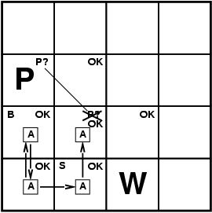
Exploring a wumpus world
A agent
B breeze
G glitter
OK safe cell
P pit
S stench
W wumpus

Slide 25
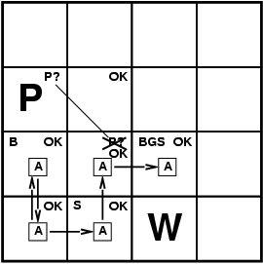
Exploring a wumpus world
A agent
B breeze
G glitter
OK safe cell
P pit
S stench
W wumpus

Slide 26
Representing Knowledge
The agent that solves the wumpus world can most effectively be implemented by a knowledge-based approach
Need to represent states and actions, update internal representations, deduce hidden properties and appropriate actions
Need a formal representation for the KB
And a way to reason about that representation

Slide 27
Logic in general
Logics are formal languages for representing information such that conclusions can be drawn
Syntax defines the sentences in the language
Semantics define the "meaning" of sentences
i.e., define truth of a sentence in a world
E.g., the language of arithmetic
x+2 ≥ y is a sentence; x2+y > {} is not a sentence
x+2 ≥ y is true iff the number x+2 is no less than the number y
x+2 ≥ y is true in a world where x = 7, y = 1
x+2 ≥ y is false in a world where x = 0, y = 6

Slide 28
Representation, reasoning, and logic
The object of knowledge representation is to express knowledge in a computer-tractable form, so that agents can perform well.
A knowledge representation language is defined by:
its syntax, which defines all possible sequences of symbols that constitute sentences of the language.
its semantics, which determines the facts in the world to which the sentences refer.

