Slide 1
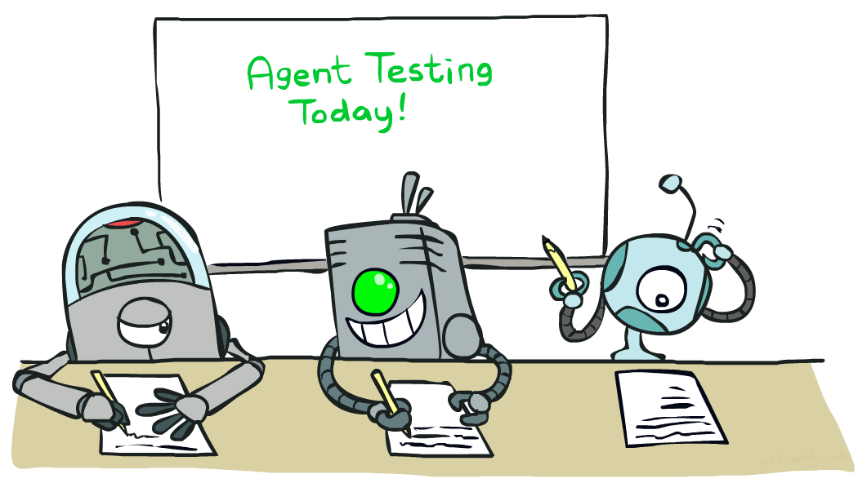
Machine Learning

Slide 2
Machine Learning
Up until now: how to use a model to make optimal decisions
Machine learning: how to acquire a model from data / experience
Learning parameters (e.g. probabilities)
Learning structure (e.g. BN graphs)
Learning hidden concepts (e.g. clustering, neural nets)

Slide 3
The Learning Problem
Learning = Improving with experience at some task
Improve over task T
With respect to performance measure P
Based on experience E
Example: Learn to play checkers
T: Play checkers
P: % of games won in world tournament
E: opportunity to play against self
Example: Learn to Diagnose Patients
T: Diagnose patients
P: Percent of patients correctly diagnosed
E: Pre-diagnosed medical histories of patients

Slide 4
Categories of Learning
Learning by examples / Supervised learning
Learning by discovery / Unsupervised learning
Learning by experimentation / Reinforcement learning

Slide 5
Types of learning
Supervised learning: learn mapping from attributes to “target”
Classification: target variable is discrete (e.g., spam email)
Regression: target variable is real-valued (e.g., stock market)
Unsupervised learning: no target variable; “understand” data structure
Clustering: grouping data into K groups
Reinforcement learning: e.g., game-playing agent (learning by experiment.)
the agent does not know the exact output for an input, but it receives feedback of its behavior
the feedback can come from an outside entity, the environment, or the agent itself

Slide 6
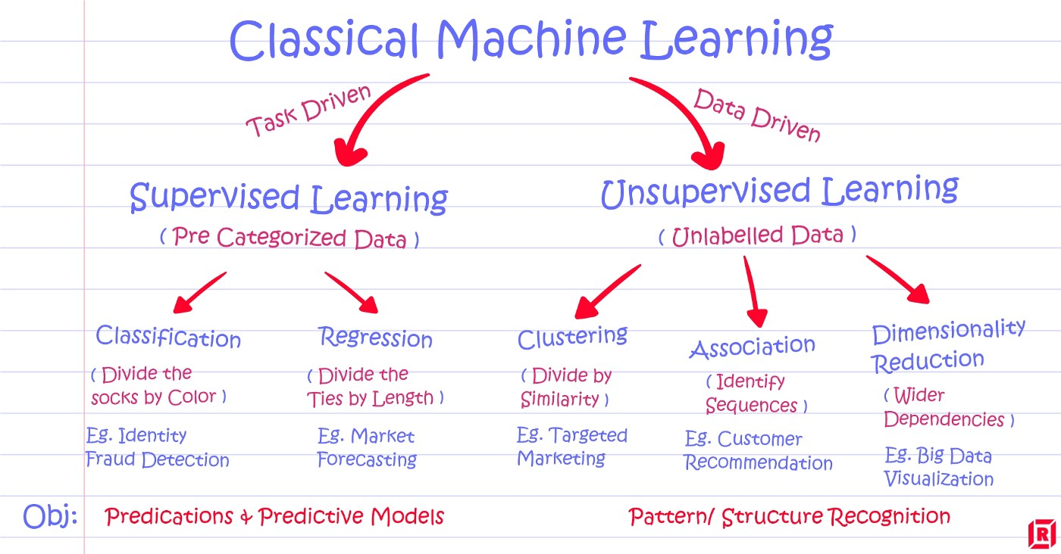

Slide 7
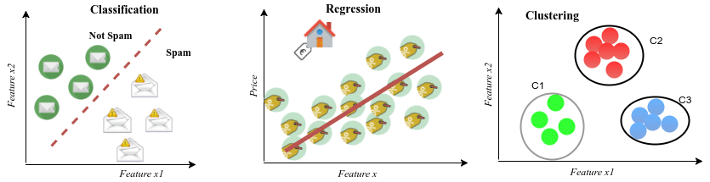

Slide 8
Learning From Examples
Learn general concepts or categories from examples
Learn a task (drive a vehicle, win a game)
Examples of objects or tasks are gathered and stored in a database
Each example is described by a set of attributes or features
Each example used for training is classified with its correct label (chair, not chair, horse, not horse, good move, bad move, etc.)
The machine learning program learns general concept description from these specific examples
The ML program should be applied to classify or perform tasks never before seen from learned concept

Slide 9
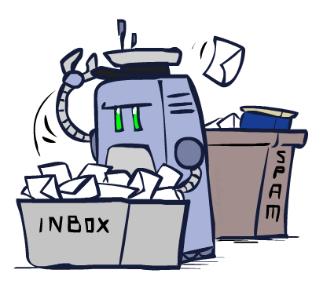
Classification

Slide 10
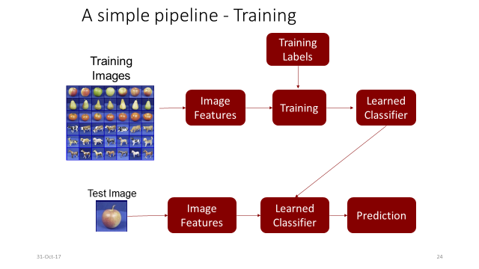

Slide 11
Example: Spam Filter
Input: an email
Output: spam/ham
Setup:
Get a large collection of example emails, each labeled “spam” or “ham”
Note: someone has to hand label all this data!
Want to learn to predict labels of new, future emails
Features: The attributes used to make the ham / spam decision
Words: FREE!
Text Patterns: $dd, CAPS
Non-text: SenderInContacts, WidelyBroadcast
…
Dear Sir.
First, I must solicit your confidence in this transaction, this is by virture of its nature as being utterly confidencial and top secret. …
TO BE REMOVED FROM FUTURE MAILINGS, SIMPLY REPLY TO THIS MESSAGE AND PUT "REMOVE" IN THE SUBJECT.
99 MILLION EMAIL ADDRESSES
FOR ONLY $99
Ok, Iknow this is blatantly OT but I'm beginning to go insane. Had an old Dell Dimension XPS sitting in the corner and decided to put it to use, I know it was working pre being stuck in the corner, but when I plugged it in, hit the power nothing happened.

Slide 12




Example: Digit Recognition
0
Input: images / pixel grids
Output: a digit 0-9
Setup:
Get a large collection of example images, each labeled with a digit
Note: someone has to hand label all this data!
Want to learn to predict labels of new, future digit images
Features: The attributes used to make the digit decision
Pixels
Shape Patterns
1
2
1
??

Slide 13
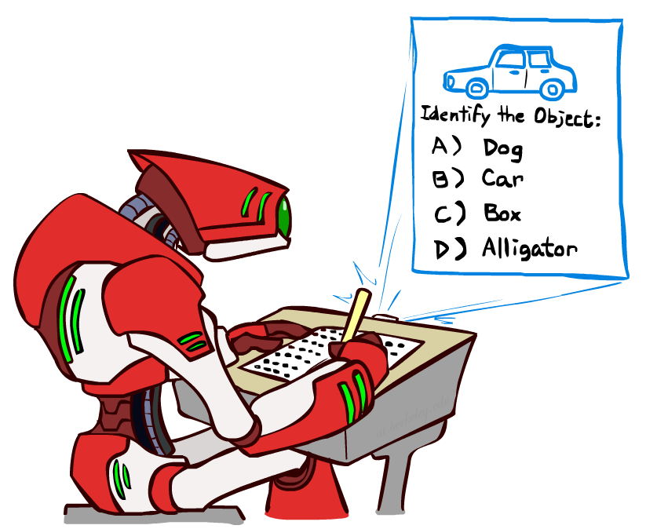
Other Classification Tasks
Classification: given inputs x, predict labels (classes) y
Examples:
Medical diagnosis (input: symptoms,
classes: diseases)
Fraud detection (input: account activity,
classes: fraud / no fraud)
Automatic essay grading (input: document,
classes: grades)
Review sentiment
… many more
Classification is an important commercial technology!

Slide 14
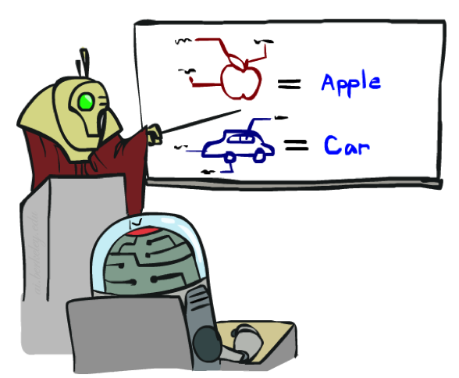

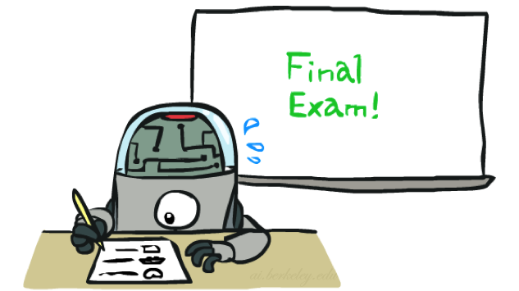
Training and Testing

Slide 15
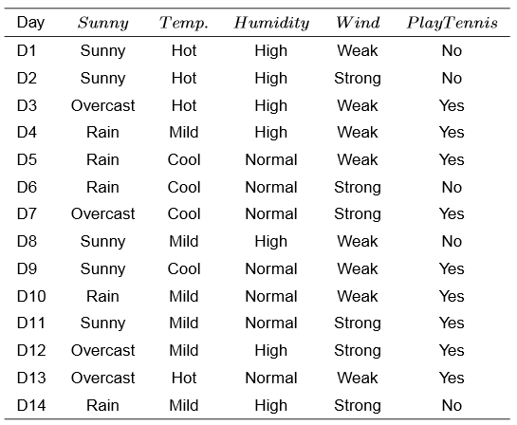
Illustrative Example
Target Label Y
Feature vector

Slide 16
Another example
Target Label Y
Features
Size (feet²) x1 | Number of bedrooms x2 | Number of floors x3 | Age of home (years) x4 | Price ($1000)
2104 | 5 | 1 | 45 | 460
1416 | 3 | 2 | 40 | 232
1534 | 3 | 2 | 30 | 315
852 | 2 | 1 | 36 | 178
… | … | … | … | …

Slide 17
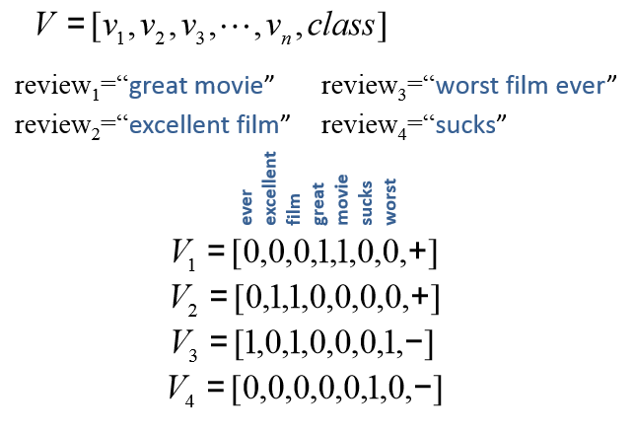
Movie review data example From text to vectors
Features
Target Label Y

Slide 18
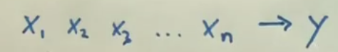
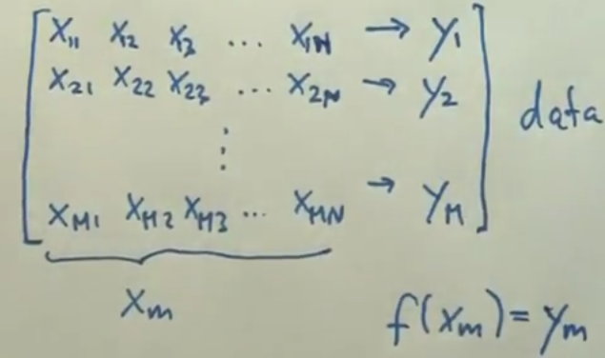
Supervised Learning
Target Label
Feature vector

Slide 19
Supervised Learning
Training Set
h is a function
h maps from x’s to y’s
Learning Algorithm
Size of house
h
Estimated price
x
Hypothesis
Estimated
value of y

