Slide 1
Learning in Neural Networks
Neurons and the Brain
Neural Networks
Perceptrons
Multi-layer Networks
Applications

Slide 2
Neural Networks
A model of reasoning based on the human brain
complex networks of simple computing elements
capable of learning from examples
collection of simple elements performs high-level operations

Slide 3
Neural Networks and the Brain
The human brain incorporates nearly 10 billion neurons and 60 trillion connections between them.
Our brain can be considered as a highly complex, non-linear and parallel information-processing system.

Slide 4
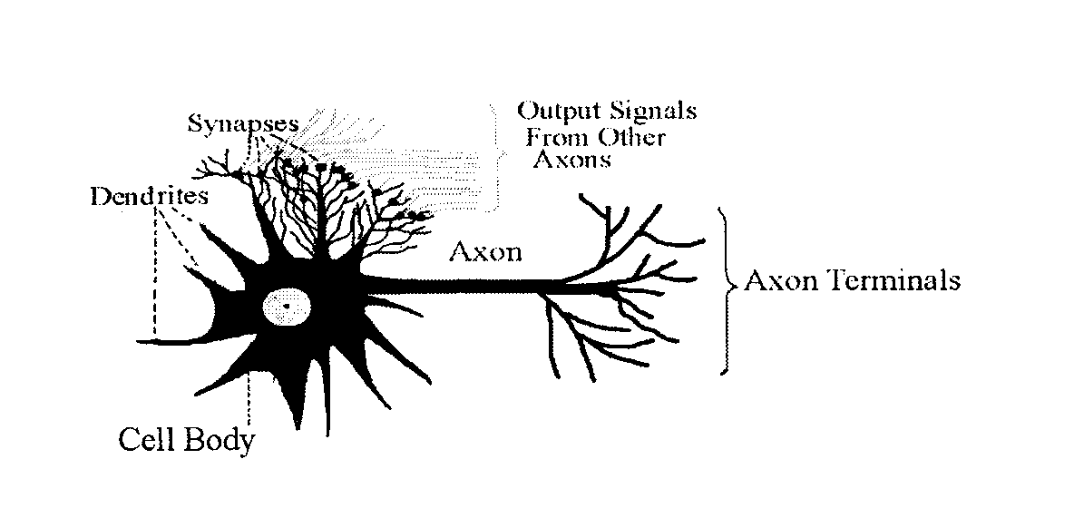
NEURAL NETWORKS

Slide 5
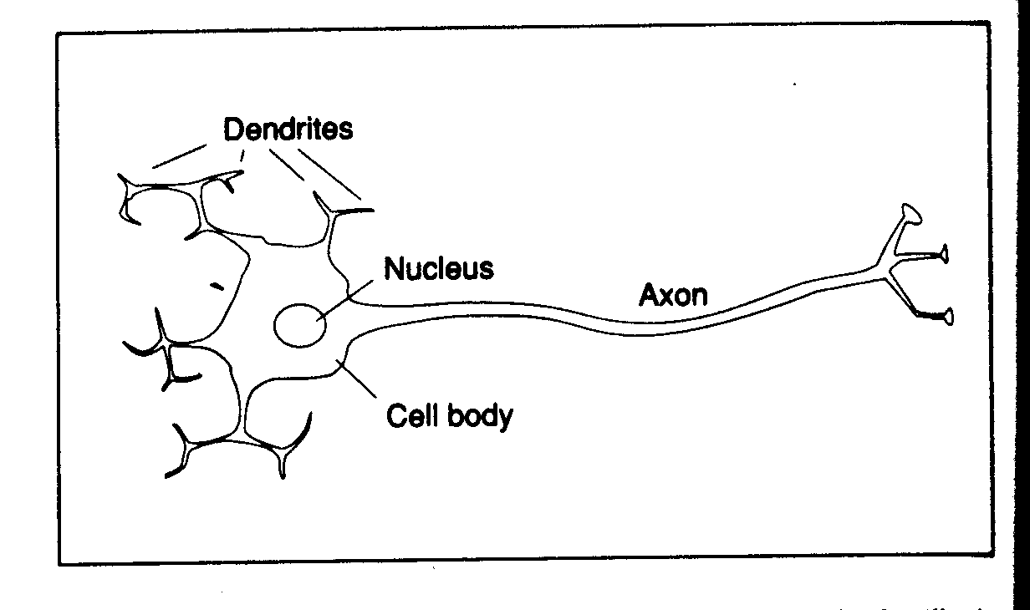
NEURAL NETWORKS
Biological Neuron

Slide 6
NEURAL NETWORKS
Biological Neuron
The main body of the cell collects the incoming signals from the other neurons through its dendrites
The incoming signals are constantly being summed in the cell body
If the result of the summation crosses a certain threshold, the cell body emits a signal of its own (called firing of the neuron)
This signal passes through the neuron’s axon, from where the dendrites of other neurons pick it up

Slide 7
NEURAL NETWORKS
There are 1,000 to 10,000 dendrites in each neuron
There is only one axon
The connection between dendrites and other neurons is electrochemical and it is called synapses
The synapses modify the signal while passing it on to dendrites
The human learning is stored in these synapses, and the connection of neurons with other neurons

Slide 8
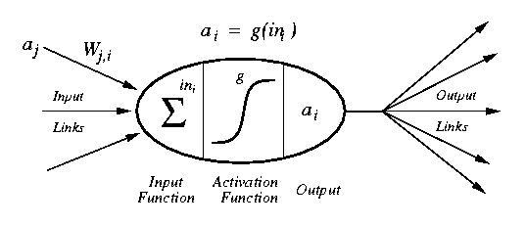
Artificial Neuron (Perceptron) Diagram
[Russell & Norvig, 1995]
weighted inputs are summed up by the input function
the (nonlinear) activation function calculates the activation value, which determines the output

Slide 9
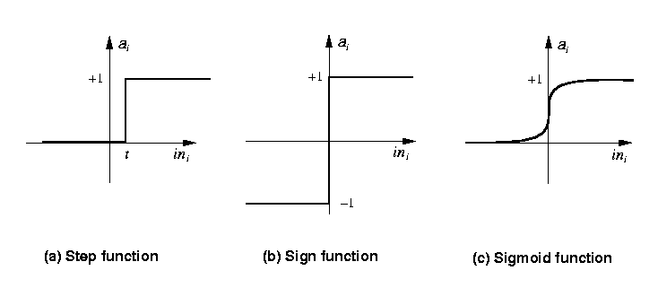
Common Activation Functions
[Russell & Norvig, 1995]
Stept(x) = 1 if x >= t, else 0
Sign(x) = +1 if x >= 0, else –1
Sigmoid(x) = 1/(1+e^{-x})

Slide 10
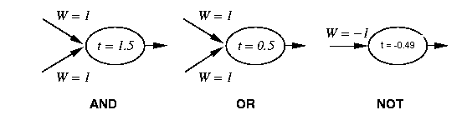
Neural Networks and Logic Gates
[Russell & Norvig, 1995]
simple neurons can act as logic gates
appropriate choice of activation function, threshold, and weights
step function as activation function

Slide 11
Network Structures
layered structures
networks are arranged into layers
Interconnections are mostly between two layers
some networks may also have feedback connections

Slide 12
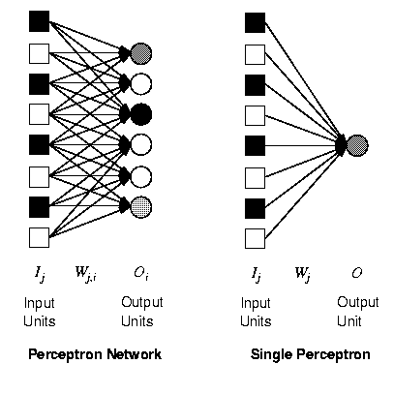
Perceptrons
single layer, feed-forward network
historically one of the first types of neural networks
late 1950s
the output is calculated as a step function applied to the weighted sum of inputs
capable of learning simple functions
linearly separable
[Russell & Norvig, 1995]

Slide 13
Perceptrons and Linear Separability
0,1
1,1
0,1
1,1
0,0
1,0
0,0
1,0
AND
XOR
[Russell & Norvig, 1995]
perceptrons can deal with linearly separable functions
some simple functions are not linearly separable
XOR function

Slide 14
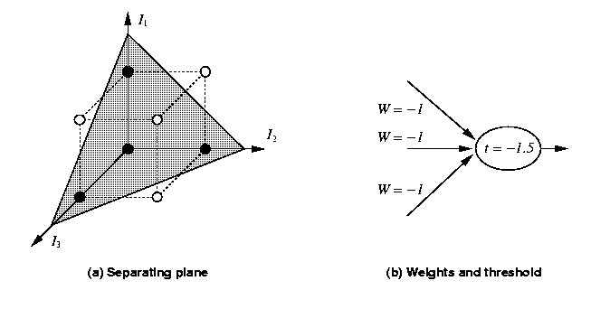
Perceptrons and Linear Separability
[Russell & Norvig, 1995]
linear separability can be extended to more than two dimensions
more difficult to visualize

Slide 15
How does the perceptron learn its classification tasks?
This is done by making small adjustments in the weights
to reduce the difference between the actual and desired outputs of the perceptron.
The initial weights are randomly assigned
usually in the range [−0.5, 0.5], or [0, 1]
Then the they are updated to obtain the output consistent with the training examples.

Slide 16
Perceptrons and Learning
perceptrons can learn from examples through a simple learning rule. For each example row (iteration), do the following:
Calculate Actual Output using
X₁W₁ + X₂W₂
calculate the error of a unit, Err_{i} as the difference between the correct (expected) output T_{i} and the actual (calculated) output O_{i} Err_{i} = T_{i} - O_{i}
adjust the weight W_{j} of the input I_{j} such that the error decreases W_{ij} = W_{ij} + α *I_{ij} * Err_{ij}
α is the learning rate, a positive constant less than unity.

Slide 17
Example of perceptron learning: the logical operation AND
X₁W₁ + X₂W₂
W_{ij} = W_{ij} + α *I_{ij} * Err_{ij}

Slide 18
Two-dimensional plots of basic logical operations
A perceptron can learn the operations AND and OR, but not Exclusive-OR.

Slide 19
Multi-Layer Neural Networks
The network consists of an input layer of source neurons, at least one middle or hidden layer of computational neurons, and an output layer of computational neurons.
The input signals are propagated in a forward direction on a layer-by-layer basis
feedforward neural network
the back-propagation learning algorithm can be used for learning in multi-layer networks

Slide 20
Diagram Multi-Layer Network
two-layer network
input units I_{k}
usually not counted as a separate layer
hidden units a_{j}
output units O_{i}
usually all nodes of one layer have weighted connections to all nodes of the next layer
O_{i}
W_{ji}
a_{j}
W_{kj}
I_{k}

Slide 21
Multilayer perceptron with two hidden layers

Slide 22
Back-Propagation Algorithm
Learning in a multilayer network proceeds the same way as for a perceptron.
A training set of input patterns is presented to the network.
The network computes its output pattern, and if there is an error − or in other words a difference between actual and desired output patterns − the weights are adjusted to reduce this error.
proceeds from the output layer to the hidden layer(s)
updates the weights of the units leading to the layer

Slide 23
Three-layer Feed-Forward Neural Network ( trained using back-propagation algorithm)

Slide 24
Three-layer network for solving the Exclusive-OR operation

Slide 25
Decision boundaries
(a) Decision boundary constructed by hidden neuron 3;
(b) Decision boundary constructed by hidden neuron 4; (c) Decision boundaries constructed by the complete
three-layer network

Slide 26
Capabilities of Multi-Layer Neural Networks
expressiveness
weaker than predicate logic
good for continuous inputs and outputs
computational efficiency
training time can be exponential in the number of inputs
depends critically on parameters like the learning rate
local minima are problematic
Learning rate avoids it
generalization
works reasonably well for some functions (classes of problems)
no formal characterization of these functions

Slide 27
Capabilities of Multi-Layer Neural Networks (cont.)
sensitivity to noise
very tolerant
they perform nonlinear regression
transparency
there is no explanation or trace for a particular answer
tools for the analysis of networks are very limited
some limited methods to extract rules from networks
prior knowledge
very difficult to integrate since the internal representation of the networks is not easily accessible

Slide 28
Applications
domains and tasks where neural networks are successfully used
Recognition (images)
series prediction
weather, financial forecasting
categorization
sorting of items (fruit, characters, …)

