Slide 1
Lecture 16 Clustering
Notes:
1

Slide 2
What is Cluster Analysis?
Cluster: A collection of data objects
similar (or related) to one another within the same group
dissimilar (or unrelated) to the objects in other groups
Cluster analysis (or clustering, data segmentation, …)
Finding similarities between data according to the characteristics found in the data and grouping similar data objects into clusters
Unsupervised learning: no predefined classes (i.e., learning by observations vs. learning by examples: supervised)
Typical applications
As a stand-alone tool to get insight into data distribution
As a preprocessing step for other algorithms

Slide 3
Clustering for Data Understanding and Applications
Information retrieval: document clustering
Land use: Identification of areas of similar land use in an earth observation database
Marketing: Help marketers discover distinct groups in their customer bases, and then use this knowledge to develop targeted marketing programs
City-planning: Identifying groups of houses according to their house type, value, and geographical location
Climate: understanding earth climate, find patterns of atmospheric and ocean
Economic Science: market research

Slide 4
Clustering as a Preprocessing Tool (Utility)
Summarization:
Preprocessing for regression, classification, and association analysis
Compression:
Image processing
Finding K-nearest Neighbors
Localizing search to one or a small number of clusters
Outlier detection
Outliers are often viewed as those “far away” from any cluster

Slide 5
Quality: What Is Good Clustering?
A good clustering method will produce high quality clusters
high intra-class similarity: cohesive within clusters
low inter-class similarity: distinctive between clusters
The quality of a clustering method depends on
the similarity measure used by the method
its implementation, and
Its ability to discover some or all of the hidden patterns

Slide 6
Measure the Quality of Clustering
Dissimilarity/Similarity metric
Similarity is expressed in terms of a distance function, typically metric: d(i, j)
The definitions of distance functions are usually rather different for interval-scaled (data is categorized, ranked and evenly spaced, e.g., temp scale, time scale), boolean, categorical and ordinal ratio (data is categorized and ranked, e.g., satisfied, neutral, unsatisfied)
Quality of clustering:
There is usually a separate “quality” function that measures the “goodness” of a cluster.
It is hard to define “similar enough” or “good enough”
The answer is typically highly subjective

Slide 7
Requirements and Challenges
Scalability
Clustering all the data instead of only on samples
Ability to deal with different types of attributes
Numerical, binary, categorical, ordinal, linked, and mixture of these
Others
Discovery of clusters with arbitrary shape
Ability to deal with noisy data
High dimensionality

Slide 8
The K-Means Clustering Method
Given k, the k-means algorithm is implemented in four steps:
Partition objects into k nonempty subsets
Compute seed points as the centroids of the clusters of the current partitioning (the centroid is the center, i.e., mean point, of the cluster)
Assign each object to the cluster with the nearest seed point
Go back to Step 2, stop when the assignment does not change

Slide 9
An Example of K-Means Clustering
K=2
Arbitrarily partition objects into k groups
Update the cluster centroids
The initial data set
Loop if needed
Reassign objects
Partition objects into k nonempty subsets
Repeat
Compute centroid (i.e., mean point) for each partition
Assign each object to the cluster of its nearest centroid
Until no change
Update the cluster centroids

Slide 10
Exercise
Given the following data, find the clusters using k-means with k=3
Person | Hours | Salary
A | 4 | 8
B | 9 | 12
C | 10 | 14
D | 3 | 7
E | 8 | 10
F | 14 | 2
G | 5 | 9
H | 16 | 3
I | 4 | 6
J | 9 | 11
K | 15 | 2

Slide 11
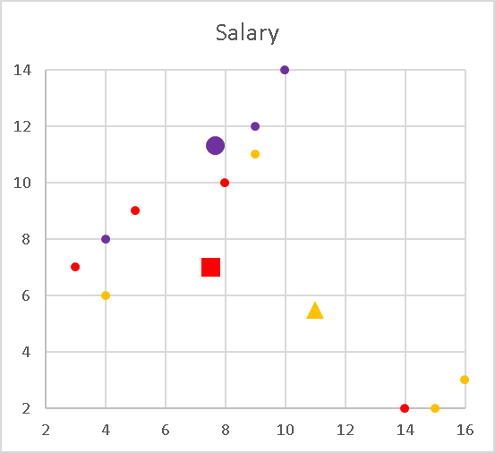
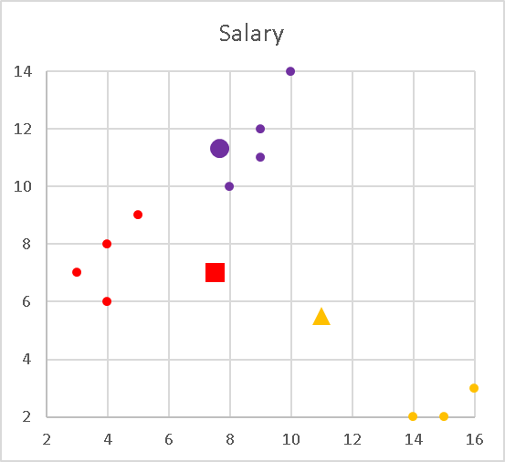
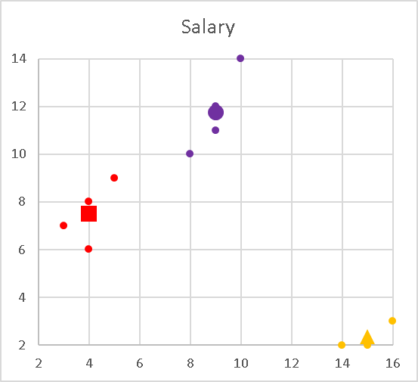
Exercise
1. Init
2. Update Membership
Given the following data, find the clusters using k-means with k=3
Person | Hours | Salary | Init | 1st | 2nd
A | 4 | 8 | X | Y | Y
B | 9 | 12 | X | X | X
C | 10 | 14 | X | X | X
D | 3 | 7 | Y | Y | Y
E | 8 | 10 | Y | X | X
F | 14 | 2 | Y | Z | Z
G | 5 | 9 | Y | Y | Y
H | 16 | 3 | Z | Z | Z
I | 4 | 6 | Z | Y | Y
J | 9 | 11 | Z | X | X
K | 15 | 2 | Z | Z | Z
3. Update Centroids
Init | Avg(Hours) | Avg(Salary)
X | (4+9+10)/3=7.6 | (8+12+14)/3=11.3
Y | (3+8+14+5)/4=7.5 | (7+10+2+9)/4=7
Z | 11 | 5.5
1st | Avg(Hours) | Avg(Salary)
X | 9 | 11.75
Y | 4 | 7.5
Z | 15 | 2.3
2nd | Avg(Hours) | Avg(Salary)
X | 9 | 11.75
Y | 4 | 7.5
Z | 15 | 2.3

Slide 12
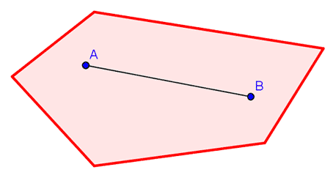
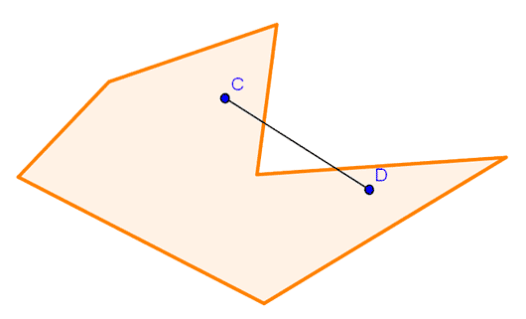
Comments on the K-Means Method
Strength: Efficient: O(tkn), where n is # objects, k is # clusters, and t is # iterations. Normally, k, t << n.
Comment: Often terminates at a local optimal
Weakness
Need to specify k, the number of clusters, in advance (there are ways to automatically determine the best k)
Sensitive to noisy data and outliers
Not suitable to discover clusters with non-convex shapes
Convex Shape Non-Convex shape

