Slide 1
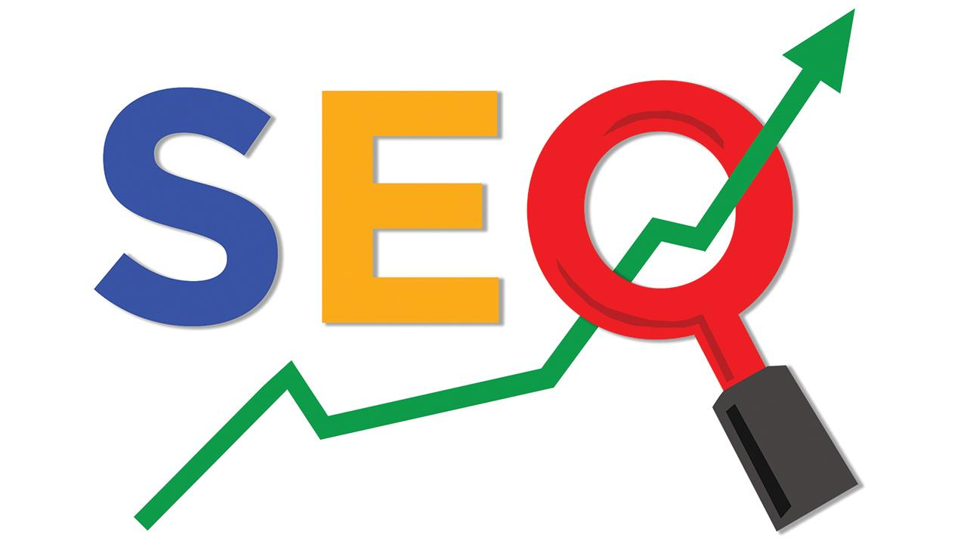
SEARCH ENGINE OPTIMIZATION
Sahar Andaleeb

Slide 2

Week # 01 Topics
SEO Introduction
Development and Growth of Search engine in Cyber Space
History
How Google Search engine Works
Google Ranking
Purpose of SEO
SEO Success Factors
Pull Marketing
Week # 01
SEO
By: Sahar Andaleeb

Slide 3
SEO Introduction
SEO ➔ Search Engine Optimization
Search ?!?
“The process of finding information or resources on the internet using a search engine like Bing or Google.”
Need is something that is essential or necessary for survival, while want is something that is desired or wished for but not essential.
SEARCH
Food, water, shelter, clothing, healthcare, hygiene, sleep, safety, education.
Pizza, soda, mansion, designer clothes, spa, Netflix, vacation, sports car
NEED
WANT
SEARCH INTENT
Week # 01
SEO
By: Sahar Andaleeb

Slide 4
SEO Intent
Intent is very important in marketing. Marketers use this intent as an important information to drive marketing campaigns.
➔Search should be the biggest channel of your web traffic..
➔Search traffic is qualified traffic….chances of conversion→ sales/leads
LEAD: “an individual or organization with an interest in what you are selling”
User search intent is important because it helps search engines provide more relevant and useful results for the user.
Allows website owners and marketers create content that matches the user’s needs and expectations.
Week # 01
SEO
By: Sahar Andaleeb

Slide 5
Classification of Website Traffic
"Search, social, referral, and direct" …. some of main categories website
Search or Organic Traffic: Traffic that that arrive at your site via search engines
Social Traffic: Traffic originating from social media platforms , includes clicks on links shared by users or promoted content on these platforms.
Referral Traffic: Traffic that comes from other websites, includes clicks on links from other websites, blogs, forums, or any other online sources that are not search engines or social media platforms.
Direct Traffic: Traffic that comes from users directly typing a website's URL into their browser, includes traffic from email marketing campaigns.
Paid Traffic, Affiliate Traffic, Email traffic
Week # 01
SEO
By: Sahar Andaleeb

Slide 6
Search Engine
Search Engine: “A software system designed to search for information on the World Wide Web. It retrieves data from its database based on the user's query and presents a list of results that match the query.
This is done by discovering and cataloguing all available content on the Internet (web pages, PDFs, images, videos, etc.) via a process known as “crawling and indexing,” and then ordering it by how well it matches the query in a process we refer to as “ranking.”
Week # 01
SEO
By: Sahar Andaleeb

Slide 7
Types Of Search Engines
..different types of search engines ..
General Search Engines:
Google: The most popular and widely used search engine globally.
Bing: Developed by Microsoft, offering web search, image, video, and map search.
Yahoo!: Provides web search, news, email, and other services.
Specialized or Vertical Search Engines:
YouTube: Specialized in searching for videos.
Amazon: Focuses on searching for products to buy.
Yelp: Concentrates on searching for local businesses and services.
Week # 01
SEO
By: Sahar Andaleeb

Slide 8
Types Of Search Engines… cont.
Academic Search Engines:
Google Scholar: Focuses on scholarly articles, theses, books, and court opinions.
IEEE Xplore: Offers access to scientific and technical content in engineering and technology.
Social Media Search Engines:
Facebook Search: Allows users to search for people, pages, groups, and posts within the Facebook platform.
Twitter Search: Enables users to search for tweets and trending topics on Twitter.
Each type of search engine serves different purposes and caters to specific user needs and preferences.
We will focus on Google
Week # 01
SEO
By: Sahar Andaleeb

Slide 9
Optimization !
Optimization: “the process of making something as effective or efficient as possible.”
maximizing desirable outcomes, minimizing undesirable ones,
or finding the best balance between competing factors.
In the context of SEO (Search Engine Optimization), optimization refers to the process of improving a website's visibility and ranking in search engine results pages (SERPs).
Week # 01
SEO
By: Sahar Andaleeb

Slide 10
SEO
Search Engine Optimization
“Search engine optimization is the practice of optimizing your web pages to increase your website’s visibility organically in the search engine result pages (SERPs).”
The art of being found organically through a search engine.
Week # 01
SEO
By: Sahar Andaleeb

Slide 11
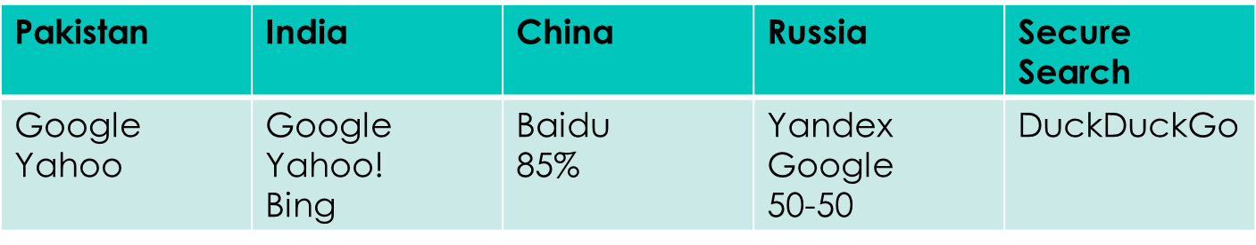
Development and Growth of Search engine in Cyber Space
The development and growth of search engines in cyberspace is influenced by several factors, such as the increasing number of websites, the emergence of Google as the dominant player, the introduction of constant algorithm updates, and the rise of social media and mobile devices.
Week # 01
SEO
By: Sahar Andaleeb

Slide 12
Google
“If it isn’t on Google,
It doesn’t exist.”
Jimmy Wales
As of 2024, Google holds approximately 90% of the global search engine market share.
Google → your new best friend !
Week # 01
SEO
By: Sahar Andaleeb

Slide 13
Why Google?
Google won the search engine race because it’s able to:
Algorithm Quality: It’s search algorithm is known for its accuracy and relevance, a major factor in its popularity.
User Experience: offers a clean, simple interface.
Speed: Google’s search engine provides results almost instantly.
Innovation: consistently invests in new technologies to improve the search experience. E.g., advanced algorithms, machine learning, and AI.
Integration: It integrates well with other services, like Gmail, Google Maps, Google Drive, and Android.
Brand Trust: Over the years, Google has built a strong brand reputation for reliability and accuracy in search.
Week # 01
SEO
By: Sahar Andaleeb

Slide 14
History of Google
Google, founded by Larry Page and Sergey Brin in 1998, began as a research project at Stanford University.
While working on their PhD projects at Stanford University, they were frustrated with the limitations of existing search engines. They envisioned a more effective method for ranking and retrieving web pages based on their link structure.
Their PageRank algorithm, evaluated the importance of pages by their incoming links, and significantly improved search accuracy and relevance.
Originally named as "Backrub," it evolved into Google, derived from the mathematical term "googol“.
Week # 01
SEO
By: Sahar Andaleeb

Slide 15
History of Google
Officially incorporated in 1998 as a company and went public in 2004.
Rapidly gained popularity for its efficient search algorithm.
Over the years, Google expanded its services beyond search to include email (Gmail), online document storage (Google Drive), maps (Google Maps), and video sharing (YouTube).
Google restructured in 2015 and becomes a wholly-owned subsidiary of Alphabet Inc., a new parent company for its various business ventures.
Google continues to expand its services, including advancements in AI, cloud computing, and hardware.
Week # 01
SEO
By: Sahar Andaleeb

Slide 16
How Google Search engine Works
How search engine works
https://www.youtube.com/watch?v=LVV_93mBfSU
How Google Search works?
https://www.youtube.com/watch?v=0eKVizvYSUQ
Week # 01
SEO
By: Sahar Andaleeb

Slide 17
Google Algorithm
Google Algorithm:
“Google algorithm is a complex set of rules and calculations used by the Google search engine to determine the relevance and ranking of web pages in search results.”
Week # 01
SEO
By: Sahar Andaleeb

Slide 18
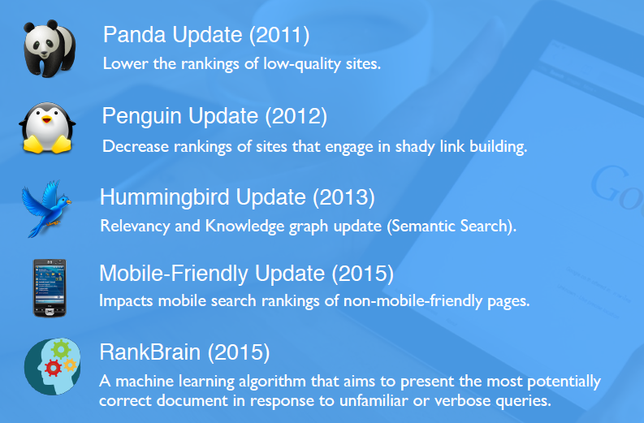
Google’s Imp. Algorithms
Week # 01
SEO
By: Sahar Andaleeb

Slide 19
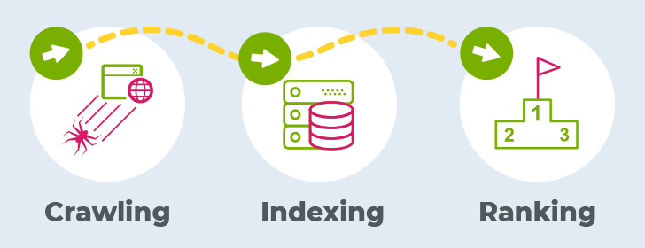
How Google Search Engine Works?
Working → 3 main steps:
Crawling
Indexing
Ranking
SERP
Week # 01
SEO
By: Sahar Andaleeb

Slide 20
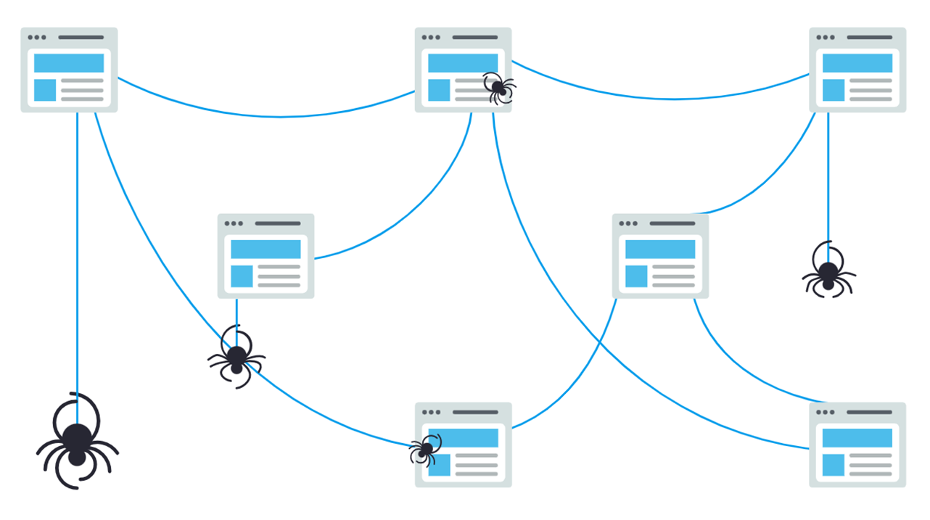
Cont.. Crawling
Crawling: (discovery phase)
The internet is web of pages connected to each other by hyperlinks. Google’s robots, run through these pages to gather new information. Following links from one page to another, they discover new information and add it to Google's index.
Google’s robots are known as Googlebots, crawlers or spiders
GoogleBot: “Small automated software program → fetch new content”
The content can be in various forms such as webpages, PDFs, images, videos or anything that can be linked to.
Week # 01
SEO
By: Sahar Andaleeb

Slide 21
Cont.. Indexing
Indexing:
Once a page is crawled. The next step is to Store and organize the new discovered content in a huge database of URLs. Once a page is in the index, it’s in its ready state to be displayed as a result to relevant queries.
Week # 01
SEO
By: Sahar Andaleeb

Slide 22
Cont.. Ranking
Ranking:
Once the URLs are in the database, the ranking process begins. At this stage, Google's algorithm sorts the search results for each query based on relevance, arranging them from most relevant to least relevant.
Finally, Google displays the search results on its Search Engine Results Page (SERP), listing the most relevant pages based on the algorithm's evaluation.
Week # 01
SEO
By: Sahar Andaleeb

Slide 23
SERP
SERP: Search Engine Result Page
It is the page that displays the results of a search query on a search engine like Google or Bing.
SERPs can contain different types of information and features, depending on the query and the search engine.
Week # 01
SEO
By: Sahar Andaleeb

Slide 24
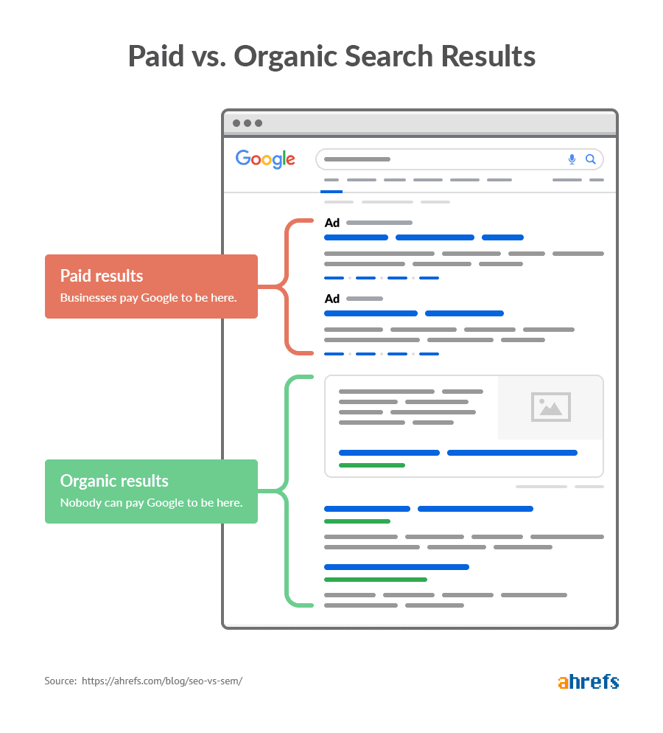
Google SERP
Week # 01
SEO
By: Sahar Andaleeb

Slide 25
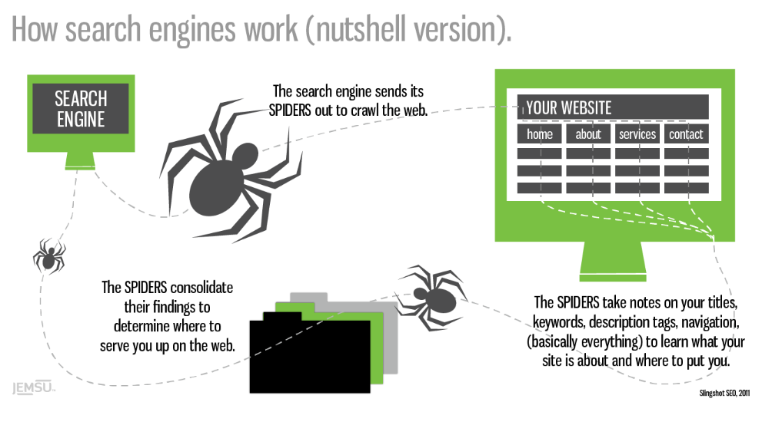
Quick Overview SE Working
Week # 01
SEO
By: Sahar Andaleeb

Slide 26
Google Ranking
Relevance: Google analyzes the content and structure of each web page to determine how well it matches the search intent and keywords of the user.
Authority: Google evaluates the trustworthiness and popularity of each web page based on the number and quality of other sites that link to it.
Usefulness: Google assesses the user experience and functionality of each web page based on factors such as load speed, mobile-friendliness, and readability.
Week # 01
SEO
By: Sahar Andaleeb

Slide 27
History Of SEO
The history of SEO dates back to the mid-1990s, when the first search engines emerged, such as AltaVista, Yahoo, and WebCrawler. The early SEO techniques involved keyword stuffing, meta tags, and link building.
Week # 01
SEO
By: Sahar Andaleeb

Slide 28
Purpose of SEO
To increase the quantity and quality of traffic to a website from search engines
To target specific keywords and topics that match the user’s intent and the website’s goals
To enhance the user experience and usability of a website
To build trust and authority for a website in its niche
To gain a competitive edge over other websites in the same industry
Week # 01
SEO
By: Sahar Andaleeb

Slide 29
Importance of SEO
SEO yields Following benefits to website Owners:
Generates more traffic
Consistent traffic
Improves user experience
Yields high ROI
Week # 01
SEO
By: Sahar Andaleeb

Slide 30
SEO Success Factors
Quality Content: Create valuable, relevant, and engaging content that addresses users' needs and interests.
Keyword Optimization: Research and use relevant keywords strategically throughout your content.
Mobile-Friendliness: Ensure your website is optimized for mobile devices to provide a seamless user experience.
Page Speed: Improve loading times to enhance user experience and decrease bounce rates.
Technical SEO: Optimize technical aspects such as site structure, URL structure ,etc., → Make it attractive for search engine crawlers.
Backlinks: Earn high-quality backlinks from authoritative websites to increase your site's authority and trustworthiness.
Week # 01
SEO
By: Sahar Andaleeb

Slide 31
SEO Success Factors..cont..
User Experience (UX): Focus on providing a positive user experience through intuitive navigation, clear calls-to-action, and easy-to-use interfaces.
On-Page Optimization: Optimize meta titles, descriptions, headings, and image alt texts to improve search engine visibility.
Local SEO: If applicable, optimize your website for local search by claiming your Google My Business listing and ensuring consistent NAP (Name, Address, Phone Number) information across online platforms.
Analytics and Monitoring: Regularly monitor your website's performance using tools like Google Analytics and Google Search Console to track progress and identify areas for improvement.
Week # 01
SEO
By: Sahar Andaleeb

Slide 32
Push Marketing
Push Marketing:
“Push marketing is a traditional approach where businesses actively push their products or services to potential customers.”
Involves promotional efforts
(customer is not actively seeking it, rather the product/service is pushed to become visible..).
The goal of push marketing is to generate immediate sales by directly promoting products or services to potential customers.
Examples:
TV commercials,
radio ads, email marketing campaigns.
Week # 01
SEO
By: Sahar Andaleeb

Slide 33
Pull Marketing
Pull Marketing:
“Pull Marketing, is a strategy where businesses create demand for their products or services by attracting and engaging potential customers.”
Instead of pushing products onto customers, pull marketing aims to pull or attract customers towards the brand.
Focus is on creating valuable content, building brand awareness, and establishing a strong online presence to draw customers in.
Examples:
SEO
SMM
Influencer marketing
The goal of pull marketing is to generate sales through customer attraction rather than aggressive promotion.
Week # 01
SEO
By: Sahar Andaleeb

Slide 34
Assignment # 01
Study both White Hat SEO and Black Hat SEO techniques. (make notes)
Q.1 Write differences between both strategies in in tabular/column format.
Q.2 What are Gray Hat techniques? Should we use it? Give your opinion in 2-3 lines.
C
Create an account on gmail and signin to Google Keyword PLanner
Week # 01
SEO
By: Sahar Andaleeb

