Slide 1

Keywords
Sahar Andaleeb
Week # 02
KEYWORDS
By: Sahar Andaleeb

Slide 2
Topics to cover
Keywords
Introduction
Purpose
Types
Keyword Researching and Planning Tools
Mapping Keywords to Webpage
Week # 02
KEYWORDS
By: Sahar Andaleeb

Slide 3
NIche
Niche: “A niche is a specialized segment of broader market for a particular product, audience, or service.”
a portion that is united by a common interest and/or demographic
covers various aspects of the same domain
Example:
Digital Marketing (various aspects of promoting products or services on the internet. )
Food (producing, processing, preparing, consuming)
Cars (designing, manufacturing, selling)
Jewellery (designing, making, selling, and wearing)
Week # 02
KEYWORDS
By: Sahar Andaleeb

Slide 4
Macro niche
Macro Niche: “Macro niches are broad segments within a niche that is still relatively broad and covers a range of topics.”
Examples:
SEO (OnPage, OffPage, Local, Technical)
Vegan food
Electric Cars
Handmade jewellery
Week # 02
KEYWORDS
By: Sahar Andaleeb

Slide 5
Micro niche
Micro Niche: “Micro niches are narrower segments within macro niches, focusing on more specific products or services.”
Subcategory of macro niche
Examples:
Local SEO
Vegan baking
Tesla
handmade wire-wrapped jewelry
Week # 02
KEYWORDS
By: Sahar Andaleeb

Slide 6
Nano niche
Nano Niche: “Nano niches are highly specialized and targeted segments within micro niches.”
serving very particular needs or interests.
Examples:
Dentist local SEO (Optimizing websites only for dentist in local search results)
Gluten-free brownies
Tesla Model 3 Performance
Handmade wire-wrapped crystal jewelry
Week # 02
KEYWORDS
By: Sahar Andaleeb

Slide 7
Niche selection
Digital Marketing
SEO
Local SEO
Dentist Local SEO
Food
Vegan Food
Vegan Baking
Gluten-Free Brownies
Cars
Electric Cars
Tesla
Tesla Model 3 Performance
Jewelry
Handmade Jewelry
Handmade wire-wrapped jewelry
Handmade wire-wrapped crystal jewelry
Week # 02
KEYWORDS
By: Sahar Andaleeb

Slide 8
keyword
Keyword:
“A keyword is a word or phrase that user enter into search engines to search for desired content on the internet.”
Search queries contains keywords.
Honda civic for sale
Lasagna
Hangout place
Hangout places in Islamabad
Keywords are important in SEO, as they help your website to rank for topics that your audience is looking for.
Week # 02
KEYWORDS
By: Sahar Andaleeb

Slide 9
Difference between niche and keyword
Niche is a specific topic or industry that you want to focus on with your content, helps you to target specific audience to offer to.
E.g: Freelance writing
While
Keyword is a word or phrase describing content of your website and helping you rank a specific term that your audience is searching for.
E.g: Content Writing
Week # 02
KEYWORDS
By: Sahar Andaleeb

Slide 10
Importance of keywords
"Keywords play a crucial role as they bridge the gap between users' search queries and the content you offer to meet those needs.
Your goal in ranking on search engines is to drive organic traffic to your site from the SERPs.
To create content that ranks well organically and drives visitors to your site, you need to understand the needs of those visitors — the language they use and the type of content they seek.
….And that’s where Keyword Research comes in.
Week # 02
KEYWORDS
By: Sahar Andaleeb

Slide 11
Types of keywords
There are different types of keywords based on length, search intent and competition.
Primary
Secondary
Informational
Navigational
Commercial
Transactional
LSI
Short-Tail
Long-Tail
Singular & Plural Keywords
Week # 02
KEYWORDS
By: Sahar Andaleeb

Slide 12
Types of keywords based on length
Short-Tail Keywords: “Keywords are the generic queries.”
These keywords usually have one to two words in length.
high search volumes
high competition
low conversion rate
dogs, cat food, books
Long-Tail Keywords: “These are more specific keywords with clear customer intent.”
Usually have five or more words in length”..
low search volumes
low competition
high conversion rate
Dogs that are good with kid, best book for learning SEO
Week # 02
KEYWORDS
By: Sahar Andaleeb

Slide 13
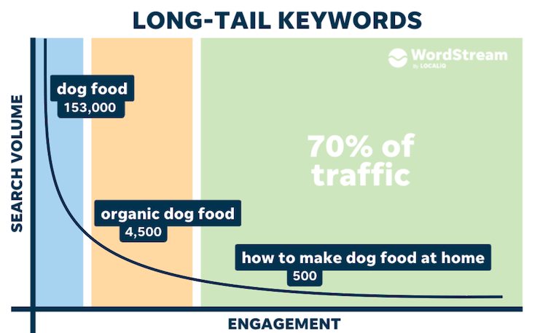
Short-tail vs. long-tail keywords
Long tail keywords with lower search volume often convert better, because searchers are more specific and intentional in their searches.
For example, a person searching for "shoes" is probably just browsing. On the other hand, someone searching for "best price red women size 7 running shoe" practically has their wallet out!
Week # 02
KEYWORDS
By: Sahar Andaleeb

Slide 14
Primary, secondary and tertiary keywords
Primary Keywords are the main keywords that you want to rank for.
highly relevant, high search volume
“Buy Laptops Online”
Where as Secondary Keywords are the keywords that support your primary keyword.
They are related terms,
Provides context and depth to your content.
“Affordable Laptops”, “Laptop Reviews”
Tertiary Keywords are more specific, long tail keywords.
less competitive but can attract highly targeted traffic.
Often addresses specific queries.
“Best laptops under $500” , “Laptops with long battery life”
Week # 02
KEYWORDS
By: Sahar Andaleeb

Slide 15
primary keyword vs seed words
Primary keywords are the main terms of your content where as Seed words (aka. seed keywords) or Head words, are the starting point for keyword research.
Example:
Online shoe store (Primary KW)
Shoes(Seed KW)
Handmade beaded bangles (Primary KW)
Handmade jewellery (Seed KW)
So although primary and seed word can sometimes overlap but they serve slightly different purposes in keyword research.
Week # 02
KEYWORDS
By: Sahar Andaleeb

Slide 16
LSI keywords
LSI: Latent Semantic Indexing
(Hidden) (meaning) (Google)
“ Keywords that are conceptually related to targeted keyword.”
Search engines use LSI keywords to deeply understand the content on a webpage.”
Improves relevancy and hence SEO.
Example:
Main keyword → “New Car Features”
some LSI keywords could be:
Automobile, engine, road, tiers, vehicle

Slide 17
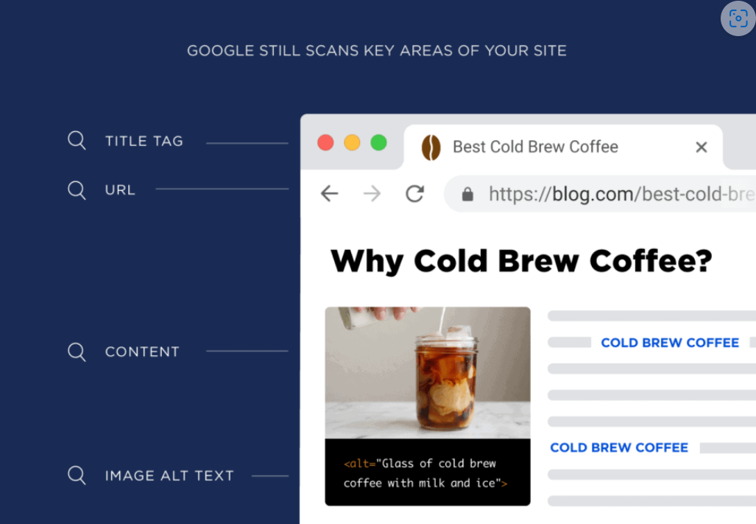
LSI keywords examples

Slide 18
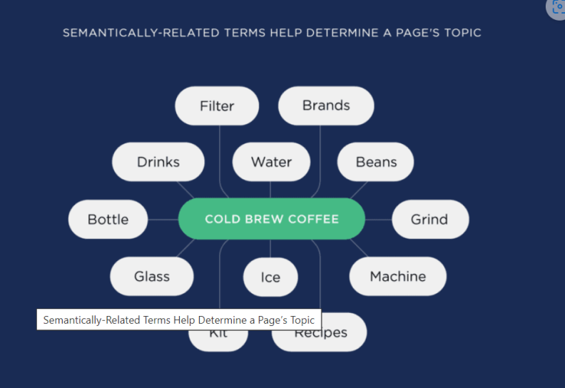
Cont.
Google looks for semantically related terms.
Some of the term related to “Cold brew coffee” are beans. Ice, glass, iced coffee, cold brew coffee brands etc.

Slide 19
Types of keyword based on user intent
Informational
Navigational
Commercial
Transactional

Slide 20
Informational Keywords
Informational Keywords:
“informational keywords are used by user when they are simply gathering general information.
A broad term that encompasses both Primary and Secondary keywords.
How
What
why
They are usually higher in the marketing funnel, meaning that people are earlier in their buying journeys and less likely to take action.

Slide 21
nevigational Keywords
Navigational Keywords: “Navigational keywords are the words that users use when they intend to find a specific website or online destination”.
A keyword that has fixed direction
User intend is fixed
White A4 paper rim Amazon
For brand awareness
Navigational can help you gain organic traffic, especially if your company has a strong brand reputation.
a company or brand name
Youtube
Sapphire
Charles&Keith

Slide 22
Commercial Keywords
Commercial Keywords: (commerce, business)
“keywords that reveal a searcher’s interest around specific products or services.”
These keywords indicate users are exploring options before making a purchase.
support the idea of purchasing, compare the product to similar products or look for free offers/tests/discounts.
You can target these keywords with comparison articles, reviews or how-to articles depending on the specific keyword.
Free coffee
Best blender for smoothies
iPad vs. iPad Air
Show website

Slide 23
TRAnsactional Keywords
Transactional Keywords:
“These are terms and phrases used by people who want to complete an action.”
keywords with the strongest intent to buy.
They are usually lower in the marketing funnel, meaning that people are ready to make a purchase or take an action.
Examples:
Buy crypto online
Honda city for sale
pizza place near me
Buy puff pastry dough online
Show product

Slide 24
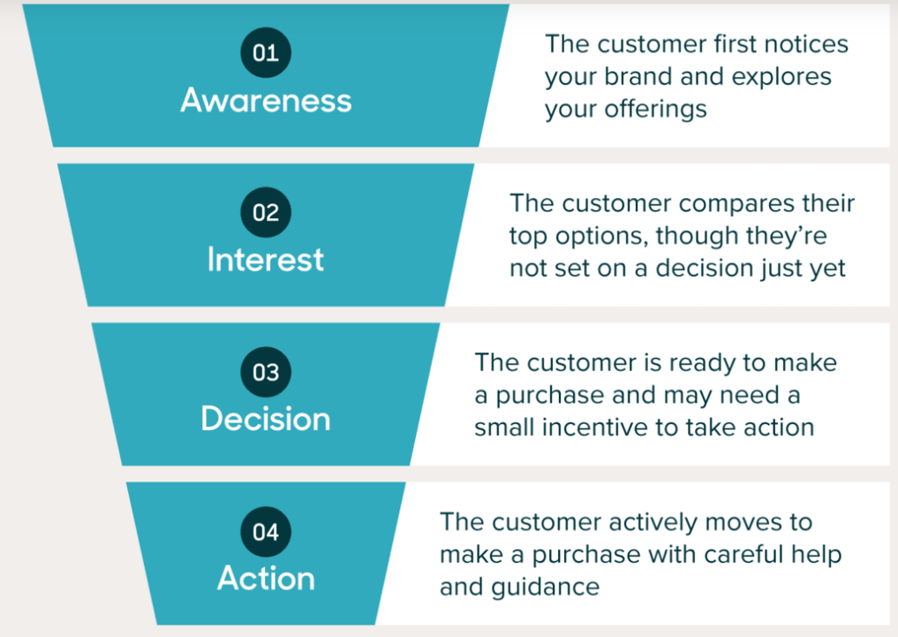
Marketng funnel
A marketing funnel is a way of visualizing the stages that a potential customer goes through before making a purchase. It usually consists of three main stages: awareness, consideration, and conversion.
The funnel shape represents the fact that not everyone who becomes aware of your product or service will end up buying it.
people will drop out at each stage.

Slide 25
Importance of keyword research
Process of discovering needs of target audience is very important.
What your to-be customers are searching for?
Done via keyword research
Best keyword research strategy should not be what you want to tell people but what they want to discover?
Week # 02
KEYWORDS
By: Sahar Andaleeb

Slide 26
Cont..
The power of keyword research lies in better understanding your target market and how they are searching for your content, services, or products.
Keyword research provides you with specific search data that can help you answer questions like:
What are people searching for?
How many people are searching for it?
In what format do they want that information?
Week # 02
KEYWORDS
By: Sahar Andaleeb

Slide 27
Keyword Research Tools
Ahrefs
SEMrush
Ubersuggest
Google Keyword Planner
MOZ Keyword Explorer
Keyword Tool
Keywords everywhere (browser extension)
KWFinder
Ranknow.pk
Week # 02
KEYWORDS
By: Sahar Andaleeb
Notes:
KW – Research …There is no cookie cutter formula to get you the keywords

Slide 28
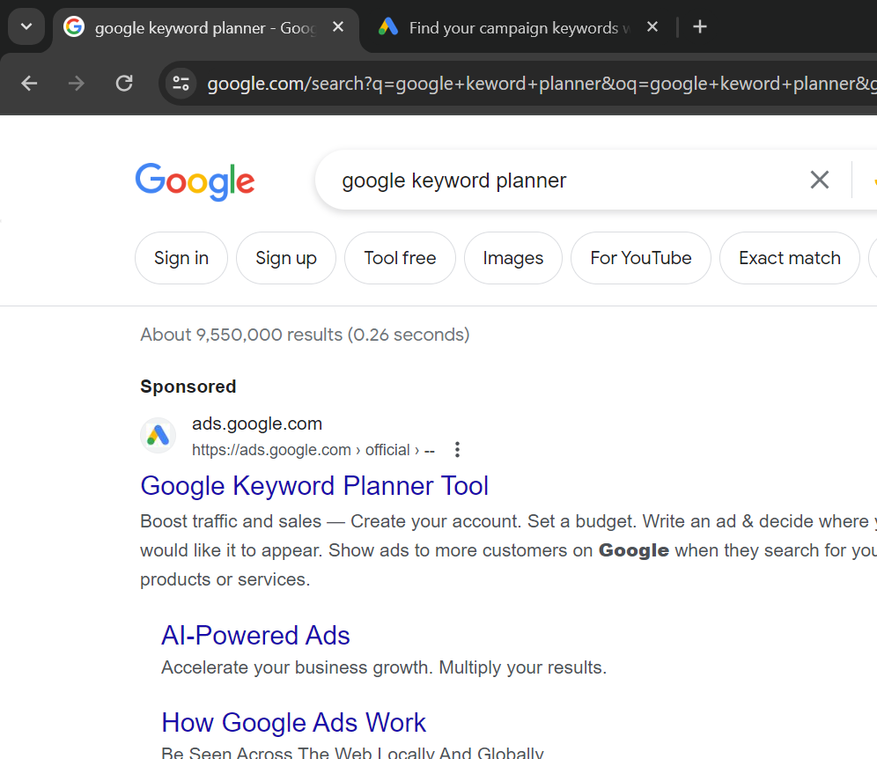
Google keyword planner
Keyword Planner helps you research keywords for your Search campaigns.
Check estimates of the searches they receive and the cost to target them.s
You can use this free tool to discover new keywords related to your business.
USE Google Keyword Planner tool for Keyword Research
but NOT for keyword Analysis
Notes:
While signing in, Skip the steps that involve ‘Create Campaign’ via ‘Expert Mode’ , sign in the tool. (avoid putting credit card credentials)

Slide 29
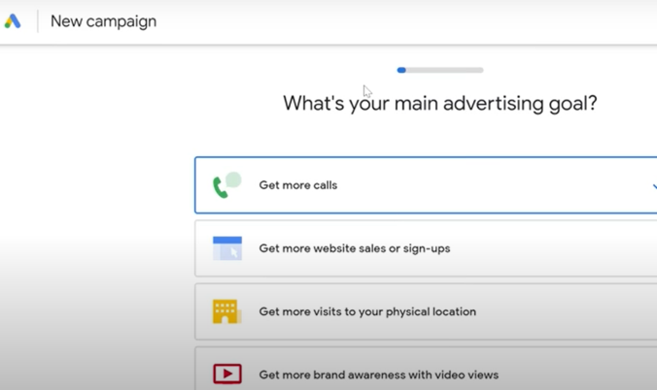
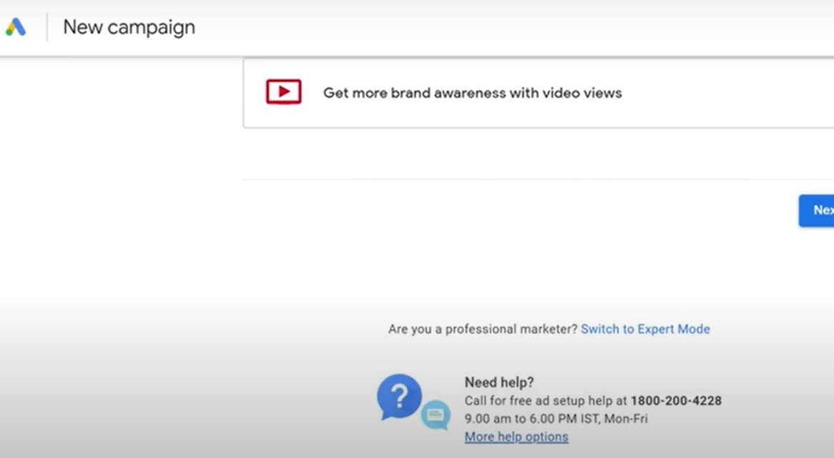
keyword planner… sign in
Notes:
While signing in, Skip the steps that involve ‘Create Campaign’ via ‘Expert Mode’ , sign in the tool. (avoid putting credit card credentials)
s

Slide 30
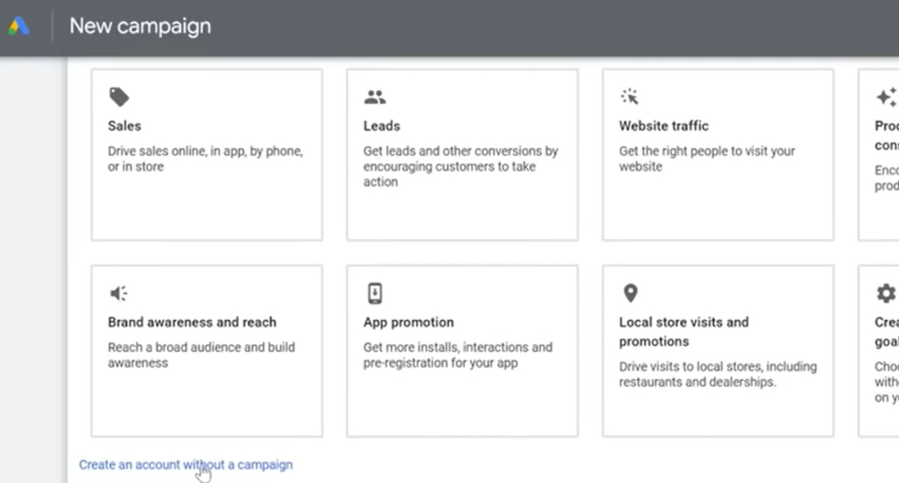
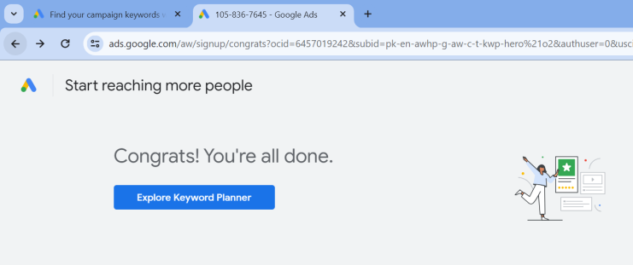
Sign in …. Cont.

Slide 31
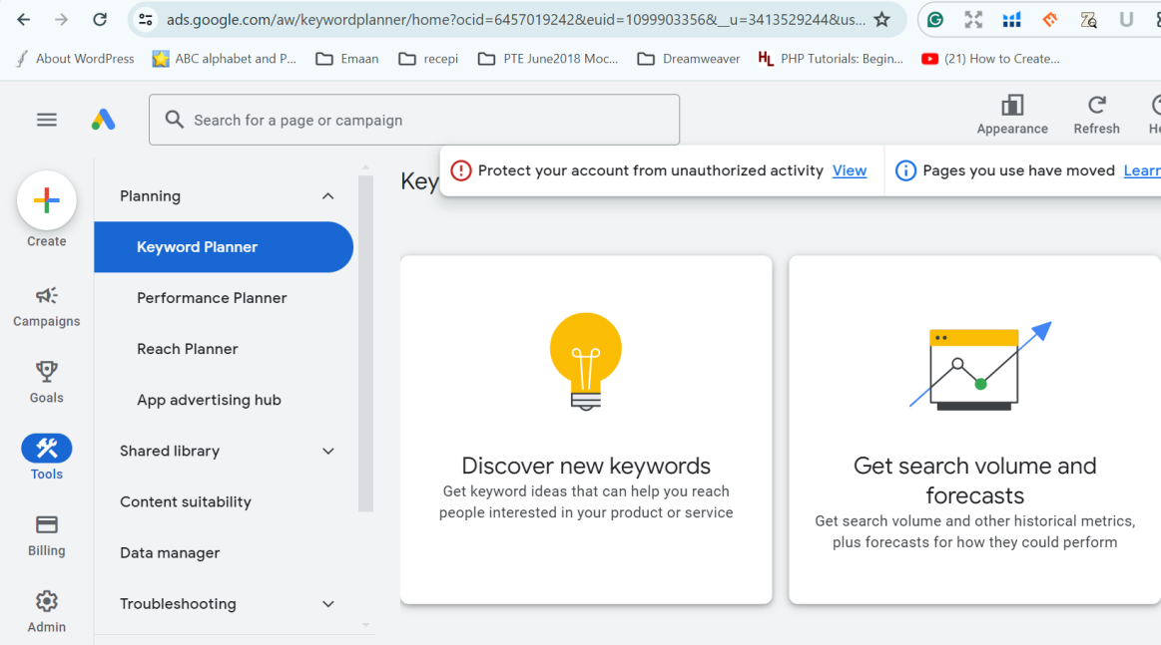
Google keyword planner… Interface
Tools → Planning →Discover new keywords
Notes:
USE Google Keyword Planner tool for Keyword Research but NOT for keyword Analysis
While signing in, Skip the steps that involve ‘Create Campaign’ via ‘Expert Mode’ , sign in the tool. (avoid putting credit card credentials)

Slide 32
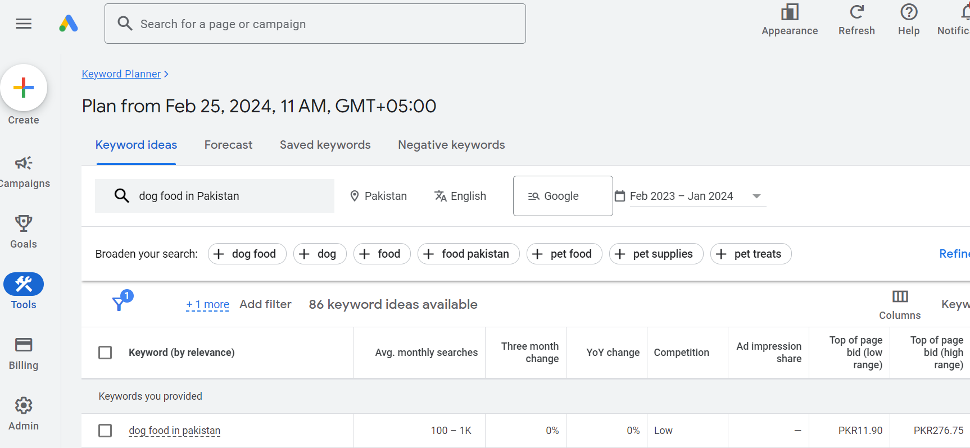

Slide 33
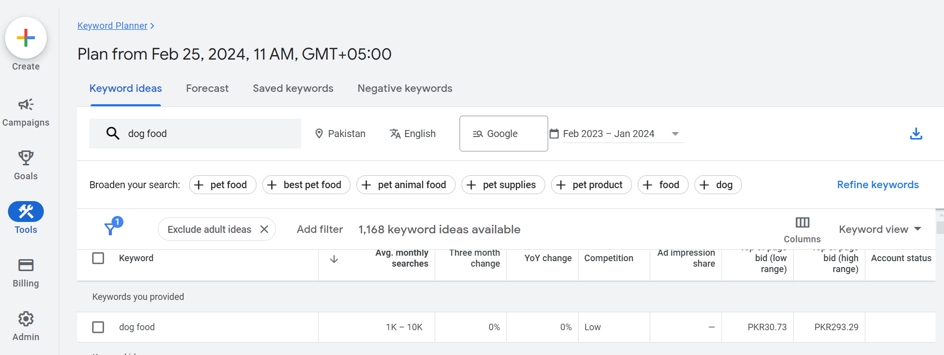
Keyword planner - Details
Sorting of Avg. monthly searches
Download → .csv

Slide 34
Steps to find relevant keywords
Niche identification
Brainstorming
Make a list of keywords you already know about your business.
List them on Excel Sheet
Use Google search engine for further ideas
Continue listing
Use Google Keyword Planner tool
Generate more ideas according to volume and competition
Download .csv → Rename*
Clean your excel file → delete unwanted data
Notes:
Rename every excel file with the seed keyword

Slide 35
Finding relevant keywords… cont.
Use paid tool for all the generated ideas
Getting more specific
Keep on downloading → synchronizing →cleaning ().xlsx
Refine your final Excel sheet until 10-12 keywords are left
Delete keywords with repeated words, words with undesired intent
Decide a threshold of volume and competition
Decide for your primary and secondary keywords
Notes:
Rename every excel file with the seed keyword

Slide 36
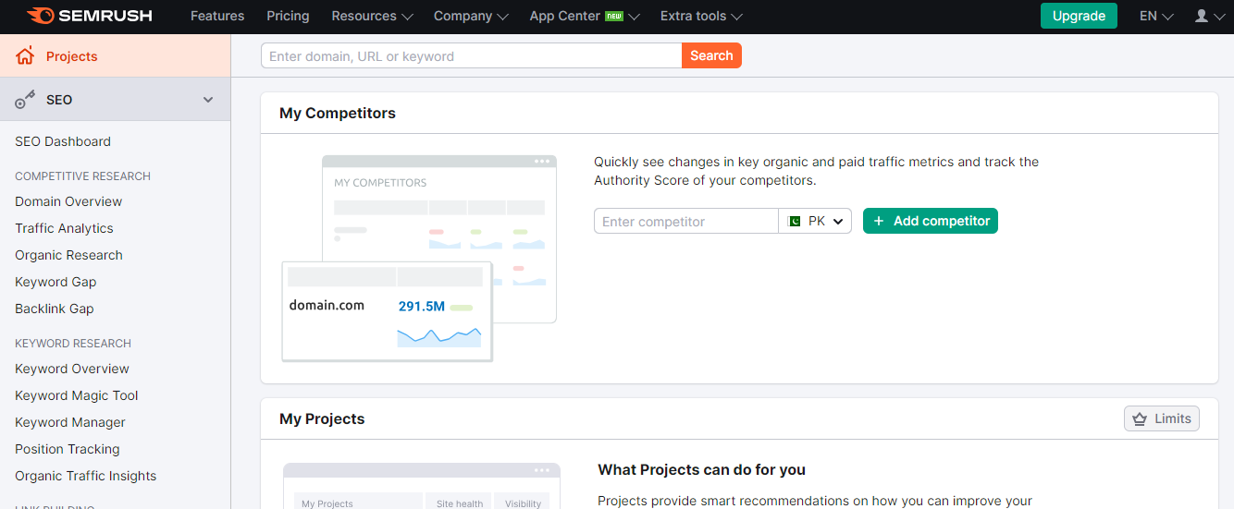
SEMRUSH TOOL

Slide 37
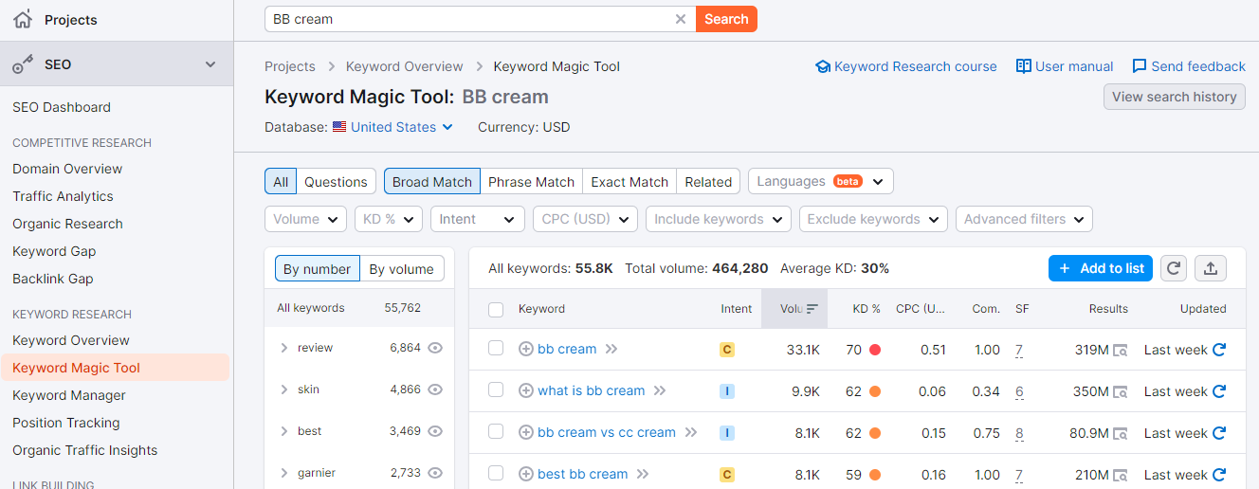
SEMRUSH … CONT.

Slide 38
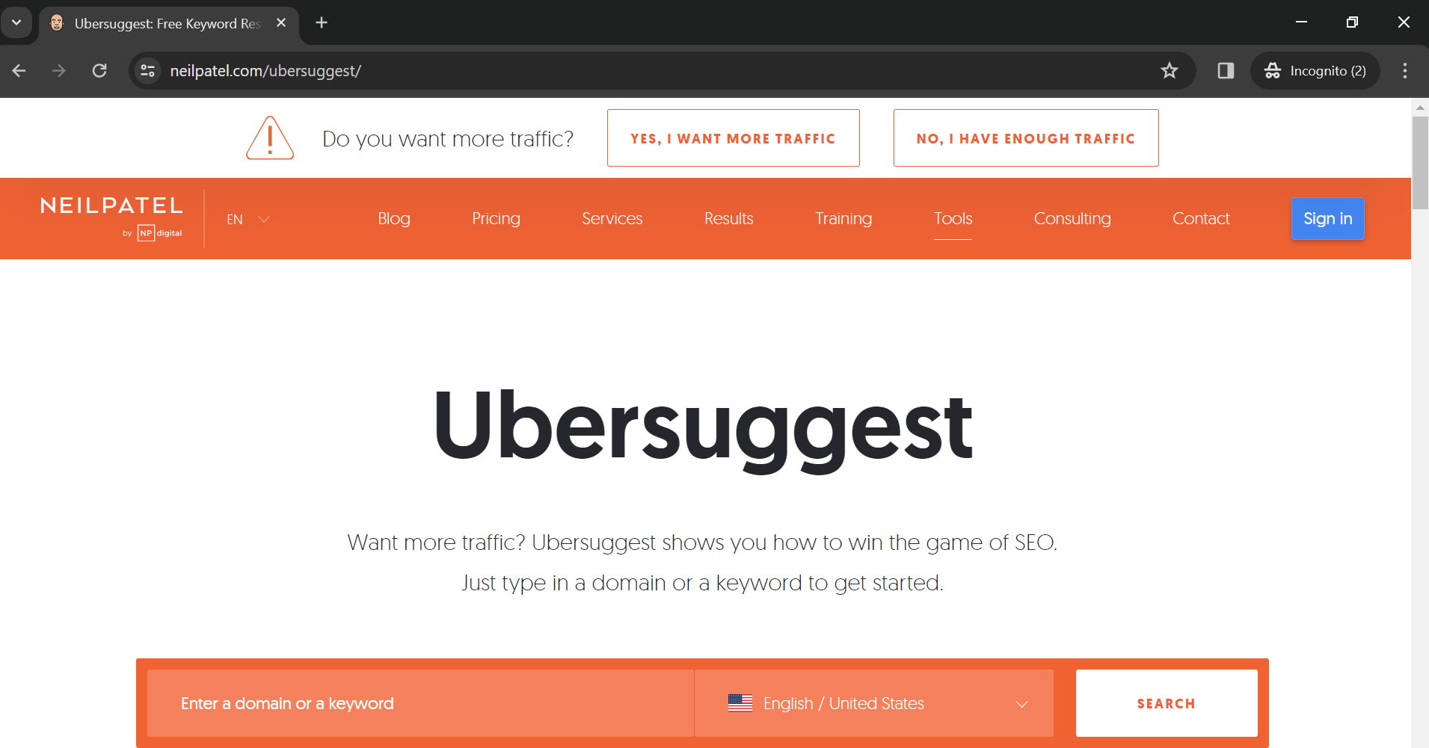
Ubersuggest tool

Slide 39
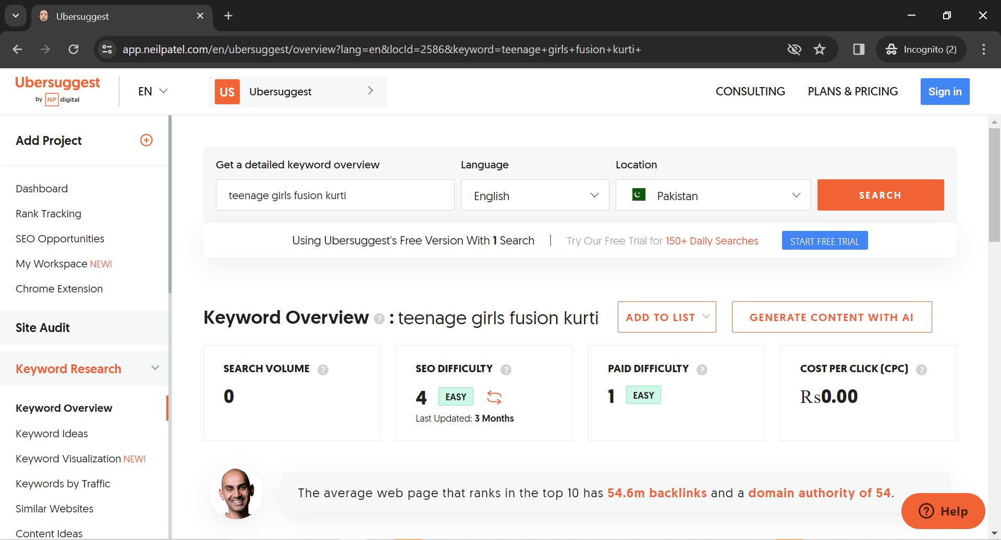
Ubersuggest tool … cont.

Slide 40
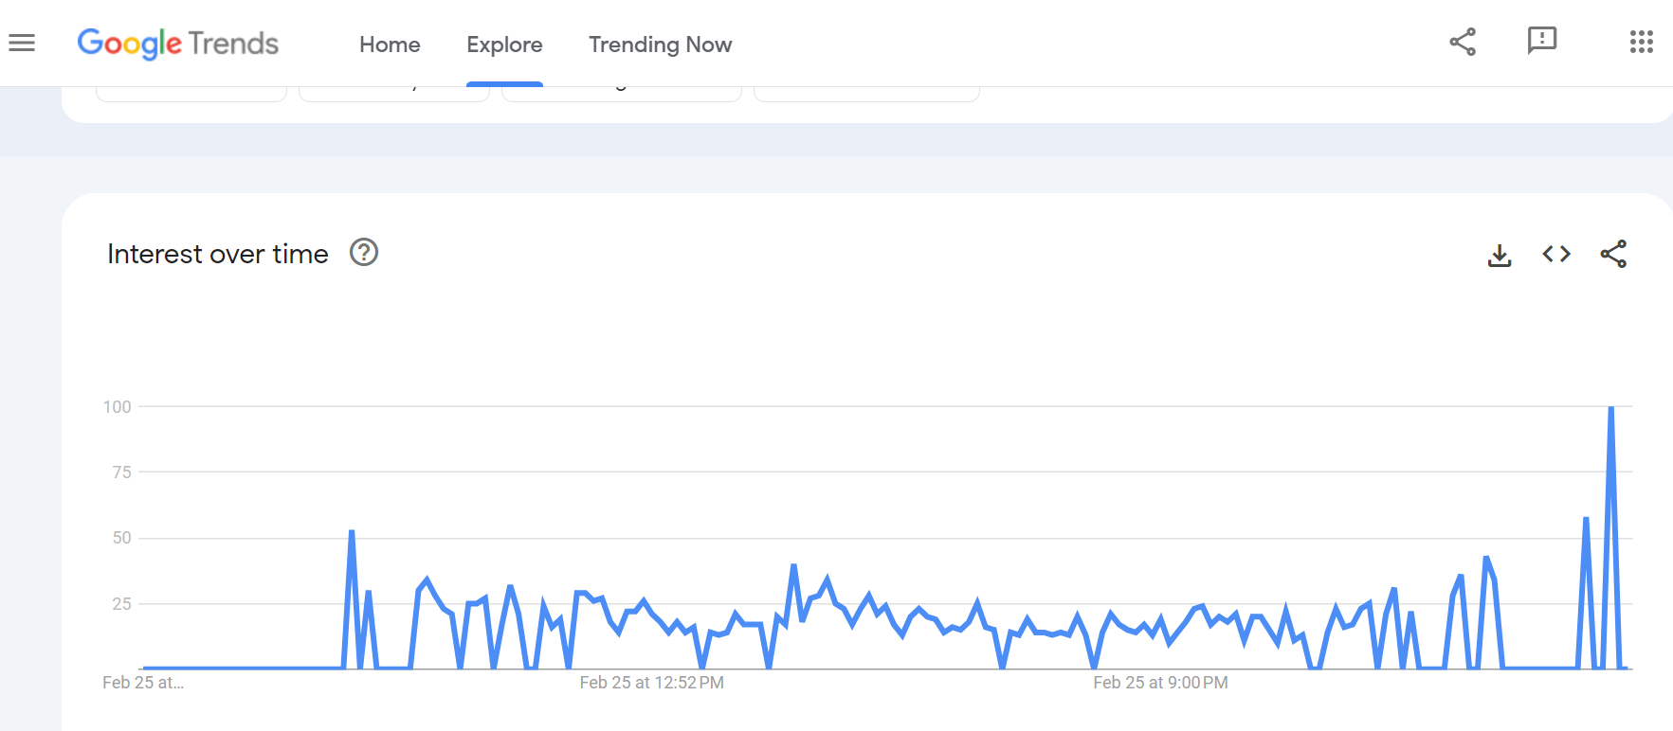
Google trends tool

Slide 41
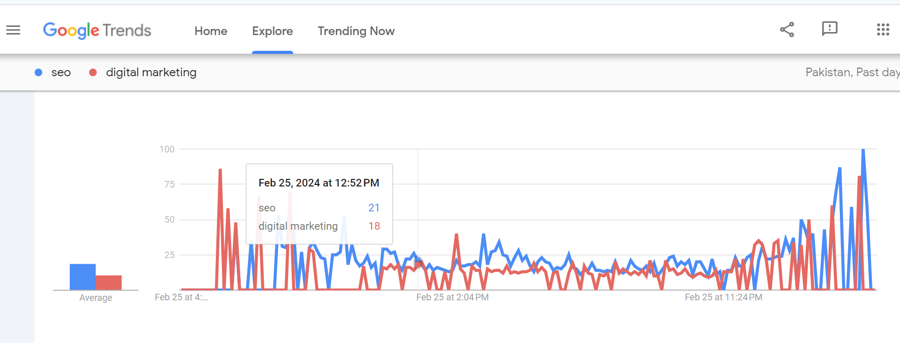
Google trends tool … cont.

Slide 42
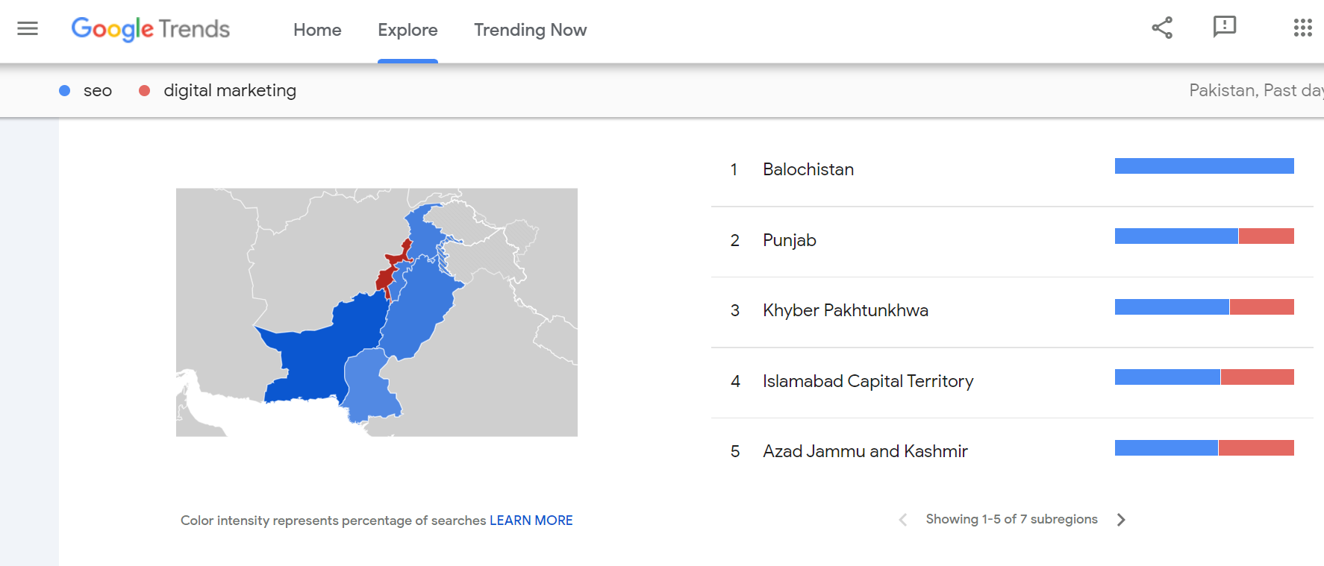
Google trends tool … cont.

Slide 43
Keyword research mistakes
Ignoring Keyword Intent
Why someone is searching
What is the person looking for
Getting information ( I ), comparing products/services (c), Buying (T)
Allowing clients to choose keywords
Client’s list should be seed words
Your client may think they know what people want? But keyword research should be based on data and not gut instincts.
Forgetting to look at the SERPs
what type of content is ranking for your top terms and use that to inspire your campaigns.
Look at the SERPs that come up when you enter a keyword.
Analyze historical trends

Slide 44
Keyword research mistakes … cont.
Aiming for one keyword per piece of content, not considering related terms.
Targeting high volume keywords only
Avoiding long tail keywords
Not knowing channels your customers are searching
Bing? Twitter? Facebook?
Words ranking well on Google does not mean they will rank well on yahoo.
Pay attention to the channels used by your users
Not paying attention to keyword localization
Keyword localization or terms used for location
People in different parts of country/ world may use different word
Soda, coke

Slide 45
Keyword research mistakes … cont.
Shunning your competitor
Study your competitor
What keywords they have used and what are they ranking for
Passing over keyword Difficulty

Slide 46
Mapping keywords to webpage
There are some basic keyword usage rules you should follow to get started.
Unique keywords should be employed on each page of your site in the areas that bots and humans normally look to reassure them that you have what they're after.
The key areas that you should place your primary keywords include:
URL
Title Tags
Meta description tag
H1,H2
Body of the content
Image Alt Attribute

Slide 47
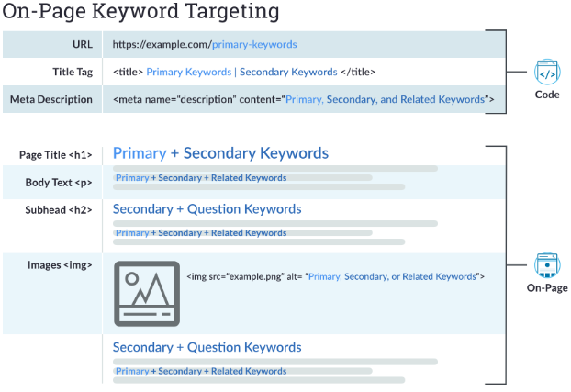
Placing Keywords: on-page keyword

