Slide 1
sem
Search engine marketing
Sahar andaleeb
Week # 12-13
SEM
By: Sahar Andaleeb

Slide 2
Digital marketing
What is Digital Marketing?
Marketing conducted via digital avenues.
“Digital Marketing is the practice of promoting products or services with the help of digital devices and technology.”
Also known as online marketing or internet marketing.
Digital chanals !! “online channels such as websites, search engines, social media platforms, email, and mobile apps.”
Marketing: “The process of promoting and selling products or services by understanding and satisfying customer needs.”
“Ignoring online marketing is like opening a business but not telling anyone,”
Week # 12-13
SEM
By: Sahar Andaleeb

Slide 3
Digital vs. traditional Marketing
Traditional Marketing:
Channels: Traditional marketing relies on offline channels such as television, radio, print media (newspapers, magazines), direct mail, billboards, and in-person events.
Reach: It typically targets mass audiences through broad-reaching platforms and does not offer much personalization.
Engagement: Interaction with audiences is limited, and feedback mechanisms are often slower compared to digital channels.
Measurability: It can be challenging to measure the effectiveness of traditional marketing efforts accurately.
Cost: Traditional marketing methods can be expensive, especially for small businesses, and ROI may be harder to quantify.
Week # 12-13
SEM
By: Sahar Andaleeb

Slide 4
Digital vs. traditional Marketing …cont.
Digital Marketing:
Channels: Digital marketing leverages online channels such as websites, search engines, social media platforms, email, and mobile apps.
Reach: Allows targeted audience based on demographics, interests, behavior, and other data, enabling personalized communication.
Engagement: Digital marketing offers greater interactivity and engagement opportunities through features like comments, shares, likes, and reviews.
Measurability: It provides robust analytics and tracking tools to measure the performance of campaigns in real-time, enabling marketers to optimize strategies based on data insights.
Cost: Digital marketing is often more cost-effective, providing budget-friendly options like (PPC) advertising, social media ads, and email marketing, allowing for spending adjustments based on performance.
Week # 12-13
SEM
By: Sahar Andaleeb

Slide 5
Inbound & outbound marketing
Inbound marketing: Attracts and engages customers through valuable content and experiences tailored to their needs and interests, drawing them towards the brand naturally.
Outbound marketing: Proactively reaches out to potential customers through traditional advertising and promotional methods, often interrupting their activities to deliver messages about products or services.
Week # 12-13
SEM
By: Sahar Andaleeb

Slide 6
Importance of digital marketing
Digital marketing is one of the most popular and powerful ways to generate awareness, interest and sales for your products or services.
Digital marketing is vital for businesses today. With almost every brand having a website or some form of digital presence, those without a digital presence, risk falling behind. Consumers rely on digital content to learn about brands, making it a crucial channel for engagement. Overall, digital marketing allows businesses to connect with their audience where they spend most of their time - online.
Week # 12-13
SEM
By: Sahar Andaleeb

Slide 7
Importance of digital marketing …cont.
The best digital marketers have a clear picture of how each digital marketing campaign supports their overarching goals.
And depending on the goals of their marketing strategy, marketers can support a larger campaign through the free and paid channels at their disposal.”
Global reach & Local reach
Low cost
Effective targeting
Multiple content types
Increased engagement
Multiple strategies
Week # 12-13
SEM
By: Sahar Andaleeb

Slide 8
Types of digital marketing
Search Engine Optimization (SEO): "Optimizing your website to "rank" higher in SERPs."
OnPage, OffPage, Tchnical, Local
Social Media Marketing: “Promoting your brand on social media channels to increase brand awareness, traffic, and leads for your business.”
Facebook, Twitter LinkedIn, Instagram, Snapchat, Pinterest, TikTok
Content Marketing: “Every effort to market through online content is considered content marketing.
Content marketing aims to entice leads to convert into customers.
Blog posts, Infographics, Videos, eBooks
Week # 12-13
SEM
By: Sahar Andaleeb

Slide 9
Types of digital marketing …cont.
Email Marketing: "Companies use email marketing as a way of communicating with their audiences.”
Blog subscription newsletters.
Follow-up emails to website visitors who downloaded something.
Customer welcome emails.
Holiday promotions to loyalty program members.
Tips or similar series emails for customer nurturing.
Week # 12-13
SEM
By: Sahar Andaleeb

Slide 10
Types of digital marketing …cont.
Affiliate Marketing: “A type of digital marketing in which companies reach out to third party websites to advertise their products and services. Also known as referrals.
Registrations, Email sign-ups, Sales and Subscriptions
Mobile Marketing: “A type of digital marketing focused on reaching the target audience via mobile devices.”
Push notifications, MMS(Multimedia Messaging Service), SMS(Short Message Service), WhatsApp.
Search Engine Marketing: “A digital marketing strategy that increases the visibility of websites in search engine results pages (SERPs) using paid advertising.”
PPC
Week # 12-13
SEM
By: Sahar Andaleeb

Slide 11
Digital marketing vs. SEM (PPC & SEO)
Digital Marketing is a broader term that includes all marketing efforts using the internet or electronic devices.
It encompasses various strategies like SSM, Influencer Marketing, Affiliate Marketing, SEO, PPC, email Marketing etc.
Whereas,Search Engine Marketing (SEM): is a subset of digital marketing focused specifically in increasing visibility on search engine results pages (SERPs) both through paid advertising such as Pay-per click (PPC) (primarily) and SEO strategies to increase SERP ranking organically.
So generally SEM is an umbrella term, targeting Search Engine Marketing and it can encompasses both PPC and SEO.
Remember both PPC and SEO are different stand alone strategies, where PPC specifically focuses on Paid Advertisement model & SEO focuses techniques targeting organic ranking on SERP.
Week # 12-13
SEM
By: Sahar Andaleeb

Slide 12
PPC vs. seo
PPC (Pay Per Click) | SEO (Search Engine Optimization)
Paid advertising strategy Improves paid ranking in SERPs. | Organic strategy Boosts unpaid ranking in SERPs.
Immediate results | Results take time
Control over ad placement, targeting, and budget | Optimizing website content, structure, and backlinks
Traffic decreases after PPC is halted | Tedious to get listed at the top of the page.
Payment is required to get listed on the top. | No upfront costs.
Suitable for quick visibility and conversions | Ideal for long-term visibility and sustainable traffic growth
Week # 12-13
SEM
By: Sahar Andaleeb

Slide 13
Pay per click (PPC)
PPC, or pay-per-click, is a form of search engine marketing (SEM) where an advertiser pays a publisher (such as Google or Facebook) a fee each time a user clicks on their ad.
Generally It’s also known as paid search marketing
When you search a keyword on any search engine, a SERP displays results that consist of both organic results and paid ads.
Ads come in many different forms, and the search engines typically indicate which results are paid advertisements.
The word “Sponsored” or “Ad”, indicates that it is an advertisement
The type of sponsored campaign you choose to employ should be based on your goals, timeline, and overall digital marketing strategy..
Week # 12-13
SEM
By: Sahar Andaleeb

Slide 14
Basics of pPC:
PPC is the process of bidding for potential clicks on an Ad you create that is displayed within the SERPS of most search engines.
Unlike traditional advertising, paid search is ‘bought’ via an auction model.
For a given keyword or phrase an advertiser can place a maximum bid; the higher the bid, the higher the likelihood that the Ad will be displayed in the top positions.
The advertiser is charged only when the advertisement is clicked, not merely displayed
Search engine marketing excels by placing ads in front of motivated customers at the moment they're ready to buy
Week # 12-13
SEM
By: Sahar Andaleeb

Slide 15
PPC Campaigns
PPC ads, come in various formats. Some are simple text-based ads, while others, like product listing ads or Shopping ads, are visual, product-based search ads. They display key information such as price and reviews, making it easy for consumers to quickly assess products.
Different formats include:
Search Ads
Display Ads
Shopping Ads
Video Ads
App Ads
Week # 12-13
SEM
By: Sahar Andaleeb

Slide 16
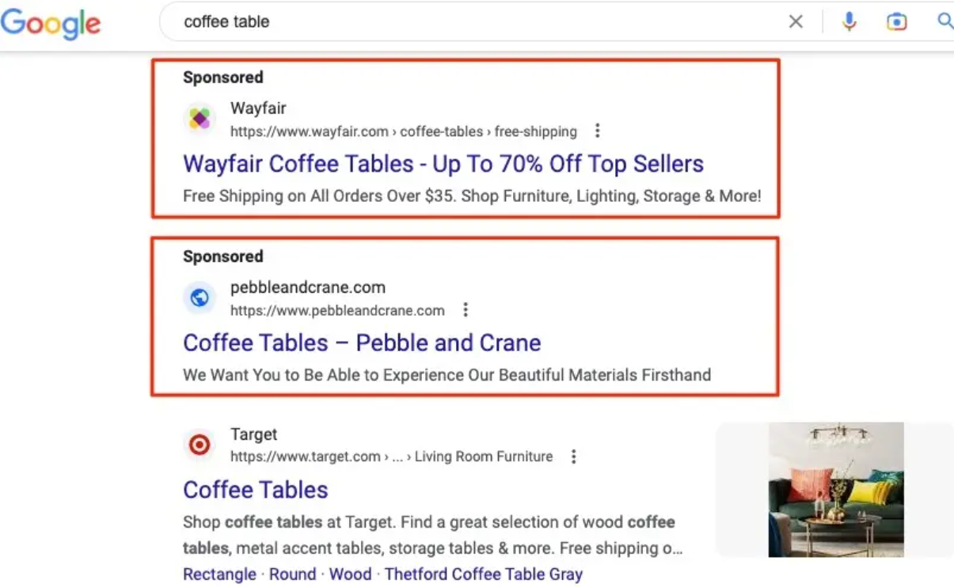
PPC Campaigns ..cont.
Search Ads are text-based ads that appear at the top or bottom of a SERP when individuals search a keyword.
Week # 12-13
SEM
By: Sahar Andaleeb

Slide 17
PPC Campaigns ..cont.
Display ads are image-based ads that appear on websites and applications.
These ads allow you to stay top of mind by reaching your audience while they browse their favorite sites and apps.
These sites and apps pull from the Google Display Network (GDN)
Google Display Network (GDN) is a collection of websites, apps, and digital platforms where advertisers can display their ads to a wide audience through Google's advertising network.
Google Advertising Network: is a vast ecosystem comprising Google-owned platforms like Google Search, YouTube, and Gmail, as well as partner websites (ask.com, Amazon, Walmart. Etc.) and apps where advertisers can display their ads to reach a broad audience online.
Week # 12-13
SEM
By: Sahar Andaleeb

Slide 18
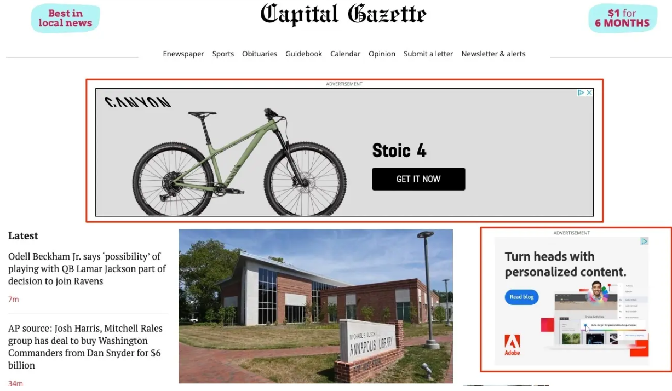
PPc Campaigns ..cont.
Display ads …cont.
Week # 12-13
SEM
By: Sahar Andaleeb

Slide 19
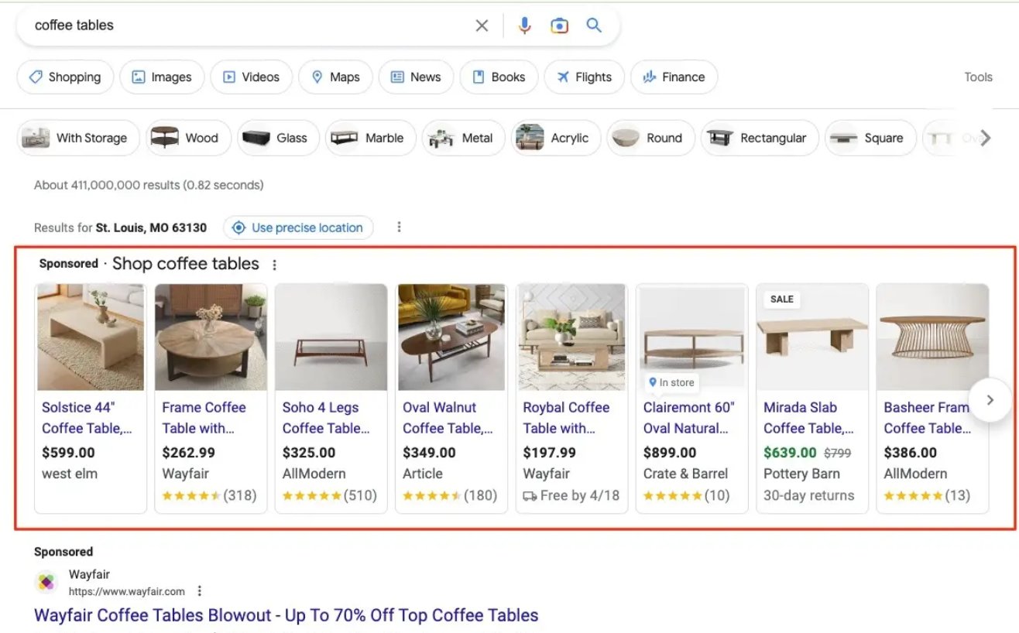
PPC Campaigns ..cont.
Shopping Ads are product listings that appear at the top of SERPs for product-related searches.
They also appear in the Google Shopping tab, and typically include an image of the product, the price, and a link to the product page.
Week # 12-13
SEM
By: Sahar Andaleeb

Slide 20
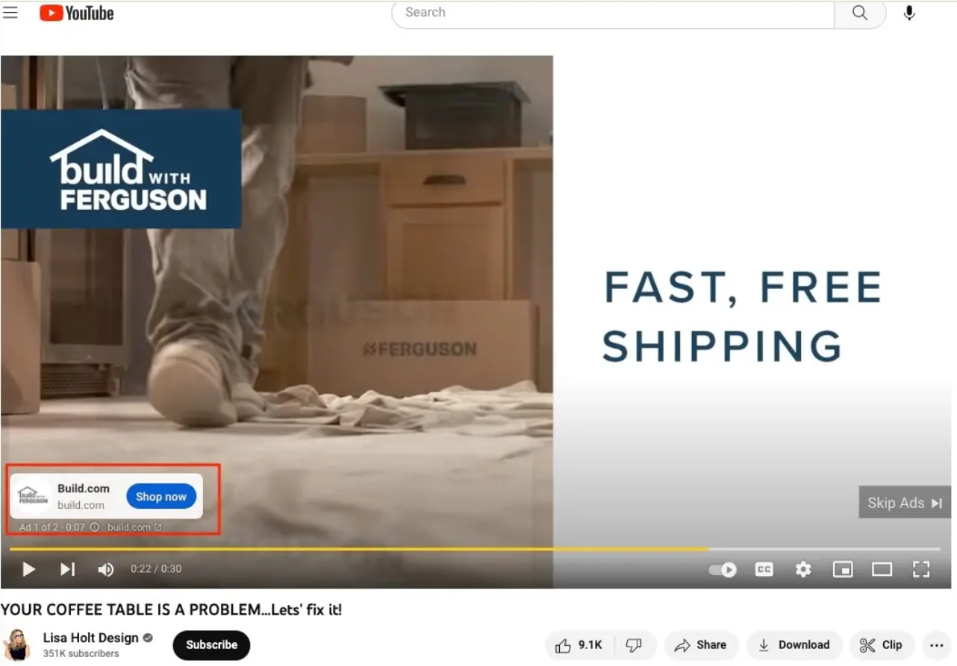
ppc Campaigns ..cont.
Video ads are advertisements that appear before, during, or at the end of videos on YouTube and other websites.
They are highly targeted based on user data, and are designed to increase brand awareness and drive traffic to your site.
Week # 12-13
SEM
By: Sahar Andaleeb

Slide 21
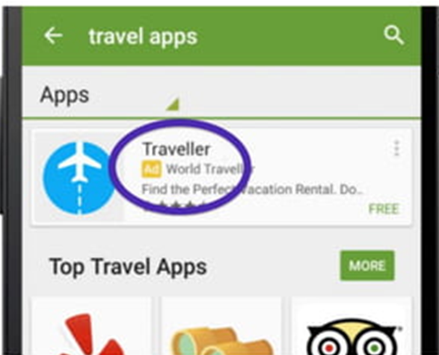
ppc Campaigns ..cont.
App ads are designed to promote your app across Google’s properties, such as Search, YouTube, and the Google Display Network. They help your business grow by finding new app users!
Week # 12-13
SEM
By: Sahar Andaleeb

Slide 22
Key terms
Impressions: Number of times that your ads are displayed to users
Clicks: Number of times a users click on your ads
Click-Through Rate (CTR): Percentage of users who clicked on your ads after they were displayed (clicks/impressions)x100.
CTRs are influenced by ad position, ad copy and brand recognition.
Cost-Per-Click (CPC): Average cost that you pay for each click on your ads
Conversion Rate (CR): is the percentage of website visitors who take a desired action, such as making a purchase, filling out a form, or subscribing to a newsletter, out of the total number of visitors.
Week # 12-13
SEM
By: Sahar Andaleeb

Slide 23
key metrics
Reach: The total users mentioning your brand plus their
followers.
Engagement: The people taking an action on your content.
Average engagement rate: the average rate of people who
took action versus people who saw your content.
Visits: The total number of times people have been to your site/page.
Unique visitors: The total number of individuals who have
been to your site/page.
Week # 12-13
SEM
By: Sahar Andaleeb

Slide 24
key metrics …cont.
Bounce rate: People arriving and then leaving without
visiting another page.
Sales: Total number of sales (you could also split this into the
separate sales channels, eg social, website, phone).
Response rate: The percentage of people who have in some
way responded to your content.
Mentions: The number of times that your brand has been mentioned.
Week # 12-13
SEM
By: Sahar Andaleeb

Slide 25
key metrics …cont.
Followers: The number of followers you have on any or all
networks.
Buzz: Combination of a number of factors that suggest how
popular you are right now.
Sentiment: Reviewing the types of message about you for
positive and negative sentiment.
Week # 12-13
SEM
By: Sahar Andaleeb

