Slide 1
Graphs
Data Structures

Slide 2
Graph Definitions
A graph G is denoted by G = (V, E) where
V is the set of vertices or nodes of the graph
E is the set of edges or arcs connecting the vertices in V
Each edge E is denoted as a pair (v,w) where v,w ε V
For example in the graph below
2
V = {1, 2, 3, 4, 5, 6}
E = {(1, 2) (2, 5) (3, 6) (4, 6) (5, 6)}
This is an example of an unordered or undirected graph
1
3
6
4
5

Slide 3
Graph Definitions (contd.)
If the pair of vertices is ordered then the graph is a directed graph or a di-graph
2
1
3
Here,
V = {1, 2, 3, 4, 5, 6}
E = {(1, 2) (2, 5) (5, 6) (6, 3) (6, 4)}
6
4
5
Vertex v is adjacent to w iff (v,w) ε E
Sometimes an edge has another component called a weight or cost. If the weight is absent it is assumed to be 1

Slide 4
Graph Definitions: Path
A path is a sequence of vertices w₁, w₂, w₃, ....w_{n} such that (w_{i}, w_{i+1}) ε E
Length of a path = # edges in the path
A loop is an edge from a vertex onto itself. It is denoted by (v, v)
A simple path is a path where no vertices are repeated along the path
A cycle is a path with at least one edge such that the first and last vertices are the same, i.e. w₁ = w_{n}

Slide 5
Graph Definitions: Connectedness
A graph is said to be connected if there is a path from every vertex to every other vertex
A connected graph is strongly connected if it is a connected graph as well as a directed graph
A connected graph is weakly connected if it is
a directed graph that is not strongly connected, but,
the underlying undirected graph is connected
2
2
1
3
1
3
Strong or Weak?
6
4
6
4
5
5

Slide 6
Applications of Graphs
Driving Map
Edge = Road
Vertex = Intersection
Edge weight = Time required to cover the road
Airline Traffic
Vertex = Cities serviced by the airline
Edge = Flight exists between two cities
Edge weight = Flight time or flight cost or both
Computer networks
Vertex = Server nodes
Edge = Data link
Edge weight = Connection speed
CAD/VLSI

Slide 7
Representing Graphs: Adjacency Matrix
Adjacency Matrix
Two dimensional matrix of size n x n where n is the number of vertices in the graph
a[i, j] = 0 if there is no edge between vertices i and j
a[i, j] = 1 if there is an edge between vertices i and j
Undirected graphs have both a[i, j] and a[j, i] = 1 if there is an edge between vertices i and j
a[i, j] = weight for weighted graphs
Space requirement is Θ(N²)
Problem: The array is very sparsely populated. For example if a directed graph has 4 vertices and 3 edges, the adjacency matrix has 16 cells only 3 of which are 1

Slide 8
Representing Graphs: Adjacency List
Adjacency List
Array of lists
Each vertex has an array entry
A vertex w is inserted in the list for vertex v if there is an outgoing edge from v to w
Space requirement = Θ(E+V)
Sometimes, a hash-table of lists is used to implement the adjacency list when the vertices are identified by a name (string) instead of an integer

Slide 9
Adjacency List Example
2
1
2
3
4
5
6
2
1
3
5
6
4
6
5
3
4
Graph
Adjacency List
An adjacency list for a weighted graph should contain two elements in the list nodes – one element for the vertex and the second element for the weight of that edge

Slide 10
Negative Cost Cycle
A negative cost cycle is a cycle such that the sum of the costs of the edges is negative
The more we cycle through a negative cost cycle, the lower the cost of the cycle becomes
1
3
Cost of the path v₁-v₅
No traversal of cycle: 6
One traversal of cycle: 0
Two traversals of cycle: -6
Three traversals of cycle: -12
...
1
4
2
2
4
-12
5
5
Negative cost cycles are not allowed when we traverse a graph to find the weighted shortest path

Slide 11
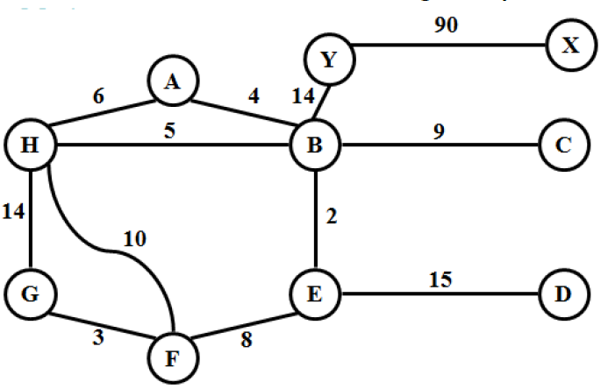
Solve it
Write the Following representation of the given graph
Adjacency List
May represent indexes of array as character

Slide 12
Application of Graphs Using a model to solve a complicated traffic light problem
GIVEN: A complex intersection.
OBJECTIVE: Traffic light with minimum phases.
SOLUTION:
Identify permitted turns, going straight is a “turn”.
Make group of permitted turns.
Make the smallest possible number of groups.
Assign each phase of the traffic light to a group.

Slide 13
Using a model to solve a complicated traffic light problem
D
E
C
B
A
An intersection

Slide 14
Using a model to solve a complicated traffic light problem
Roads C and E are one way, others are two way.
There are 13 permitted turns.
EB,EC,ED,EA
AB,AC,AD
BA,BC,BD
DA,DB,DC
Some turns such as AB (from A to B) and EC can be carried out simultaneously.
Other like AD and EB cross each other and can not be carried out simultaneously.
The traffic light should permit AB and EC simultaneously, but should not allow AD and EB.
D
C
E
B
A

Slide 15
Using a model to solve a complicated traffic light problem
D
AB & AC
E
C
AD & EB
B
A
An intersection

Slide 17
Using a model to solve a complicated traffic light problem
SOLUTION:
We model the problem using a structure called graph G(V,E).
A graph consists of a set of points called vertices, and lines connecting the points, called edges.
Drawing a graph such that the vertices represent turns.
Edges between those turns that can NOT be performed simultaneously.

Slide 18
Using a model to solve a complicated traffic light problem
D
E
AB
AC
AD
C
BA
BC
BD
B
DA
DB
DC
A
An intersection
EA
EB
EC
ED
Partial graph of incompatible turns

Slide 19
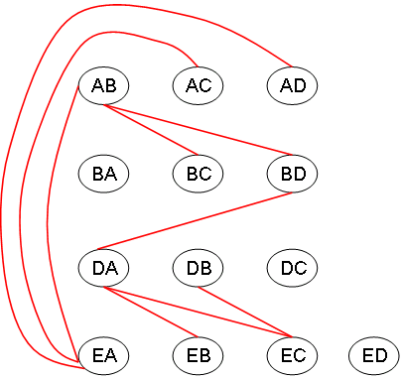
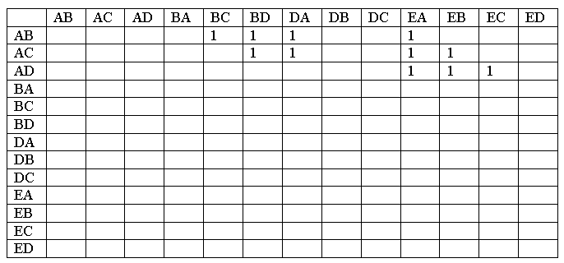
Using a model to solve a complicated traffic light problem
Partial table of incompatible turns

Slide 20
Graph Searching
Given: a graph G = (V, E), directed or undirected
Goal: methodically explore every vertex and every edge
Ultimately: build a tree on the graph
Pick a vertex as the root
Choose certain edges to produce a tree
Note: might also build a forest if graph is not connected

Slide 21
Breadth-First Search
Given a G=(V,E) and distinguished source vertex s, BFS systematically explores the edges of G to “discover” every vertex reachable from s.
Creates a BFS tree rooted at s that contains all such vertices.
Expands the frontier between discovered and undiscovered vertices uniformly across the breadth of the frontier.
The algorithm discovers all vertices at distance k from s before discovering any vertices at distance k+1

Slide 22
Breadth-First Search
will associate vertex “colors” to guide the algorithm
White vertices have not been discovered
All vertices start out white
Grey vertices are discovered but not fully explored
They may be adjacent to white vertices and represent the frontier between the discovered and the undiscovered.
Black vertices are discovered and fully explored
They are adjacent only to black and gray vertices
Explore vertices by scanning adjacency list of grey vertices

Slide 23
Breadth-First Search: Example
r
s
t
u
∞
∞
∞
∞
∞
∞
∞
∞
v
w
x
y

Slide 24
Breadth-First Search: Example
r
s
t
u
∞
0
∞
∞
∞
∞
∞
∞
v
w
x
y
Q:
s

Slide 25
Breadth-First Search: Example
r
s
t
u
1
0
∞
∞
∞
1
∞
∞
v
w
x
y
Q:
w
r

Slide 26
Breadth-First Search: Example
r
s
t
u
1
0
2
∞
∞
1
2
∞
v
w
x
y
Q:
r
t
x

Slide 27
Breadth-First Search: Example
r
s
t
u
1
0
2
∞
2
1
2
∞
v
w
x
y
Q:
t
x
v

Slide 28
Breadth-First Search: Example
r
s
t
u
1
0
2
3
2
1
2
∞
v
w
x
y
Q:
x
v
u

Slide 29
Breadth-First Search: Example
r
s
t
u
1
0
2
3
2
1
2
3
v
w
x
y
Q:
v
u
y

Slide 30
Breadth-First Search: Example
r
s
t
u
1
0
2
3
2
1
2
3
v
w
x
y
Q:
u
y

Slide 31
Breadth-First Search: Example
r
s
t
u
1
0
2
3
2
1
2
3
v
w
x
y
Q:
y

Slide 32
Breadth-First Search: Example
r
s
t
u
1
0
2
3
2
1
2
3
v
w
x
y
Q:
Ø

Slide 33
Breadth-First Search: Properties
BFS calculates the shortest-path distance to the source node
Shortest-path distance δ(s,v) = minimum number of edges from s to v, or ∞ if v not reachable from s
BFS builds breadth-first tree, in which paths to root represent shortest paths in G
Thus can use BFS to calculate shortest path from one vertex to another in O(V+E) time

Slide 34
Depth First Search
Depth-first search: Strategy
Go as deep as can visiting un-visited nodes
Choose any un-visited vertex when you have a choice
When stuck at a dead-end, backtrack as little as
possible
Back up to where you could go to another unvisited vertex
Then continue to go on from that point
Eventually you’ll return to where you started

Slide 35

DFS [Easy One]
1. Initialize all nodes to the ready state (STATUS=1)
2. PUSH stating node A on stack and change its status to waiting
3. Repeat 4-5 until stack is empty
4. POP N. Process it and change its status to processes
5. PUSH on stack all the neighbors of N that are still in ready state and change their status to waiting
6. Exit

Slide 36
Shortest Path Problem in Graphs

Slide 37
Problem
A motorist wishes to find the shortest possible route from Islamabad to Lahore.
Route map is given where distance between each pair of adjacent intersections is marked.
One possible way is to enumerate all the routes from Islamabad to Lahore, add up the distance on each route and select the shortest.
There are hundreds and thousands of possibilities, most of them are simply not worth considering.

Slide 38
Contd…
A route from Islamabad to Peshawar to Lahore is obviously a poor choice, as Peshawar is hundreds of miles out of the way.
In this presentation, we show how to solve such problems efficiently.

Slide 39
Shortest path problem
We are given a weighted, graph G=(V,E), with weight function w:E->R mapping edges to real-valued weights.
The weight of path p=<v₀,v₁,…v_{k}> is the sum of the weights of its constituent edges.

Slide 40
Variants
Assume that the graph is connected. The shortest path problem has several different forms:
Given two nodes A and B, find the shortest path in the weighted graph from A to B.
Given a node A, find the shortest path from A to every other node in the graph. (single-source shortest path problem)
Find the shortest path between every pair of nodes in the graph. (all-pair shortest path problem)

Slide 41
Single-Source Shortest Path
Problem: given a weighted graph G, find the minimum-weight path from a given source vertex s to another vertex v
“Shortest-path” = minimum weight
Weight of path is sum of edges

Slide 42
Dijkstra’s Algorithm
Similar to breadth-first search
Grow a tree gradually, advancing from vertices taken from a queue
Also similar to Prim’s algorithm for MST
Use a priority queue keyed on d[v]

Slide 43
Dijkstra’s Algorithm
The idea is to visit the nodes in order of their closeness to A; visit A first, then visit the closest node to A, then the next closest node to A, and so on.
The closest node to A, say X, must be adjacent to A and the next closest node, say Y, must be either adjacent to A or X. The third closest node to A must be either adjacent to A or X or Y, and so on. (Otherwise, this node is closer to A than the third closest node.)

Slide 44
Dijkstra’s Algorithm
The next node to be visited must be adjacent to some visited node. We call the set of unvisited nodes that are adjacent to an already visited node the fringe.
The algorithm then selects the node from the fringe closest to A, say B, then visits B and updates the fringe to include the nodes that are adjacent to B. This step is repeated until all the nodes of the graph have been visited and the fringe is empty.

