Slide 1
Data Mining
Lecture 6
Introduction to Classification

Slide 2
Classification vs. Prediction
Classification:
predicts categorical class labels (discrete or nominal)
classifies data (constructs a model) based on the training set and the values (class labels) in a classifying attribute and uses it in classifying new data
Prediction:
models continuous-valued functions, i.e., predicts unknown or missing values
Typical Applications
credit approval
target marketing
medical diagnosis
treatment effectiveness analysis

Slide 3
Classification—A Two-Step Process
Model construction: describing a set of predetermined classes
Each tuple/sample is assumed to belong to a predefined class, as determined by the class label attribute
The set of tuples used for model construction is training set
The model is represented as classification rules, decision trees, or mathematical formulae
Model usage: for classifying future or unknown objects
Estimate accuracy of the model
The known label of test sample is compared with the classified result from the model
Accuracy rate is the percentage of test set samples that are correctly classified by the model
Test set is independent of training set, otherwise over-fitting will occur
If the accuracy is acceptable, use the model to classify data tuples whose class labels are not known

Slide 4
Classification Process (1): Model Construction
Classification
Algorithms
Training
Data
Classifier
(Model)
IF rank = ‘professor’
OR years > 6
THEN tenured = ‘yes’

Slide 5
Classification Process (2): Use the Model in Prediction
Classifier
Testing
Data
Unseen Data
(Jeff, Professor, 4)
Tenured?

Slide 6
Illustrating Classification Task

Slide 7
An example application
An emergency room in a hospital measures 17 variables (e.g., blood pressure, age, etc) of newly admitted patients.
A decision is needed: whether to put a new patient in an intensive-care unit or not.
Due to the high cost of ICU, those patients who may survive less than a month are given higher priority.
Problem: to predict high-risk patients and discriminate them from low-risk patients.
Independent Variables: Blood pressure, age, …
Dependent Variables: risk class (high or low)

Slide 8
Another application
A credit card company receives thousands of applications for new cards. Each application contains information about an applicant,
age
Marital status
annual salary
outstanding debts
credit rating
etc.
Problem: to decide whether an application should be approved, or not.
Independent Variables: age, debts, credit rating …
Dependent Variables: Approved/Not Approved)

Slide 9
Machine learning and our focus
Humans learn from past experiences.
A computer does not have “experiences”.
A computer system learns from data, which represent some “past experiences” of an application domain.
Our focus: learn a target function that can be used to predict the values of a discrete class attribute, e.g., approve or not-approved, and high-risk or low risk.
The task is commonly called:
Supervised learning,
classification, or
inductive learning.

Slide 10
The data and the goal
Data: A set of data records (also called examples, instances or cases) described by
k attributes: A₁, A₂, … A_{k}.
a class: Each example is labelled with a pre-defined class.
Goal: To learn a classification model from the data that can be used to predict the classes of new (future, or test) cases/instances.

Slide 11
Classification Examples
Teachers classify students’ grades as A, B, C, D, or F.
Identify mushrooms as poisonous or edible.
Predict when a river will flood.
Identify individuals with credit risks.
Speech recognition
Pattern recognition
Etc…

Slide 12
Classification Through Rules: Grading
x
<90
>=90
If x >= 90 then grade =A.
If 80<=x<90 then grade =B.
If 70<=x<80 then grade =C.
If 60<=x<70 then grade =D.
If x<50 then grade =F.
x
A
<80
>=80
x
B
<70
>=70
x
C
<50
>=60
F
D

Slide 13
Classification: Letter Recognition
View letters as constructed from 5 components:
Letter A
Letter B
Letter C
Letter D
Letter E
Letter F

Slide 14
Example of a Decision Tree
categorical
categorical
continuous
class
Splitting Attributes
Refund
Yes
No
NO
MarSt
Single, Divorced
Married
TaxInc
NO
< 80K
> 80K
NO
YES
Training Data
Model: Decision Tree

Slide 15
Another Example of Decision Tree
categorical
categorical
continuous
class
MarSt
Single, Divorced
Married
NO
Refund
Yes
No
NO
TaxInc
< 80K
> 80K
NO
YES
There could be more than one tree that fits the same data!

Slide 16
Decision Tree Classification Task
Decision Tree

Slide 17
Apply Model to Test Data
Test Data
Start from the root of tree.
Refund
Yes
No
NO
MarSt
Single, Divorced
Married
TaxInc
NO
< 80K
> 80K
NO
YES

Slide 18
Apply Model to Test Data
Test Data
Refund
Yes
No
NO
MarSt
Single, Divorced
Married
TaxInc
NO
< 80K
> 80K
NO
YES

Slide 19
Apply Model to Test Data
Test Data
Refund
Yes
No
NO
MarSt
Single, Divorced
Married
TaxInc
NO
< 80K
> 80K
NO
YES

Slide 20
Apply Model to Test Data
Test Data
Refund
Yes
No
NO
MarSt
Single, Divorced
Married
TaxInc
NO
< 80K
> 80K
NO
YES

Slide 21
Apply Model to Test Data
Test Data
Refund
Yes
No
NO
MarSt
Single, Divorced
Married
TaxInc
NO
< 80K
> 80K
NO
YES

Slide 22
Apply Model to Test Data
Test Data
Refund
Yes
No
NO
MarSt
Single, Divorced
Married
Assign Cheat to “No”
TaxInc
NO
< 80K
> 80K
NO
YES

Slide 23
Decision Tree Classification Task
Decision Tree

Slide 24
Decision Tree Induction
Many Algorithms:
Hunt’s Algorithm (one of the earliest)
CART
ID3, C4.5
SLIQ,SPRINT

Slide 25
Design Issues of Decision Tree Induction
How should training records be split?
Method for specifying test condition
depending on attribute types
Measure for evaluating the goodness of a test condition
How should the splitting procedure stop?
Stop splitting if all the records belong to the same class or have identical attribute values
Early termination

Slide 26
Methods for Expressing Test Conditions
Depends on attribute types
Binary
Nominal
Ordinal
Continuous
Depends on number of ways to split
2-way split
Multi-way split

Slide 27
Test Condition for Nominal Attributes
Multi-way split:
Use as many partitions as distinct values.
Binary split:
Divides values into two subsets

Slide 28
Test Condition for Ordinal Attributes
Multi-way split:
Use as many partitions as distinct values
Binary split:
Divides values into two subsets
Preserve order property among attribute values
This grouping violates order property

Slide 29
Test Condition for Continuous Attributes

Slide 30
Splitting Based on Continuous Attributes
Different ways of handling
Discretization to form an ordinal categorical attribute
Ranges can be found by equal interval bucketing, equal frequency bucketing (percentiles), or clustering.
Static – discretize once at the beginning
Dynamic – repeat at each node
Binary Decision: (A < v) or (A ≥ v)
consider all possible splits and finds the best cut
can be more compute intensive

Slide 31
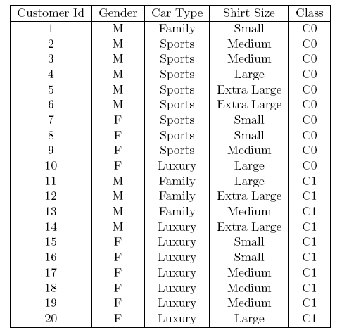
How to determine the Best Split
Before Splitting: 10 records of class 0, 10 records of class 1
Which test condition is the best?

Slide 32
How to determine the Best Split
Greedy approach:
Nodes with purer class distribution are preferred
Need a measure of node impurity:
High degree of impurity
Low degree of impurity

Slide 33
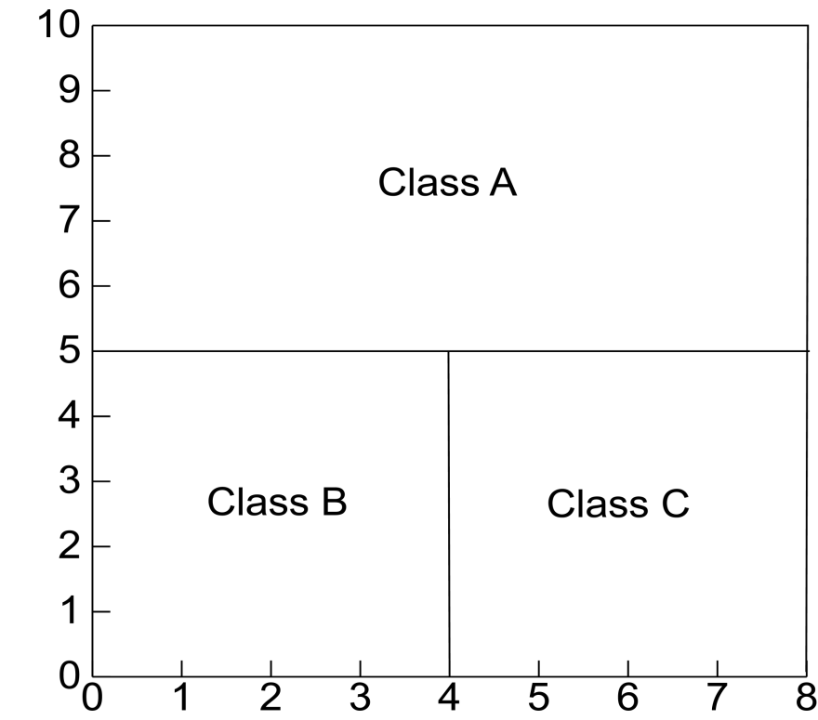
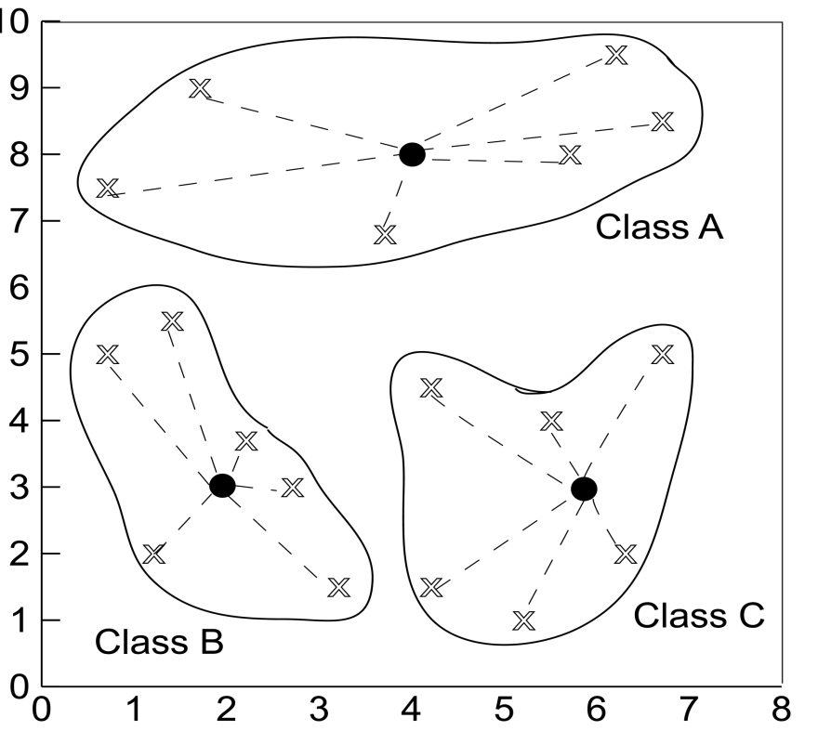
Defining Classes
Distance Based
Partitioning Based

Slide 34
Defining data Types
Classification Problem
Independent Variables: any type
Dependent Variables: Categorical
Attributes: Numerical vs Categorical
Numerical: numeric valued attributes such as salary etc…
Categorical: Non-numeric valued
Ordered Categorical Attribute: Student Grade
Unordered Categorical Attribute: Gender
If Dependent Variables is Numerical:
Regression Analysis could be applied

Slide 35
Height Example Data

Slide 36
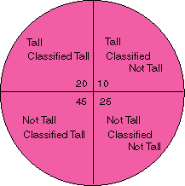
Classification Performance
True Positive
False Negative
False Positive
True Negative

Slide 37
Confusion Matrix Example
Using height data example with Output1 correct and Output2 actual assignment

Slide 38
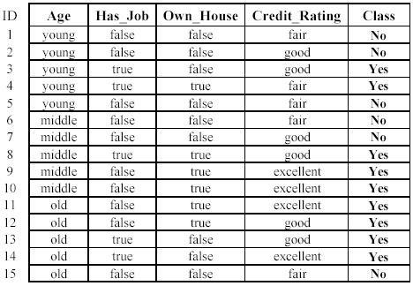
An example: data (loan application)
Approved or not

Slide 39
Supervised vs. Unsupervised Learning
Supervised learning: Learning through already known examples.
Supervision: The data (observations, measurements, etc.) are labeled with pre-defined classes.
Test data are classified into these classes too.
Unsupervised learning
Class labels of the data are unknown
Given a set of data, the task is to establish the existence of classes or clusters in the data

Slide 40
Loan data: Supervised

Slide 41
Loan Data: Unsupervised
?
Dependent Variable Not Known
Clustering

Slide 42
What do we mean by learning?
Given
a data set D,
a task T, and
a performance measure M,
a computer system is said to learn from D to perform the task T if after learning the system’s performance on T improves as measured by M.
In other words, the learned model helps the system to perform T better as compared to no learning.

Slide 43
An example
Data: Loan application data
Task: Predict whether a loan should be approved or not.
Performance measure: accuracy.
No learning: classify all future applications (validate data) to the majority class (i.e., Yes):
Accuracy = 9/15 = 60%.
We can do better than 60% with learning.

Slide 44
Fundamental assumption of learning
Assumption: The distribution of training examples is identical to the distribution of test examples (including future unseen examples).
In practice, this assumption is often violated to certain degree.
Strong violations will clearly result in poor classification accuracy.
To achieve good accuracy on the test data, training examples must be sufficiently representative of the test data.

Slide 45
Predictive Accuracy of Classifications
Test data analysis:
Error rate
Confusion matrix
Accuracy estimation method
Holdout Method
Random Sub-sampling method
K-fold Cross-validation method
Leave-one-out method
Bootstrap method
Bootstraping, Bagging, and Boosting (improving the accuracy of classification results)

Slide 46
Other Evaluation Criteria
Speed
Time to develop and use the learnt model
Robustness
Produces reliable results in case noise, missing values are present
Scalability
Works on smaller as well as large datasets
Interpretability
Results of classification are explainable
Goodness of model
Model of correct size, compact, and high accuracy

