Slide 1
Data Mining
Lecture 1
Overview of Data Mining

Slide 2
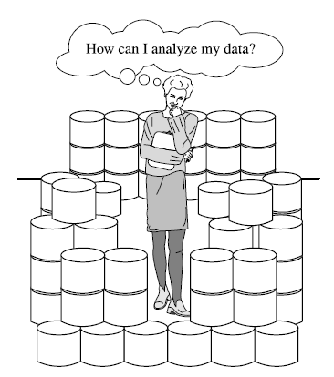
Why Data Mining?

Slide 3
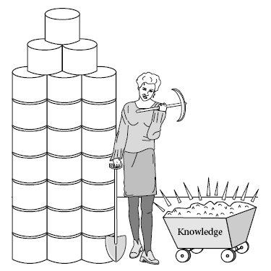
What is Data Mining?

Slide 4
What Is Data Mining?
Data mining (knowledge discovery from data)
Extraction of interesting (non-trivial, implicit, previously unknown and potentially useful) patterns or knowledge from huge amount of data
Data mining: a misnomer?
Alternative names
Knowledge discovery (mining) in databases (KDD), knowledge extraction, data/pattern analysis, data archeology, data dredging, information harvesting, business intelligence, etc.
Watch out: Is everything “data mining”?
(Deductive) query processing.
Expert systems or small ML/statistical programs

Slide 5
Data Mining—What’s in a Name?
Information Harvesting
Knowledge Mining
Data Mining
Knowledge Discovery
in Databases
Data Dredging
Data Archaeology
Data Pattern Processing
Database Mining
Knowledge Extraction
Siftware
The process of discovering meaningful new correlations, patterns, and trends by sifting through large amounts of stored data, using pattern recognition technologies and statistical and mathematical techniques

Slide 6
What is (not) Data Mining?
What is not Data Mining?
Look up phone number in phone directory
Query a Web search engine for information about “Amazon”
What is Data Mining?
Certain names are more prevalent in certain US locations (O’Brien, O’Rurke, O’Reilly… in Boston area)
Group together similar documents returned by search engine according to their context (e.g. Amazon rainforest, Amazon.com,)

Slide 7
What is Data Mining? Real Example from the NBA
Play-by-play information recorded by teams
Who is on the court
Who shoots
Results
Coaches want to know what works best
Plays that work well against a given team
Good/bad player matchups
Advanced Scout (from IBM Research) is a data mining tool to answer these questions
Starks+Houston+
Ward playing
http://www.nba.com/news_feat/beyond/0126.html

Slide 8
Why Data Mining?—Potential Applications
Data analysis and decision support
Market analysis and management
Target marketing, customer relationship management (CRM), market basket analysis, cross selling, market segmentation
Risk analysis and management
Forecasting, customer retention, improved underwriting, quality control, competitive analysis
Fraud detection and detection of unusual patterns (outliers)
Other Applications
Text mining (news group, email, documents) and Web mining
Stream data mining
DNA and bio-data analysis

Slide 9

Why Mine Data? Commercial Viewpoint
Lots of data is being collected and warehoused
Web data, e-commerce
purchases at department/ grocery stores
Bank/Credit Card transactions
Computers have become cheaper and more powerful
Competitive Pressure is Strong
Provide better, customized services for an edge (e.g. in Customer Relationship Management)

Slide 10
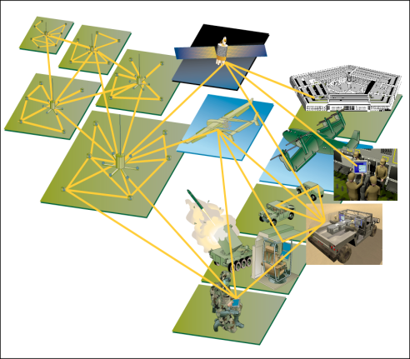

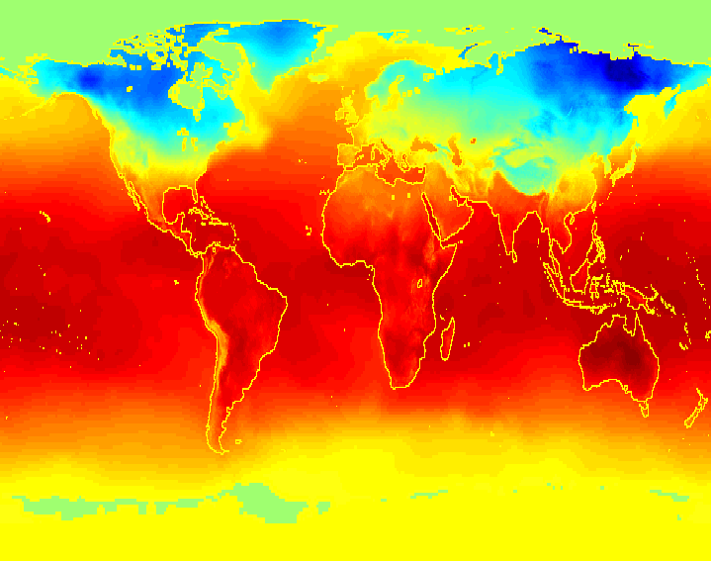
Why Mine Data? Scientific Viewpoint
Data collected and stored at enormous speeds (GB/hour)
remote sensors on a satellite
telescopes scanning the skies
microarrays generating gene expression data
scientific simulations generating terabytes of data
Traditional techniques infeasible for raw data
Data mining may help scientists
in classifying and segmenting data
in Hypothesis Formation

Slide 11
Why Data Mining Now?
Growth in OLTP data
Growth in data due to cards
Growth in data due to Web
Growth in data due to other sources
Growth in data storage capacity
Decline in the cost of processing
Competitive environment
Availability of software

Slide 12
Mining Large Data Sets - Motivation
There is often information “hidden” in the data that is not readily evident
Human analysts may take weeks to discover useful information
Much of the data is never analyzed at all
The Data Gap
Total new disk (TB) since 1995
Number of analysts

Slide 13
Integration of Multiple Technologies
Machine
Learning
Artificial
Intelligence
Database
Management
Statistics
Algorithms
Visualization
Data
Mining
Notes:
10

Slide 14
Data Mining: Confluence of Multiple Disciplines
Database
Systems
Statistics
Machine
Learning
Data Mining
Visualization
Algorithm
Other
Disciplines

Slide 15
Data Mining: Classification Schemes
General functionality
Descriptive data mining
Predictive data mining
Different views, different classifications
Kinds of data to be mined
Kinds of knowledge to be discovered
Kinds of techniques utilized
Kinds of applications adapted

Slide 16
Knowledge Discovery in Databases: Process
Interpretation/
Evaluation
Knowledge
Data Mining
Preprocessing
Patterns
Selection
Preprocessed
Data
Data
Target
Data
adapted from:
U. Fayyad, et al. (1995), “From Knowledge Discovery to Data Mining: An Overview,” Advances in Knowledge Discovery and Data Mining, U. Fayyad et al. (Eds.), AAAI/MIT Press

Slide 17
Origins of Data Mining
Draws ideas from machine learning/AI, pattern recognition, statistics, and database systems
Traditional Techniques may be unsuitable due to
Enormity of data
High dimensionality of data
Heterogeneous, distributed nature of data
Statistics/ AI
Machine Learning/
Pattern Recognition
Data Mining
Database systems

Slide 18
Multi-Dimensional View of Data Mining
Data to be mined
Relational, data warehouse, transactional, stream, object-oriented/relational, active, spatial, time-series, text, multi-media, heterogeneous, legacy, WWW
Knowledge to be mined
Characterization, discrimination, association, classification, clustering, trend/deviation, outlier analysis, etc.
Multiple/integrated functions and mining at multiple levels
Techniques utilized
Database-oriented, data warehouse (OLAP), machine learning, statistics, visualization, etc.
Applications adapted
Retail, telecommunication, banking, fraud analysis, bio-data mining, stock market analysis, Web mining, etc.

Slide 19
Ingredients of an Effective KDD Process
Visualization and
Human Computer
Interaction
“In order to discover
anything, you must
be looking for
something.” Laws
of Serendipity
Plan
for
Learning
Generate
and Test
Hypotheses
Discover
Knowledge
Determine
Knowledge
Relevancy
Evolve
Knowledge/
Data
Goals for Learning
Knowledge Base
Database(s)
Discovery Algorithms
Background Knowledge

Slide 20
Data Mining: History of the Field
Knowledge Discovery in Databases workshops started ‘89
Now a conference under the auspices of ACM SIGKDD
IEEE conference series started 2001
Key founders / technology contributors:
Usama Fayyad, JPL (then Microsoft, now has his own company, Digimine)
Gregory Piatetsky-Shapiro (then GTE, now his own data mining consulting company, Knowledge Stream Partners)
Rakesh Agrawal (IBM Research)
The term “data mining” has been around since at least 1983 – as a pejorative term in the statistics community

Slide 21
A Brief History of Data Mining Society
1989 IJCAI Workshop on Knowledge Discovery in Databases (Piatetsky-Shapiro)
Knowledge Discovery in Databases (G. Piatetsky-Shapiro and W. Frawley, 1991)
1991-1994 Workshops on Knowledge Discovery in Databases
Advances in Knowledge Discovery and Data Mining (U. Fayyad, G. Piatetsky-Shapiro, P. Smyth, and R. Uthurusamy, 1996)
1995-1998 International Conferences on Knowledge Discovery in Databases and Data Mining (KDD’95-98)
Journal of Data Mining and Knowledge Discovery (1997)
1998 ACM SIGKDD, SIGKDD’1999-2001 conferences, and SIGKDD Explorations
More conferences on data mining
PAKDD (1997), PKDD (1997), SIAM-Data Mining (2001), (IEEE) ICDM (2001), etc.

