Slide 1
Data Mining
Lecture 3
Data Mining Techniques

Slide 2
Data Mining Tasks
Prediction Methods
Use some variables to predict unknown or future values of other variables.
Description Methods
Find human-interpretable patterns that describe the data.

Slide 3
Data Mining Tasks...
Association Rule Discovery [Descriptive]
Sequential Pattern Discovery [Descriptive]
Classification [Predictive]
Clustering [Descriptive]
Regression [Predictive]
Deviation Detection [Predictive]

Slide 4
Association Rule Discovery: Definition
Given a set of records each of which contain some number of items from a given collection;
Produce dependency rules which will predict occurrence of an item based on occurrences of other items.
Rules Discovered:
{Milk} --> {Coke}
{Diaper, Milk} --> {Beer}

Slide 5
Association Rule Discovery: Application 1
Marketing and Sales Promotion:
Let the rule discovered be
{Bagels, … } --> {Potato Chips}
Potato Chips as consequent => Can be used to determine what should be done to boost its sales.
Bagels in the antecedent => Can be used to see which products would be affected if the store discontinues selling bagels.
Bagels in antecedent and Potato chips in consequent => Can be used to see what products should be sold with Bagels to promote sale of Potato chips!

Slide 6
Association Rule Discovery: Application 2
Supermarket shelf management.
Goal: To identify items that are bought together by sufficiently many customers.
Approach: Process the point-of-sale data collected with barcode scanners to find dependencies among items.
A classic rule --
If a customer buys diaper and milk, then he is very likely to buy beer.
So, don’t be surprised if you find six-packs stacked next to diapers!

Slide 7
Association Rule Discovery: Application 3
Inventory Management:
Goal: A consumer appliance repair company wants to anticipate the nature of repairs on its consumer products and keep the service vehicles equipped with right parts to reduce on number of visits to consumer households.
Approach: Process the data on tools and parts required in previous repairs at different consumer locations and discover the co-occurrence patterns.

Slide 8
Sequential Pattern Discovery: Definition
Given is a set of objects, with each object associated with its own timeline of events, find rules that predict strong sequential dependencies among different events.
Rules are formed by first discovering patterns. Event occurrences in the patterns are governed by timing constraints.
(A B) (C) (D E)
(A B) (C) (D E)
<= xg
>ng
<= ws
<= ms

Slide 9
Sequential Pattern Discovery: Examples
In telecommunications alarm logs,
(Inverter_Problem Excessive_Line_Current)
(Rectifier_Alarm) --> (Fire_Alarm)
In point-of-sale transaction sequences,
Computer Bookstore:
(Intro_To_Visual_C) (C++_Primer) --> (Perl_for_dummies,Tcl_Tk)
Athletic Apparel Store:
(Shoes) (Racket, Racketball) --> (Sports_Jacket)

Slide 10
Classification: Definition
Given a collection of records (training set )
Each record contains a set of attributes, one of the attributes is the class.
Find a model for class attribute as a function of the values of other attributes.
Goal: previously unseen records should be assigned a class as accurately as possible.
A test set is used to determine the accuracy of the model. Usually, the given data set is divided into training and test sets, with training set used to build the model and test set used to validate it.

Slide 11
Classification Example
categorical
categorical
continuous
class
Test
Set
Learn
Classifier
Training
Set
Model

Slide 12
Classification: Application 1
Direct Marketing
Goal: Reduce cost of mailing by targeting a set of consumers likely to buy a new cell-phone product.
Approach:
Use the data for a similar product introduced before.
We know which customers decided to buy and which decided otherwise. This {buy, don’t buy} decision forms the class attribute.
Collect various demographic, lifestyle, and company-interaction related information about all such customers.
Type of business, where they stay, how much they earn, etc.
Use this information as input attributes to learn a classifier model.

Slide 13
Classification: Application 2
Fraud Detection
Goal: Predict fraudulent cases in credit card transactions.
Approach:
Use credit card transactions and the information on its account-holder as attributes.
When does a customer buy, what does he buy, how often he pays on time, etc
Label past transactions as fraud or fair transactions. This forms the class attribute.
Learn a model for the class of the transactions.
Use this model to detect fraud by observing credit card transactions on an account.

Slide 14
Classification: Application 3
Customer Attrition/Churn:
Goal: To predict whether a customer is likely to be lost to a competitor.
Approach:
Use detailed record of transactions with each of the past and present customers, to find attributes.
How often the customer calls, where he calls, what time-of-the day he calls most, his financial status, marital status, etc.
Label the customers as loyal or disloyal.
Find a model for loyalty.

Slide 15
Classification: Application 4
Sky Survey Cataloging
Goal: To predict class (star or galaxy) of sky objects, especially visually faint ones, based on the telescopic survey images (from Palomar Observatory).
3000 images with 23,040 x 23,040 pixels per image.
Approach:
Segment the image.
Measure image attributes (features) - 40 of them per object.
Model the class based on these features.
Success Story: Could find 16 new high red-shift quasars, some of the farthest objects that are difficult to find!

Slide 16
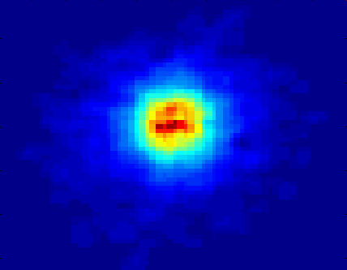
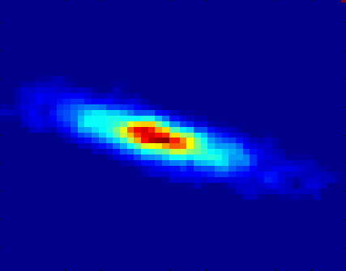
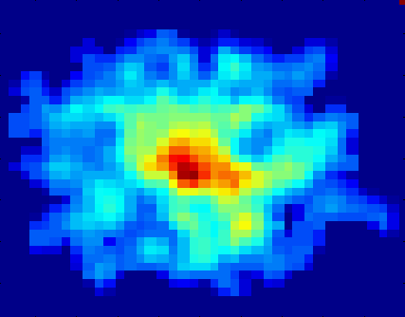
Classifying Galaxies
Early
Class:
Stages of Formation
Attributes:
Image features,
Characteristics of light waves received, etc.
Intermediate
Late
Data Size:
72 million stars, 20 million galaxies
Object Catalog: 9 GB
Image Database: 150 GB

Slide 17
Clustering Definition
Given a set of data points, each having a set of attributes, and a similarity measure among them, find clusters such that
Data points in one cluster are more similar to one another.
Data points in separate clusters are less similar to one another.
Similarity Measures:
Euclidean Distance if attributes are continuous.
Other Problem-specific Measures.

Slide 18
Illustrating Clustering
Euclidean Distance Based Clustering in 3-D space.
Intracluster distances
are minimized
Intercluster distances
are maximized

Slide 19
Clustering: Application 1
Market Segmentation:
Goal: subdivide a market into distinct subsets of customers where any subset may conceivably be selected as a market target to be reached with a distinct marketing mix.
Approach:
Collect different attributes of customers based on their geographical and lifestyle related information.
Find clusters of similar customers.
Measure the clustering quality by observing buying patterns of customers in same cluster vs. those from different clusters.

Slide 20
Clustering: Application 2
Document Clustering:
Goal: To find groups of documents that are similar to each other based on the important terms appearing in them.
Approach: To identify frequently occurring terms in each document. Form a similarity measure based on the frequencies of different terms. Use it to cluster.
Gain: Information Retrieval can utilize the clusters to relate a new document or search term to clustered documents.

Slide 21
Illustrating Document Clustering
Clustering Points: 3204 Articles of Los Angeles Times.
Similarity Measure: How many words are common in these documents (after some word filtering).

Slide 22
Clustering of S&P 500 Stock Data
Observe Stock Movements every day.
Clustering points: Stock-{UP/DOWN}
Similarity Measure: Two points are more similar if the events described by them frequently happen together on the same day.
We used association rules to quantify a similarity measure.

