Slide 1
Data Mining
Lecture 4
Association Rule Mining

Slide 2
What Is Association Mining?
Association rule mining:
Finding frequent patterns, associations, correlations, or causal structures among sets of items or objects in transaction databases, relational databases, and other information repositories.
Frequent pattern: pattern (set of items, sequence, etc.) that occurs frequently in a database [AIS93]
Motivation: finding regularities in data
What products were often purchased together? — Beer and diapers?!
What are the subsequent purchases after buying a PC?
What kinds of DNA are sensitive to this new drug?
Can we automatically classify web documents?

Slide 3
Association Rules
Wal-Mart collects more than 20 million point of sale transaction data every day
Effective analysis could yield a lot of interesting patterns
One way of doing analysis is to mine rules

Slide 4
Association Rules
Finding interesting customer habits by finding associations
Market Basket Analysis (MBA)

Slide 5
Other Applications
Engineering
Controls
Customer segmentation
Marketing
Medicine

Slide 6
Basic Concepts
Association Rule
Support
Confidence
Probability

Slide 7
Basic Concepts:Association Rules
Transaction-id | Items bought
10 | A, B, C
20 | A, C
30 | A, D
40 | B, E, F
Itemset X={x₁, …, x_{k}}
Find all the rules X→Y with min confidence and support
support, s, probability that a transaction contains X∪Y
confidence, c, conditional probability that a transaction having X also contains Y.
Customer
buys both
Customer
buys diaper
Let min_support = 50%, min_conf = 50%:
A → C (50%, 66.7%)
C → A (50%, 100%)
Customer
buys beer

Slide 8
Mining Association Rules: Example
Min. support 50%
Min. confidence 50%
Transaction-id | Items bought
10 | A, B, C
20 | A, C
30 | A, D
40 | B, E, F
Frequent pattern | Support
{A} | 75%
{B} | 50%
{C} | 50%
{A, C} | 50%
For rule A ⇒ C:
support = support({A}∪{C}) = 50%
confidence = support({A}∪{C})/support({A}) = 66.6%

Slide 9
Mining Association Rules: What We Need to Know
Goal: Rules with high support/confidence
How to compute?
Support: Find sets of items that occur frequently
Confidence: Find frequency of subsets of supported itemsets
If we have all frequently occurring sets of items (frequent itemsets), we can compute support and confidence!

Slide 10
Problem Statement
I = {i₁ , i₂, …….., i_{n}} : a set of items
Transaction T : a set of items such that T ⊆ I
Database D: a set of transactions
A transaction T contains X, a set of some items in I, X ⊆ I, if X ⊆ T
An Association Rule: is an implication of the form X ⇒ Y, where X, Y ⊆ I
antecedent
consequent

Slide 11
X → Y
Itemsets (X,Y) appear in 10% of the transaction
80% of the time Y appears when X is given
Support
prevalence
Confidence
predictability

Slide 12
X → Y : Probabilistic Terms
Itemsets (X,Y) appear in 10% of the total transactions together
80% of the total transactions in which X appears Y also appears with X
Support
Prevalence P(XUY)
Confidence
Predictability P(XUY)/P(X)

Slide 13
Support ( P(XUY))
Total Transactions in Database: N
Support(X):
(Number of times X appears in dataset) / N
Support(X,Y):
(Number of times X and Y appears together in dataset) / N
Confidence (X→Y):
Support(X,Y) / Support(X):
No. of times X and Y appear/No. of times X appears

Slide 14
Support vs Confidence
Which one is higher, support or confidence?

Slide 15
Why Support/Confidence?
Helpful in finding patterns or itemsets that occurs frequently in a data set
Used for Association rules thresholding

Slide 16
Interpretation
Minimum support:
– high ⇒ few valid rules that occur very often
– low ⇒ many valid rules that occur rarely
Minimum confidence:
– high ⇒ few rules, but all “almost logically true”
– low ⇒ many rules, but many of them very uncertain
Typical values: minsup= 2% to 10%
minconf = 70% to 90%

Slide 17
Finding Associations
Find all rules that have support and confidence greater than user-specified minimum support and minimum confidence

Slide 18
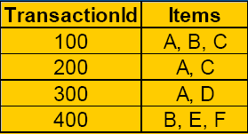
Example
Find rules with minsup=50% and minconf=50%
A ⇒ C, the rule has 50% support and 66.6% confidence
C ⇒ A, the rule has 50% support and 100% confidence
All other rules have values less than the threshold specified

Slide 19
Finding Associations
Find associations between most frequently occurring itemsets
Itemsets: Items / entities that occur often in the data set.
Various ways are available to find frequent itemsets

Slide 20
Interpretation of Rules
Market Basket Analysis
******* ? ********* ⇒ Profits Increase
Factors that effect the increase in profit
High Income ⇒ ******** ? *******
Factors that follow high income

Slide 21
Frequent Pattern Analysis?
Frequent pattern: a pattern (a set of items, subsequences, substructures, etc.) that occurs frequently in a data set
First proposed by Agrawal, Imielinski, and Swami in the context of frequent itemsets and association rule mining

Slide 22
Frequent Patterns/Itemsets
Motivation: Finding inherent regularities in data
– What products were often purchased
together?— Beer and diapers !
– What are the subsequent purchases after
buying a PC?
– What kinds of DNA are sensitive to a new drug?
– Can we automatically classify web documents?

Slide 23
Frequent Patterns
Applications
– Basket data analysis
– cross-marketing
– catalog design
– sale campaign analysis
– Web log (click stream) analysis, and
– DNA sequence analysis.

Slide 24
Mining and Frequent Patterns
Intrinsic and important property of data sets are revealed
This forms the basis for many data mining tasks/algorithms
– Association, correlation, and causality analysis
– Sequential, structural (e.g., sub-graph) patterns
– Pattern analysis in spatiotemporal, multimedia,
time-series, and stream data
– Classification: associative classification
– Cluster analysis: frequent pattern-based clustering

Slide 25
Finding Associations: Basic Algorithm
Interpretation/
Evaluation
Knowledge
Data Mining
Preprocessing
Patterns
Find Frequent Item Sets
Selection
Preprocessed Data
Data
Target
Data
Find All Possible Association
Retain Associations with min support and min confidence
Notes:
Mine for:
Selection
Aggregation
Abstraction
Visualization
Transformation/Conversion
Statistical Analysis
“Cleaning”

Slide 26
Basic Algorithm for finding Associations
Find all sets of items
Li={Ii1, Ii2, ..., Iim}, Li ⊆ I, that have
support(Li) ≥ minsup.
Sets Li are frequent itemsets.
Use the frequent itemsets to generate the association rules of the form:
Li → Lj (i ≠ j )

Slide 27
Freq. Itemset generation
Input: The market base transaction dataset.
Process
– Determine large 1-itemsets.
– Repeat until no new large 1-itemsets are identified.
– Generate (k+1) length candidate itemsets from length k large itemsets.
– Prune candidate itemsets that are not large.
– Count the support of each candidate itemset.
– Eliminate candidate itemsets that are small.
Output
Frequent Itemsets (large > min support threshold).

Slide 28
Freq. Itemset generation
C_{k}: Candidate itemset of size k
L_{k} : frequent itemset of size k
L₁ = {frequent items};
for (k = 1; L_{k} !=∅; k++) do
Ck+1 = candidates generated from L_{k};
for
each transaction t in database
do
increment the count of all candidates in C_{k+1} that are contained in t
2. L_{k+1} = candidates in C_{k+1} with min_support
return ∪_{k} L_{k};

Slide 29
Candidate Generation
How to generate candidates?
– 1: self-joining L_{k}
– 2: pruning

Slide 30
Algo: Generating Candidates
Suppose the items in L_{k-1} are listed in an order
1: self-join L_{k-1}
INSERT INTO C_{k}
SELECT p.item₁, p.item₂, …, p.item_{k-1}, q.item_{k-1}
FROM L_{k-1} p, L_{k-1} q
WHERE p.item₁=q.item₁, …, p.item_{k-2}=q.item_{k-2},
p.item_{k-1} < q.item_{k-1}
2: pruning
– For each itemset c in C_{k} do
• For each (k-1)-subsets s of c do if (s is not in L_{k-1}) then delete c from C_{k}

Slide 31
Example: Candidate-generation
L₃={abc, abd, acd, ace, bcd}
Self-joining: L₃*L₃
- abcd from abc and abd
- acde from acd and ace
Pruning:
– acde is removed because ade is not in L₃
C4={abcd}

Slide 32
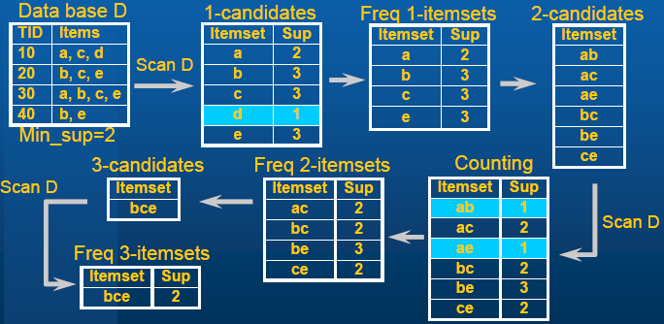
Example:
A level-wise, candidate-generation-and-test approach (Agrawal& Srikant 1994)
Note: Combine those itemsets that have same prefixes, ac and ce cannot be combined, however bc and be can be combined

Slide 33
Basic Algorithm for finding Associations
Find all sets of items
Li={Ii1, Ii2, ..., Iim}, Li ⊆ I, that have
support(Li) ≥ minsup.
Sets Li are frequent itemsets.
Use the frequent itemsets to generate the association rules of the form:
Li → Lj (i ≠ j )

Slide 34

Generating Rules
Freq 3-itemsets
b c → e
b e → c
c e → b
b → c e
c → b e
e → b c
From freq 3 item set only

Slide 35
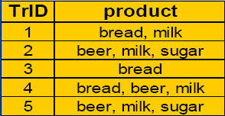
Example
Given the following database:
Assume the following values for minsup and minconf:
minsup = 30%
minconf = 70%

Slide 36
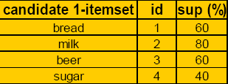
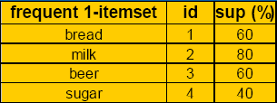
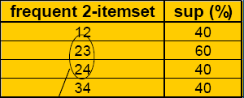
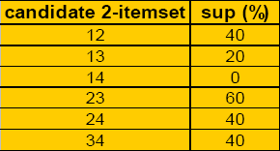
Step 1: Generating Freq. Itemsets
C1 L1
C2 L2
only these could combine

Slide 37


Step 1: cont…
C3 L3
C4 = ∅ L4 = ∅
No More Frequent Itemsets possible

Slide 38
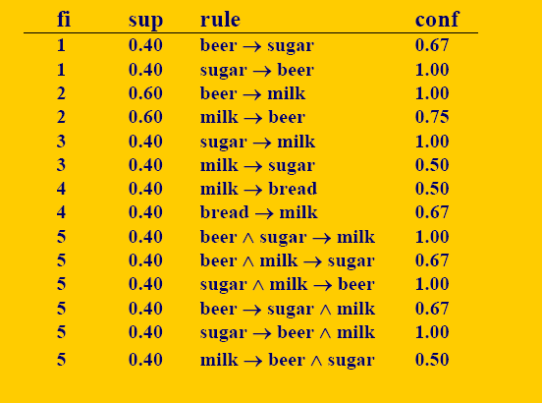
Step 2: Generating Rules

Slide 39
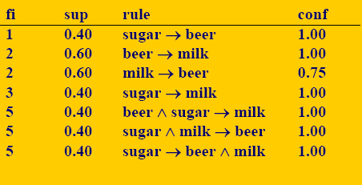
Applying Confidence Threshold
Final result of Apriori algorithm:
(rules with confidence above 70%)

Slide 40
Properties
Monotonicity property: all subsets of a frequent itemset are frequent, in other words, if B is frequent and A ⊆ , then A is also frequent
Consequence: if A is not frequent, then it is not necessary to generate the itemsets which include A

Slide 41
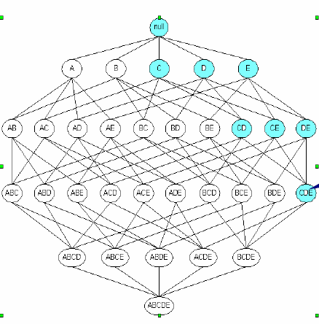
If Super set freq. Then Subsets Freq
if {c,d,e} is frequent
then all its subsets
must also be
frequent

Slide 42
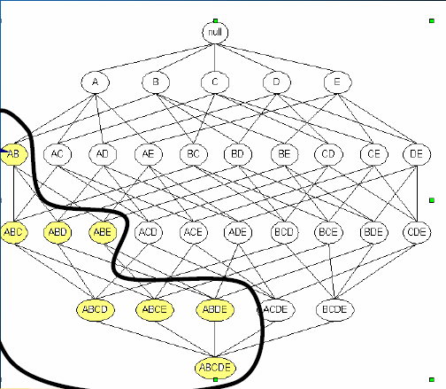
If Subset Infreq. Then Superset is also Infreq.
if {c,d,e} is infrequent
then all its subsets
must also be
infrequent
This would help prune the search space for frequent patterns

Slide 43
Bottleneck of Apriori
For every count operation DB scan is required
Multiple database scans are costly
Mining long patterns needs many passes of scanning and generates lots of candidates
– To find frequent itemset i₁i₂…i₁₀₀
# of scans: 100
# of Candidates: (₁₀₀1) + (₁₀₀2) + … + (₁1₀0₀0) = 2¹⁰⁰-1 =
1.27*10³⁰ !
Bottleneck: candidate-generation-and-test
Can we avoid candidate generation?

Slide 44
Improvement to Apriori
Apriori TID
Direct Hashing and Pruning
Dynamic Itemset Counting
Frequent Pattern Growth
(not apriori based, but finds
associations)

