Slide 1
Data Mining
Lecture 5
Association rules: Different algorithm types

Slide 2
Apriori TID
Reduces the number of scans of the database
Shrinks the number of candidates
Facilitates in finding support for the candidates

Slide 3
Apriori TID
Same candidate generation function as Apriori.
Does not use database for counting support after the first pass.
Encoding of the candidate itemsets used in the previous pass.
Saves reading effort.

Slide 4
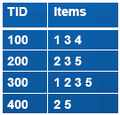
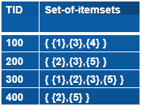
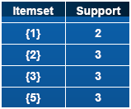
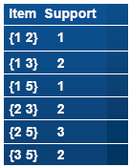
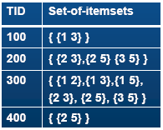
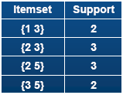



Apriori Tid Example: Support Count:2
Database
T1
L1
C2
T2
L2
C3
T3
L3

Slide 5
Frequent Pattern Tree

Slide 6
Why FP-Tree?
The bottleneck of the Apriori-like method is at the candidate set generation and test.
This problem is attacked in the following three aspects:
– FP-tree is an extended prefix-tree structure storing crucial, quantitative information about frequent patterns.
– FP-tree is not Apriori-like restricted generation and- test but restricted test only.
– Search technique employed in mining is a partitioning-based, divide-and-conquer method rather than Apriori-like bottom-up generation of frequent itemsets combinations.

Slide 7
FP-Tree
FR tree
Don’t Generate Candidates
Transaction Database
Header Table
FP-Tree
Association Rules
Support
Conditional FP-Tree
Confidence
Large Itemsets

Slide 8
Mining Frequent Patterns using FP-tree
Build the FP-Tree.
Build the header table.
Create conditional pattern bases.
Create conditional FP-Tree.
Enumeration of all frequent patterns in each conditional FP-Tree.

Slide 9
Example of FP-tree
TID | Item Bought | (Ordered) Frequent Items
100 | f, a, c, d, g, i, m, p | c, f, a, m ,p
200 | a, b, c, f, l, m, o | c, f, a, b, m
300 | b, f, h, j, o | f, b
400 | d, c, k, s, p | c, b, p
500 | a, f, c, e, l, p, m, n | c, f, a, m, p
Scan for DB drives frequent items:
<(c:4), (f:4), (a:3), (b:3), (m:3), (p:3)>
Scans of DB drives FP-tree
root
c:4
f:1
Item | Head of node-links
c f a b m p | 4 4 3 3 3 3
b:1
f:3
b:1
a:3
p:1
m:2
b:1
p:2
m:1

Slide 10
FP-tree Definition
It consists of one root labeled as "null".
– A set of item prefix subtrees as the children of the root.
– A frequent-item header table.
Each node in the item prefix subtree consists of three fields:
– item-name
– count
– node-link
frequent-item header table consists of two fields:
– item-name
– head of node-link

Slide 11
Conditional pattern bases
Item | Cond. Pattern base
c | null
f | c:3
a | cf:3
b | cfa:1, c:1, f:1
m | cfa:2, cfab:1
p | cfam:2, cb:1
Start with the frequent header table.
Traverse tree by following links from frequent items.
Accumulate prefix paths to conditional pattern bases.
root
c:4
f:1
Item | Head of node-links
c f a b m p | 4 4 3 3 3 3
b:1
f:3
b:1
a:3
p:1
m:2
b:1
p:2
m:1

Slide 12
Create conditional FP-Tree
For every pattern base
Accumulate the frequency for each item.
Construct as FP-Tree for the frequent items of the pattern base.
Conditional FP-tree
Conditional pattern base
Item | Cond. Pattern base
c | null
f | c:3
a | cf:3
b | cfa:1, c:1, f:1
m | cfa:2, cfab:1
p | cfam:2, cb:1
Item | Cond. Pattern base
c | null
f | {(c:3)} | f
a | {(c:3, f:3)} | a
b | null
m | {(c:3, f:3, a:3)} |m
p | {(c:3)} | p

Slide 13
Conditional FP-Tree
Conditional FP-tree
Conditional FP-tree of
c f a b m p
Item | Cond. Pattern base
c | null
f | {(c:3)} | f
a | {(c:3, f:3)} | a
b | null
m | {(c:3, f:3, a:3)} |m
p | {(c:3)} | p
root
root
root
root
root
root
c:3
c:3
c:3
c:3
f:3
f:3
a:3

Slide 14
Enumeration of all frequent patterns
Conditional FP-tree of
c f a b m p
Generate all frequent patterns
Item | Frequent Pattern
c | (c:4)
f | (f:4) , (cf:4)
a | (a:3), (ca:3), (fa:3), (cfa:3)
b | (b:3)
m | (m:3), (cm:3), (fm:3), (am:3), (cfm:3), (cam:3), (fam:3), (cfam:3)
p | (p:3), (cp:3)
root
root
root
root
root
root
c:3
c:3
c:3
c:3
f:3
f:3
a:3

Slide 15
Algorithm 1 (FP-Tree construction)
Input: Transaction DB, minimum support threshold.
Output: FP-Tree
1. Collect the set of frequent items F and their support.
Sort F in support order as prefix.
2. Create the root T of an FP-Tree, and label it as "null“.
Select and sort F in transaction according to the order of prefix.
3. Let the item list be [p|P], p is the first item and P is remainder.
for each item list call insertTree(Items, T);
4. function insertTree([p|P], T)
if T has child N and N.itemName = p.itemName then
N.count++;
else create node N = p, N.count=1, be linked to T,
node-link to the nodes with the same itemName;
if P is nonempty then call insertTree(P, N);

Slide 16
Algorithm 2 (FP-growth)
Input: FP-Tree, minimum support threshold, without DB.
Output: The complete set of frequent patterns.
Method: Call FP-growth (FP-Tree, null)
Procedure FP-growth (Tree, α) {
1. if Tree contain a single path P then
2. for each combination (denote as β) of the nodes in P
do
3. generate pattern β∪α with support = minimum support
in β
4. else for each ai in the Header Table of Tree do {
5. generate pattern β = ai∪α with support = ai.support
6. construct β's conditional pattern base and
β's conditional FP-Tree Treeβ;
7. if Treeβ ≠ null then
8. call FP-growth (Treeβ, β); } }

Slide 17
Properties of FP-Tree
FP-Tree contains the complete information of DB in relevance to frequent pattern mining.
The height of the tree is the maximal number f frequent items in any transaction in the database.
All the possible frequent patterns that contain frequent item can be obtained by following it’s node-links, starting from it’s head in the FPTree header.
The complete set of the frequent patterns of T can be generated by the enumeration of all the combination of single path with the support is the minimal support of the items contained in the single path.

Slide 18
Experimental Evaluation and Performance Study
Experimental environment
– CPU: 450-MHz Pentium PC
– RAM: 128MB main memory
– OS: Microsoft Windows NT
– Software: Microsoft Visual C++ 6.0
– Data Sets:
 | #item | #length | #Large | #Trans.
D1 | 1K | 25 | 10 | 10K
D2 | 10K | 25 | 20 | 100K

Slide 19
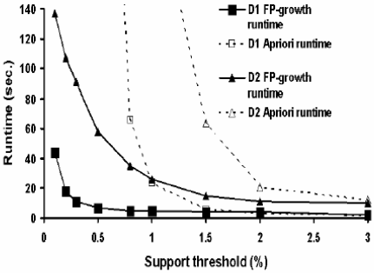
Experimental Evaluation
Scalability with threshold

Slide 20
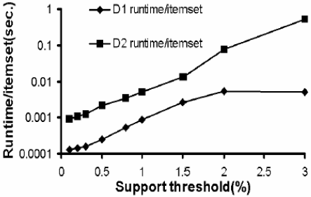
Experimental Evaluation
Run time of FP-growth

Slide 21
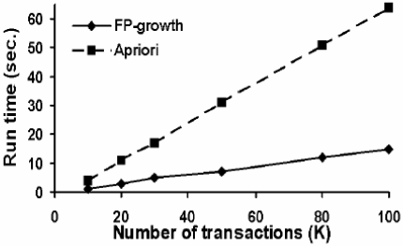
Experimental Evaluation
Scalability with number of transactions
– Support = 1.5%

Slide 22
Conclusion
Advantage of FP-growth
– Saves the costly database scans in the subsequent mining processes.
– Avoids costly candidate generation, count accumulation and prefix path count adjustment are usually much less costly than candidate generation.
– Reduces the size of the subsequent condition pattern bases and conditional FPtrees.
FP-growth method has also been implemented in the new version DBMiner.

Slide 23
Other Parameters - Associations
Support
Confidence
Lift
Conviction
Leverage

Slide 24
Lift
Given a rule L => R, lift is the:
Ratio of the probability that L and R occur together to the multiple of the two individual probabilities for L and R, i.e.,
Lift = [Pr (L,R)] / [Pr(L)Pr(R)]
Why is lift Important ?

Slide 25
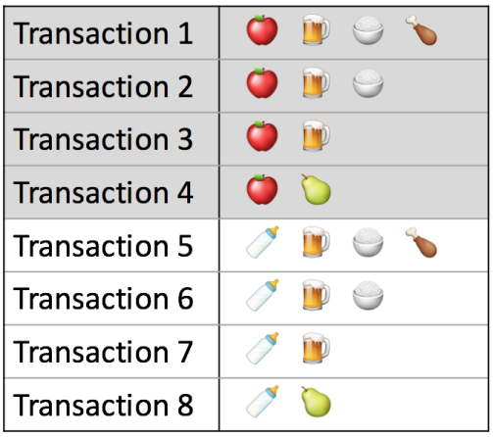
Lift example

Slide 26
Lift
If this value is 1, then L and R are independent.
The higher the value of lift, the more likely that the existence of L and R together in a transaction is not just a random occurrence, but because of some relationship between them.

Slide 27
Leverage
Leverage measures the difference between the probability of co-occurrence of L and R and the independent probabilities of each of L and R
Leverage = [Pr (L,R)] - [Pr(L)Pr(R)]
Similar to Lift (instead of ratio it takes difference)
Leverage measures the proportion of additional cases covered by both L and R above those expected if L and R were independent of each other.
Thus, for leverage, values above 0 are desirable, whereas for lift, we want to see values greater than 1

Slide 28
Conviction
Conviction is similar to lift, but it measures the effect of the right-handside of the rule not being true. It also inverts the ratio. So, conviction is measured as:
Conviction = [Pr (L) Pr(not R)] / [Pr(L,R)]

Slide 29
Important Lesson
It is sufficient to focus on a combination of support, confidence, and either lift or leverage to quantitatively measure the "quality" of the rule.
However, the real value of a rule, in terms of usefulness and actionability is subjective and depends heavily on the particular domain and business objectives.

