Slide 1
ENS Events Radar
Junaid

Slide 2
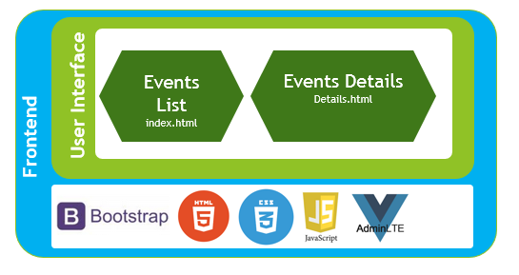
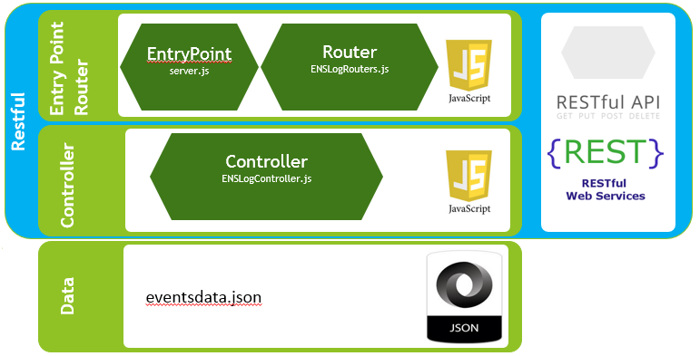
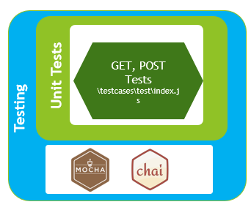
Architecture

Slide 3




Architecture - Backend
EntryPoint
server.js
Router
ENSLogRouters.js
Entry Point
Router
Restful
Controller
ENSLogController.js
Controller
Data
eventsdata.json

Slide 4




Architecture - Frontend
Events List
index.html
Events Details
Details.html
User Interface
Frontend
Data

Slide 5


Architecture - Testing
GET, POST Tests
\testcases\test\index.js
Unit Tests
Testing
Data

Slide 6
Thanks

