Slide 1


INTELLISENSE FOR WEB BASED EDITOR

Slide 2
SHALIN AGRAWAL
RAJ MANVAR
SYED JUNED ALI
LASHIT JAIN
SHIVANG NAGARIA
TEAM 9
Intellisense for web based IDE

Slide 3
For AssessMachine
Barna Bhattacharyya
Amit Kripalani
TA MENTOR
-ROHIT SVK

Slide 4
WORKFLOW

Slide 5



WORKFLOW
Data Extraction
Language Libraries
Generated JSON file
ADMIN

Slide 6

WORKFLOW
ADMIN
Notes:
<number>

Slide 7

WORKFLOW
User Codes
Code sent to Cloud for Intellisense

Slide 8
WORKFLOW
Caches some data
Cloud sends back data

Slide 9
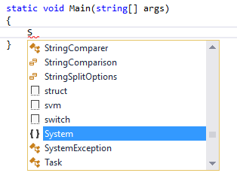
And VOILA…
Intellisense Works!!!

Slide 10
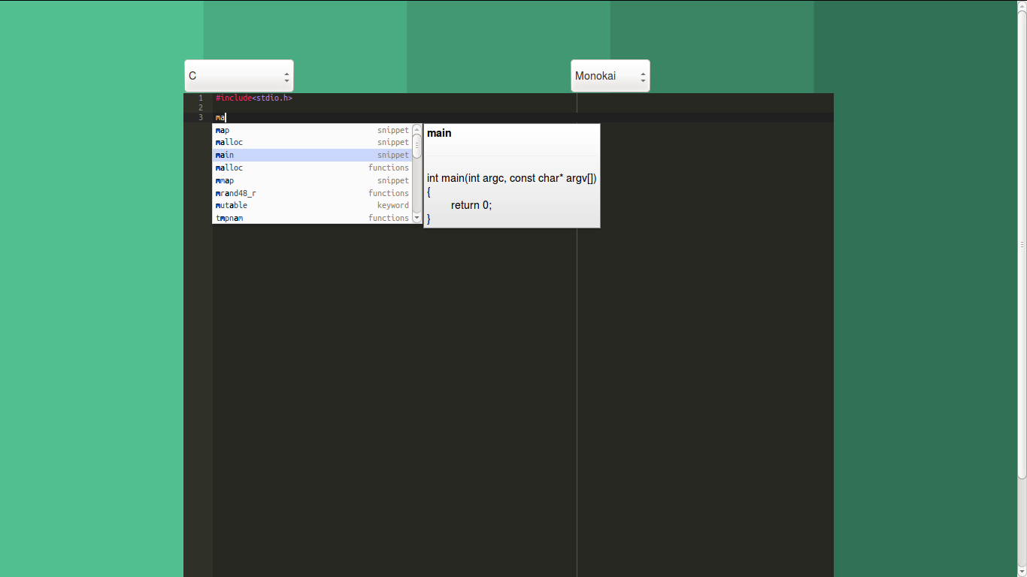
SNIPPETS

Slide 11
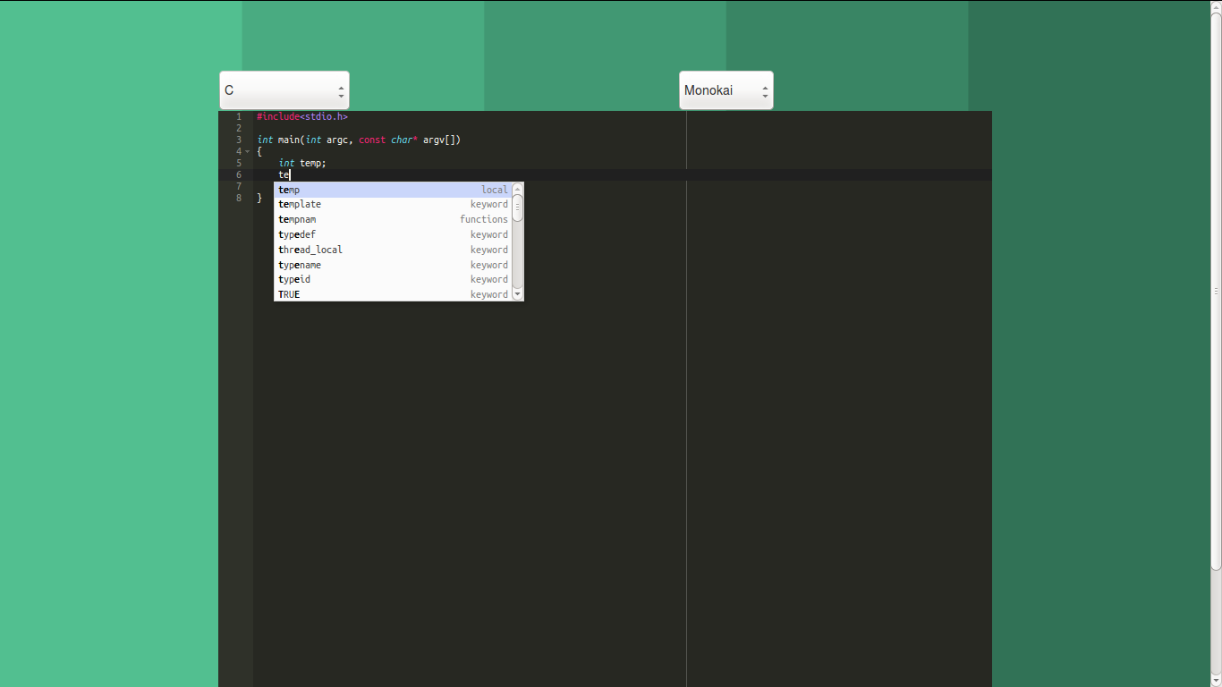
LOCAL VARIABLE CACHING

Slide 12
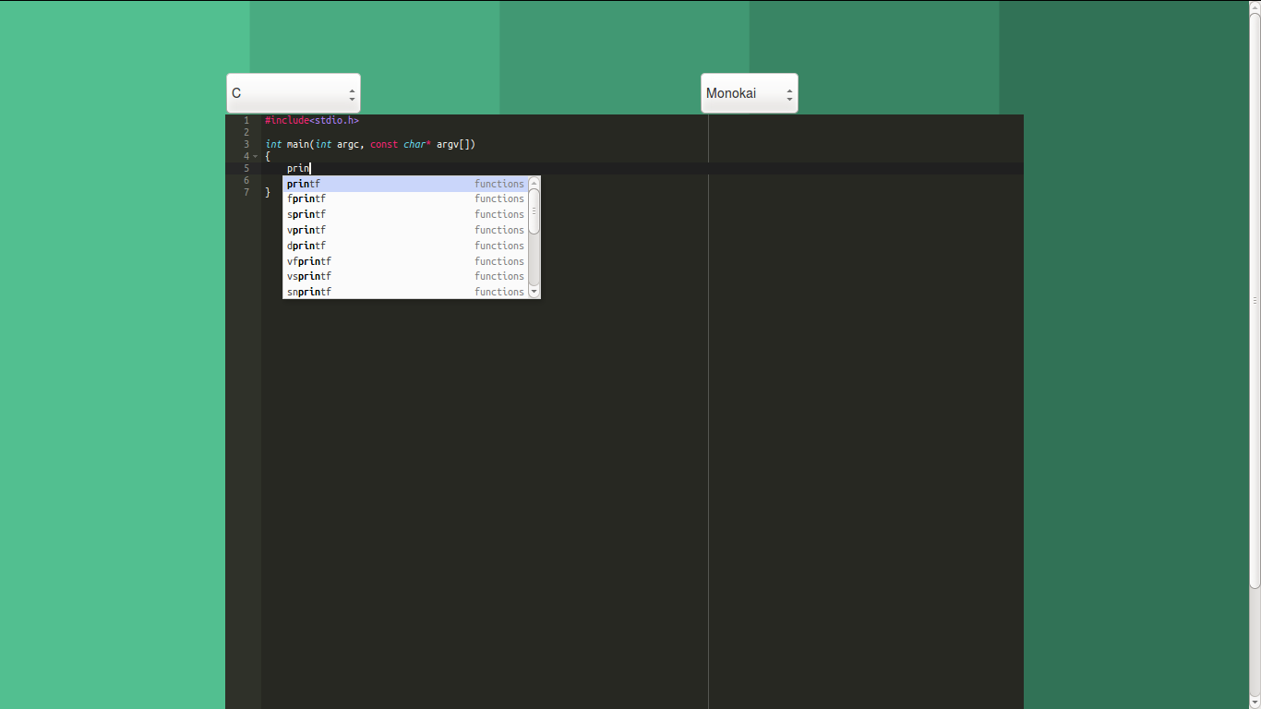
FUNCTION AUTO COMPLETION

Slide 13
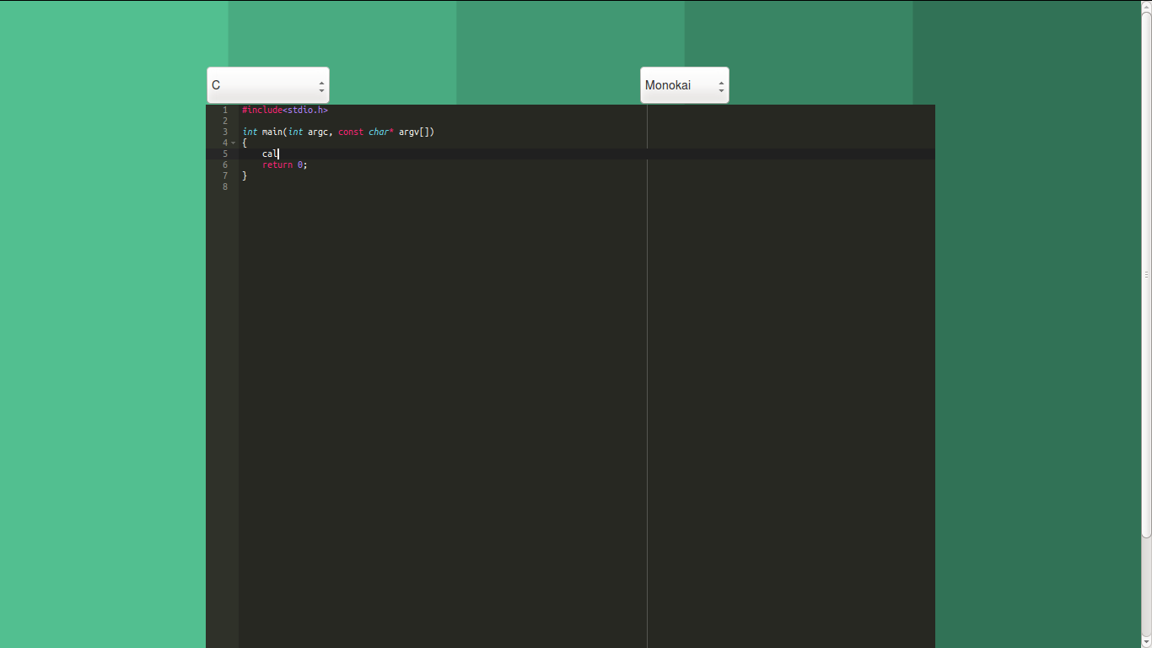
LIBRARY SPECIFIC DATA RETRIEVAL

Slide 14
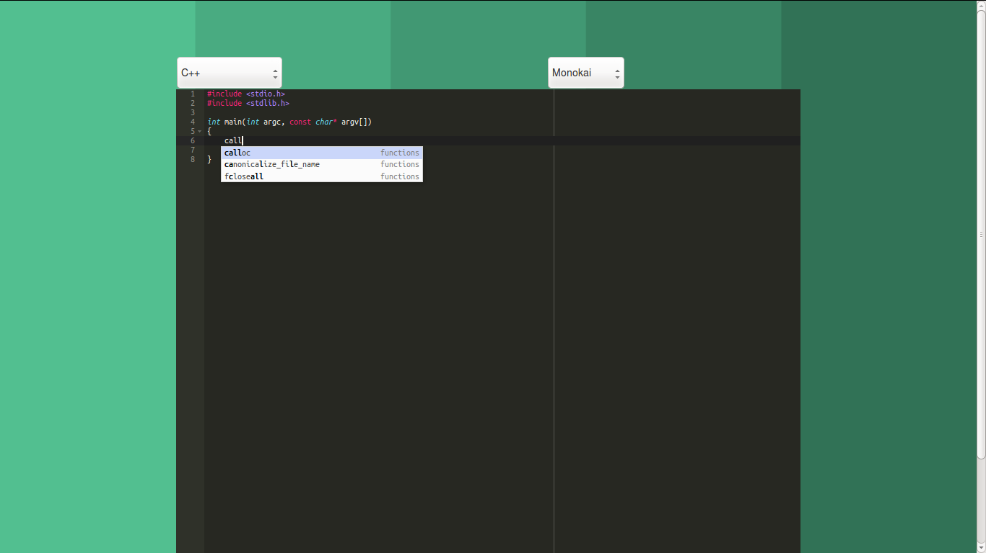
LIBRARY SPECIFIC DATA RETRIEVAL

Slide 15
Thank You

