Slide 1
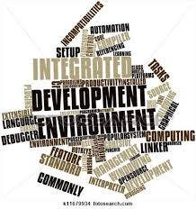
Intellisense in a web based Integrated development environment

Slide 2
Team on Project
Syed Juned Ali
Lashit Jain
Raj Manvar
Shalin Agarwal
Shivang Nagaria

Slide 3
For Access Machines
Amit Kriplani
Barna Bhattacharya
TA Mentor
-Rohit SVK

Slide 4
Agenda
Overview
What is the project , Who does it help
Features
How does it help the users
Resources
Where to get more information about the application

Slide 5
What is an IDE?
An IDE i.e Integrated development environment is a software application that helps a software programmer to build software applications by providing comprehensive tools and features.
An IDE normally consists of a source code editor,build automation tools and a debugger.
Modern IDE's provide with a great helpful functionality of intelligent code completion.
Examples – Eclipse , Netbeans

Slide 6
Intellisense
Intellisense which is intelligent code completion is the main focus of our IDE.
We are using intellisense in our IDE to apply it in recruitment of candidates
The IDE will make a really programming friendly environment , mainly focusing on logic and voiding the syntactical dependence
Intellisense will be extended to many languages like C,C++,java,C#,Python etc.
The selection procedure will save time and also provide a good quality of employees

Slide 7
How does it work?
The interviewee logs in and is redirected to the editor page.
The interviewee types the name of a function
A list of functions related to the input drops down via a Ajax call to the database of the application.
The list contains the name , signature , return type and the argument types of a function.
Even the local variables are cached and when a user types the prefix of a local variable a drop down list comes up having the names of all local variables having the same prefix.

Slide 8




The Big Picture
User logs in to use IDE
All local variables are stored in cache for scope variable detection
Ajax call from the IDE gives the required data
Local variables are passed to the IDE via Ajax call
All the library functions are passed to the IDE via Ajax

Slide 9
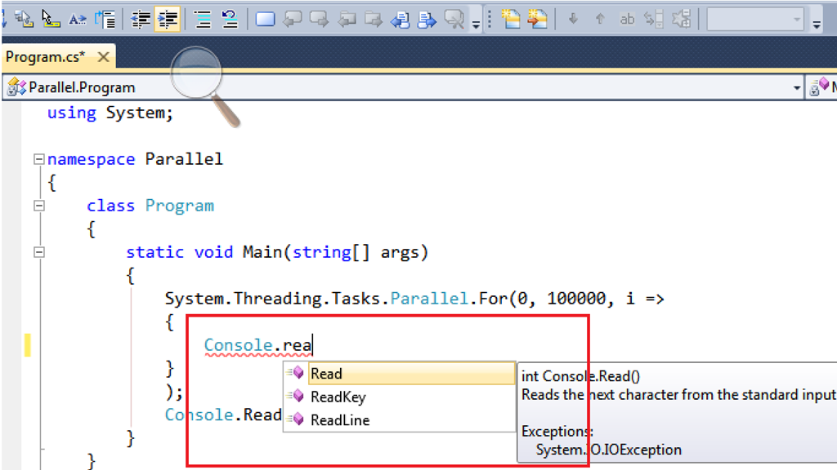
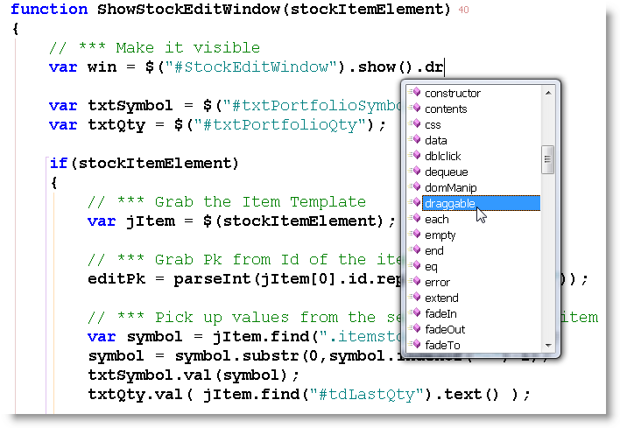
Pictorial representation of Intellisense
Extracting Functions
Class “Console” has the Read , Readline , Readkey as functions which pop down as a list when we just type prefix “rea”
A list of all the related functions of the class “#StockEditWindow.show()” are listed down via intellisense.
This way Intellisense not only saves time but also helps us not remembering the exact syntax or function name.

Slide 10
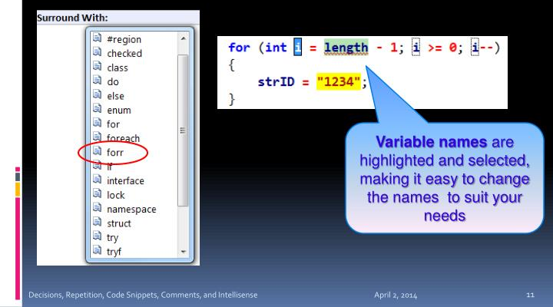
Pictorial representation of Intellisense
Caching and highlighting of local variables

Slide 11

Code snippets
Using code snippets saves a lot of time and helps not remembering the syntax thus implementing our desired output.
Code snippets are customizable segments of code that are easily inserted when needed.
They relieve the programmer from writing the skeleton code in common situations like for loop,try-catch-finally etc.

Slide 12
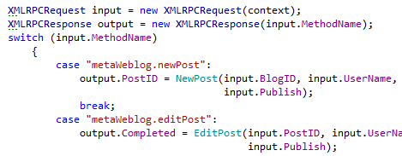
Pictorial representation of Intellisense
Syntax highlighting
The Syntax Highlighting feature allows you to easily distinguish between local variables and fields in your code.

Slide 13
Features of Intellisense
Code snippets
Scope variable detection
Variable highlighting
Auto-completion of function names
Extracting all the related functions of a particular class
Major Advantages
Syntactical independence
More emphasis on logic rather than code
Learning more about the code
Application in quality candidates selection in interviews which is our motive.

Slide 14
Resources
To know more about the IDE visit
www.accessmachines.com/IDE
To know more about intellisense visit
www.en.wikipedia.org/wiki/Intelligent_code_completion

